Slide 1

Unit 3: All about food
Lesson 3b: grammar
(page 57)

Slide 2
Lesson Outline
Warm-up
Presentation
Practise
Production
Consolidation
Wrap-up

Slide 3
Objectives
By the end of this lesson, students will be able to…
use quantifiers (a lot of, lots of, many, much, a few, a little, few, little, no) correctly.

Slide 4

WARM-UP

Slide 5
Match the two columns.
a bar of 1
a packet of 2
a can of 3
a carton of 4
a loaf of 5
a jar of 6
a bottle of 7
a crisps
b juice
c chocolate
d soda
e water
d jam
f bread

Slide 6

It’s time to learn …

Slide 7

Presentation

Slide 8
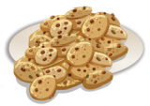









Quantifiers
too many
a lot of/lots of
some/a few
(very) few
no
too much
a lot of/lots of
some/a little
(very) little
no

Slide 9
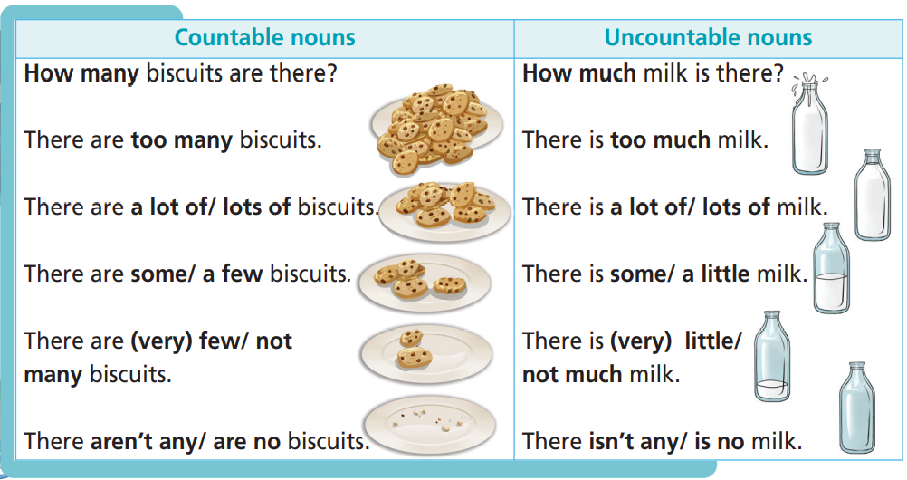
Read the examples.

Slide 10
 | countable | uncountable | affirmative | negative | interrogative
Lots of/ a lot of
Many
Much
A few
A little
Few
Little
No
✓
✓
✓
✓
✓
✓
✓
✓
✓
✓
✓
✓
✓
✓
✓
✓
✓
✓
✓
✓
✓
✓
✓

Slide 11

Practise

Slide 12
Read the theory box. Then choose the correct word.
1 There isn’t many/much milk left.
2 How much/many bread is in the cupboard?
3 How many/much eggs go in the cake mix?
4 He’s got a lot of/a little sweets in his bag.

Slide 13
5 There is many/lots of sugar in this ice cream.
6 We haven’t got many/much orange juice.
7 There are a few/a little apples. Let’s make an apple pie.
8 There’s very few/little butter left.

Slide 14
Complete the exchanges. Use a lot of/lots of, any, some, much or many.
1 A: Have we got __________ milk?
B: Yes, there’s _________________ in the fridge. How ______ do you need?
2 A: How _________ sugar do you want in your tea?
B: Not __________. Half a teaspoon.
3 A: There’s __________________ apple pie left. Do you want _____?
B: No, thanks. Would you like __________ grapes? There are ____________ them in the fridge.
any
a lot of/lots of/some
much
much
much
some/a lot of/lots of
some
some
a lot of/lots of

Slide 15
4 A: How _____________ tomatoes do we need for the sandwiches?
B: Not _____________. Just two. We need _______________ butter, though. There isn’t _____________ in the fridge. Can you buy a packet, please?
5 A: Are there _____________ potatoes?
B: Not _____________. We need to buy _____________.
6 A: I want to make an omelette but there aren’t _____________ eggs in the
fridge. There aren’t ________________ peppers, either.
B: How _____________ eggs do you need?
A: Six. And get four peppers.
many
many
a lot of/lots of
any/much
any
many
some
any
any
many

Slide 16
Production

Slide 17
6 It’s Saturday. Decide on what you need to buy from the supermarket for the week. Write your shopping list.
Example
A: Do we need any apples?
B: No, we have got a lot of apples. We need some milk.
A: How much?
B: A carton.

Slide 18
A: Do we need any milk?
B: Yes. We haven’t got any.
A: How many cartons?
B: Two. What about eggs?
A: We’ve got a few, but we need some more.
B: How many?
A: Six. And there isn’t any bread.
B: Let’s get two loaves.
Sample
Shopping list
2 cartons of milk
6 eggs
2 loaves of bread

Slide 19

CONSOLIDATION

Slide 20
Write three sentences about your daily diet, using the quantifiers you have studied today.
Everyday I eat some rice, a lot of vegetables and a little meat. I drink two liters of water and some milk.
Sometimes, I eat a few sweets. I don’t drink any coffee.

Slide 21

WRAP-UP

Slide 22
Today’s lesson
Grammar
quantifiers

Slide 23
Homework
Practise speaking and writing sentences, using quantifiers.
Complete the writing notes in TA 6 Right on Notebook (p. 30)
Prepare the next lesson (p. 58 SB)
Do the exercises in TA 6 Right on Notebook (p. 29)

Slide 24

Enjoy your day!

