Slide 1

Unit 5: Food and Drinks
Lesson 3.1: Listening & Reading
Page 42

Slide 2



LESSSON OUTLINE
Consolidation

Slide 3
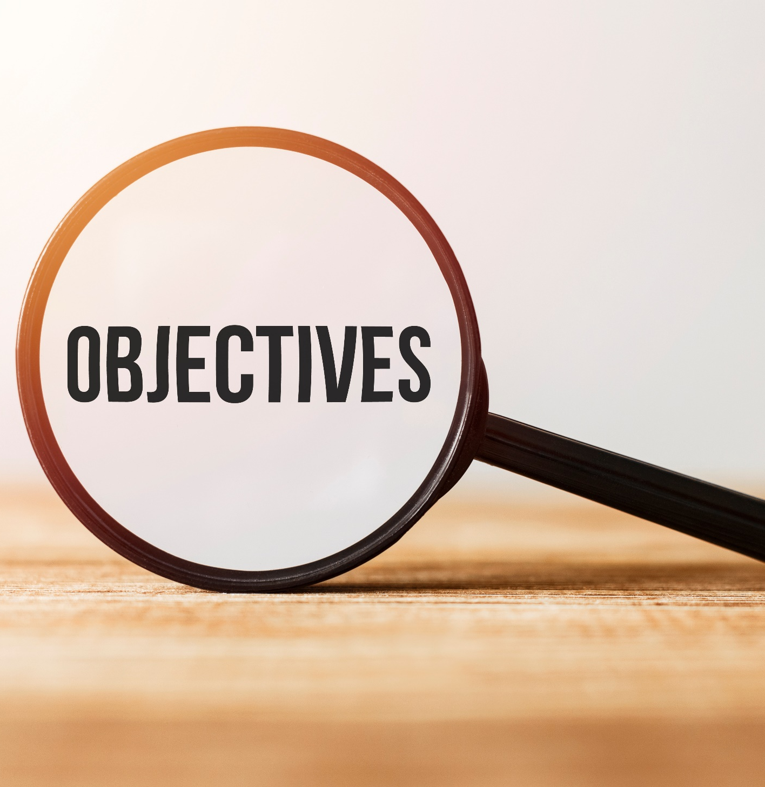
By the end of this lesson, students will be able to…
practice listening and reading for main ideas and specific information.
be well-prepared for the writing activity in the next lesson.

Slide 4

WARM-UP

Slide 5
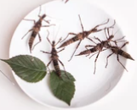
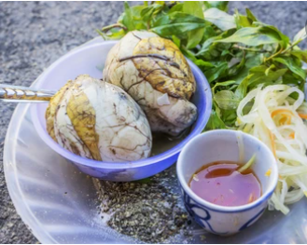
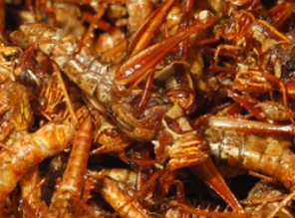
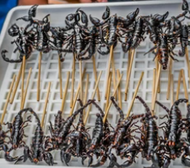
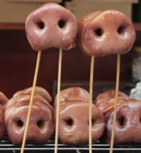
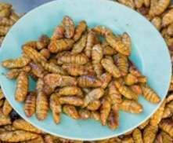
Have you ever eaten any of these food? Are they unusual?
S
T
R
A
N
G
E
F
O
O
D

Slide 6


It’s listening time….

Slide 7
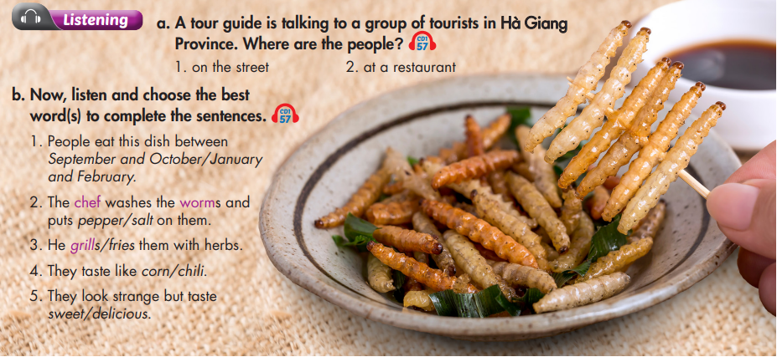

Slide 8
Pre – listening
Before listening
a. Underline the key words and guess where the people are.
a person who works in the travel industry, giving guided tours to groups of visitors
a person who travels and visits places for pleasure and interest
is a province in the Northeast region of Vietnam

Slide 9

While - listening
Listen the first time to recognize where the people are.
Okay, here we are, it's lunch time. Let's try some tasty local food! I'd like to tell you about one of Hà Giang's famous dishes, sâu tre, which is Vietnamese for "bamboo worms."
They are at the restaurant.

Slide 10
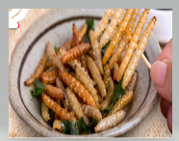
Underline the key words in each question and predict the answer.
1. People eat this dish between September and October/January and February.
2. The chef washes the worms and puts pepper/salt on them.
3. He grills/fries them with herbs.
4. They taste like corn/chili.
5. They look strange but taste sweet/delicious.

Slide 11
b. Now, listen and circle.
1. People eat this dish between September and October / January and February.
People usually eat this dish between September and October, when the worms are really juicy.

Slide 12
2. The chef washes the worms and puts pepper/salt on them.
3. He grills/fries them with herbs.
The chef washes the worms and puts salt on them.
Then, he fries them with herbs in hot oil, or steams them.

Slide 13
Some people say they taste like grilled corn, and other people say they taste like cheese.
4. They taste like corn/chili.
5. They look strange but taste sweet/delicious.
Yeah, I know, they look a little bit strange to you, but really, they taste delicious.

Slide 14

Post - listening
Share your ideas
Would you dare to try unusual food while traveling to new places? Why or Why not?

Slide 15
Audio Scripts
Imagine you are a tour guide and the whole class are tourists. Act it out.
Okay, here we are, it's lunch time. Let's try some tasty local food! I'd like to tell you about one of Hà Giang's famous dishes, sâu tre, which is Vietnamese for "bamboo worms“. People usually eat this dish between September and October, when the worms are really juicy. The chef washes the worms and puts salt on them. Then, he fries them with herbs in hot oil, or steams them. Some people say they taste like grilled corn, and other people say they taste like cheese. Yeah, I know, they look a little bit strange to you, but really, they taste delicious. I think you should all try one! Who wants to go first? Nobody? Okay, I'll eat one to show you… yum!

Slide 16
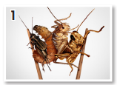
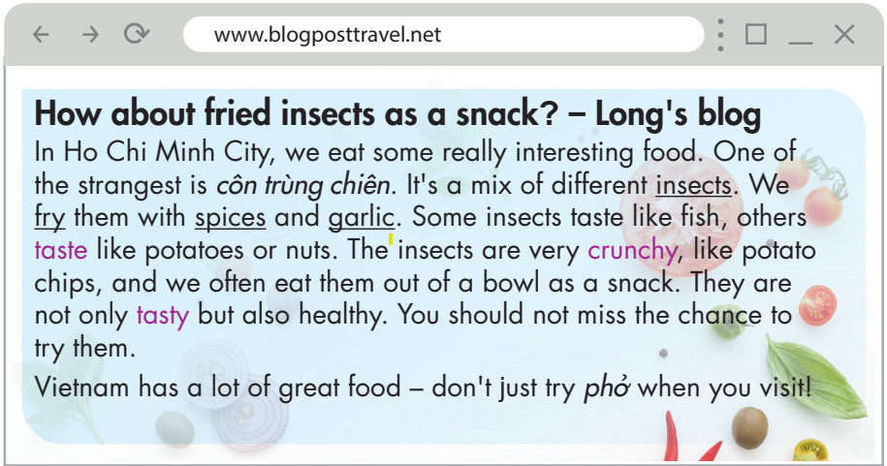
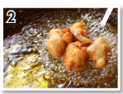
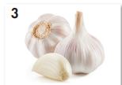
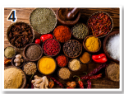
Pre - reading
Match the underlined words with the pictures.
A. insects
B. garlic
C. spices
D. fry

Slide 17
Scan the blog and fill in the blanks.
While - reading
b. Now, read and fill in the blanks.
1. Côn trùng chiên is one of the ___________ foods in Ho Chi Minh City.
2. Some ___________ taste like fish.
3. The insects are very ___________.
4. We often eat côn trùng chiên from a ___________.
5. The insects are not only tasty, but they are ___________ too.
strangest
insects
crunchy
bowl
healthy

Slide 18
While - reading
What’s the blog about?
Identify main idea of the text.
Who or what is mentioned?
What: fried insect or côn trùng chiên
What does the writer talk about fried insect or côn trùng chiên?
It’s an unusual but interesting kind of food to try.

Slide 19

Post - reading
Work in pairs
I would like to try sâu tre/ trứng vịt lộn since it looks unusual but interesting. I guess it tastes yummy, too.

Slide 20

CONSOLIDATION

Slide 21
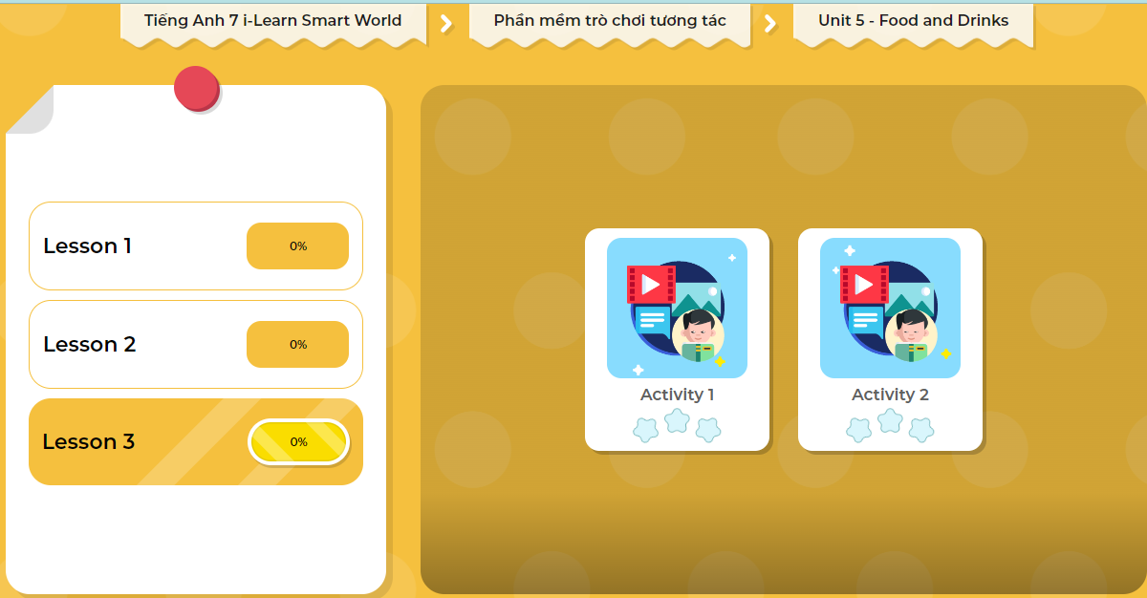
LET’S PLAY!
Click here to play the games

Slide 22

WRAP-UP

Slide 23
Today’s lesson
Listening:
- Listen for gist and choose the correct information.
Reading:
- Skim and scan for general and specific information.

Slide 24
Homework
Do the Listening and Reading exercises on page 30 WB.
Do the exercises in Tiếng Anh 7 i-Learn Smart World Notebook on page 32.
Prepare the next lesson (page 43 SB).
Play the consolidation games in Tiếng Anh 7 i-Learn Smart World DHA App on www.eduhome.com.vn

Slide 25
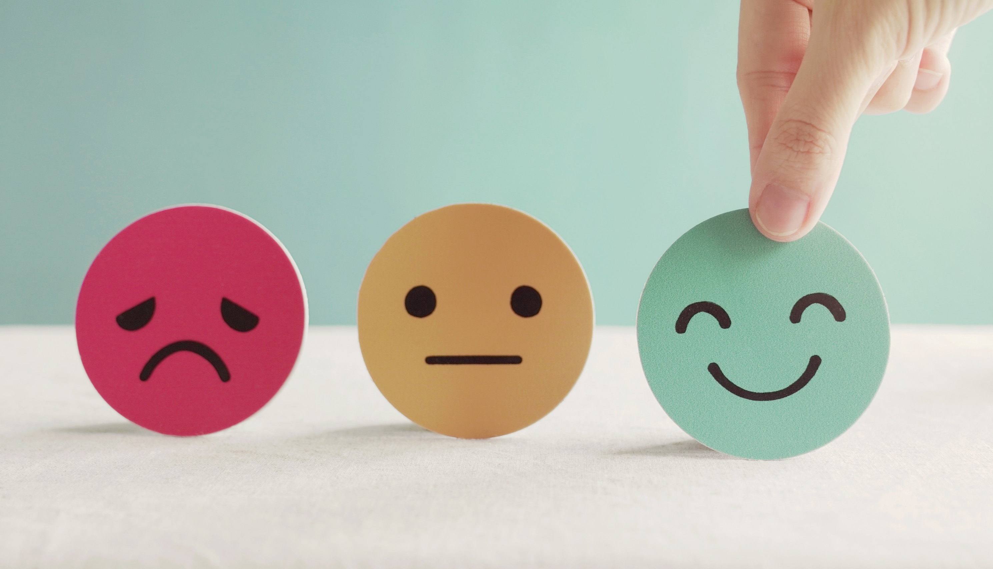
Lesson 3
Stay positive and have a nice day!

