Slide 1


Slide 2

Unit
9
1
Unit
FAMILY LIFE
Protecting the environment
LESSON 7
Communication and Culture/ CLIL

Slide 3

Unit
1
1
FAMILY LIFE
Family Life
Unit
OBJECTIVES
To review expressions for making and responding to apologies .
To help students learn about Earth Hour through CLIL( Environmental studies) and learn some content vocabulary.
To give Ss an opportunity to personalize the CLIL topic.

Slide 4
LESSON 7
COMMUNICATION AND CULTURE
Unit
GETTING STARTED
WARM-UP
Watch two pictures about Earth Hour
PRESENTATION
Vocabulary
I. Communication
Task 1: Listen and complete the conversations with the expressions in the box.
Task 2: Make similar conversations making and responding to apologies.
II. Culture
Task 1: Look at the pictures and answer the questions
Task 2: Read the text and complete each blank of the fact file about Earth Hour with ONE word.
Task 3: Watch the video and discuss the questions.
PRACTICE
CONSOLIDATION
Groupwork: Talk about Earth Hour
CONSOLIDATION
Wrap-up
Home work

Slide 5

LESSON 7
COMMUNICATION AND CULTURE
Unit
GETTING STARTED
WARM-UP
VIDEO WATCHING
In this video, Paul says sorry for making Noelia fall over. Watch the video and:
Complete the conversation with the correct information.
Listen and repeat at the end of the clip.

Slide 6
LESSON 7
COMMUNICATION AND CULTURE
Unit
GETTING STARTED
WARM-UP
VIDEO WATCHING
Complete the conversation with the correct information.
Paul: Noelia! I am so (1) ! Are you OK?
Noelia: I think so. That was lucky.
Paul: I'm (2) sorry! I didn't see you!
Noelia: That's (3) . I shouldn't have been running.
Paul: No, no, I should have been (4) .
Noelia: And they teach you (5) inside at school!
Paul: Still, it was my (6) and I'm sorry.
Noelia: I'm sorry (7) . It was both of us. Honestly, (8) .I'm fine. Don't (9) about it.
Hey, I saved the laptop though!
Bob: Yeah, I'll be there in …
Noelia: Oh no!
Bob: Uh oh!
Paul: Ahhhh …
sorry
really
all right
paying attention
not to run
fault
it's fine
worry
too

Slide 7


PRESENTATION
backup (n)
/ˈbækʌp/
a copy of a file, etc. that can be used if the original is lost or damaged

Slide 8

PRESENTATION
device (n)
/dɪˈvaɪs/
an object or a piece of equipment that has been designed to do a particular job

Slide 9
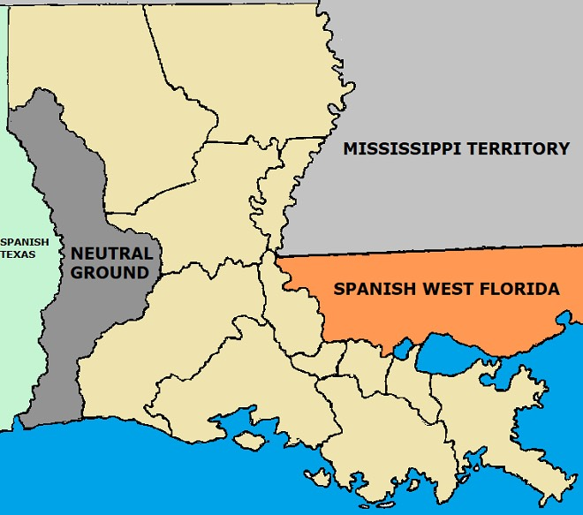
PRESENTATION
erritory
/ˈterətri/
the land that is under the control of a particular country or political leader.

Slide 10
PRESENTATION
New words | Pronunciation | Meaning
backup (n) | /ˈbækʌp/ | a copy of a file, etc. that can be used if the original is lost or damaged
device (n) | /dɪˈvaɪs/ | an object or a piece of equipment that has been designed to do a particular job
territory (n) | /ˈterətri/ | land that is under the control of a particular country or political leader.

Slide 11

PRACTICE - COMMUNICATION
Everyday English - Making and responding to apologies
1
Listen and complete the conversations with the expressions in the box. Then practise them in pairs.
Never mind
I’d like to apologise for
That’s all right
I’m sorry to
1
Mai: (1)……………… submitting my assignment late. I‘m sorry, but my laptop was broken.
Mr Ha: (2)…………….... Next time you should finish it earlier and have a back-up copy in case you have any technical problems.
2
Nam: (3) …………….. keep you waiting for so long. The talk was longer than expected.
Mai: (4)……………… We still have enough time for dinner before the show.

Slide 12
PRACTICE - COMMUNICATION
Everyday English - Making and responding to apologies
1
Listen and complete the conversations with the expressions in the box. Then practise them in pairs.
1
Mai: (1) ………………………………….submitting my assignment late. I‘m sorry, but my laptop was broken.
Mr Ha: (2) ………………………. Next time you should finish it earlier and have a back-up copy in case you have any technical problems.
2
Nam: (3) ………………….. keep you waiting for so long. The talk was longer than expected.
Mai: (4) ………………………….. We still have enough time for dinner before the show.
I’d like to apologise for
That’s all right
I’m sorry to
Never mind

Slide 13
PRACTICE - COMMUNICATION
PRACTICE
2
Work in pairs . Make similar conversations making and responding to apologies. Use the expressions below to help you
Useful expressions
Making apologies | Responding to apologies
( I hope you’ll) excuse me for… | Don’t mention it.
Sorry for… I am sorry to… | Never mind.
I’d like to apologise for… | That’s all right.
Please accept my apology for… | Don’t worry about it.

Slide 14
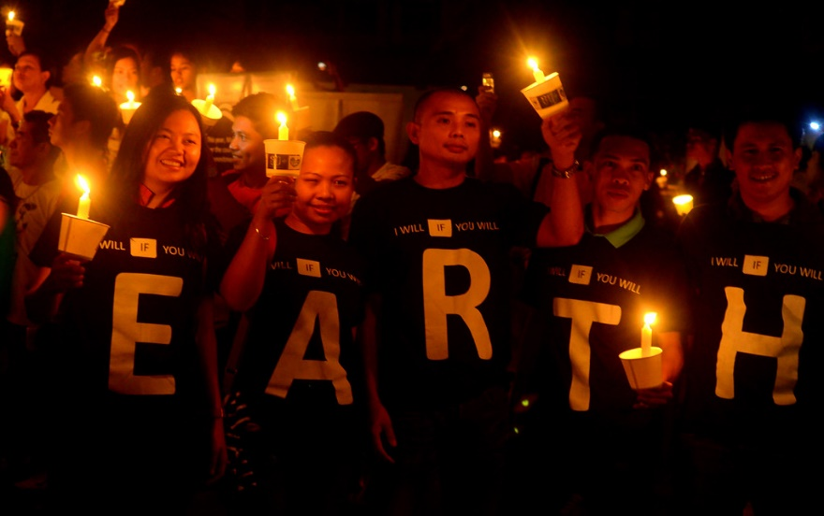

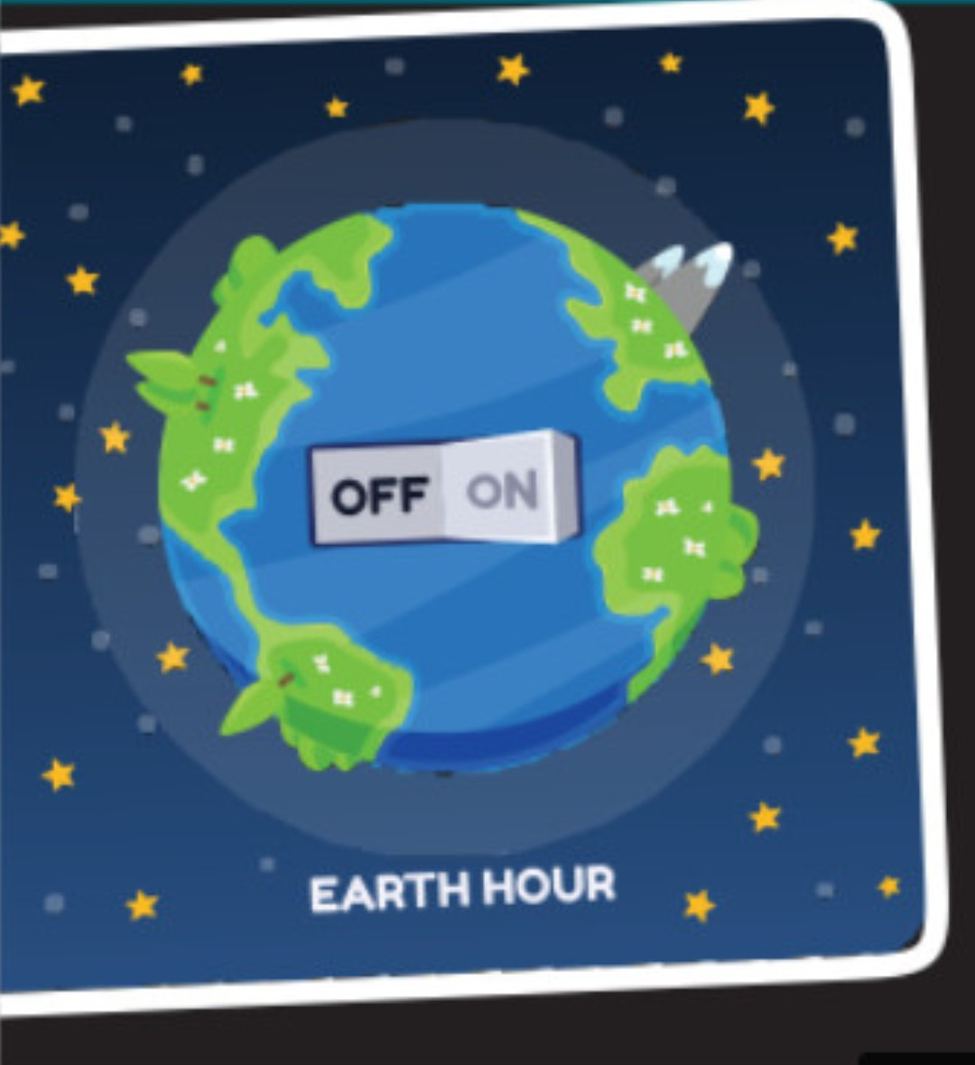
PRACTICE - CULTURE
PRACTICE
1
Look at the pictures and answer the question:
What do you know about Earth Hour?

Slide 15
PRACTICE - CULTURE
2
Read the text and complete each blank about Earth Hour with ONE word.
EARTH HOUR
Organized by | World Wide Fund for Nature
Held from | 8.30 p.m. – 9.30p.m on the last (1)………………….of March.
Started in | Sydney, Australia, in 2007
Aims | - to show the public (2)………….....for protecting the environment and saving the planet - to draw attention to (3)……..........change and global energy issues -to promote green (4) ……………worldwide
First held in Viet Nam in | (5) ……………….with a variety of activities nationwide.
Saturday
support
climate
activities
2009

Slide 16
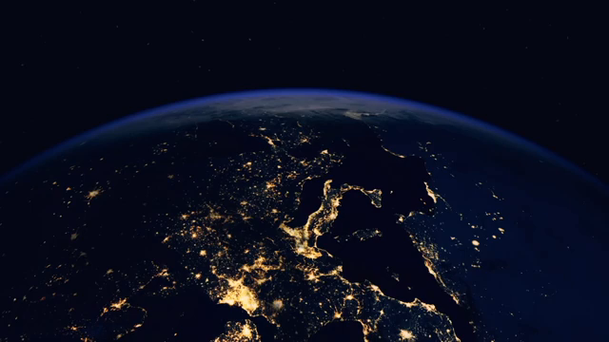
PRACTICE - CULTURE
3
Watch a video about Earth Hour. Work in pairs. Discuss the following questions.

Slide 17
PRACTICE - CULTURE
2
QUESTIONS:
1. Do you want to take part in this lights- out event in Viet Nam? Why or why not?
2. If you have a chance to take part in the event, what would you do?
3. What can you do to prevent the Covid-19 pandemic from spreading in Vietnam?

Slide 18
PRODUCTION
2
GROUPWORK:
TALK ABOUT EARTH HOUR

Slide 19
LESSON 7
COMMUNICATION AND CULTURE
Unit
GETTING STARTED
WARM-UP
Watch two pictures about Earth Hour
PRESENTATION
Vocabulary
I. Communication
Task 1: Listen and complete the conversations with the expressions in the box.
Task 2: Make similar conversations making and responding to apologies.
II. Culture
Task 1: Look at the pictures and answer the questions
Task 2: Read the text and complete each blank of the fact file about Earth Hour with ONE word.
Task 3: Watch the video and discuss the questions.
PRACTICE
CONSOLIDATION
Groupwork: Talk about Earth Hour
CONSOLIDATION
Wrap-up
Home work

Slide 20
CONSOLIDATION
1
Wrap-up
To review expressions for making and responding to apologies.
To help Ss learn about Earth Hour through CLIL( Environmental studies) and learn some content vocabulary.
To give Ss an opportunity to personalize the CLIL topic.

Slide 21
CONSOLIDATION
2
Homework
Do exercises in the workbook

Slide 22


