Slide 2


Unit
11
ELECTRONIC DEVICES
LESSON 5: SKILLS 1
1

Slide 3
LESSON 5: SKILLS 1
LESSON 1: GETTING STARTED
WARM-UP
Warm up: Video watching
- Task 1: Work in pairs. Discuss the following questions.
- Vocabulary teaching
- Task 2: Read the following leaflets and match the highlighted words with their meanings.
- Task 3: Read the leaflets again and tick T (True) or F (False).
READING
- Task 4: Work in pairs. Ask and answer the following questions about an electronic device which is important to you. Make notes of your partner’s answers.
- Task 5: Work in groups. Take turns to talk about the electronic device that is important to your partner.
SPEAKING
CONSOLIDATION
Wrap-up
Homework

Slide 4
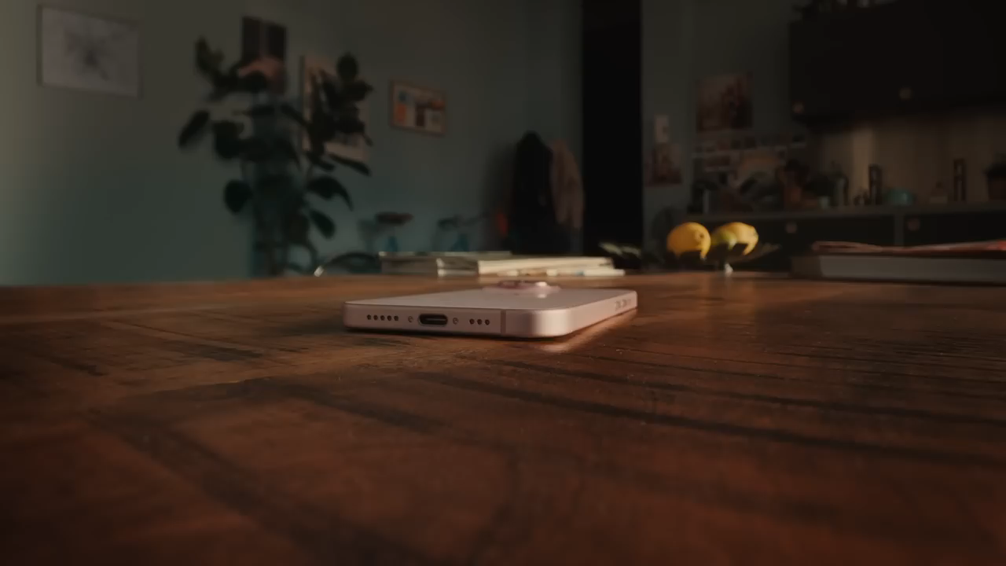
WARM-UP
WATCH THE VIDEO
VIDEO
WATCHING

Slide 5
WARM-UP
APPLE’S NEW IPHONE 15

Slide 6

PRE READING
1
Work in pairs. Discuss the following questions
1. What electronic device do you use most often?
2. What do you use it for?

Slide 7
VOCABULARY
stylish (adj)
/ˈstaɪ.lɪʃ/
sành điệu
fashionable; elegant and attractive

Slide 8
VOCABULARY
privacy (n)
/ˈpraɪ.və.si/
sự riêng tư
the state of being not
watched or disturbed by
other people

Slide 9
VOCABULARY
New words | Pronunciation | Meaning
1. stylish (adj) | /ˈstaɪ.lɪʃ/ | sành điệu
2. privacy (n) | /ˈpraɪ.və.si/ | sự riêng tư

Slide 10
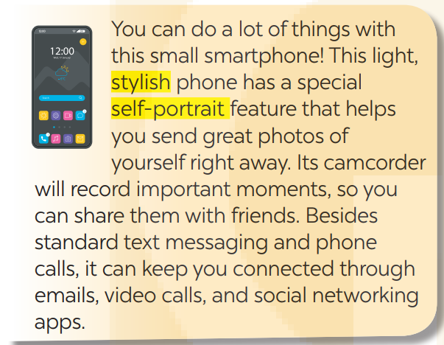
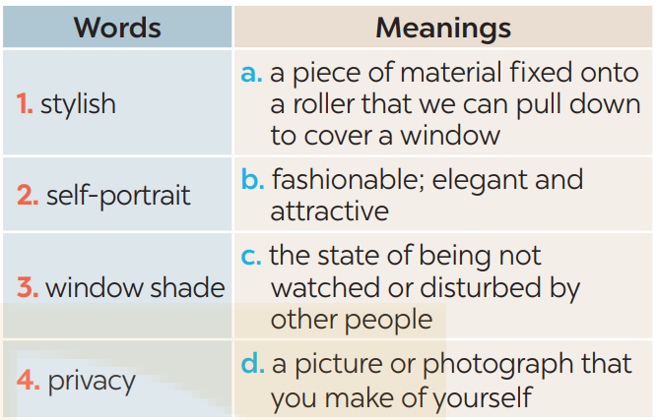
WHILE READING
2
Read the following leaflets and match the highlighted words with their meanings.
1. b 2. d

Slide 11
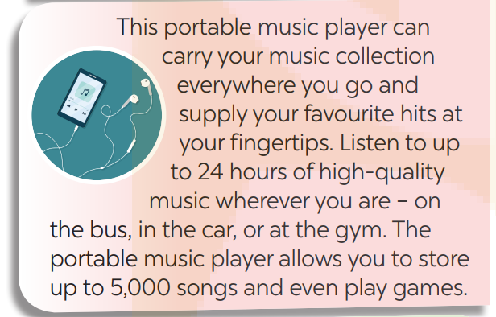
WHILE READING
2
Read the following leaflets and match the highlighted words with their meanings.

Slide 12
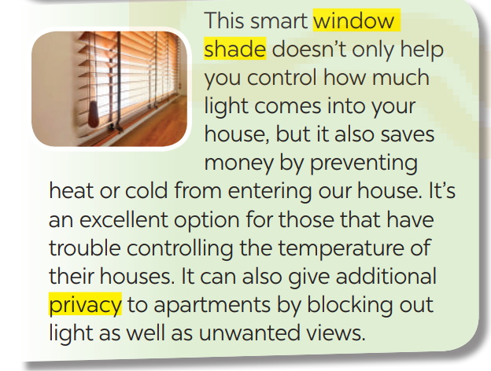
WHILE READING
2
Read the following leaflets and match the highlighted words with their meanings.
3.a 4. c

Slide 13
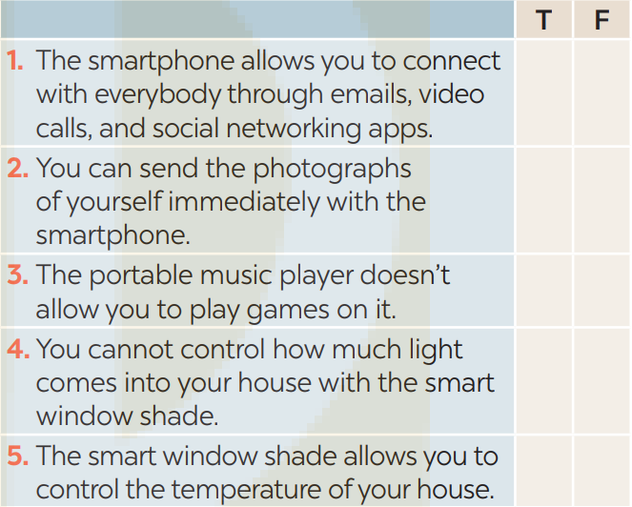
WHILE READING
3
Read the leaflets again and tick T (True) or F (False).
X
X
X
X
X

Slide 14
SPEAKING
4
Work in pairs. Ask and answer the following questions about an electronic device which is important to you. Make notes of your partner’s answers.
1. What electronic device is important to you?
2. How long have you had it?
3. What does it look like?
4. When do you use it?
5. Why is it important to you?

Slide 15
SPEAKING
5
Work in groups. Take turns to talk about the electronic device that is important to your partner.
I talked with Hung about the smartphone that is important to him. He’s had this smartphone for almost three years now. It's a sleek black smartphone with a vibrant touchscreen display. The back has a glossy finish, and it's not too big, making it easy to hold. Hung uses his smartphone during the day for various purposes. It's his alarm clock in the morning, his communication tool to stay connected with his family and friends, a quick way to check emails and notifications, and even a source of entertainment during his free time. This smartphone is important to him for several reasons. It's not just a communication device; it's like a mini personal assistant. It helps him stay organized with his schedules, assignments, and reminders. It's also his primary source of information and a quick way to search for anything he needs to know.

Slide 16
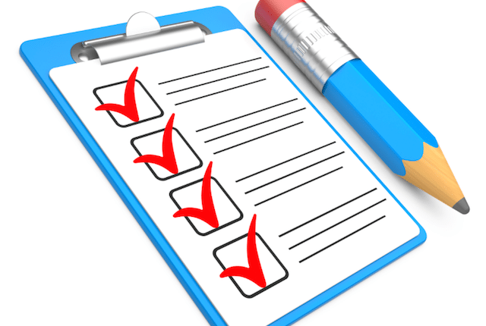
CONSOLIDATION
1
Wrap-up
What have we learnt in this lesson?
Reading about electronic devices
Talking about an electronic device which is important to you.

Slide 17
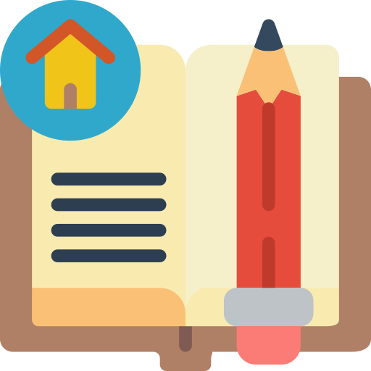
CONSOLIDATION
2
Homework
- Do exercises in the Workbook.

Slide 18
Website: hoclieu.vn
Fanpage: facebook.com/www.tienganhglobalsuccess.vn/

