Slide 1


English 8
UNIT 7 . POLLUTION
PERIOD 56: A CLOSER LOOK 2
Welcome to our class

Slide 2
GRAMMAR
1. Conditional sentences type 1: review
1. Put the verbs in brackets into the correct form.
recycle
If we (cycle)…………………….. more, we (help) …………………….. the Earth.
2. Factories (not dump) …………………….. waste into rivers if the government (fine)……………... ..them heavily.
3. If people (travel) ………………….. to work by bus, there (be) ……………………. fewer car fumes.
4. We (save) ……………….…. thousands of trees if we
(not waste) ………………………… paper.
5. If we (use)…………………… water carefully, more people (have) ……………………. fresh water.
will help
will not/won’t dump
fines
travel
will be
will save
don’t waste
use
will have

Slide 3
2. Combine each pair of sentences to make a conditional sentences type 1.
Students are more aware of protecting the environment. Teachers teach environmental issues at school.
………………………………………………………………………………………………………………………
2. Light pollution happens. Animals change their behaviour patterns.
…………………………………………………………………………………………………………………………….
→Students will be more aware of protecting the environment
if teachers teach environmental issues at school.
→ If / When light pollution happens, animals will change their behavior patterns.

Slide 4
The levels of radioactive pollution decrease. We switch from nuclear power to renewable energy sources.
…………………………………………………………………………………………………………………………….
4. The water temperature increases. Some aquatic creatures are unable to reproduce.
…………………………………………………………………………………………………………………………….
5. People get more diseases. The water is contaminated.
…………………………………………………………………………………………………………………………….
→ The levels of radioactive pollution will decrease , if we switch from nuclear power to renewable energy sources.
→ If the water temperature will increase, some aquatic creatures will be unable to reproduce.
→ People will get more diseases if the water is contaminated.

Slide 5
CONDITIONAL SENTENCES TYPE 2
-The conditional sentence type 2 describes a thing which is not true or is unlikely to happen in the present or future.
If + S + V (past simple), S + would / could / might + inf.
If clause main clause
Example: If it wasn’t noisy here, I could hear you clearly. (But it’s very noisy in here)
- The conditional sentence type 2 can be used to give advice.
Example: I were you, I would see the doctor immediately.
Note: We can use both was and were with I / He / She / It in the If clause.

Slide 6
3. Match an If clause in A with a suitable main clause in B.
A | B
1. If I were you, | a. What would happen?
2. If Lan wasn’t ill, | b. I’d look for a new place to live.
3. If there were fewer cars on the roads, | c. She would join our tree planting activity.
4. If people really cared about the environment, | d. There would be less pollution.
5. If there was no fresh water in the world, they wouldn’t dump waste into the lake. | e. They wouldn’t dump waste into the lake.

Slide 7
4. Put the verbs in brackets into the correct form.
were
If you (be) …………… the president, what you (do) …………………… to help the environment?
2. They get sick so often. If they (exercise) ……………. more, they (be) ……………….. healthier.
3. If I (have) …………… one million US dollars, I (build) ……………….. more parks in our city.
4. Ngoc’s mother is unhappy. If Ngoc (tidy) …………….. her room every day, her mother (not be) ……………… so upset.
5. There isn’t a garden at our house. If there (be) …………, we (grow) ………………… vegetables.
would you do
exercised
would be
had
would build
tidied
wouldn’t be
was / were
would grow

Slide 8
5. Write a conditional sentence type 2 for each situation, as in the example.
People throw rubbish in the street. The street doesn’t look attractive.
2. There are so many billboards in our city. People can not
enjoy the view.
→
3. There is so much light in the city at night. We can not see the stars clearly.
→If people didn’t throw rubbish in the street, It would look attractive.

Slide 9
4. We turn on the heater all the time. We have to pay three million dong for electricity a month.
→
5. The karaoke bar makes so much noise almost every night. The residents complain to its owner.
→
6. She has a headache after work every day. She works in a noisy office.
→

Slide 10
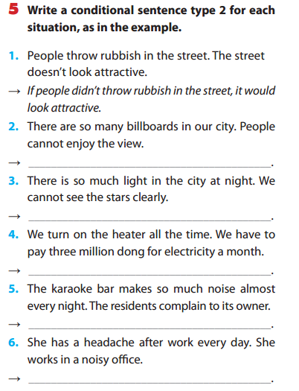

Slide 11
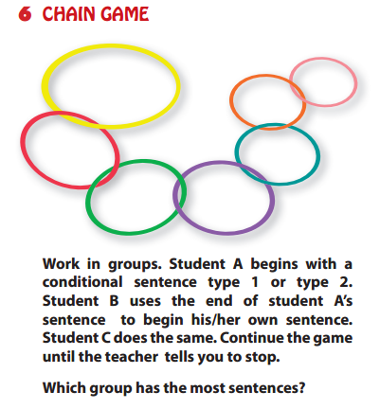
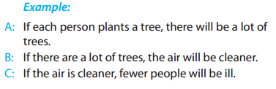

Slide 12
Homework:
Learn by heart the grammar
Do the exercises B5,6- 5 (Workbook)
B3,4- 4,5 (Exercise notebook)
Prepare: Unit 7 (Communication)

