Slide 1

Unit 4: Festivals and Free Time
Lesson 3.1: Vocabulary & Listening
Page 36

Slide 2
Lesson Outline
Warm-up
Vocabulary
Listening
Consolidation
Wrap-up

Slide 3
Objectives
By the end of this lesson, students will be able to…
know and use vocabulary related to traditional festivals.
ask and answer about some traditional festivals such as Kwanzaa, Lunar New Year, Thanksgiving, Christmas and Halloween.
listen for specific information.

Slide 4

New words
watch fireworks
decorate a house or tree
visit family and friends
get lucky money, candy, or gifts
play games or music
buy fruits or flowers
watch parades
eat traditional food

Slide 5

WARM-UP

Slide 6

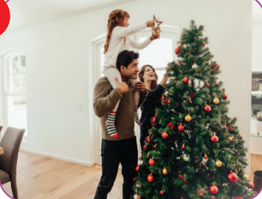
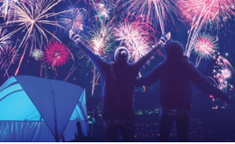
Work in pairs
Do you like festivals?
Which festivals are they in the pictures?
What do you usually do during these festivals?

Slide 7
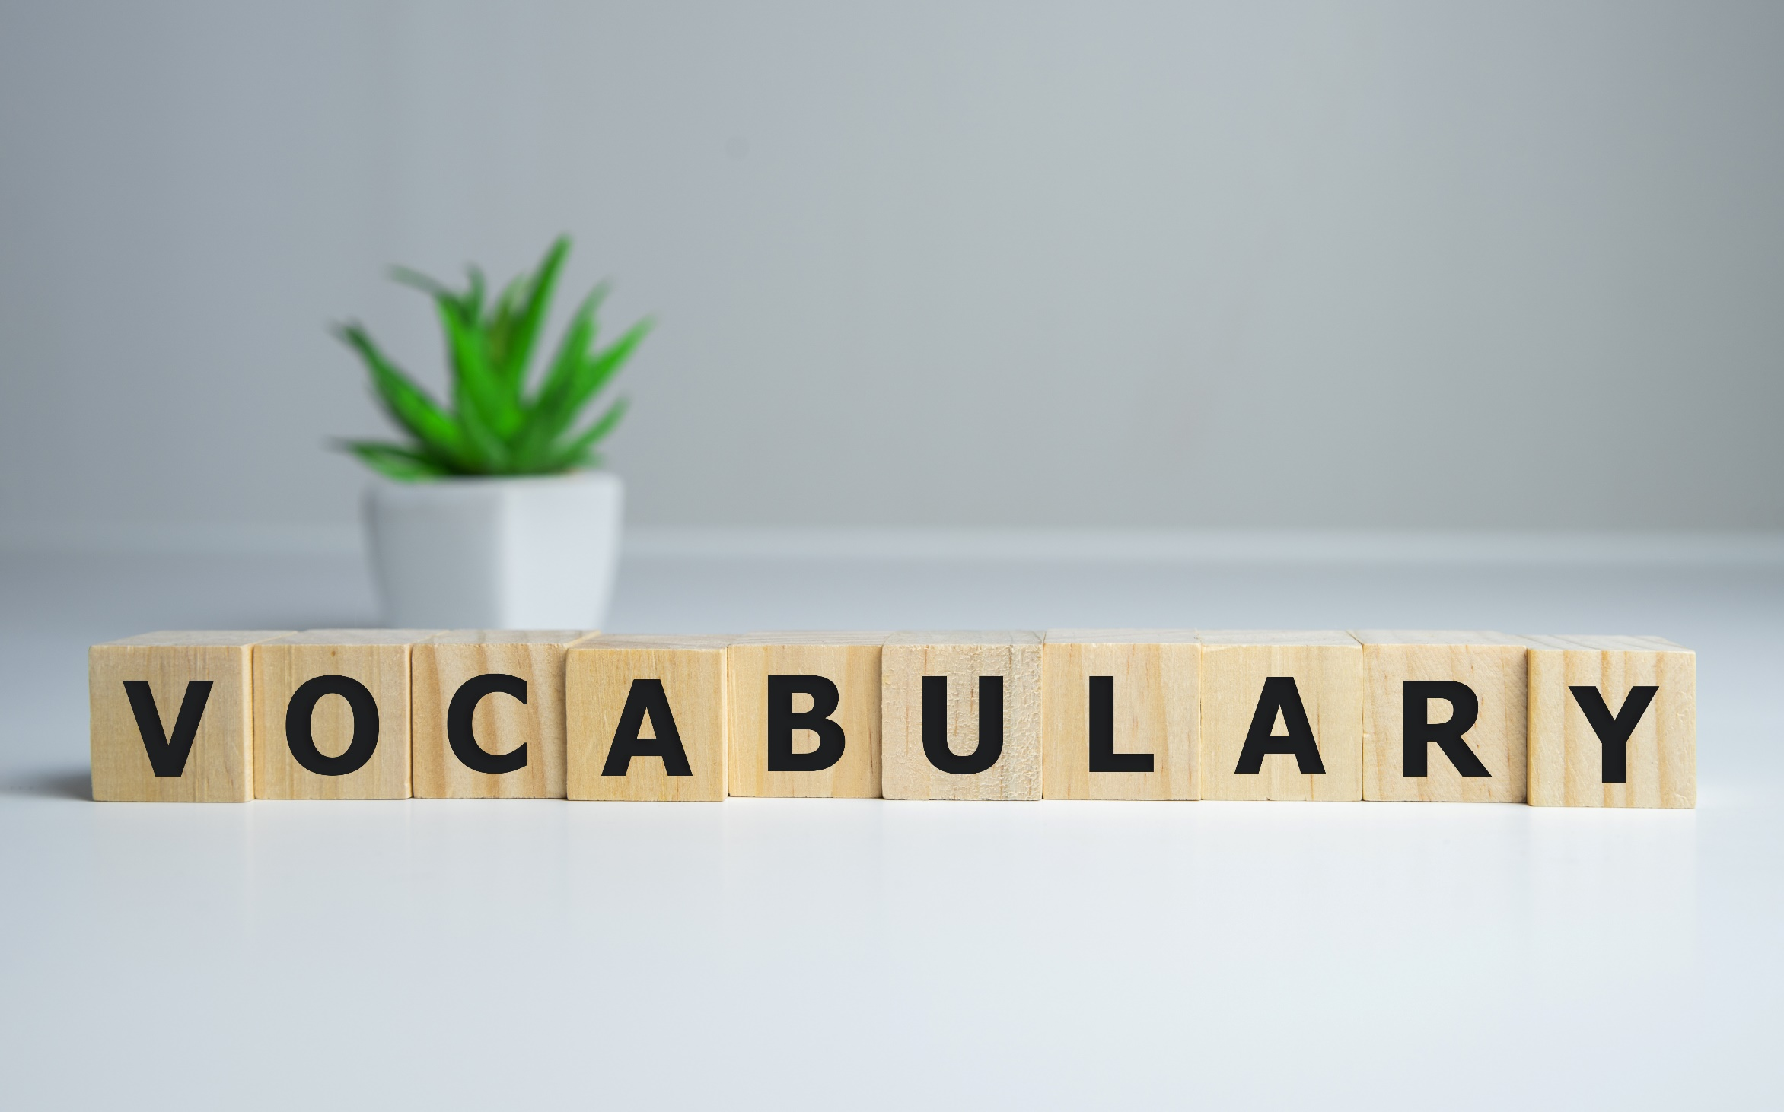


Slide 8
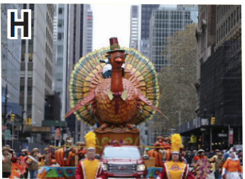
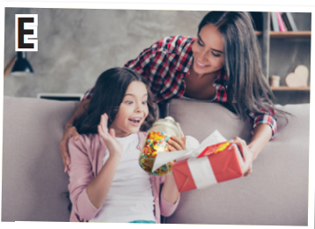
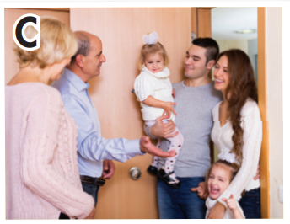
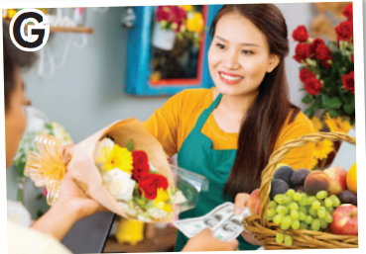
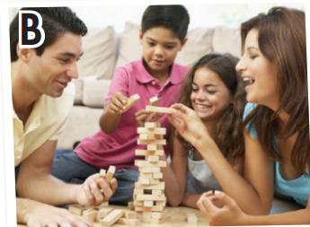
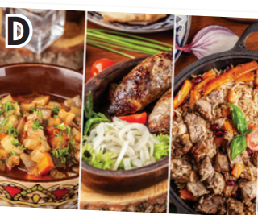
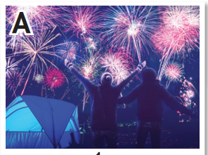
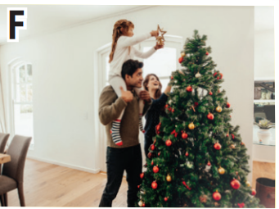


What are they doing?
- watch fireworks : xem pháo hoa
- decorate a house or tree : trang trí nhà cửa hoặc cây
- visit family and friends : đến thăm gia đình và bạn bè
- get lucky money, candy, or gifts : nhận tiền lì xì, kẹo, hoặc quà
- play games or music : chơi game hoặc nhạc
- buy fruits or flowers : mua trái cây hoặc hoa
- watch parades : xem diễu hành
- eat traditional food : ăn món ăn truyền thống

Slide 9
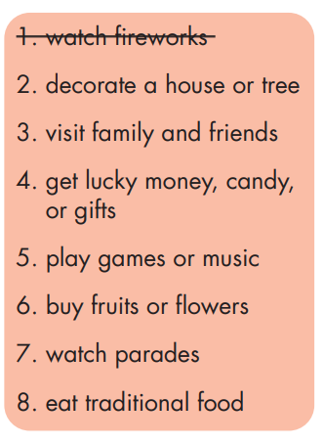
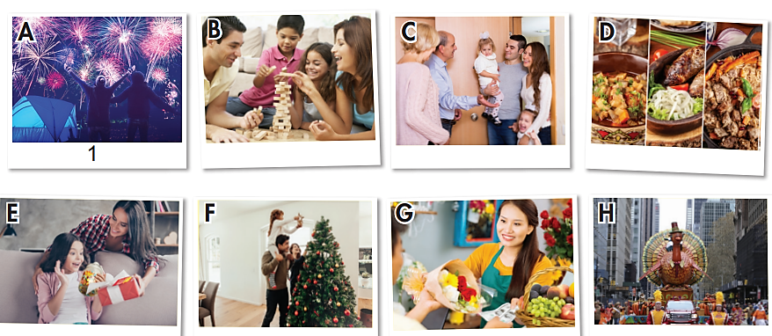
5
3
8
4
2
6
7

Slide 10
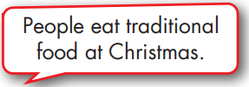
………………………………
……………………………..
Christmas
New Year
Halloween

Slide 11
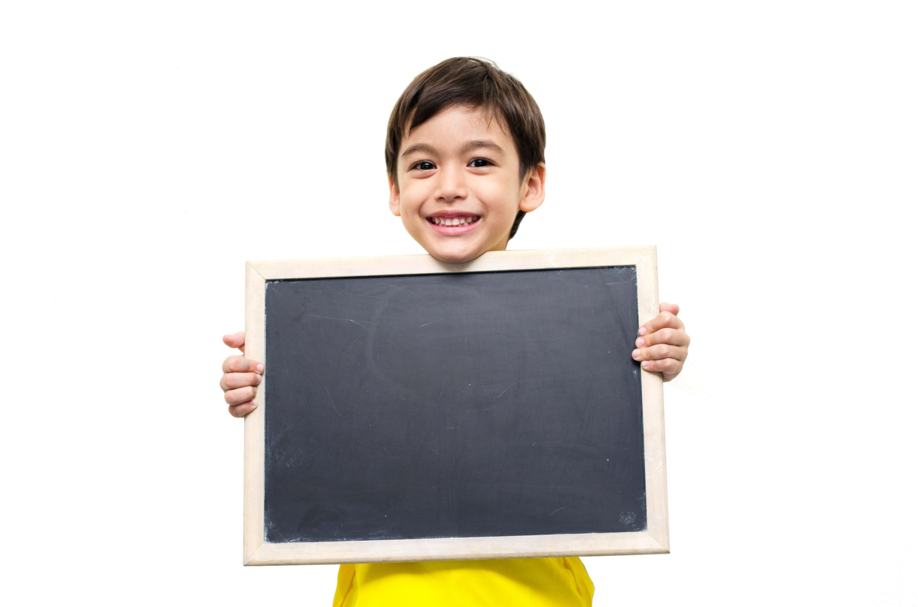
Listening

Slide 12
Pre-Listening
Read the instruction quickly. Underline the key words.

Slide 13
While-Listening
Yes / No
Kwanzaa is an African-American festival.
Christmas is celebrated in many countries.
In the USA, people celebrate Thanksgiving.
My favorite festival is Lunar New Year. In South Korea, people call it Seollal.

Slide 14
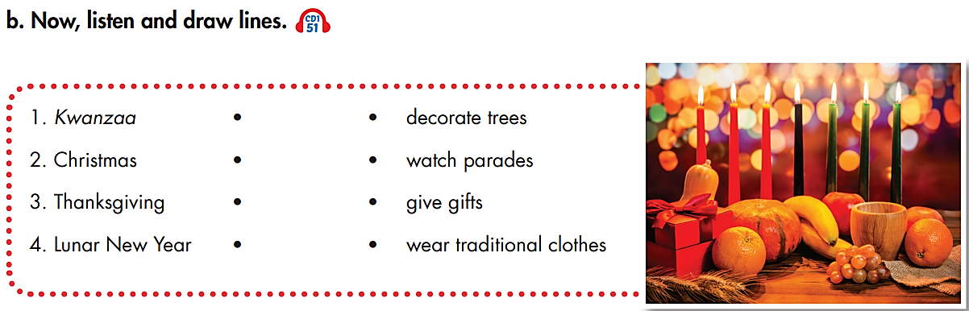
Pre-Listening
Read the instruction quickly. Underline the key words.

Slide 15
While-Listening

Slide 16
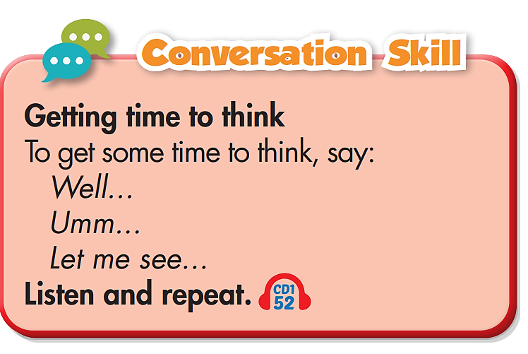
Post-Listening

Slide 17
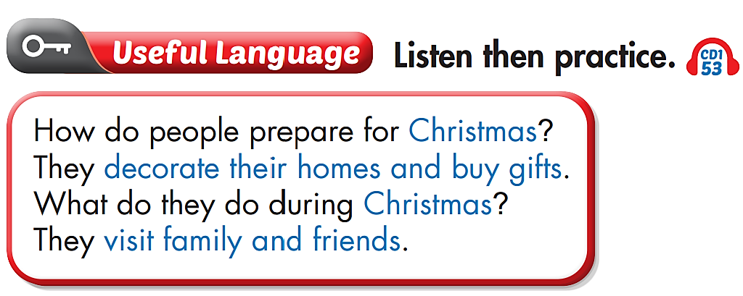
Post-Listening

Slide 18
Post-Listening
Practice the conversation with a partner.
Wilson: Kwanzaa is an African-American festival. People wear traditional clothes and decorate their homes with fruits and vegetables.
Louise: Christmas is celebrated in many countries. In France, it's called, ummmm…Noel. People listen to Christmas music and decorate Christmas trees.
Chad: Well…In the USA, people celebrate Thanksgiving. People eat special food and watch parades with their families and friends.
Alice: My favorite festival is Lunar New Year. In South Korea, people call it Seollal. Families stay at home, eat special food, and…let me see…umm, give each other gifts.

Slide 19

CONSOLIDATION

Slide 20
Ask and answer about your favorite festival.
Names of festivals: Kwanzaa, Christmas, Thanksgiving, Lunar New Year, Halloween
New words: watch fireworks ; decorate a house or tree ; visit family and friends ; get lucky money, candy, or gifts ; play games or music ; buy fruits or flowers ; watch parades ; eat traditional food; wear traditional clothes; …
Structure: How do people prepare for ……………..?
What do they do during …………….?
Using some phrases to get time to think
(Well…, Let me see…, Umm…)

Slide 21
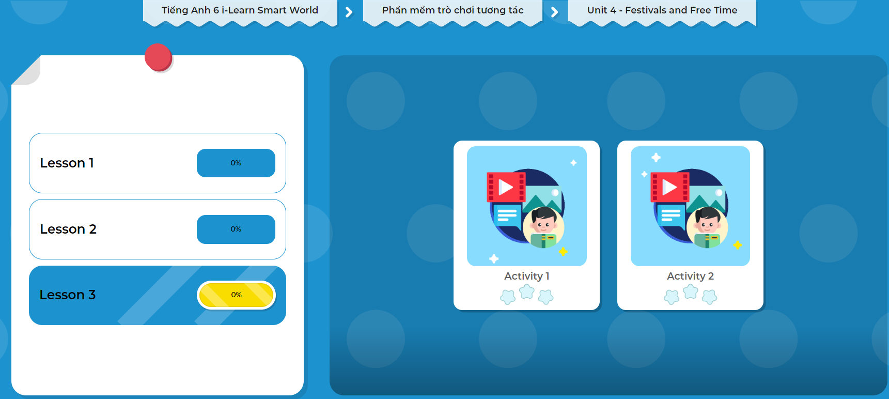
Click on the picture to play the games.

Slide 22

WRAP-UP

Slide 23
Today’s lesson
Vocabulary
watch fireworks
decorate a house or tree
visit family and friends
get lucky money, candy, or gifts
play games or music
buy fruits or flowers
watch parades
eat traditional food

Slide 24
Today’s lesson
Structures/ Sentence patterns
How do people prepare for ……………..?
What do they do during …………….?
Using some phrases to get time to think (Well…, Let me see…, Umm…)

Slide 25
Homework
Review the vocabulary and practice using them.
Do the exercise(s) in Tiếng Anh 6 i-Learn Smart World Workbook (page 24).
Do the vocabulary exercise in Tiếng Anh 6 i-Learn Smart World Notebook (page 24).
Play the consolation games in Tiếng Anh 6 i-Learn Smart World DHA App on www.eduhome.com.vn.
Prepare the next lesson (page 37 - SB).

Slide 26
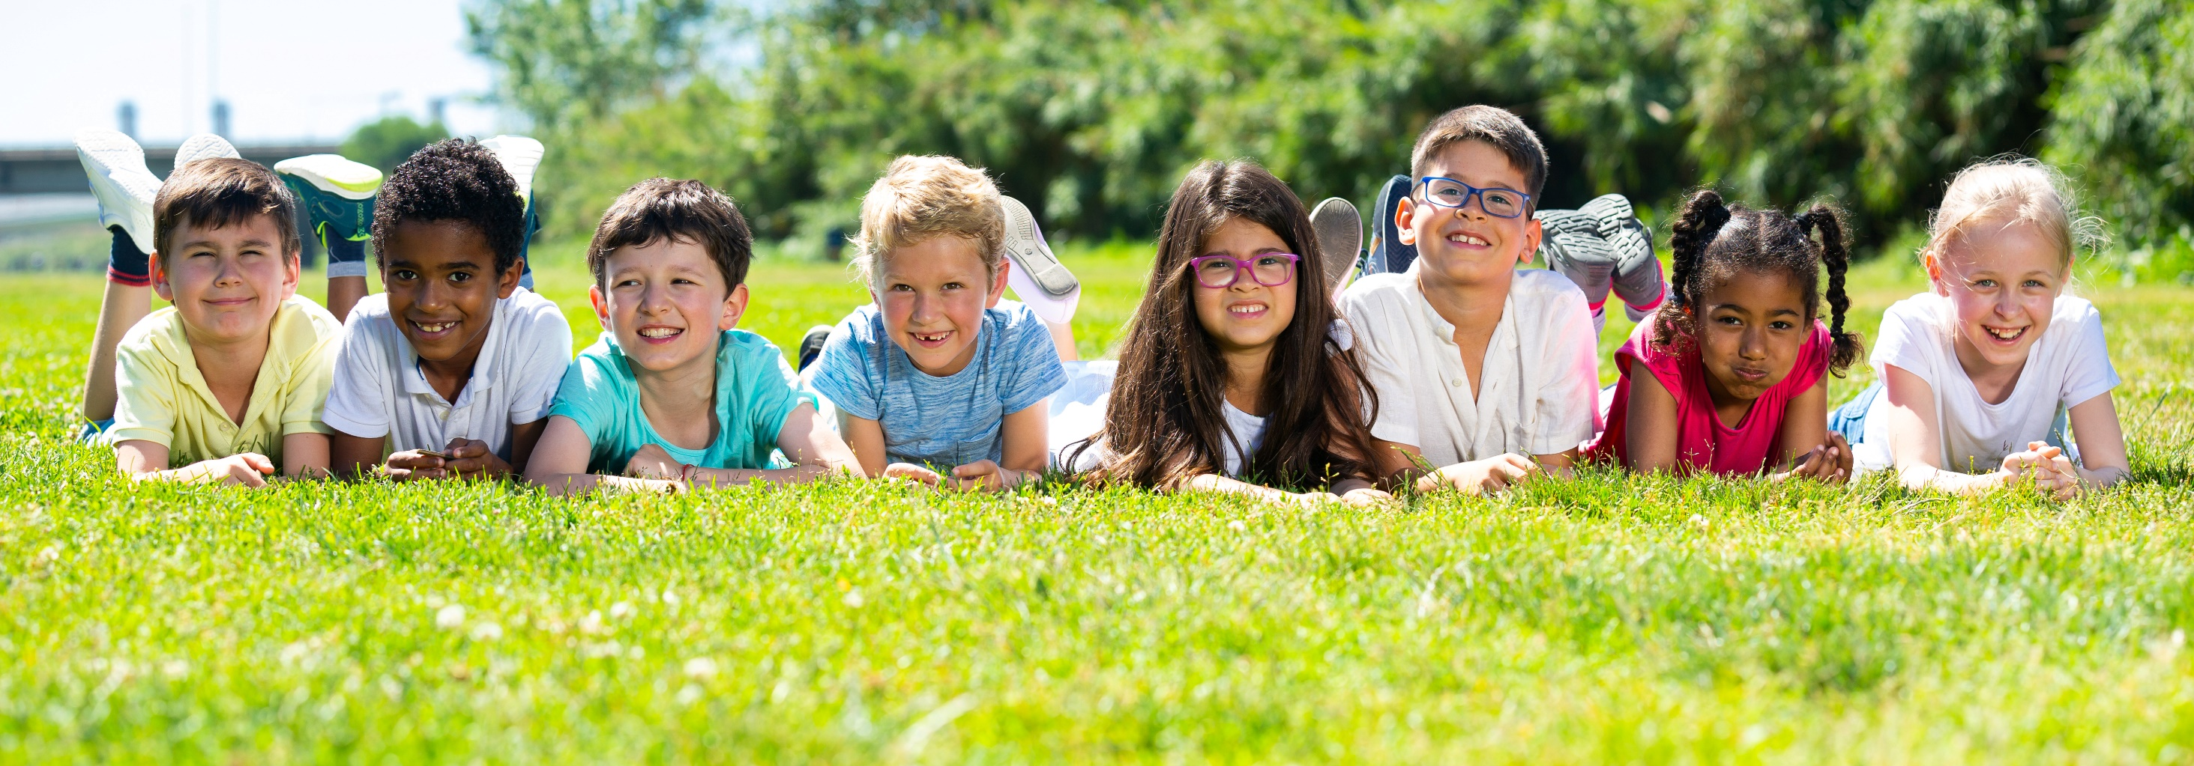
Have a nice day!

