Slide 2
HUMAN ACTIVITIES AND GLOBAL WARMING
Unit
5
GLOBAL WARMING
Unit
FAMILY LIFE
LESSON 4
SPEAKING
Student Book – page 56

Slide 3
LESSON 4
SPEAKING
WARM-UP
Matching game
CONTROLLED PRACTICE
Task 1: Match the activities with their effects.
Task 2: Complete the conversation.
LESS CONTROLLED PRACTICE
Task 3: Talk about the other human activities that contribute to global warming.
FREE PRACTICE
Task 4: Decide which human activity contributes to global warming the most.
CONSOLIDATION
Wrap-up
Homework

Slide 4
WARM-UP
MATCHING GAME
Work in groups.
Match the cream (cause) with the correct bowl (effect) to make a perfect parfait.
Raise hands to take turn for your group.

Slide 5
WARM-UP
The snow fell all night
It rained all week
Lightning struck the tree
Ice on the poles is melting
Schools and factories are closed today
It burned and blocked the road
The town was flooded
Sea level is rising

Slide 6
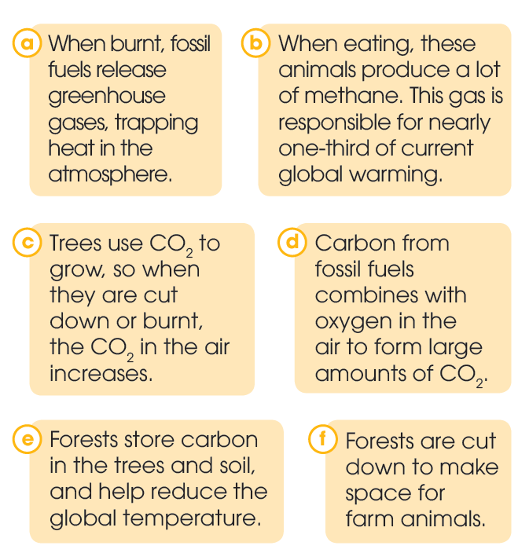
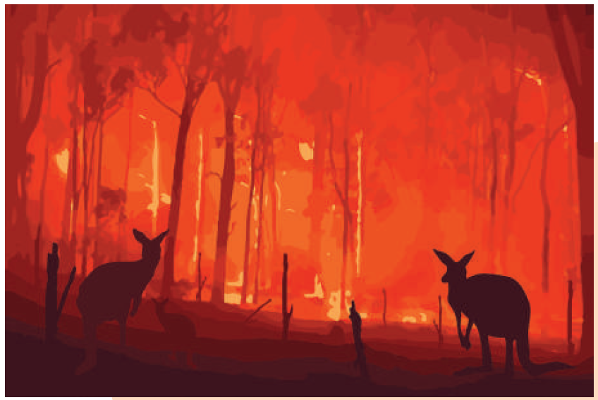
CONTROLLED PRACTICE
1
Match the activities (1–3) with their possible effects on the environment (a–f).
KEYS
1. c, e
2. a, d
3. b, f

Slide 7
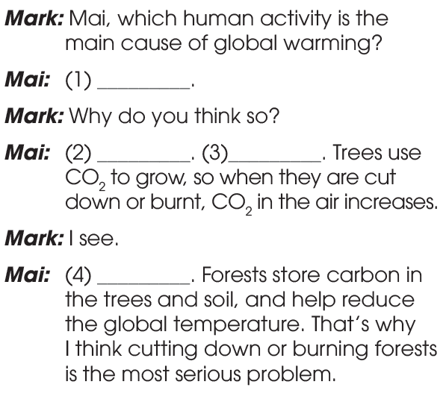
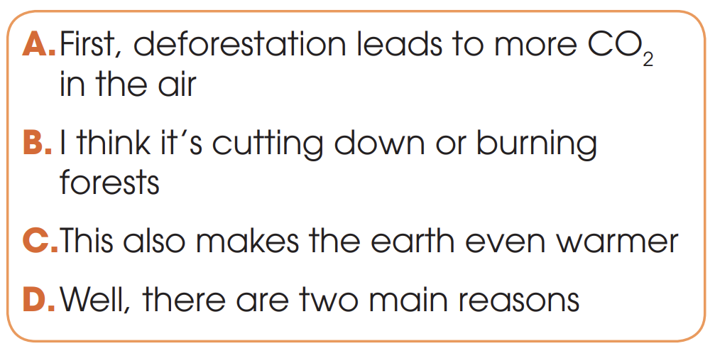
CONTROLLED PRACTICE
2
Use the sentences in the box to complete the conversation. Then practise it in pairs.
B
D
A
C

Slide 8
CONTROLLED PRACTICE

Slide 9
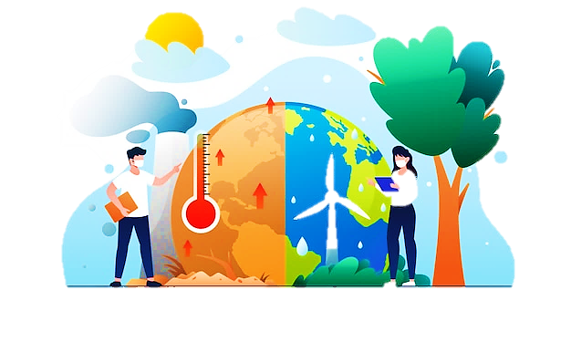
LESS CONTROLLED PRACTICE
3
Work in pairs. Talk about the other human activities that contribute to global warming. Use the ideas in 1, the model and the tips in 2 to help you.

Slide 10
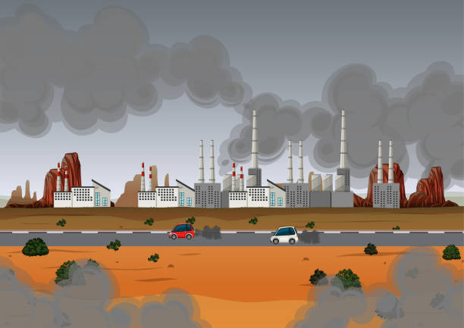
FREE PRACTICE
4
Work in groups. Decide which human activity contributes to global warming the most. Report to the whole class.

Slide 11
CONSOLIDATION
1
Wrap-up
What have you learnt today?
Talk about human activities and global warming
Present ideas clearly in a discussion
New Vocabulary to talk about global warming

Slide 12
CONSOLIDATION
2
Homework
Do exercises in the workbook.
Prepare for Lesson 5 - Unit 5.

Slide 13
Website: hoclieu.vn
Fanpage: facebook.com/tienganhglobalsuccess.vn/

