Slide 1

Unit 9: Houses in the Future
Lesson 1.2: Grammar
Page 71

Slide 2
Lesson Outline
Warm-up
Grammar
Consolidation
Wrap-up

Slide 3
Objectives
By the end of this lesson, students will be able to…
- Give ideas about the future using the Future Simple.
- Use Indefinite Quantifiers before nouns to show the
amount or quantity.

Slide 4

WARM-UP

Slide 5
PAIR WORK
Do you prefer to live in a city or in the countryside?
Why?

Slide 6



Slide 7
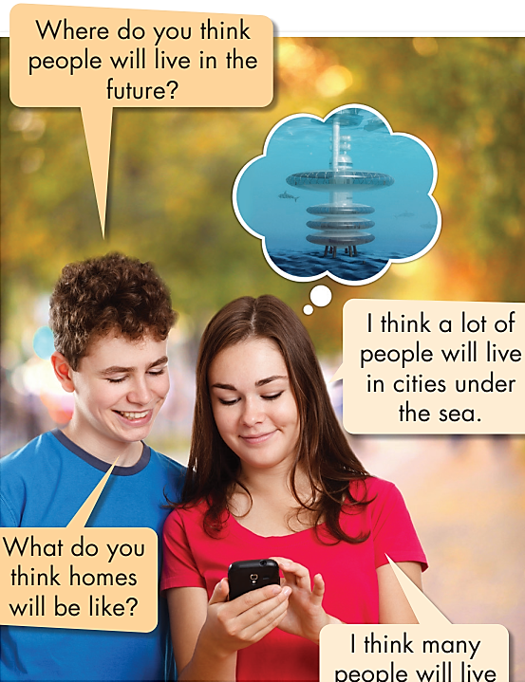
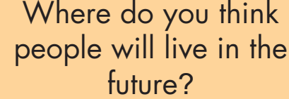


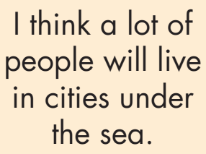
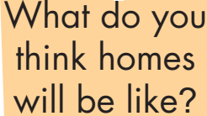
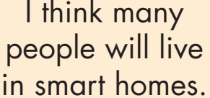





Slide 8

Presentation

Slide 9
Future Simple
We use the Future Simple and "think" to give our
ideas about the future.
Look and read the sentences:
I think people will live in megacities.
He thinks people will live in megacities.
They don't think people will live in megacities.
She doesn't think people will live in megacities.
We won't live in a megacity.
What do you think homes will be like?
I think people will live in smart homes.

Slide 10
Indefinite Quantifiers
We use indefinite quantifiers before nouns to show the amount or quantity if we don't know exactly how much
there is or how many there are.
With countable nouns, we can use:
☞ a few/some for small quantities
☞ many/lots of/a lot of for large quantities
Look and read the sentences:
I think a few people will live underground.
I think many people will live under the sea.
I think a few people will live underground.
I think many people will live under the sea.

Slide 11

Practice

Slide 12

you/think/lots/people/live/smart homes? __________________________________________________
what/you think homes/be like? __________________________________________________
I think/lot of/people/live/megacities. __________________________________________________
you/think/people/live/earthscrapers? __________________________________________________
I think/some people/live in eco-friendly homes. __________________________________________________
where/you/think/people/live? __________________________________________________
Do you think lots of people will live in smart homes?
What do you think homes will be like?
I think a lot of people will live in megacities.
Do you think people will live in earthscrapers?
I think some people will live in eco-friendly homes.
Where do you think people will live?

Slide 13
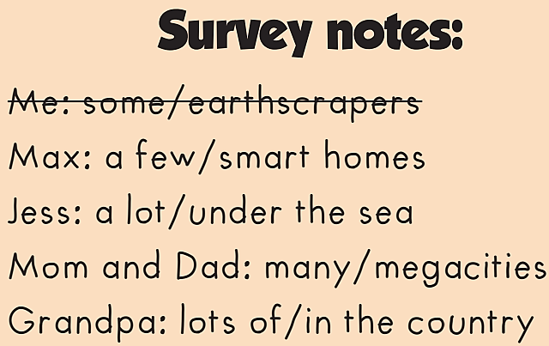
1._______________________________________________
2._______________________________________________
3._______________________________________________
4._______________________________________________
5._______________________________________________
I think some people will live in earthscrapers.
Max thinks
a few people will live in smart homes.
Jess thinks a lot of people will live under the sea.
Mom and Dad think many people will live in megacities.
Grandpa thinks lots of people will live in the country.

Slide 14
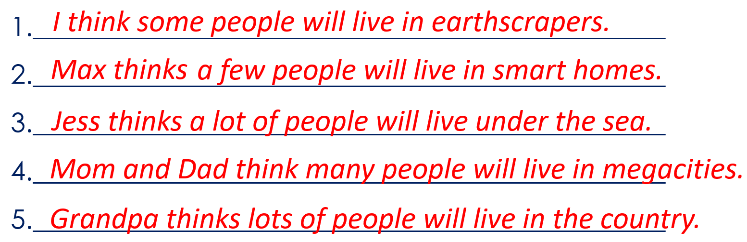

Slide 15
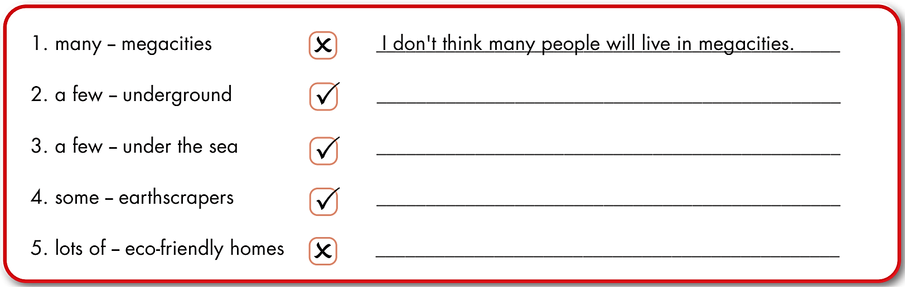
Extra Practice
WB page 51
I think a few people will live underground.
I think a few people will live under the sea.
I think some people will live in earthscrapers.
I don't think lots of people will live in
eco-friendly homes.

Slide 16
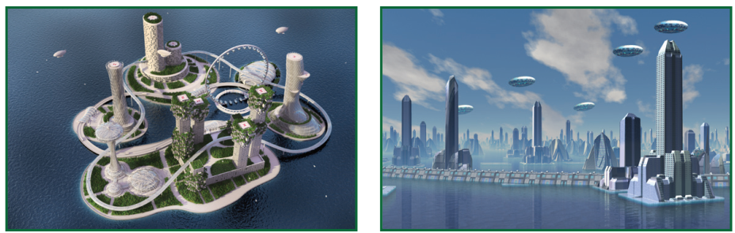
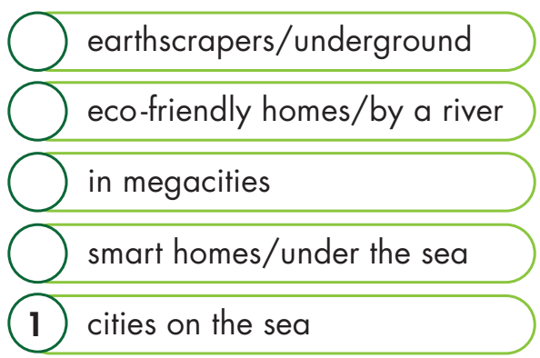
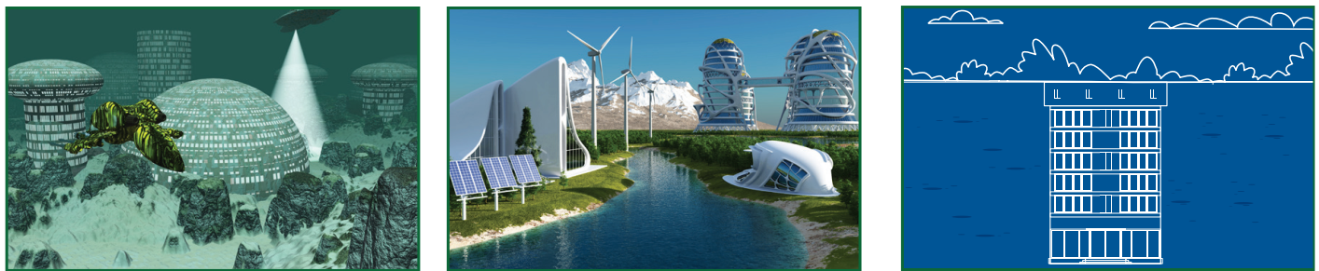
WB page 51
1
2
5
4
2
3
3
4
5

Slide 17
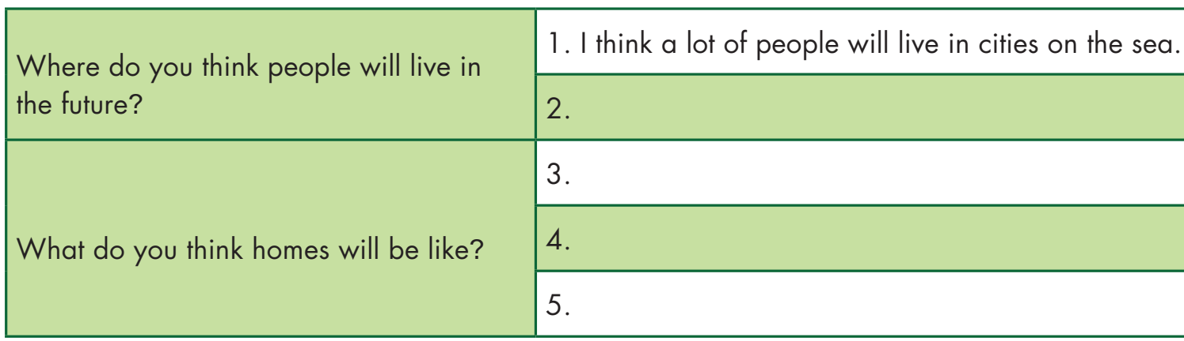
5
4
2
3
I think a lot of people will live in megacities.
I think a few people will live in smart homes
under the sea.
I think people will live in eco-friendly homes
by a river.
I think people will live in earthscrapers
underground.

Slide 18

CONSOLIDATION

Slide 19
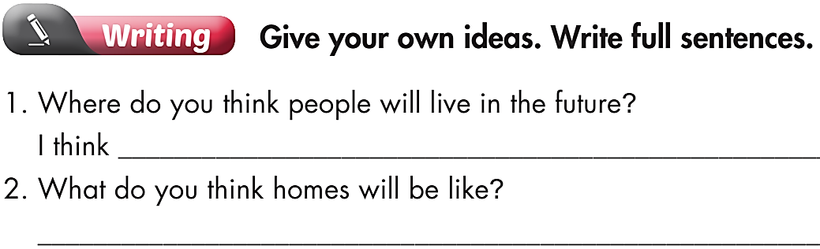

Slide 20

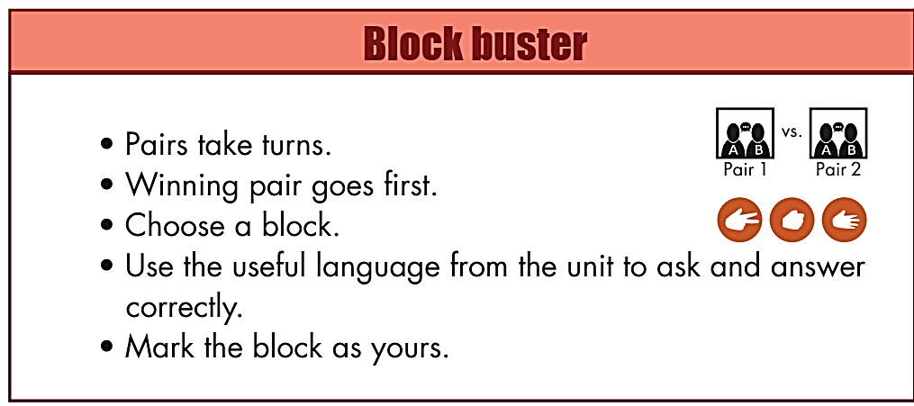
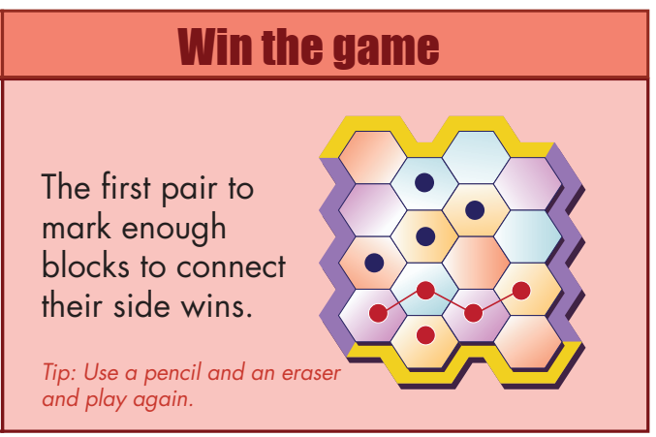
Review Games
Page 118

Slide 21
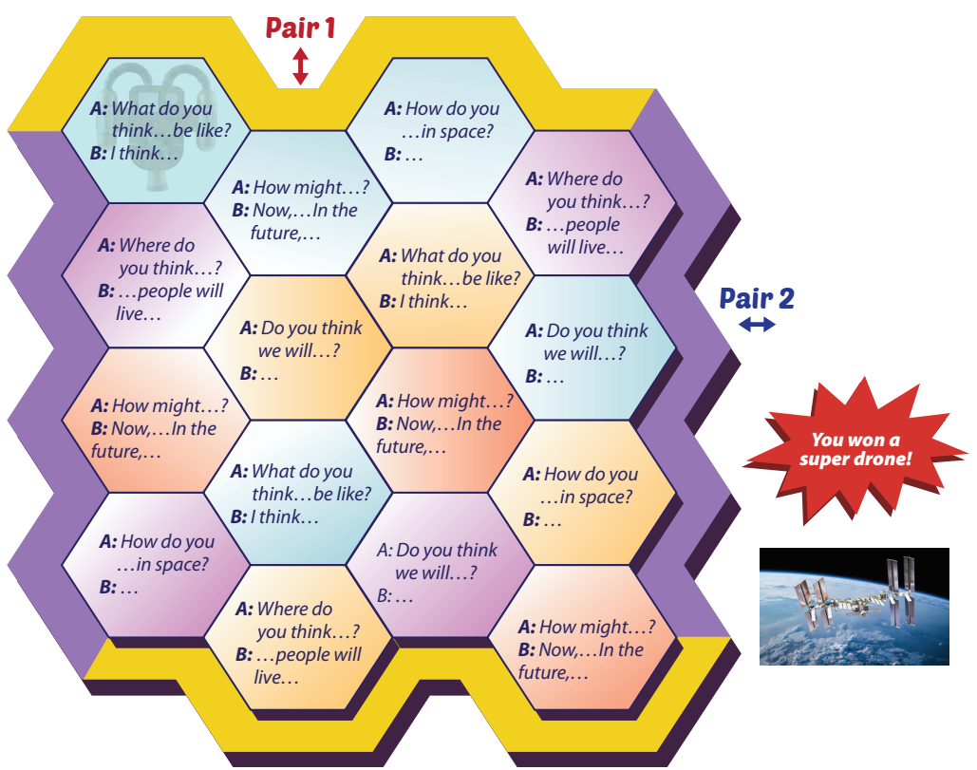

Slide 22

WRAP-UP

Slide 23
Today’s lesson
Grammar
- The Future Simple
- Indefinite Quantifiers

Slide 24
Homework
Review the Future Simple and Indefinite Quantifiers.
Complete the grammar notes in Tiếng Anh 6 i-Learn Smart World Notebook on page 53
Prepare the next lesson (page 72 - SB)
Play the consolidation games in Tiếng Anh 6 i-Learn Smart World DHA App on www.eduhome.com.vn

Slide 25

Have a nice day!

