Slide 1


Slide 2


Unit
12
CAREER CHOICES
LESSON 1: GETTING STARTED
What will you do
in the future?

Slide 3

OBJECTIVES
By the end of the lesson, students will be able to:
Use the words related to Jobs
Gain vocabulary to talk about Future Jobs.

Slide 4
LESSON 1: GETTING STARTED
LESSON 1: GETTING STARTED
WARM-UP
Option 1: Think!
Option 2: Future Vision
Vocabulary
PRESENTATION
Task 1: Listen and read.
Task 2: Read the conversation again and answer the questions.
Task 3: Match the words and phrases in the conversation with their pictures.
Task 4: Choose the correct answer A, B, C, or D to complete each sentence
PRACTICE
PRODUCTION
Task 5: Game: Guess My Jobs
CONSOLIDATION
Wrap-up
Homework

Slide 5


WARM-UP
OPTION 1
Look at the pictures and name the jobs
THINK

Slide 6
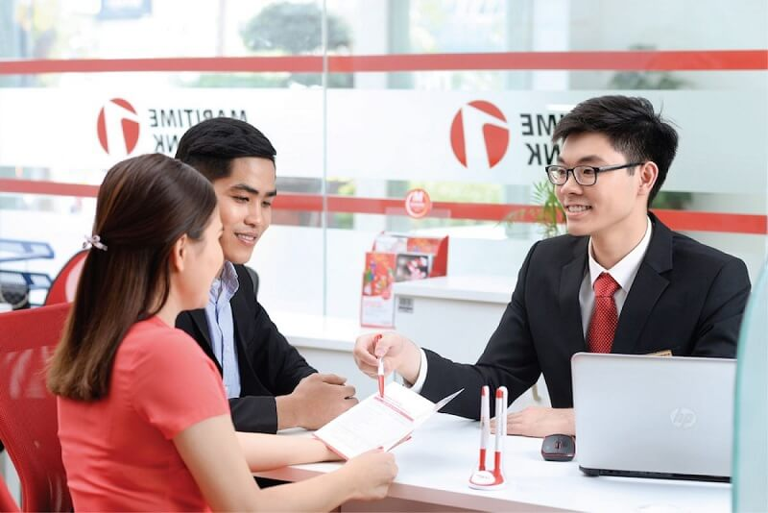
WARM-UP
OPTION 1
HA LONG BAY
IT ENGINEER

Slide 7
WARM-UP
OPTION 1
HA LONG BAY
Banker

Slide 8
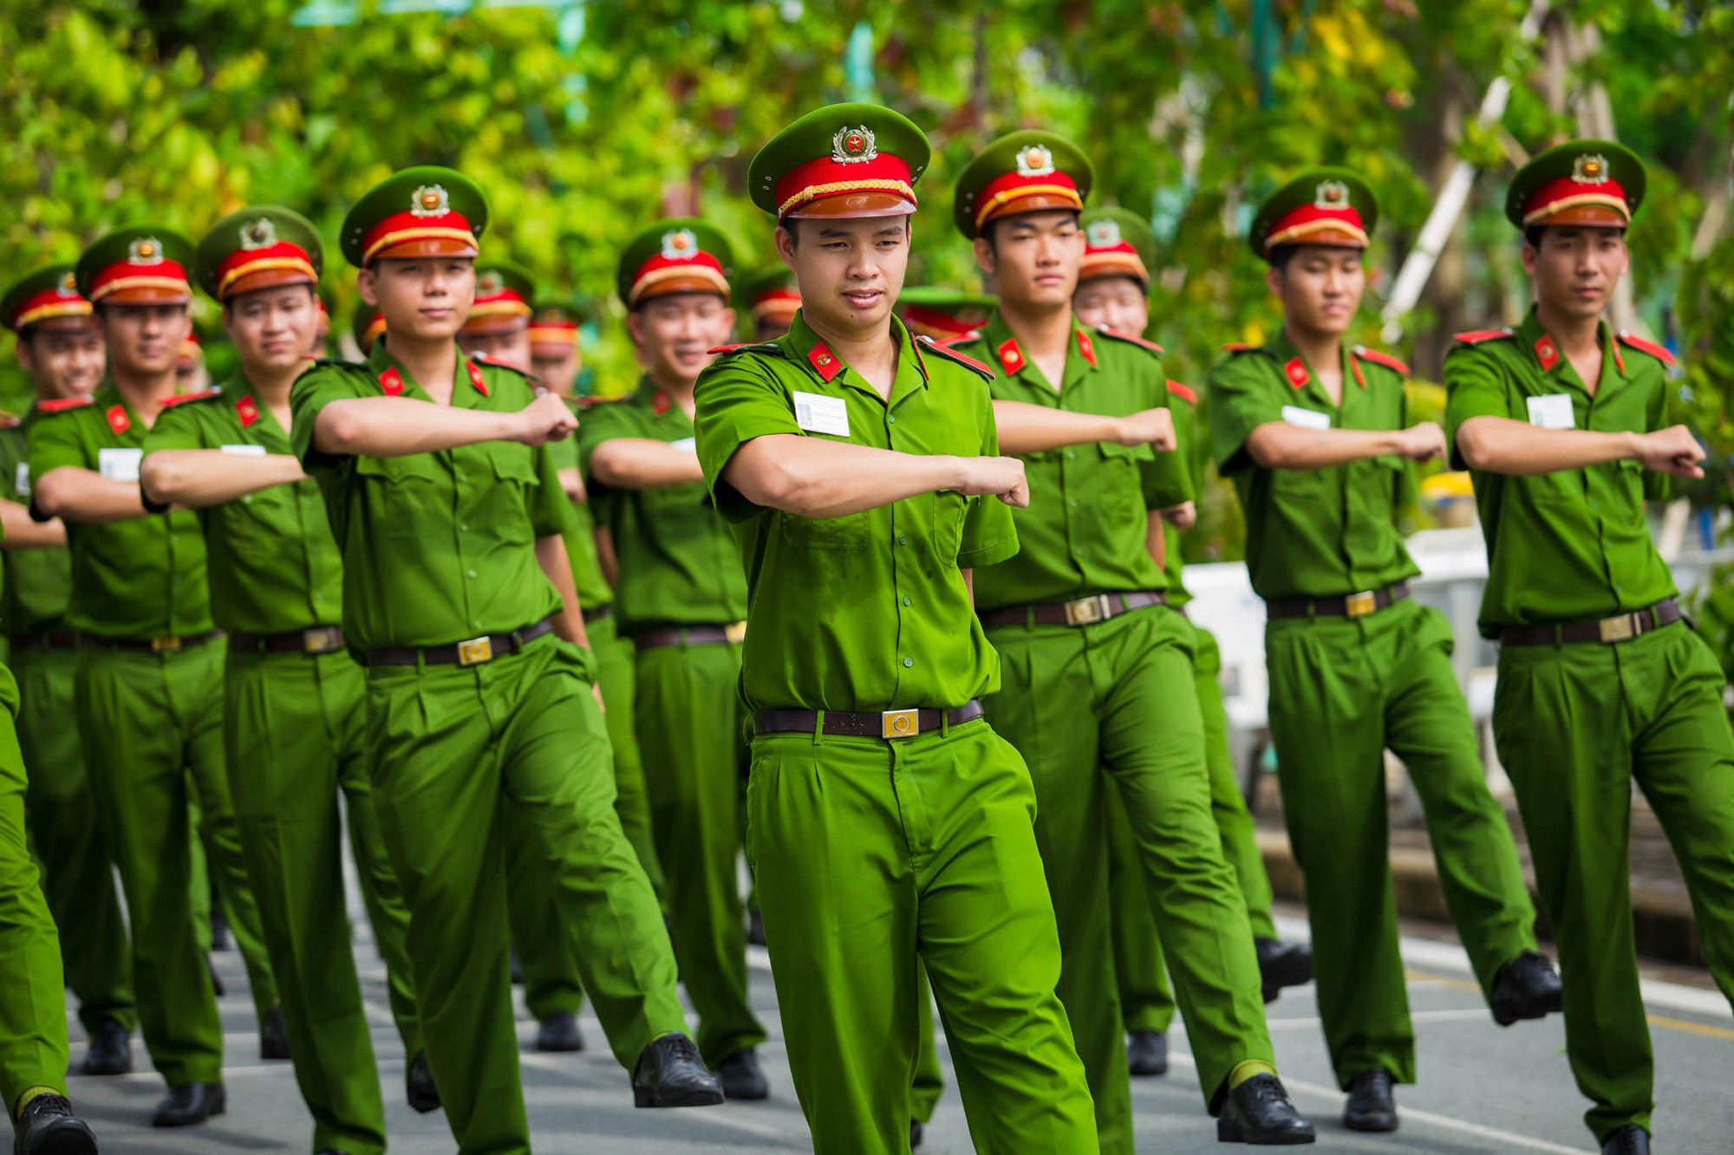
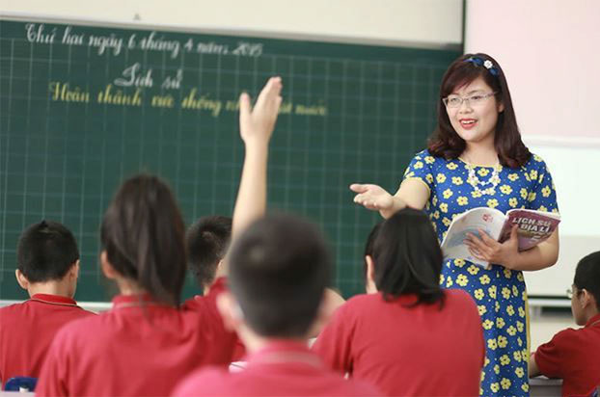
WARM-UP
OPTION 1
HA LONG BAY
Police

Slide 9
WARM-UP
OPTION 1
HA LONG BAY
Teacher

Slide 10

WARM-UP
OPTION 2
Future Vision

Slide 11
WARM-UP
OPTION 2
- Imagine yourselves ten years from now in your ideal job.
Questions:
- What does your daily routine look like?
- What skills do you need to get there?
- What challenges and rewards do you face?
Future Vision
- Describe your future job in detail.

Slide 12



PRESENTATION
The series of jobs that a person has in a particular area of work, usually involving more responsibility as time passes.
career (n)
/kəˈrɪə/
sự nghiệp

Slide 13
PRESENTATION
training or preparation for a new job or activity.
orientation (n)
/ˌɔːriənˈteɪʃn/
sự định hướng

Slide 14
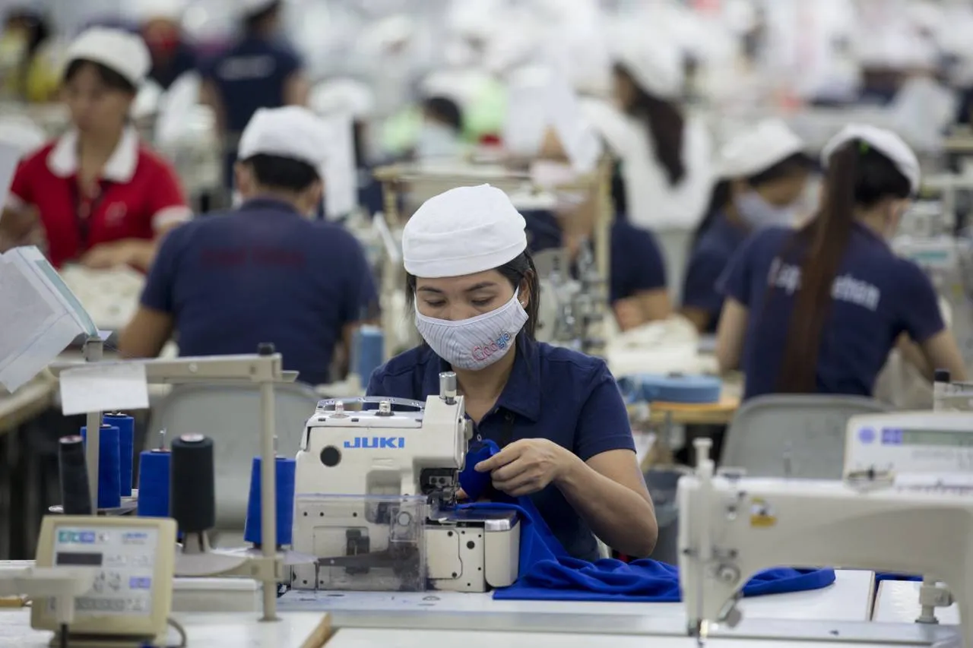
PRESENTATION
providing knowledge and skills that prepare you for a particular job
vocational (adj)
/vəʊˈkeɪʃənl/
Ex: The school offers vocational programs in electrical work.
thuộc về nghề nghiệp, hướng nghiệp

Slide 15
PRESENTATION
a person whose occupation is making and altering garments.
garment worker
/ˈɡɑːmənt ˈwɜːkə/
công nhân may

Slide 16
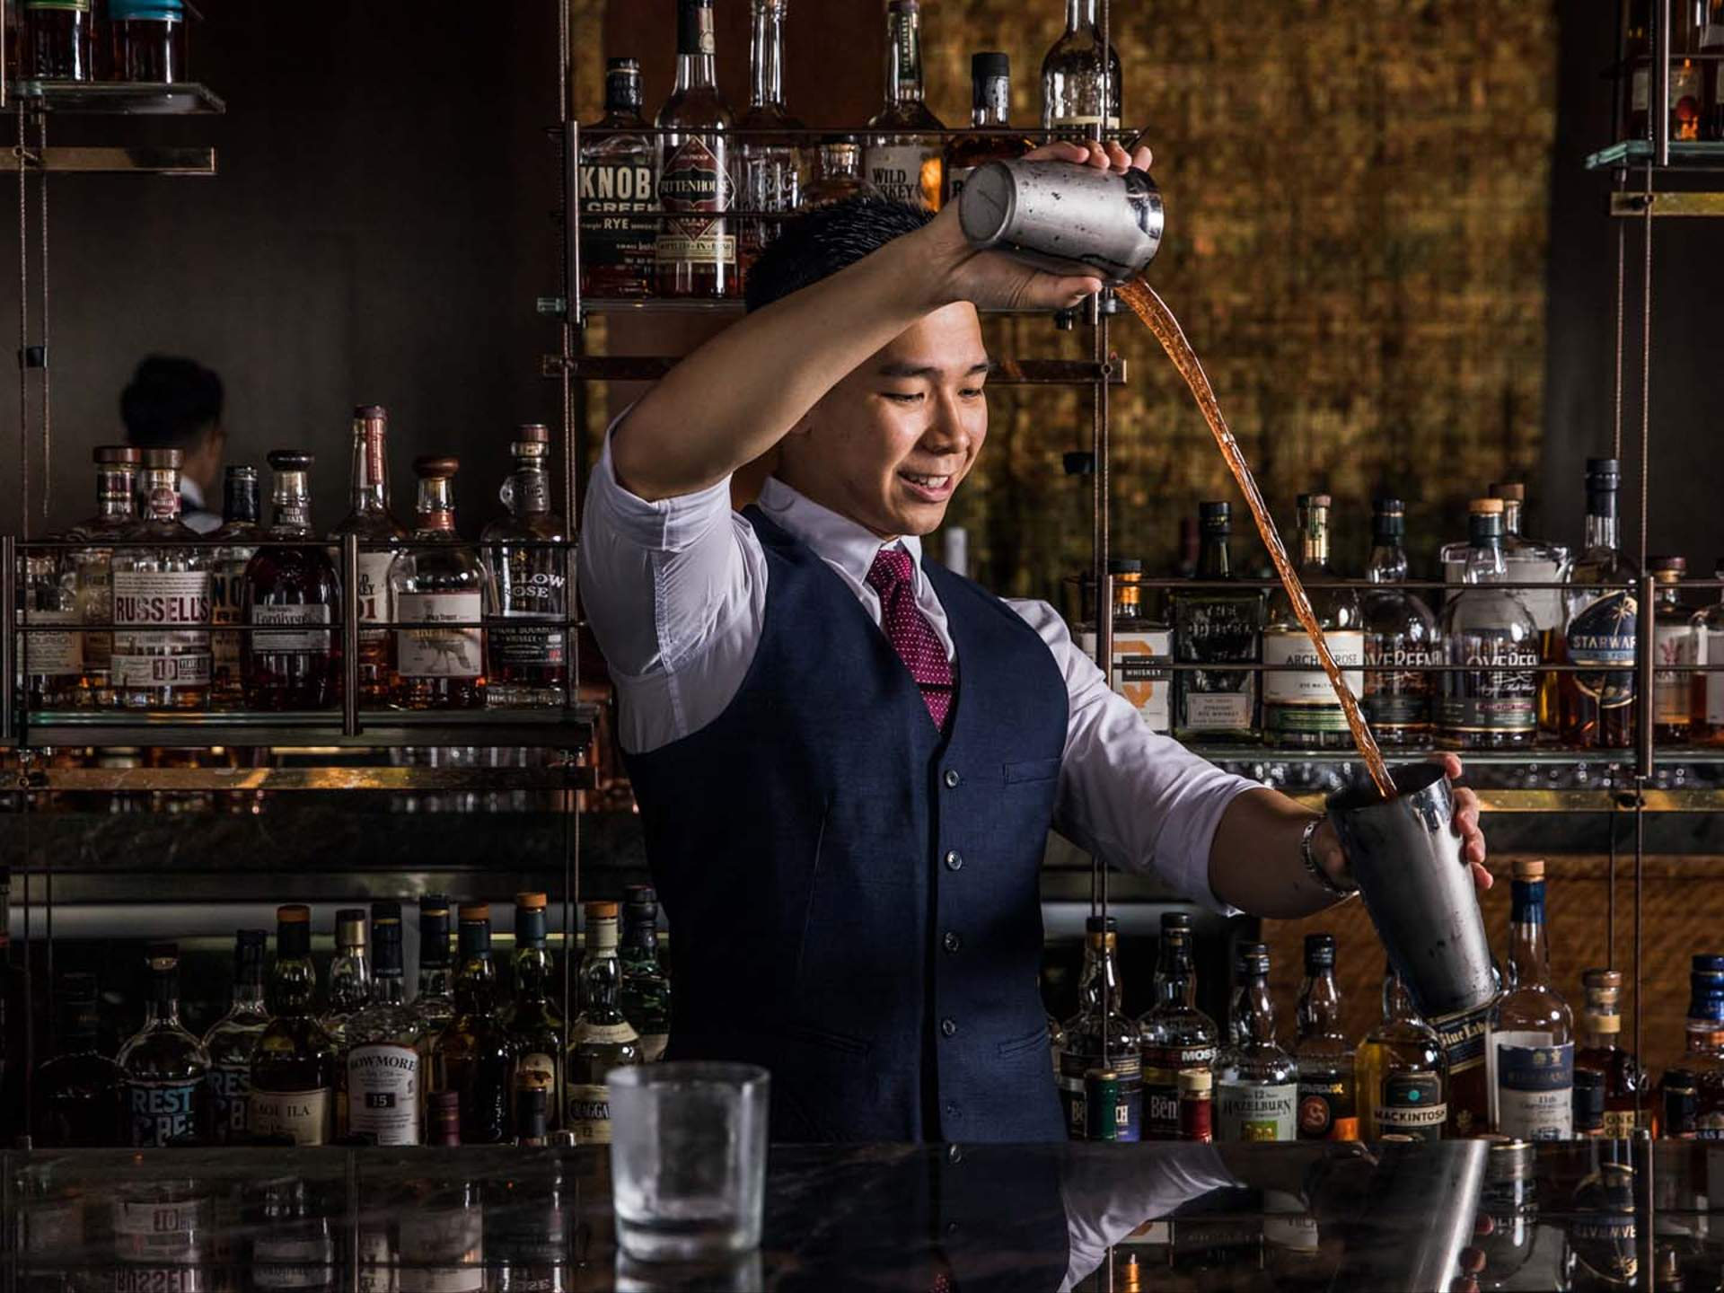
PRESENTATION
someone who makes and serves drink in a bar
bartender (n)
/ˈbɑːtendə/
thợ pha chế đồ uống có cồn

Slide 17
PRESENTATION
based on the ideas that relate to a subject, not the practical uses of that subject.
theoretical (adj)
Ex: theoretical physics
/θɪəˈret.ɪ.kəl/
(thuộc) lý thuyết

Slide 18
PRESENTATION
New words | Pronunciation | Meaning
1. career (n) | /kəˈrɪə/ | sự nghiệp
2. orientation (n) | /ˌɔːriənˈteɪʃn/ | sự định hướng
3. vocational (adj) | /vəʊˈkeɪʃənl/ | thuộc về nghề nghiệp, hướng nghiệp

Slide 19
PRESENTATION
New words | Pronunciation | Meaning
4. garment worker | /ˈɡɑːmənt ˈwɜːkə/ | công nhân may
5. bartender (n) | /ˈbɑːtendə/ | thợ pha chế đồ uống có cồn
6. theoretical (adj) | /θɪəˈret.ɪ.kəl/ | (thuộc) lý thuyết

Slide 20
LESSON 1: GETTING STARTED
LESSON 1: GETTING STARTED
WARM-UP
Option 1: Think!
Option 2: Future Vision
Vocabulary
PRESENTATION
Task 1: Listen and read.
Task 2: Read the conversation again and answer the questions.
Task 3: Match the words and phrases in the conversation with their pictures.
Task 4: Choose the correct answer A, B, C, or D to complete each sentence
PRACTICE

Slide 21

PRACTICE
- The girls and the boys are thinking about their career.
Questions:
1/ Who can provide the girl with advice?
2/ What did they do yesterday?
Suggested answers:
1/ parents, teachers at their school, brothers/ sisters, friends, consultants, teachers at vocational schools, etc.
2/ Mi attended a career orientation session and Nick did his project.

Slide 22
PRACTICE
1
Listen and read.
Mi: Did you attend the career orientation session yesterday?
Nick: No, I didn’t. I had to complete my project. How was it?
Mi: It was really informative. There were three guest speakers from vocational colleges. They introduced their job training courses for lower secondary leavers.
Nick: My teacher told us that if we didn’t like academic subjects, we should apply for courses which would prepare us for a job such as mechanic, hairdresser, or garment worker. That way, we could start working and earn a living earlier.
Mi: My cousin did that. He learnt bartending after finishing grade 9. Now he’s a skilful bartender and makes lots of money.

Slide 23
PRACTICE
1
Listen and read.
Nick: And you? What will you be in five years from now?
Mi: Well, I’ll be studying at a teachers’ college because I want to be a teacher.
How about you?
Nick: I’ll be a fashion designer.
Nick: I’ll be a fashion designer.
Mi: You really want to be a fashion designer?
Nick: Yeah. My art teacher says I have such a good sense of style that I should get formal training in fashion design after high school.
Mi: Hope you’ll achieve your dream. Nick: Thanks. I think we should know our passions and abilities to make a good career choice.

Slide 24
PRACTICE
Questions:
1. What they did yesterday?
2. Have you had attended any career orientation session at your school or somewhere else and what happened.
 | T | F
1. Tom took part in the Natural Wonders Contest.
2. Lan is not keen on natural wonders.
3. Tom suggested ways to preserve natural wonders.
4. Tom asked the host if he wanted to go to Ha Long Bay.

Slide 25
PRACTICE
2
Read the conversation again and answer the questions.
1. Where did the guest speakers come from?
2. According to Nick’s teacher, who should apply for vocational courses?
3. What did Mi’s cousin do after finishing grade 9?
vocational colleges
students who don’t like academic subjects
learnt bartending

Slide 26
PRACTICE
2
Read the conversation again and answer the questions.
4. What quality does a fashion designer need to have?
5. What do we need to know to make a good career choice?
a good sense of style
our passions and abilities

Slide 27


PRACTICE
3
Match the words and phrases in the conversation with their pictures.
1. bartender
2. fashion designer
3. garment worker
4. hairdresser
5. mechanic

Slide 28
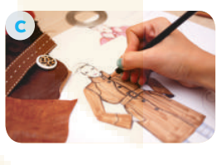

PRACTICE
3
Match the words and phrases in the conversation with their pictures.
1. bartender
2. fashion designer
3. garment worker
4. hairdresser
5. mechanic

Slide 29

PRACTICE
3
Match the words and phrases in the conversation with their pictures.
1. bartender
2. fashion designer
3. garment worker
4. hairdresser
5. mechanic

Slide 30
PRACTICE
4
Choose the correct answer A, B, C, or D to complete each sentence.
1. Subjects like maths, physics, English, and literature are called ______ subjects.
A. theoretical
C. academic
B. art
D. physical
2. She earns a ______ by selling home-made foods.
A. life
C. money
B. salary
D. living

Slide 31
PRACTICE
4
Choose the correct answer A, B, C, or D to complete each sentence.
3. He went to college to get ______ training in business management.
A. life-long
C. formal
B. informal
D. online
4. Finding a ______ job in big cities is rather difficult.
A. teacher
C. taught
B. teaching
D. teach

Slide 32
PRACTICE
4
Choose the correct answer A, B, C, or D to complete each sentence.
5. Career ______ programmes are useful because they help students make good decisions about their future jobs.
A. orientation
C. tradition
B. pressure
D. income

Slide 33
LESSON 1: GETTING STARTED
LESSON 1: GETTING STARTED
WARM-UP
Option 1: Think!
Option 2: Future Vision
Vocabulary
PRESENTATION
Task 1: Listen and read.
Task 2: Read the conversation again and answer the questions.
Task 3: Match the words and phrases in the conversation with their pictures.
Task 4: Choose the correct answer A, B, C, or D to complete each sentence
PRACTICE
PRODUCTION
Task 5: Game: Guess My Jobs

Slide 34

PRODUCTION
GAME: Guess My Job.
Work in two groups. Take turns to explain and guess the jobs the teacher shares. The group with more correct answers wins.
5
- Work in two big groups A and B.
- Each group to send a person to the board.
- Show the picture or the name of a job. The group explains the job to their member.
- The person who can guess the job correctly and most quickly gains a point for their group.

Slide 35
PRODUCTION
GAME: Guess My Job.
Work in two groups. Take turns to explain and guess the jobs the teacher shares. The group with more correct answers wins.
5
E.g:
Group members: This person works in a garage. He repairs cars or motorbike.
Student A: mechanic.

Slide 36
LESSON 1: GETTING STARTED
LESSON 1: GETTING STARTED
WARM-UP
Option 1: Think!
Option 2: Future Vision
Vocabulary
PRESENTATION
Task 1: Listen and read.
Task 2: Read the conversation again and answer the questions.
Task 3: Match the words and phrases in the conversation with their pictures.
Task 4: Choose the correct answer A, B, C, or D to complete each sentence
PRACTICE
PRODUCTION
Task 5: Game: Guess My Jobs
CONSOLIDATION
Wrap-up
Homework

Slide 37

CONSOLIDATION
2
Homework
- Do exercises in the workbook.

Slide 38
CONSOLIDATION
2
Homework
- Prepare for the Project of the unit
- Open book p.133, look at the picture and say what the topic of the project is
- Work in groups to design a poster.
- You will show and present in Lesson 7 – Looking back and Project.

Slide 39
CONSOLIDATION
2
Homework
- In groups, Ss choose two jobs that your members want to do in the future. Yoy compare the jobs.
- Then, you prepare a poster presentation to explain the similarities and differences between the two jobs
- Your poster should include pictures, drawings and/or photos to illustrate the features of the jobs. The poster should be well-organised so that readers see key points on it.

Slide 40
CONSOLIDATION
2
Homework
Information:
What are the jobs?
What types of training does each job require?
What skills and personal qualities do they need to do the jobs well?
Which job will be more popular in the future?

Slide 41
Website: hoclieu.vn
Fanpage: facebook.com/www.tienganhglobalsuccess.vn/

