Slide 1

Unit 10: Cities around the World
Lesson 3.2: Writing
Page 85

Slide 2
Lesson Outline
Warm-up
Pre-Writing: Reading
Pre-Writing: Speaking
Writing
Consolidation
Wrap-up

Slide 3
Objectives
By the end of this lesson, students will be able to…
- read and get some ideas about Cities topics;
- compare and talk about cities around the world;
- write a short paragraph about a city;

Slide 4

WARM-UP

Slide 5
Answer the questions:
+ What are some famous cities in the world?
+ Which cities would you like to visit the most? Why?
+ Which information will you mention when you talk or write about a city?

Slide 6

Writing

Slide 7
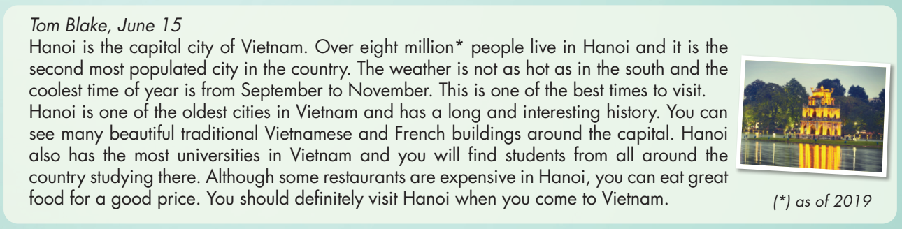
Pre-Writing
a. Read the article and choose the best headline.
1. Hanoi's Beautiful Landmarks
2. Hanoi Travel Guide
3. Hanoi's Rich History

Slide 8
Pre-Writing
Read and answer the questions
over 8 millions
1. How many people live in Hanoi? ________________________
2. When should you visit Hanoi? _________________________
3. What styles of buildings can you see in Hanoi?
_________________________________
4. Are all restaurants expensive in Hanoi? _________________
from September to November
traditional Vietnamese and French
No, they aren’t.

Slide 9
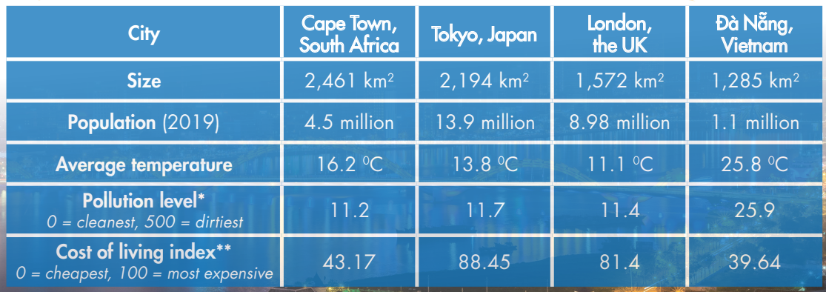
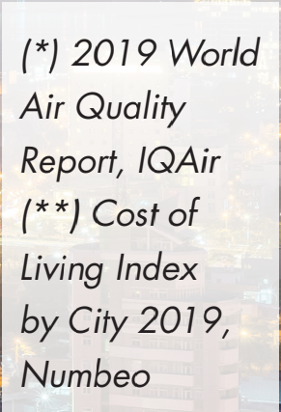
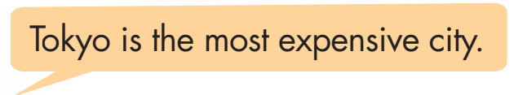
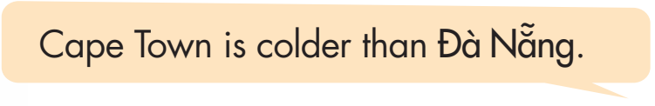
Pre-Writing
CITIES AROUND THE WORLD
In pairs: Look at the table and compare the cities using superlatives and comparatives.

Slide 10
Pre-Writing
Compare your city with the cities in the table.

Slide 11
Pre-Writing
To write a paragraph about a city you should:
1. Introduce the name of the city and the location.
2. Talk about the size/ the area (compare to other cities).
3. Say something related to the population of that city.
4. Mention the weather/temperature/ best time to visit.
5. What is it famous for/ what are interesting facts?

Slide 12
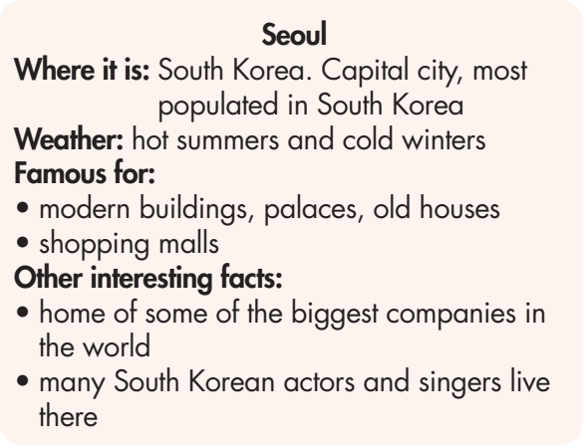
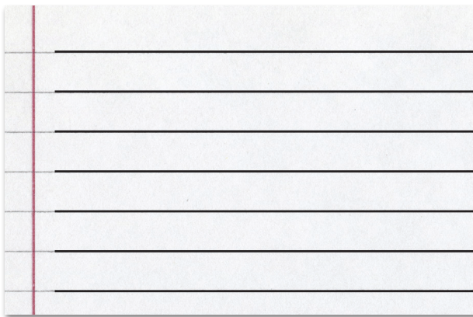
While-Writing
Write a paragraph about Seoul (using the notes) or a city you know. Write 50 to 60 words.

Slide 13
Post-Writing
Give feedback
Check whether your writing include the following ideas:
Introduce the name of the city and the location.
Talk about the size/ the area (compare to other cities).
Say something related to the population of that city.
Mention the weather/temperature/ best time to visit.
What is it famous for/ what are interesting facts?
Check linking words, grammar, and spellings

Slide 14
Post-Writing
Suggested answer
Seoul is the capital city of South Korea. Although it is not the biggest city, it’s the most populated city in the country. Seoul has hot summers and cold winters. It is famous for its modern buildings, palaces, and old houses. There are many shopping malls in Seoul. It is also the home of some of the biggest companies in the world, and many famous South Korean actors and singers live there.

Slide 15
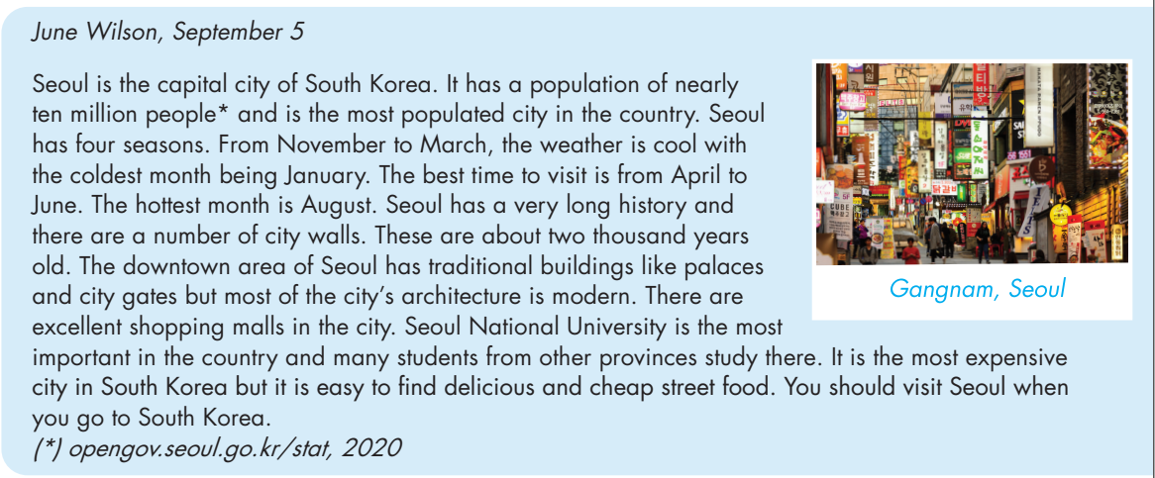
a. Read the article and choose the best headline.
Extra Practice
WB page 61
Seoul’s Four Seasons
Modern Seoul
Seoul Guide for Visitors

Slide 16
b. Read and answer the questions.
Extra Practice
WB page 61
1. How many people live in Seoul? nearly ten million people
2. When should you visit Seoul?
3. What old buildings can you see in Seoul?
4. What is cheap to buy in Seoul?
from April to June
city walls, palaces, and city gates
street food

Slide 17
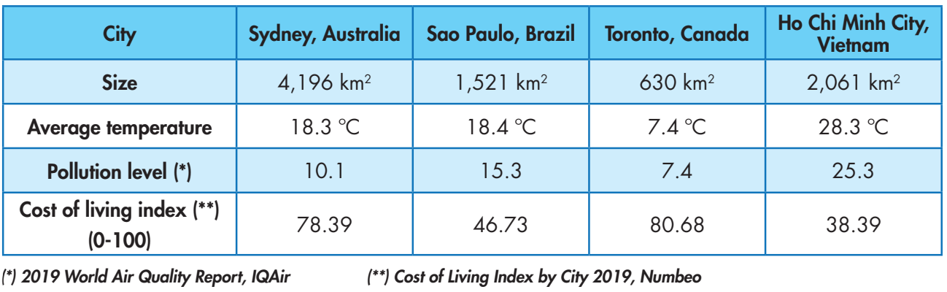
Extra Practice
WB page 61
Look at the table and write two sentences about each of the following using superlatives.
Example: 1. (size) ____ Sydney is the biggest city.
Toronto is the smallest city.

Slide 18
Extra Practice
WB page 61
Look at the table and write two sentences about each of the following using superlatives.
2. (temperature) ___________________________________________
3. (pollution) ______________________________________________
4. (cost) __________________________________________________

Slide 19
Extra Practice
WB page 61
Look at the table and write two sentences about each of the following using superlatives.
2. (temperature)
3. (pollution)
4. (cost)
Ho Chi Minh City has the highest temperature./
Ho Chi Minh City is the hottest city.
Toronto has the lowest temperature./ Toronto is the coldest city.
Ho Chi Minh City is the most polluted city.
Toronto is the cleanest city.
Toronto is the most expensive city.
Ho Chi Minh City is the cheapest city.

Slide 20

CONSOLIDATION

Slide 21
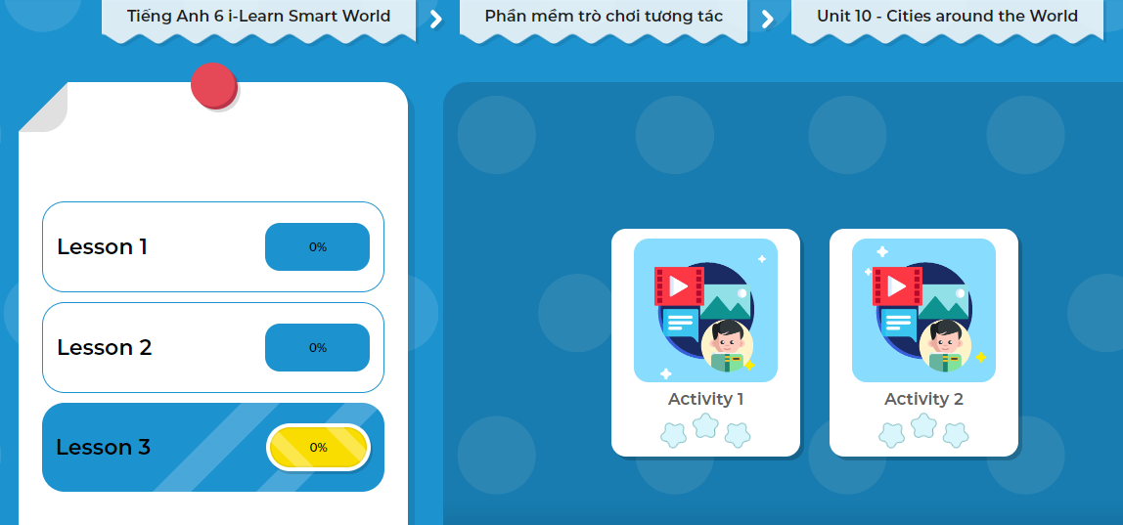
LET’S PLAY!
Click here to play the game!
Notes:
Mở Ứng dụng DHA trên Eduhome. Sách lớp 6, Unit 10, Lesson 3, Activity 2

Slide 22

WRAP-UP

Slide 23
Today’s lesson
To write a paragraph about a city you should:
1. Introduce the name of the city and the location.
2. Talk about the size/ the area (compare to other cities).
3. Say something related to the population of that city.
4. Mention the weather/temperature/ best time to visit.
5. What is it famous for/ what are interesting facts?

Slide 24
Homework
Write a paragraph about your city or a city you love
Prepare the next lesson (pages 104 & 105 SB)
Complete the writing notes in Tiếng Anh 6 i-Learn Smart World Notebook (page 63)

Slide 25

Enjoy your day!

