Slide 1

Unit 8: The World around Us
Lesson 2.3: Pronunciation & Speaking
Page 67

Slide 2
Lesson Outline
Warm-up
Pronunciation
Practice
Speaking
Consolidation
Wrap-up

Slide 3
Objectives
By the end of this lesson, students will be able to learn…
Speaking: Preparing for the trip
Structure: - What do we need for the trip?
- We need to bring _____ so ___________.
Pronunciation: the /oʊ/ sound

Slide 4

WARM-UP

Slide 5

Work in pairs.
Choose the word whose main stress is placed
differently from the others.
1. A. parade B. mountain C. battle D. army
/pəˈreɪd/ /ˈmaʊntn/ /ˈbætl/ /ˈɑːrmi/
2. A. action B. horror C. cartoon D. drama
/ˈækʃn/ /ˈhɔːrər/ /kɑːrˈtuːn/ /ˈdræmə/
3. A. difficult B. exciting C. fantastic D. important
/ˈdɪfəkəlt/ /ɪkˈsaɪtɪŋ/ /fænˈtæstɪk/ /ɪmˈpɔːrtnt/

Slide 6
Work in pairs.
Choose the word whose underlined part is
pronounced differently from that of the other words.
1. A. bat B. fan C. dad D. arm
2. A. pillow B. tower C. towel D. shower
3. A. can B. bag C. glass D. change
/bæt/
/fæn/
/dæd/
/ˈɑːrm/
/ˈpɪloʊ/
/ˈtaʊər/
/ˈtaʊəl/
/ˈʃaʊər/
/kæn/
/bæɡ/
/ɡlæs/
/tʃeɪndʒ/

Slide 7
Game
Work in groups: Think about the words beginning with the letter below.
S
B
P
J
T
F
sleeping bag flashlight food bottled water tent battery pillow towel jacket

Slide 8

Pronunciation
/oʊ/

Slide 9
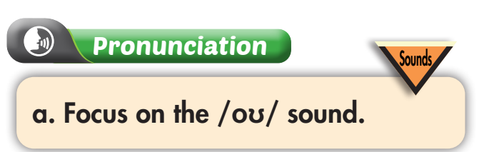
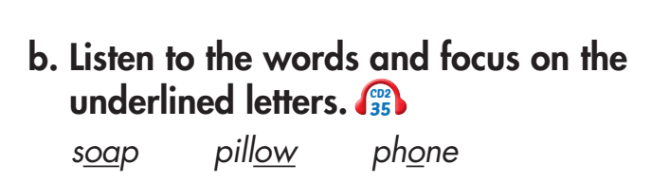


d. Read the words with the correct sound to a partner.

Slide 10

Practice

Slide 11
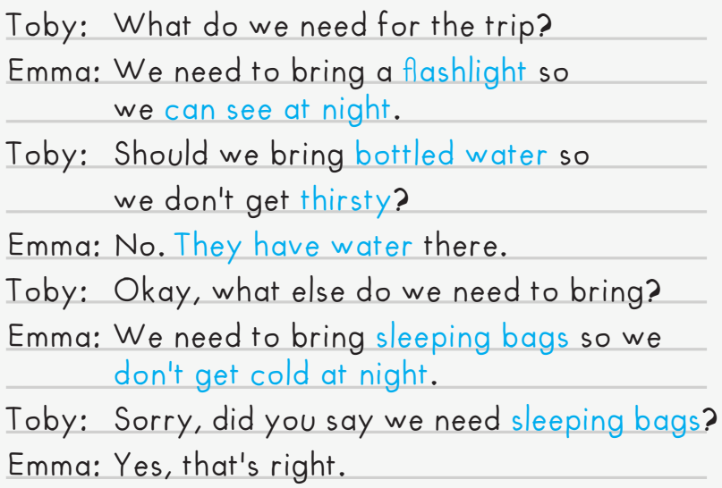

Slide 12
Toby: What do we need for the trip?
Emma: We need to bring a ____________ so
we ___________.
Toby: Should we bring __________so
we don't get ___________?
Emma: No. ____________ there.
Toby: Okay, what else do we need to bring?
Emma: We need to bring _______________ so we _____________.
Toby: Sorry, did you say we need _________?
Emma: Yes, that's right.
tent/ cell phone
have somewhere to stay/ can call our parents
food/ toys
hungry/ bored
There's a restaurant/ There's lots to do
jackets/ books
don't get cold/ can read at night
jackets/ books
Practice the conversation with the red words.

Slide 13
Toby: What do we need for the trip?
Emma: We need to bring a ____________ so
we ___________.
Toby: Should we bring __________ so we don't get ___________?
Emma: No. ____________ there.
Toby: Okay, what else do we need to bring?
Emma: We need to bring _______________ so we _____________.
Toby: Sorry, did you say we need _________?
Emma: Yes, that's right.
tent/ cell phone
have somewhere to stay/ can call our parents
food/ toys
hungry/ bored
There's a restaurant/ There's lots to do
jackets/ books
don't get cold/ can read at night
jackets/ books
Practice the conversation with the red words

Slide 14

Toby: What do we need for the trip?
Emma: We need to bring a _______ so
we ______________.
Toby: Should we bring _______ so
we don't get _______?
Emma: No. ______________ there.
Toby: Okay, what else do we need to bring?
Emma: We need to bring _______ so we
______________.
Toby: Sorry, did you say we need _______?
Emma: Yes, that's right.

Slide 15

Production

Slide 16
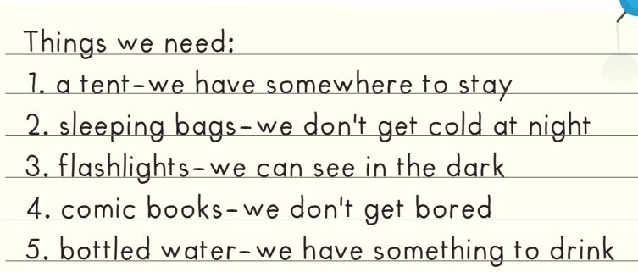
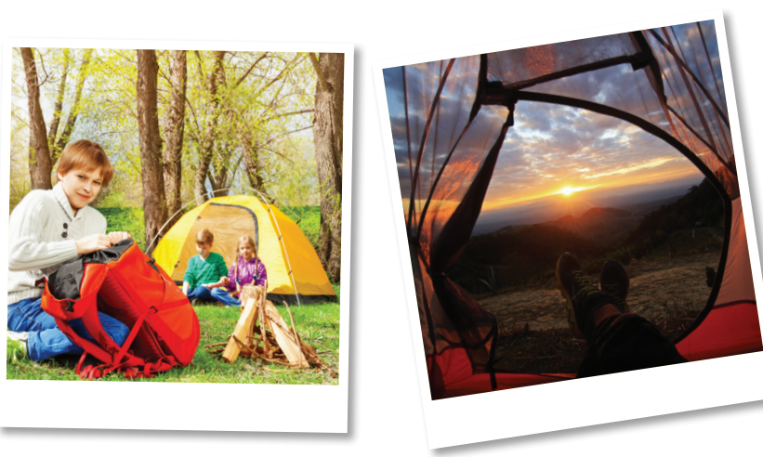
Extra Practice
WB page 47
1. Do they need a tent?
___________________________________________________________________
2. Do they need batteries?
___________________________________________________________________
3. Do they need bottled water?
___________________________________________________________________
4. Do they need a camera?
___________________________________________________________________
5. Do they need comic books?
___________________________________________________________________
What do they need for their camping trip?
6. _________________ bottled water so ___________________________________.
7. _________________ sleeping bags so __________________________________.
8. _________________ flashlights so ______________________________________.
Yes, they do.
No, they don't.
Yes, they do.
No, they don't.
Yes, they do.
They need
they have something to drink
They need
they don't get cold at night
They need
they can see in the dark

Slide 17

Speaking

Slide 18
Pre-Speaking
Work in pairs and discuss the questions.
Can you name some national parks in Vietnam? Which national park do you want to visit? Why?
Ba Bể National Park, Cát Bà National Park, Cúc Phương National Park, Cát Tiên National Park

Slide 19


Pre-Speaking
a. You're preparing for a camping trip to Cát Tiên National Park.
Work in pairs. Look at the list and choose the five most important items to bring with you and give reasons why.
What do we need to bring for our camping trip?
Should we bring a tent so we
have somewhere to stay?
We need to bring bottled water
so we don't get thirsty.
Yes, good idea.

Slide 20
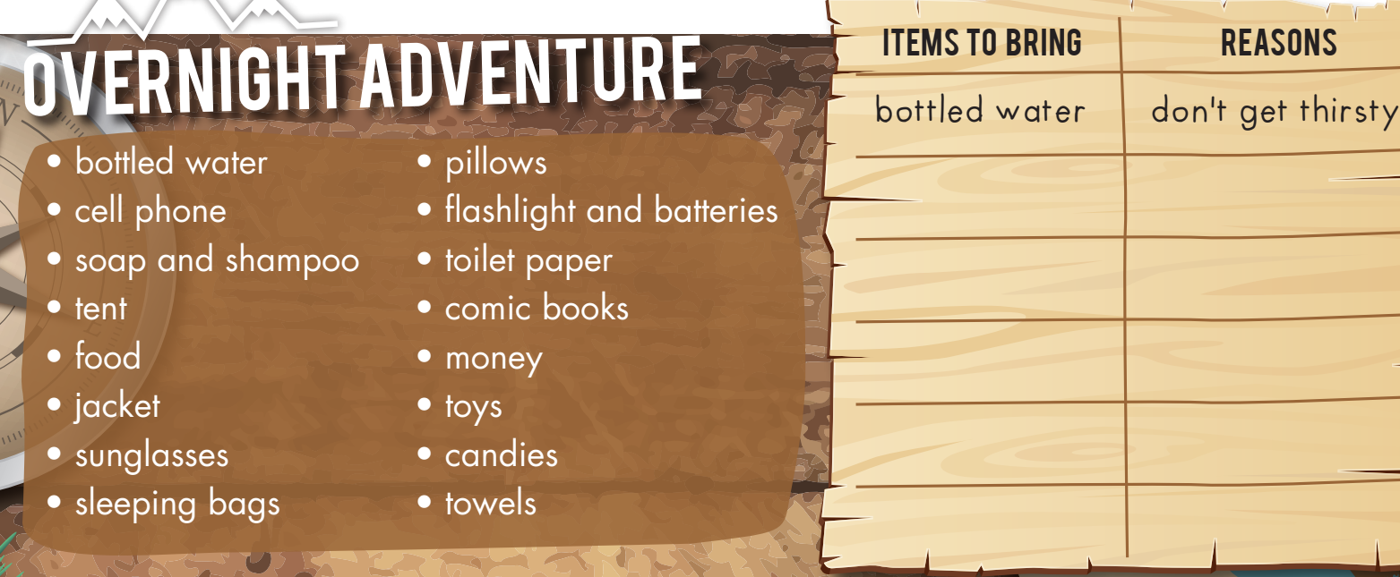
What do we need to bring for our camping trip?
We need to bring bottled water
so we don't get thirsty.
Should we bring a tent so we have somewhere to stay?
Yes, good idea.

Slide 21
Post-Speaking

Slide 22


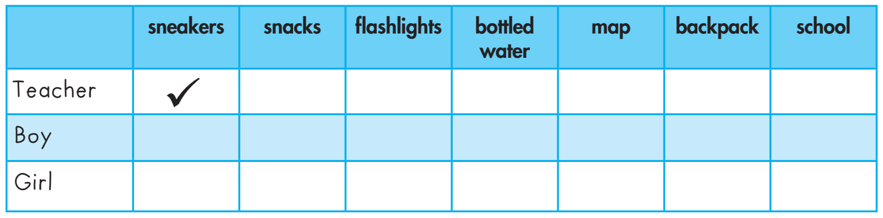
Listen and tick ( ) the things the speakers say.

Slide 23
Script
Teacher: Listen, you two. We're going hiking at the Green Hills Mountain next week. We need to plan the trip.
Liam: OK. What should people bring?
Teacher: We need sneakers to protect our feet.
Liam: We also need something to eat so everyone should buy some snacks.
Teacher: Great idea. Should we bring flashlights so we can see the caves?
Lucy: Yes! Yes! And we should bring bottled water so we have something to drink.
Liam: How will we know where to go?
Teacher: I'll bring a map for that. What should we bring to carry everything?
Lucy: Oh, everyone should bring a backpack.
Teacher: Thank you. All right, let's make a list for everyone.

Slide 24

CONSOLIDATION

Slide 25
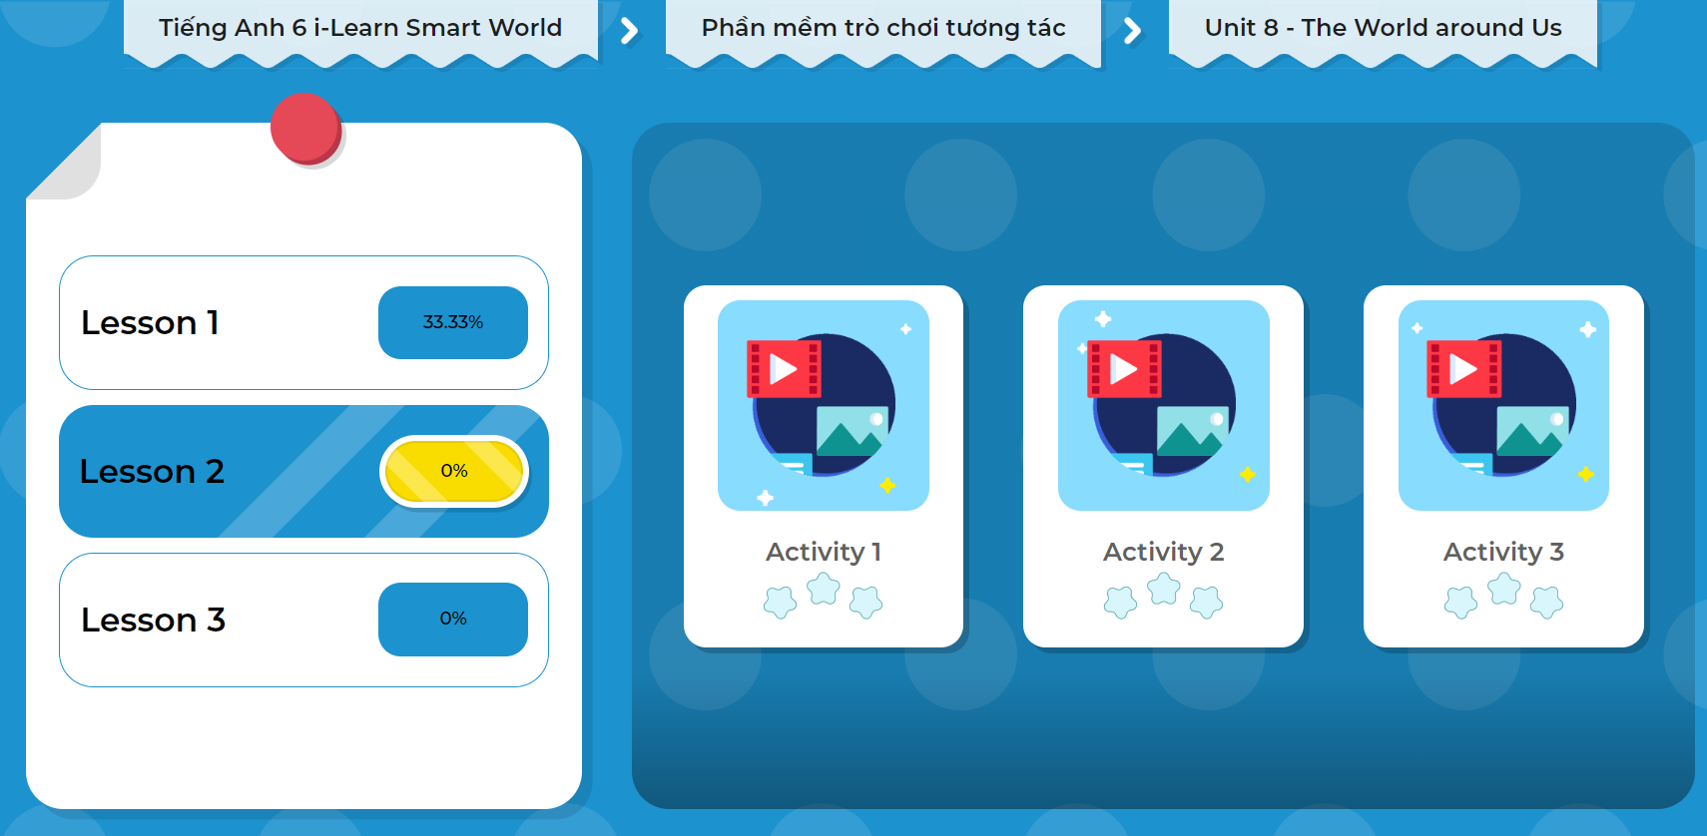
Extra Practice
DHA App
LET’S PLAY!

Slide 26

WRAP-UP

Slide 27
Today’s lesson
Speaking
Preparing for the trip
Phonics:
The /oʊ/ sound
Structures/ Sentence patterns
- What do we need for the trip?
- We need to bring _____ so ___________.

Slide 28
Homework
Review vocabularies, grammar and make sentences using them.
Do the exercises on page 46, 47 WB.
Prepare the next lesson (page 68 - SB).
Play the consolidation games in Tiếng Anh 6 i-Learn Smart World DHA App on www.eduhome.com.vn

Slide 29
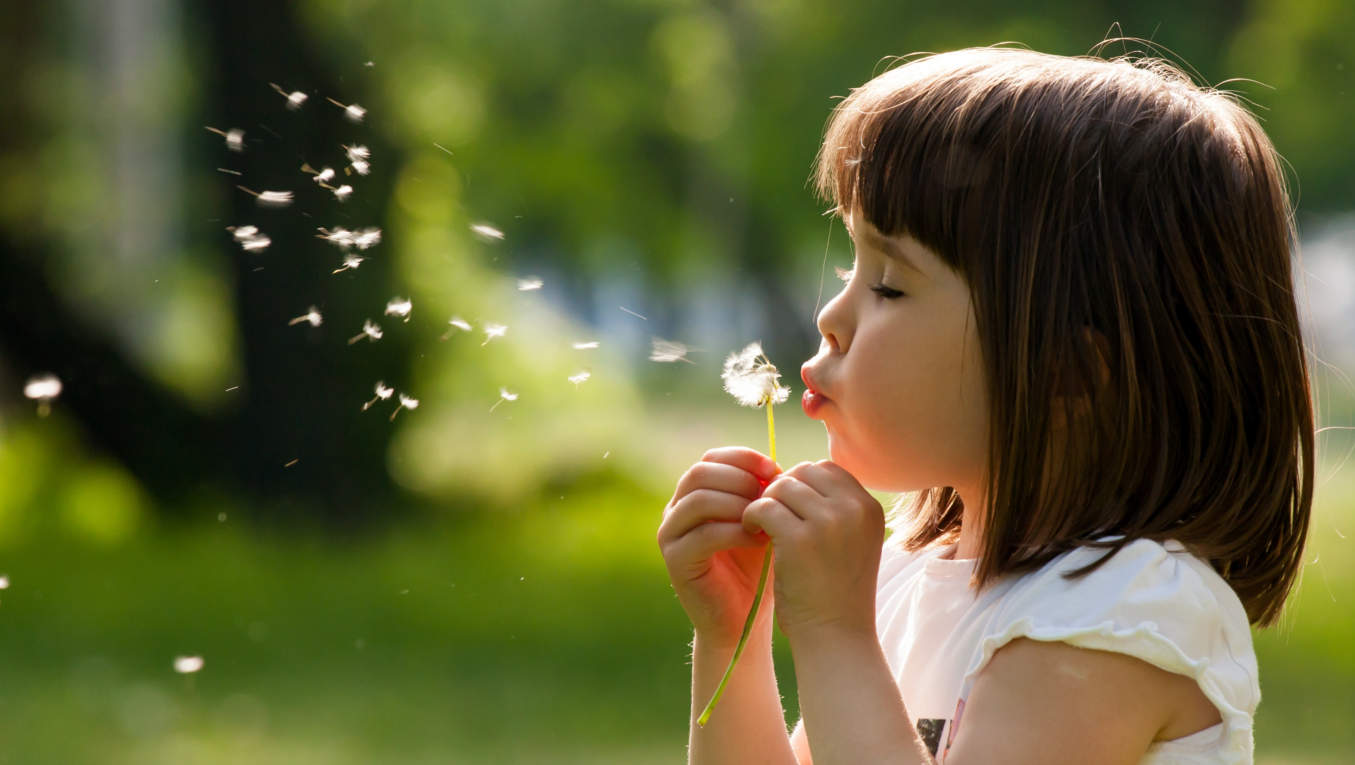
Enjoy your day!

