Slide 1
This is place where farming the fish
This is the home of HCM President
You raising a bird here
The animals that human use in plowing the field
The place which have water flow from high down to low
The people who do agriculture
Meaning of the word “fly” in Vietnamese
Opppsites with village
The people live in here
Where planting alot of trees
C
I
T
1
T
Y
H
2
H
O
U
S
E
F
O
R
E
3
E
S
T
C
4
C
A
G
E
F
I
S
H
P
O
O
N
D
S
5
B
U
U
F
A
L
L
O
6
N
N
G
H
E
A
N
7
W
A
T
8
T
E
R
F
A
L
L
F
A
R
M
E
R
R
9
B
A
Y
Y
10

Slide 2
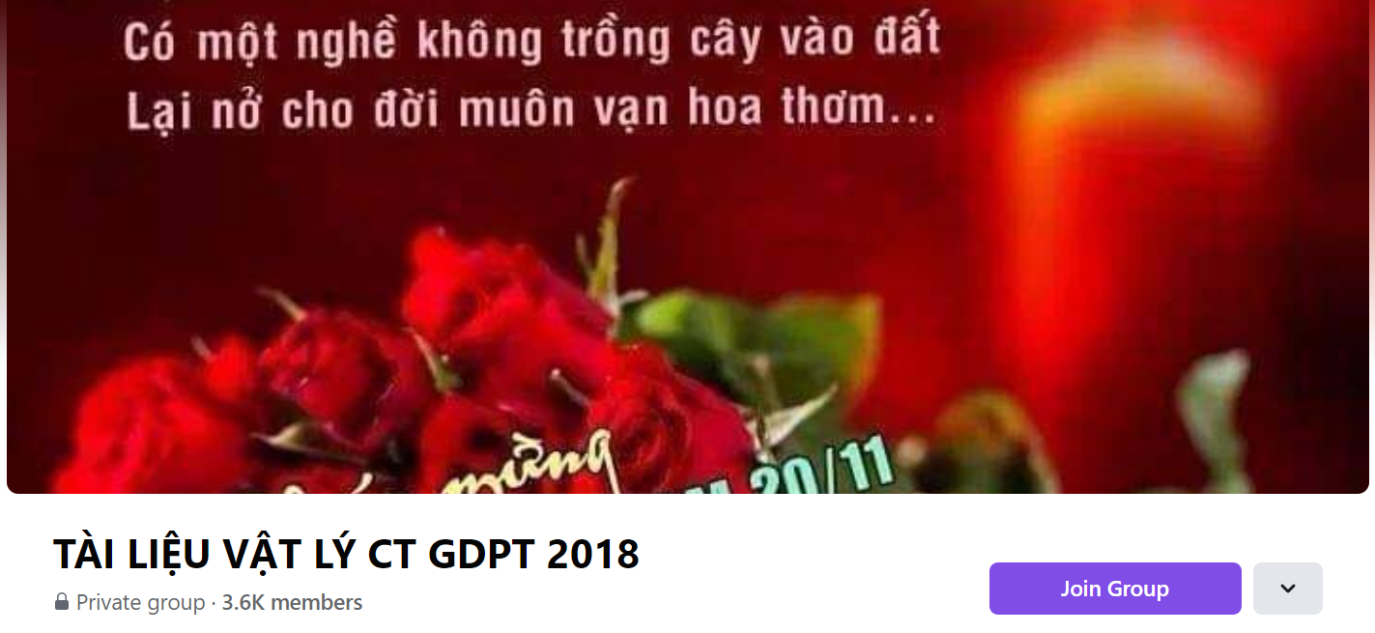
SƯU TẦM: ĐOÀN VĂN DOANH, NAM TRỰC, NAM ĐỊNH
LINK NHÓM DÀNH CHO GV BỘ MÔN VẬT LÝ TRAO ĐỔI TÀI LIỆU VÀ CHUYÊN MÔN CT 2018
https://www.facebook.com/groups/299257004355186

