Slide 1

Unit 1: My World
Lesson: Overview
Pages 12 & 13

Slide 2
Lesson Outline
Warm-up
Vocabulary
Listening
Consolidation
Wrap-up

Slide 3
Objectives
By the end of this lesson, students will be able to…
- revise vocabulary for and talk about appearance.
- describe people.
- practise listening for details.

Slide 4

WARM-UP

Slide 5
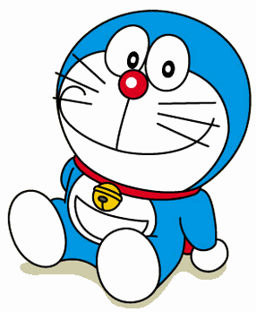
Who is this?
This is a cartoon character.
He’s from Japan.
He’s short and chubby.
He is blue.
He’s from the future.
Doraemon
Answer

Slide 6

It’s time to learn …

Slide 7
Vocabulary
Appearance

Slide 8

Presentation

Slide 9

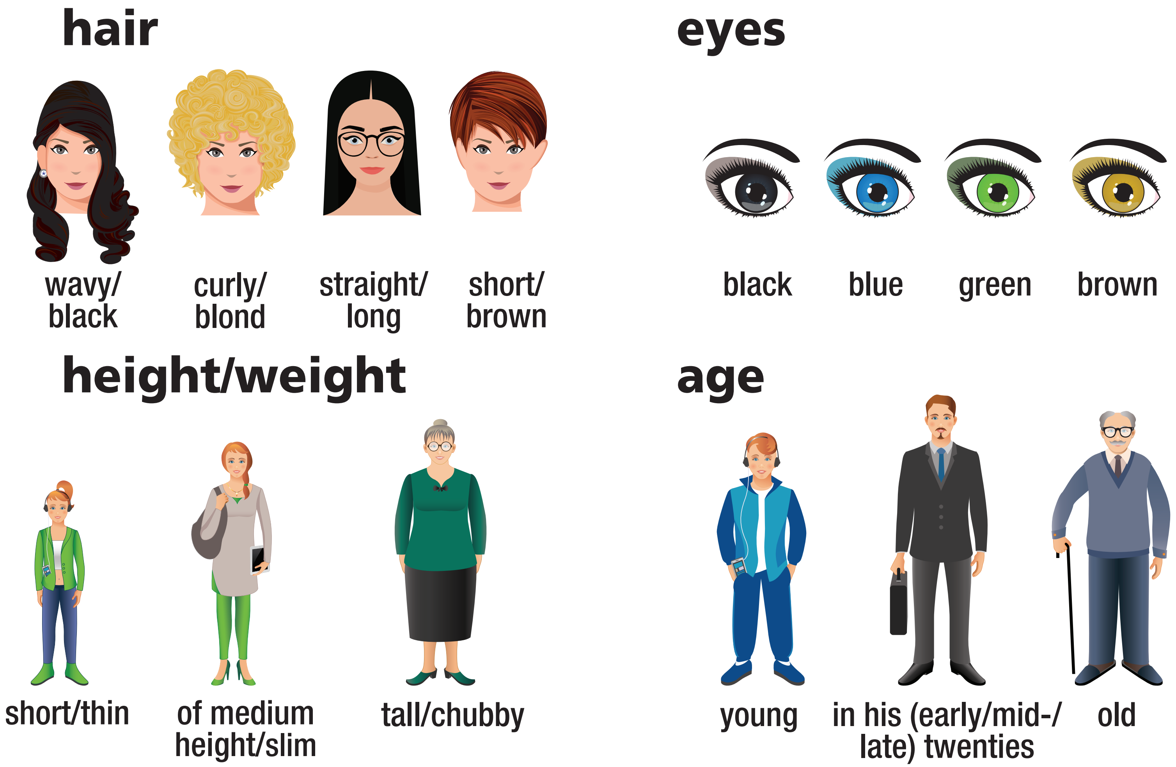
1 Listen and repeat.

Slide 10
Check vocabulary: Rub out and remember

Slide 11

Practice

Slide 12
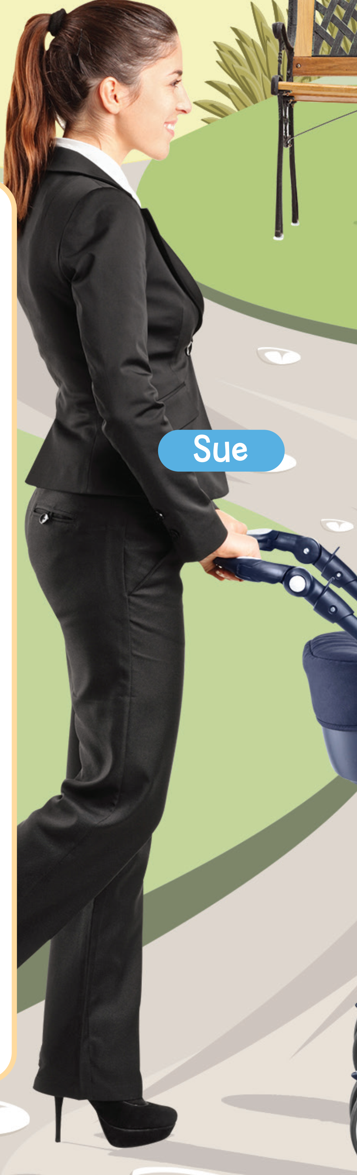

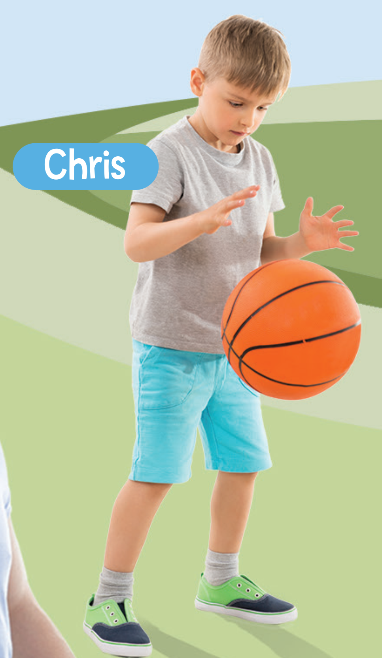
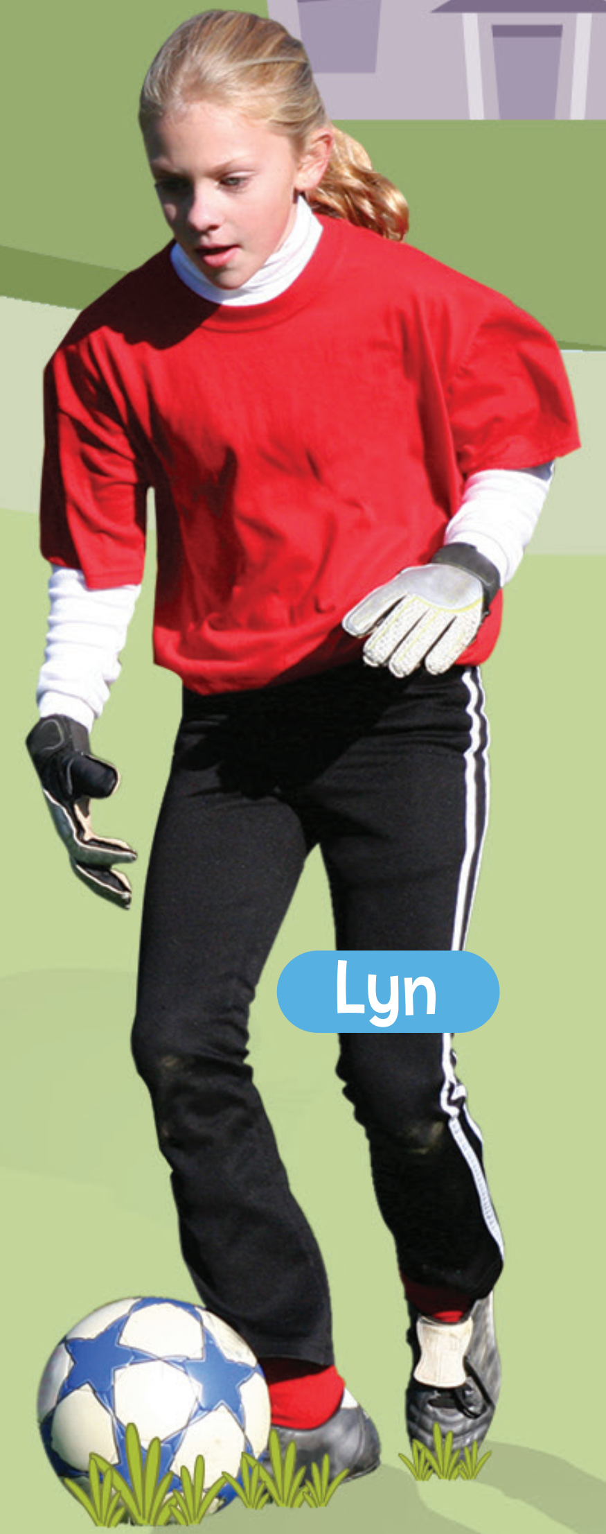
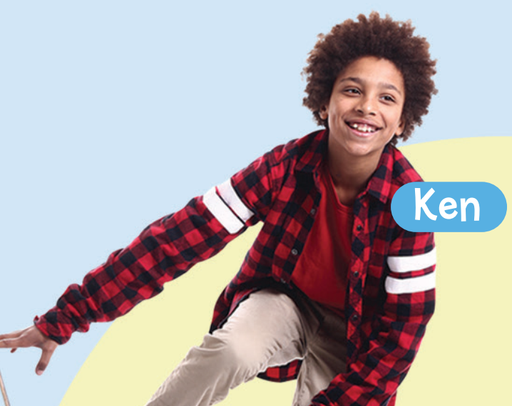
2 Look at the picture. Write the answers for these questions in your
notebook.
Who’s wearing …
1 blue shorts and trainers?
=> Chris
2 a red top and gloves?
=> Lyn
3 a red and black shirt?
=> Ken
4 a black and white T-shirt?
=> Keith
5 a black suit and high heels?
=> Sue

Slide 13
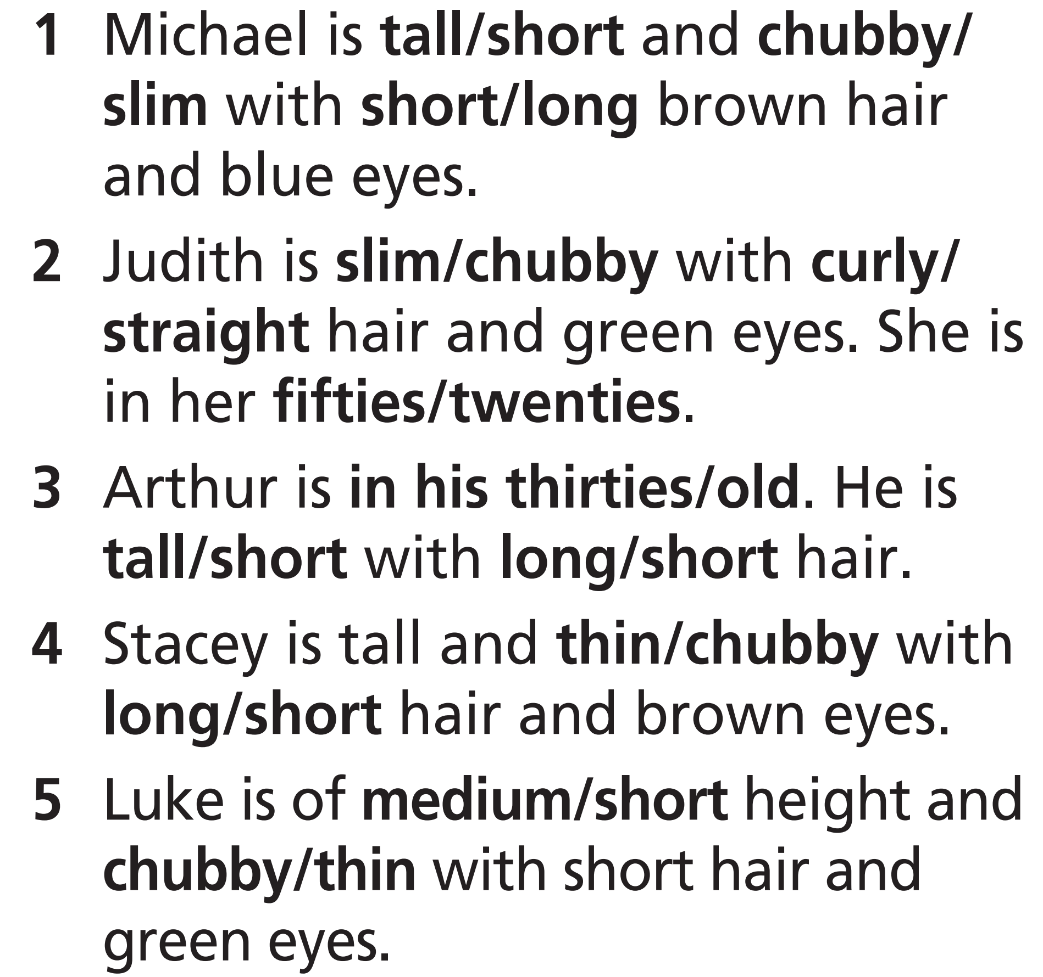
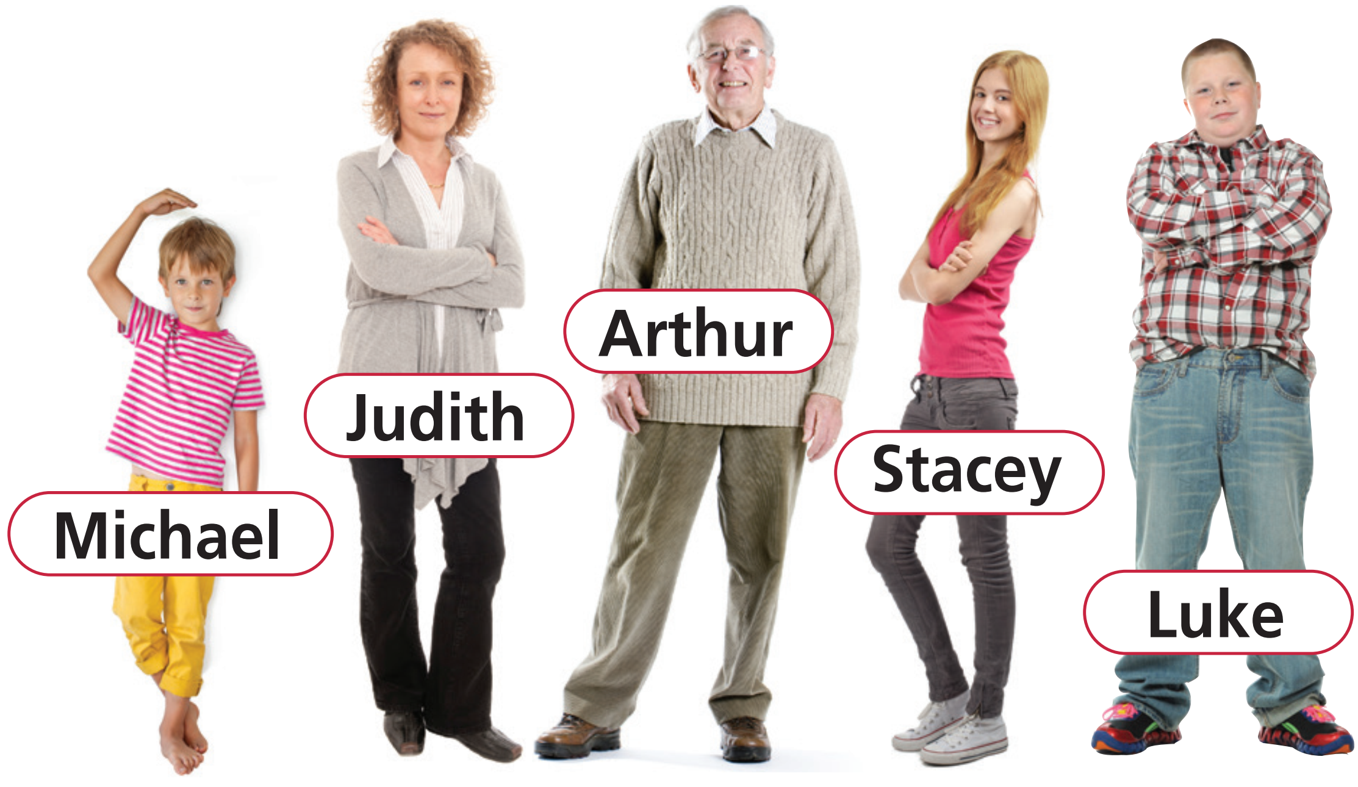
Extra Practice
WB, page 10
★ Look at the pictures and choose the correct option.

Slide 14

Production

Slide 15
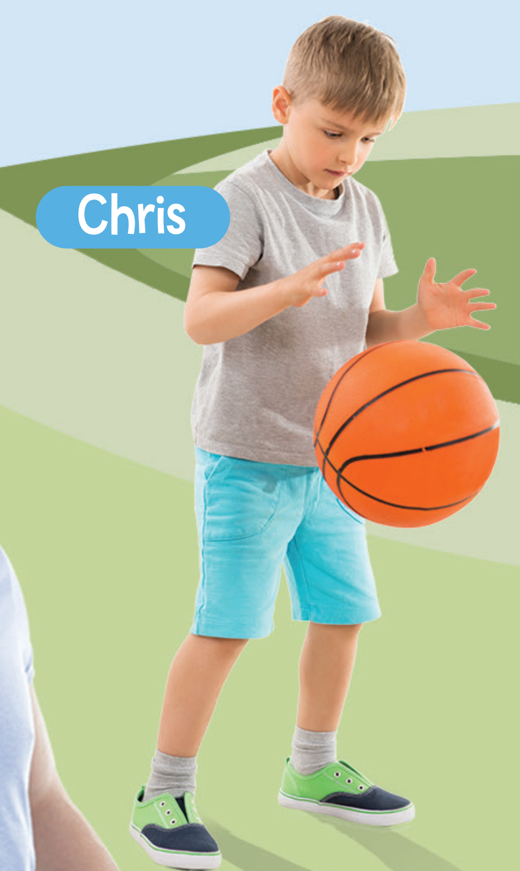
3 Use the words in Exercise 1 to describe the people in the picture as in the example.
Example
Chris is young, short and thin with short straight fair hair. He’s wearing a grey T-shirt, blue shorts and green and black trainers.

Slide 16

Listening

Slide 17
Pre-listening
Read the task and underline the key words.
Listen to Tim describing his best friend. Decide if the statements are R (right) or W (wrong).
1 Bob is in his early twenties.
2 He is of medium height.
3 He’s got wavy black hair and blue eyes.

Slide 18
While-listening
Listen and write your answers.
Now, listen and check your answers.
1 Bob is in his early twenties.
2 He is of medium height.
3 He’s got wavy black hair and blue eyes.
eighteen
W
R
W
brown eyes

Slide 19
Extra Practice
Listen again and choose the correct options
Now, listen again and check your answers.
Bob is Tim’s _________.
A. best friend B. brother C. cousin
2. Bob is _________.
A. short B. chubby C. slim
His hair is __________.
A. short B. long C. straight
Audio script
This is my best friend, Bob. He’s eighteen. He’s young, slim and of medium height. He’s got long wavy black hair and brown eyes.

Slide 20
Post-listening
Choose a person in the picture and describe him/her. Make three mistakes. Your partner corrects them.
Example
A: Chris is tall and thin with short curly fair hair. He’s wearing a T-shirt and jeans.
B: Chris is short and thin with short straight fair hair. He’s wearing a T-shirt and shorts.

Slide 21

CONSOLIDATION

Slide 22
Work in pairs. Describe a person in the classroom. Your partner will guess who he/she is.

Slide 23

WRAP-UP

Slide 24
Today’s lesson
Vocabularies
Appearance
Structures/ Sentence patterns
Sentences to describe people

Slide 25
Homework
Practise the vocabularies and make sentences using them.
Do the exercises in TA 7 Right on WB (pages 10, 62)
Prepare the next lesson (page 14 SB)
Do the exercise in TA 7 Right on Notebook (pages 2,3)

Slide 26

Lesson 3
Stay positive and have a nice day!

