Slide 2




REVIEW
2
PART 1 - LANGUAGE
1

Slide 3
PART 1 – LANGUAGE
LESSON 1: GETTING STARTED
WARM-UP
Warm-up: Chase the pictures, guess the words
Pronunciation
Task 1: Read the sentences. Pay attention to the underlined words. Then listen and repeat.
PRESENTATION
Vocabulary
Task 2: Choose the correct answer A, B, C, or D to complete each sentence.
Task 3: Write the correct form of the word in brackets to complete each sentence.
PRACTICE
Grammar
Task 4: Choose the correct answer A, B, C, or D to complete each sentence.
Task 5: Use the correct forms of the verbs in brackets to complete the sentences.
PRODUCTION
CONSOLIDATION
Wrap-up
Homework

Slide 4
WARM-UP
Chase pictures
Guess
words
Pictures on the slides
Guess the topic of each picture
Raise hand to give the answer

Slide 5
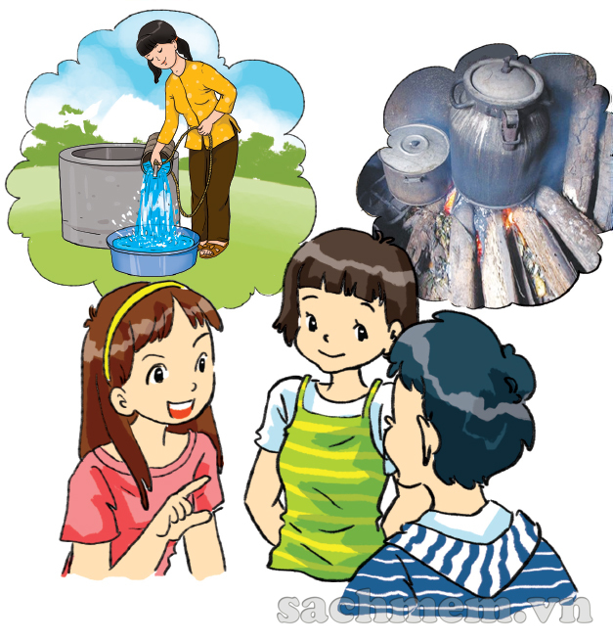
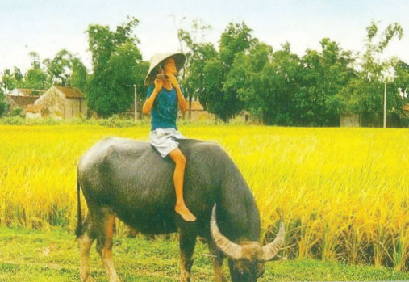
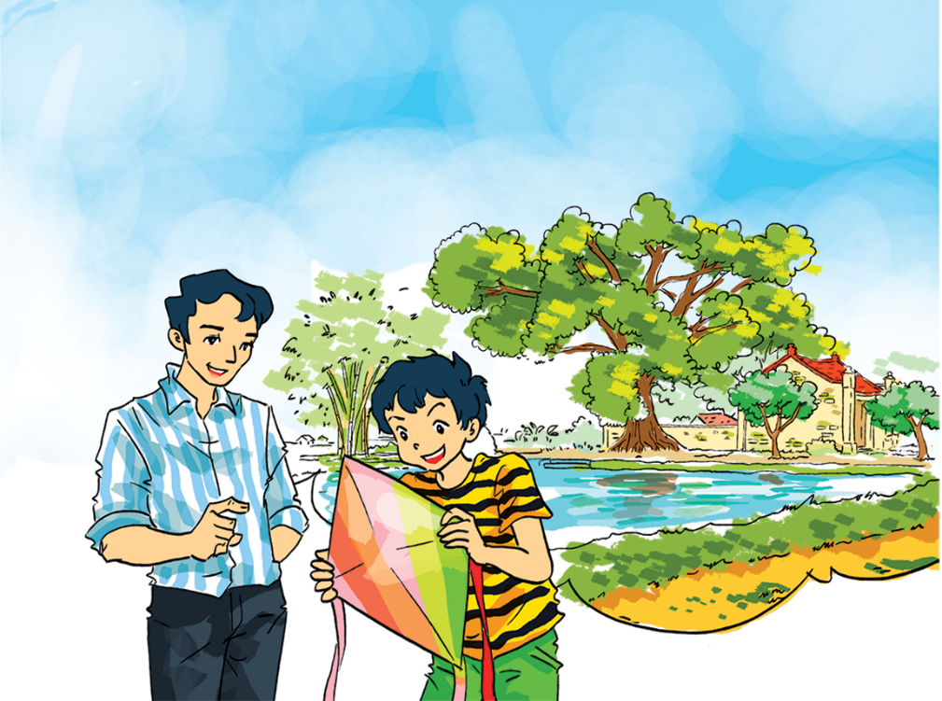
PRESENTATION
Topic 1
Remember(ing) the past

Slide 6

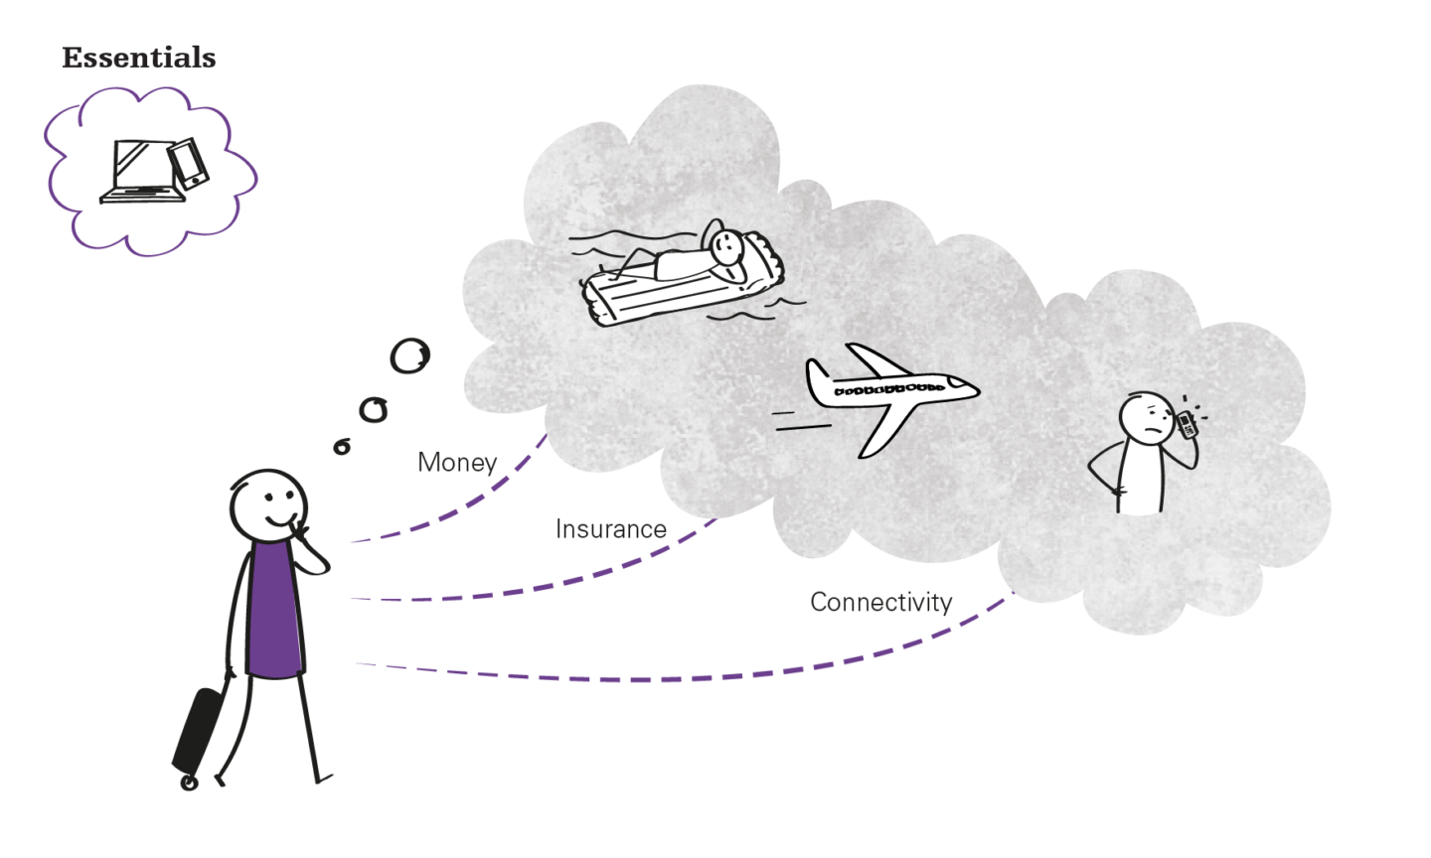
PRESENTATION
Topic 2
Our experiences

Slide 7
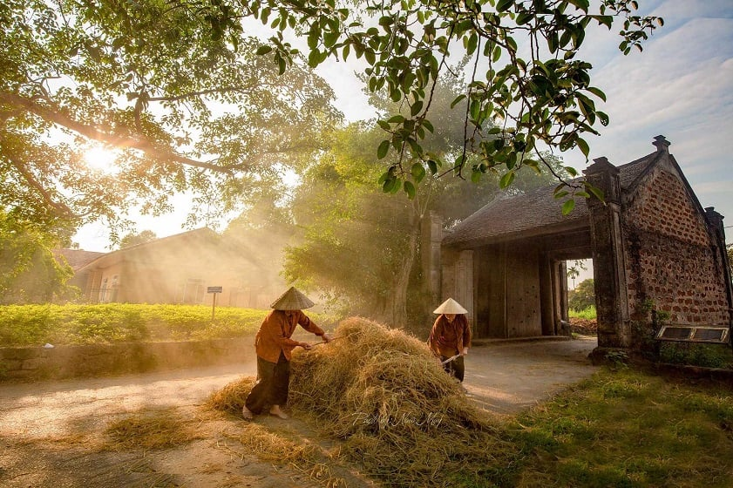
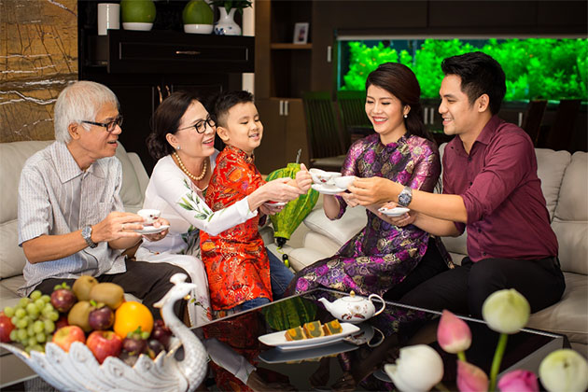
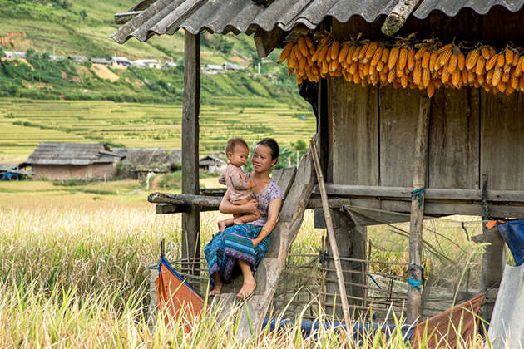
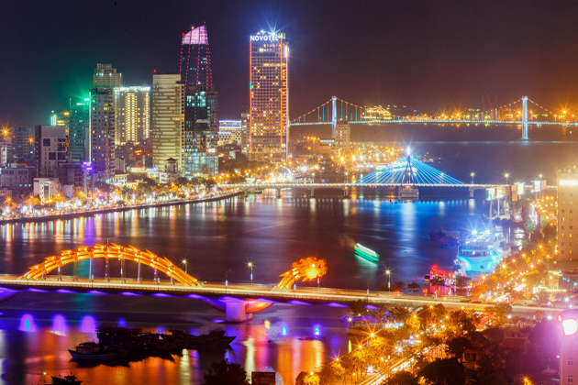
PRESENTATION
Topic 3
Vietnamese lifestyles:
then and now

Slide 8

PRACTICE - PRONUNCIATION
1
Read the sentences. Pay attention to the underlined words. Then listen and repeat.
1. The water overflowed from the dam and flooded the area.
2. African American musicians created jazz about 100 years ago.
3. The children thought all the food at the party was yummy.
4. The presentation focused on the values of teamwork.
5. He sometimes remembers his younger days in the mountain village.

Slide 9
PRACTICE - VOCABULARY
2
Choose the correct answer A, B, C, or D to complete each sentence.
1. Angkor Wat in Cambodia is a World ______ Site.
A. Camping B. Construction C. Heritage D. Building
2. Watching the forest from the top of the mountain is an amazing ______.
A. experience B. habit C. sight D. accident
3. In my grandfather’s ______, people travelled mostly on foot or by bike.
A. age B. generation C. past D. year

Slide 10
PRACTICE - VOCABULARY
2
Choose the correct answer A, B, C, or D to complete each sentence.
4. The word ______ is new to most elderly people. They didn’t know about it in their time.
A. ‘eco-tour’ B. ‘dance’ C. ‘festival’ D. ‘community’
5. Nowadays, ______ books have significantly replaced paper books.
A. science B. picture C. comic D. online

Slide 11
PRACTICE - VOCABULARY
3
Write the correct form of the word in brackets to complete each sentence.
1. I have ______________ memories about my trip to Sentosa in Singapore. (forget)
2. Children nowadays are more aware of environment __________ than we did in the past. (protect)
3. The most memorable part of our _____ was the boat ride on the River Cam. (tourism)
4. England is very good at __________ its historic buildings and monuments. (preserve)
5. We are getting ready for our graduation _____________. (perform)
unforgettable
protection
tour
preserving
performance

Slide 12
PRACTICE - GRAMMAR
4
Choose the correct answer A, B, C, or D to complete each sentence.
1. Do you ______ not showing this photo in your presentation?
A. wish B. mind C. decide D. think
2. We ______ we had more time to research changes in our village.
A. fancy B. decide C. wish D. like
3. – How was your ceramic course?
– Fantastic. I ______ how to make simple items.
A. have learnt B. was learning C. am learning D. learn

Slide 13
PRACTICE - GRAMMAR
4
Choose the correct answer A, B, C, or D to complete each sentence.
4. I went to the Exhibit Hall while my friend Mark ______ to the museum attendant.
A. talked B. was talking C. has talked D. talks
5. I wish I ______ visit Angkor Wat in Cambodia.
A. can B. should C. will D. could

Slide 14
PRACTICE - VOCABULARY
5
Use the correct forms of the verbs in brackets to complete the sentences.
1. We (walk) _______________ down the hill when we saw the castle. It was so beautiful in the sunset.
2. I wish I (have) _____ more time to spend at the Viet Nam National Village for Ethnic Culture and Tourism.
3. ______ you (ever / make) ____________ a handicraft item?
4. We all decided (choose) ___________ the Return to the Past class.
5. Do you mind (search) ___________ for more information about Japanese cartoons?
were walking
had
Have
ever made
to choose
searching

Slide 15

CONSOLIDATION
1
Wrap-up
What have we learnt in this lesson?
Pronunciation?
Vocabulary?
Grammar?

Slide 16

CONSOLIDATION
2
Homework
- Do exercises in the workbook;
- Prepare for Review 2 – Skills.

Slide 17
Website: hoclieu.vn
Fanpage: facebook.com/www.tienganhglobalsuccess.vn/

