Slide 2
Unit
5
OUR CUSTOMS AND TRADITIONS
LESSON 1: GETTING STARTED
LESSON 1: GETTING STARTED
Tet is coming!

Slide 3
LESSON 1: GETTING STARTED
WARM-UP
Asking questions
PRESENTATION
Vocabulary
Task 1: Listen and read.
Task 2: Read the conversation again and tick T (True) or F (False).
Task 3: Match the phrase with the correct pictures.
Task 4: Complete the sentences with the verbs from the box.
PRACTICE
FURTHER PRACTICE
Task 5: Quiz Time
CONSOLIDATION
Wrap-up
Homework

Slide 4
WARM-UP
1. Can you name some festivals in Viet Nam?
2. Do you like Mid-Autumn Festival?
3.Do you like Tet holiday?
4. What do you do before Tet holiday?
5. What do you do during Tet holiday?
Answer
the questions!

Slide 5
PRESENTATION
admire (v)
/ədˈmaɪər/
khâm phục, ngưỡng mộ

Slide 6
PRESENTATION
chase away (v)
/tʃeɪs əˈweɪ/
xua đuổi

Slide 7
PRESENTATION
pray (v)
/preɪ/
cầu nguyện

Slide 8
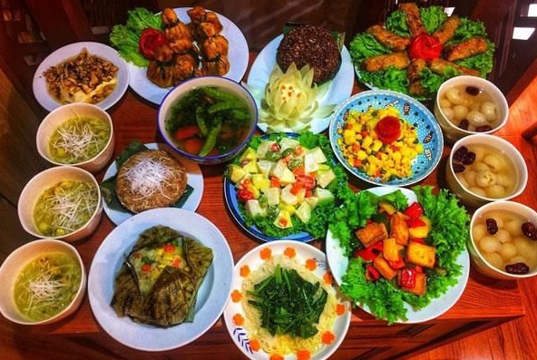
PRESENTATION
offering (n)
/ˈɒfərɪŋ/
đồ thờ cúng

Slide 9
PRESENTATION
ornamental tree
/ɔːnəˈmentl triː/
cây cảnh

Slide 10
PRESENTATION
New words | Pronunciation | Meaning
1. admire (v) | /ədˈmaɪər/ | khâm phục
2. chase away | /tʃeɪs/ | xua đuổi
3. pray (v) | /preɪ/ | cầu nguyện
4. offering (n) | /ˈɒfərɪŋ/ | đồ thờ cúng
5. ornamental tree | /ɔːnəˈmentl triː/ | cây cảnh

Slide 11
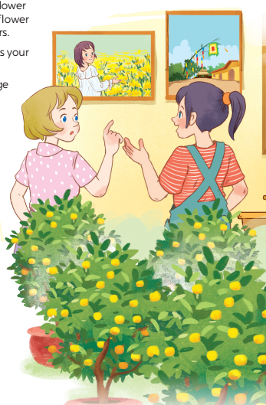
PRACTICE
1
Listen and read.
- What can you see in each picture?
- Can you guess the places that the picture show?

Slide 12
PRACTICE
1
Listen and read.
Elena: Wow, this girl looks so cute.
Trang: Yeah ... She’s my cousin. She’s at Sa Dec Flower Village. Tet is coming soon, so many people visit flower villages to take pictures with the blooming flowers.
Elena: Oh, I’m fond of admiring the flowers. Does your family visit places like this too?
Trang: Yes, we do. We usually visit nhat Tan Village to buy kumquat trees and peach blossoms.
Elena: I see flowers and ornamental trees everywhere these days. What are they for?
Trang: We, Vietnamese, use plants and flowers for decorations and for oﬀerings. They are an important part of our Tet tradition.
Elena: And what’s that tall tree in the photo?
Trang: Well, it’s actually a bamboo pole. People place it in the yard of the communal house. They hang decorative items like small bells and lanterns on it. They want to chase away bad luck and pray for a lucky new year.
Elena: Interesting! I didn’t know that.

Slide 13
PRACTICE
2
Read the conversation again and tick T (True) or F (False).
Sentences | T | F
1. Elena and Trang are at Sa Dec Flower Village.
2. Many people visit ﬂower villages to take photos.
3. Trang’s family usually buys kumquat trees and peach blossoms at Nhat Tan Village.
4. Flowers are not part of any Vietnamese traditions.
5. People decorate bamboo poles with small bells and lanterns for New Years.
Trang’s cousin is at Sa Dec Flower Village
Plants and flowers are an important part of Tet

Slide 14
PRACTICE
3
Match the phrases with the correct pictures.

Slide 15
PRACTICE
4
Complete the sentences with the verbs from the box.
1. The British decorate their Christmas trees and ______ presents under them.
2. Tom likes to ______ the view from the hill.
3. In many cultures, knocking on wood is a way to ______ away bad spirits.
4. Many Asians go to Buddhist temples to ______ for good luck.
place
admire
chase
pray

Slide 16
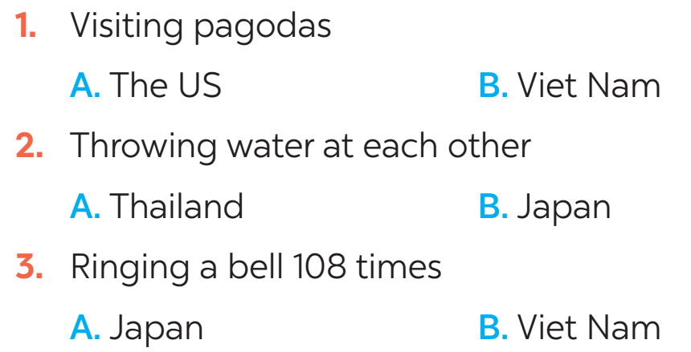
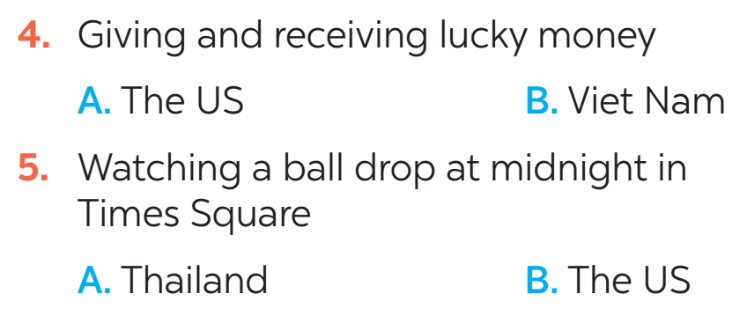
FURTHER PRACTICE
5
New Years around the world.
People around the world celebrate New Years differently. Choose the tradition below.

Slide 17
CONSOLIDATION
1
Wrap-up
What have we learnt in this lesson?
identify the topic of the unit
use lexical items related to Tet holiday

Slide 18
CONSOLIDATION
2
Homework
- Learn the new words by heart.
- Practise talking about Tet Holiday.

Slide 19
Website: hoclieu.vn
Fanpage: facebook.com/www.tienganhglobalsuccess.vn/

