Slide 1
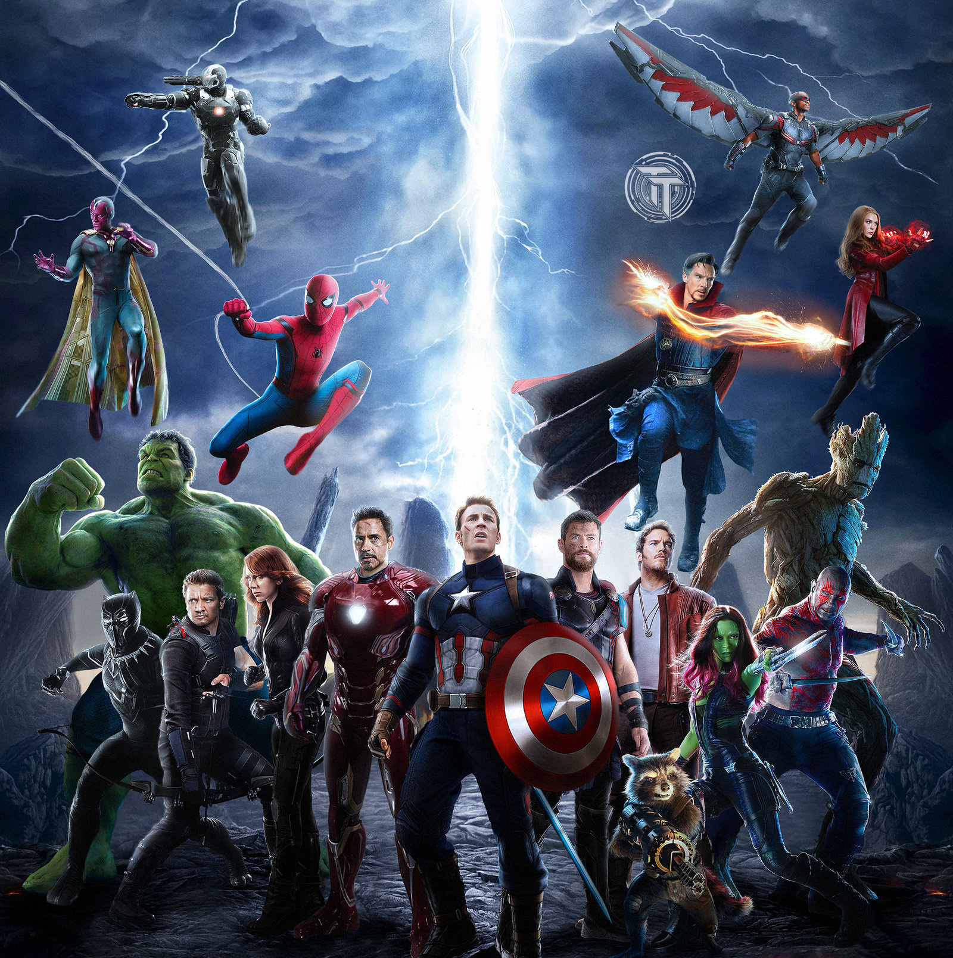
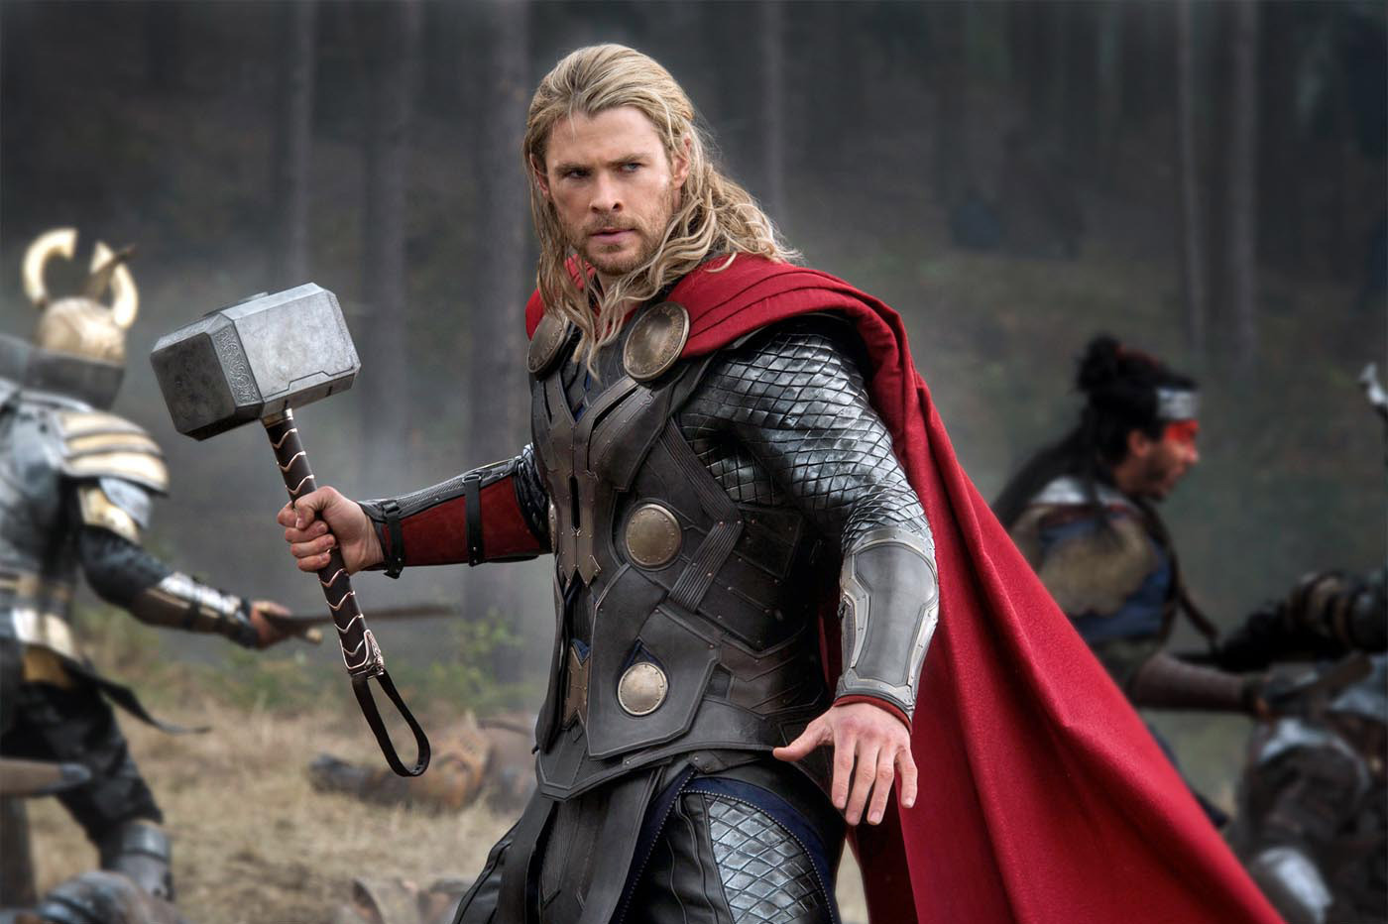
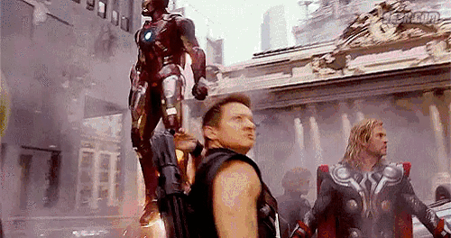
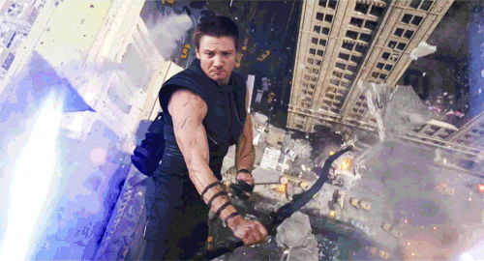
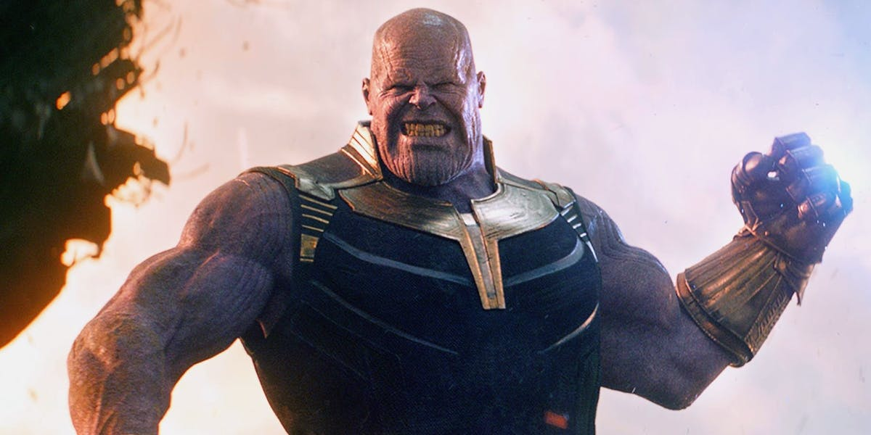
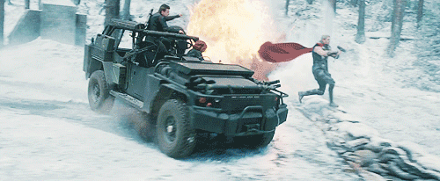
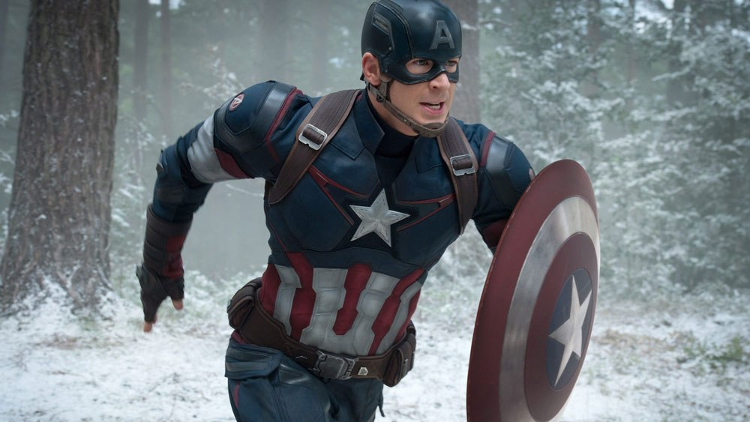
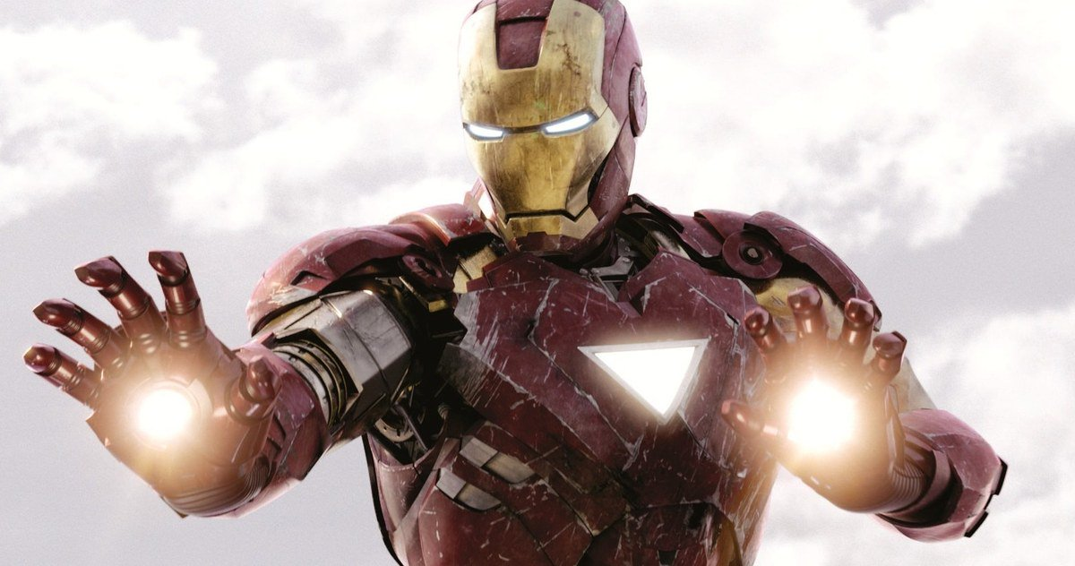
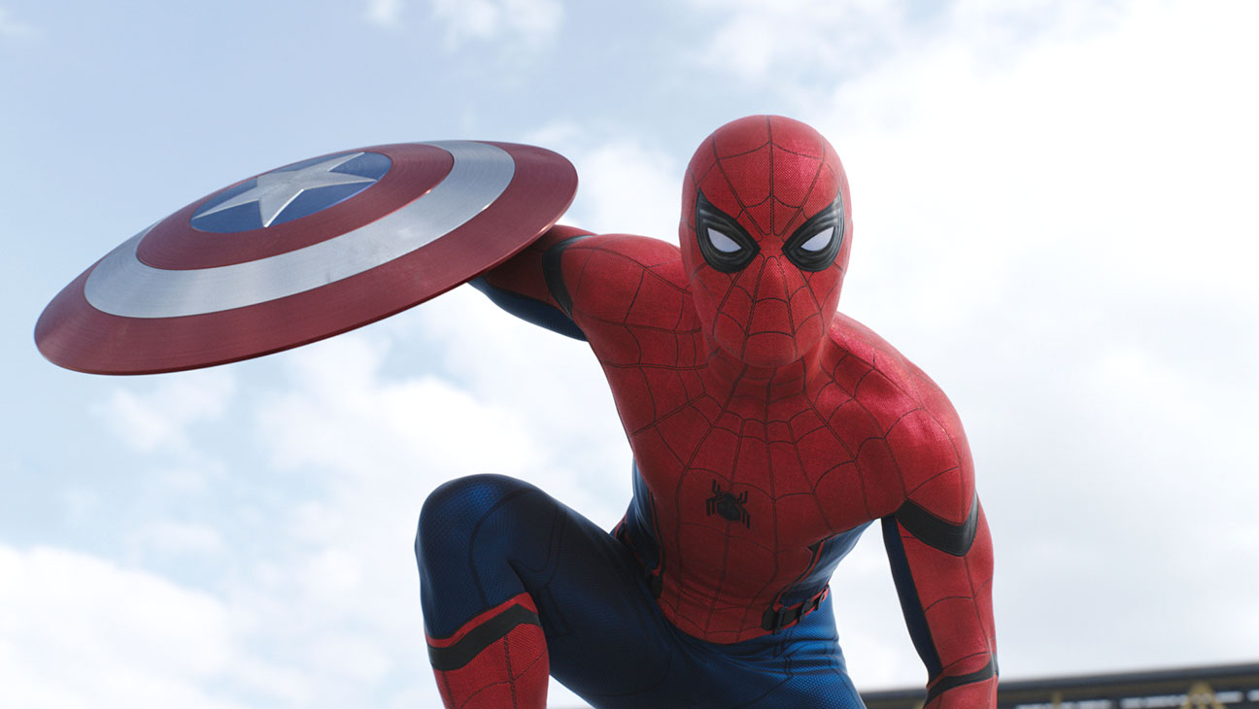
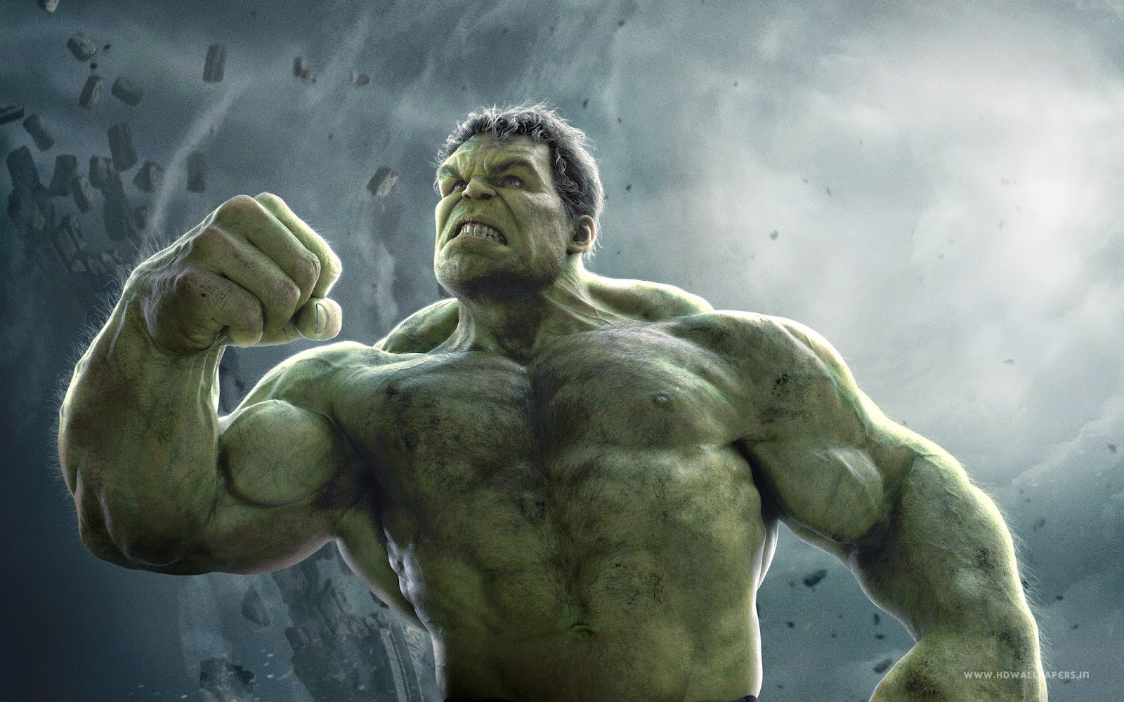
English game
Play Game!
By Alex Harvey

Slide 2
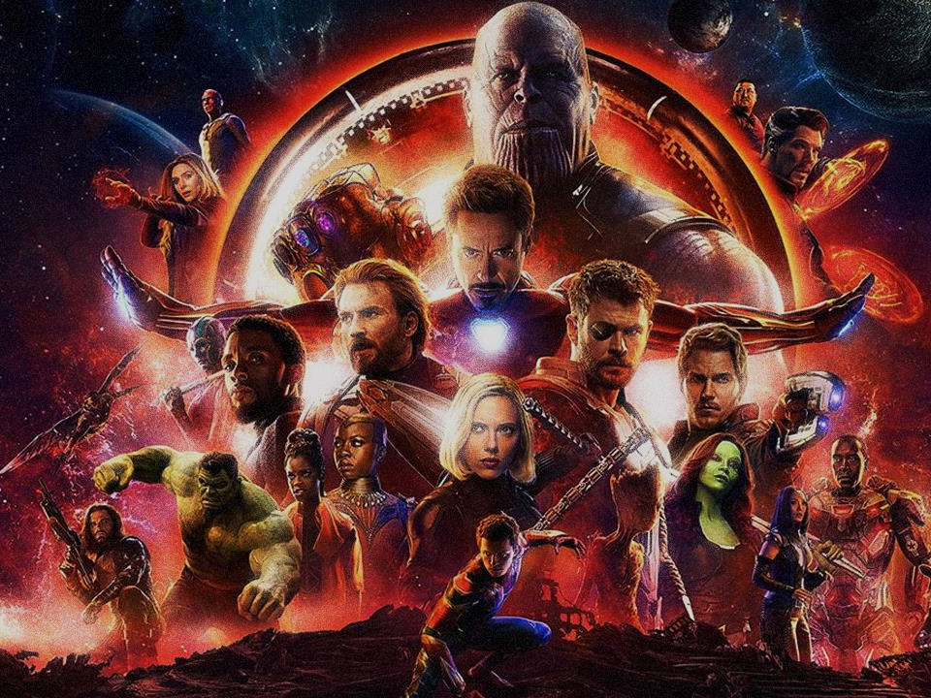
A
B
C
D
E
F
G
H
I
J
K
L
M
N
O
P
Q
R
S
T
U
V
W
X
Y

Slide 3
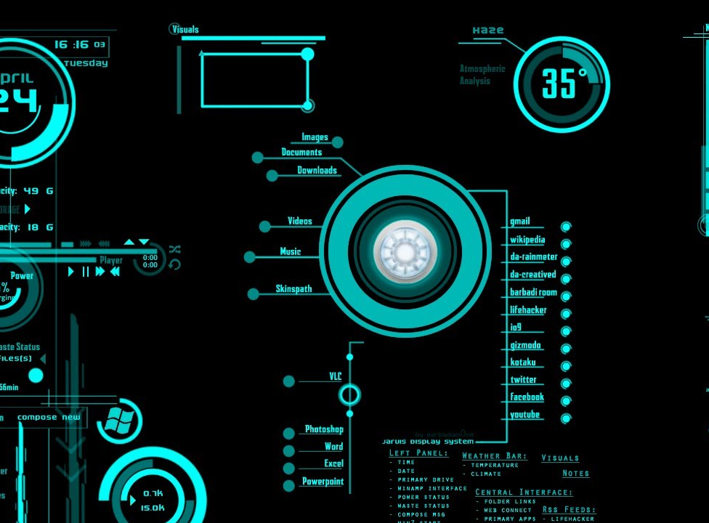
The light is green. Let’s...
Go

Slide 4
1 POINT!

Slide 5
The light is red. Let’s...
Stop

Slide 6
2 POINTS!

Slide 7
The light is yellow. Let’s...
Wait

Slide 8
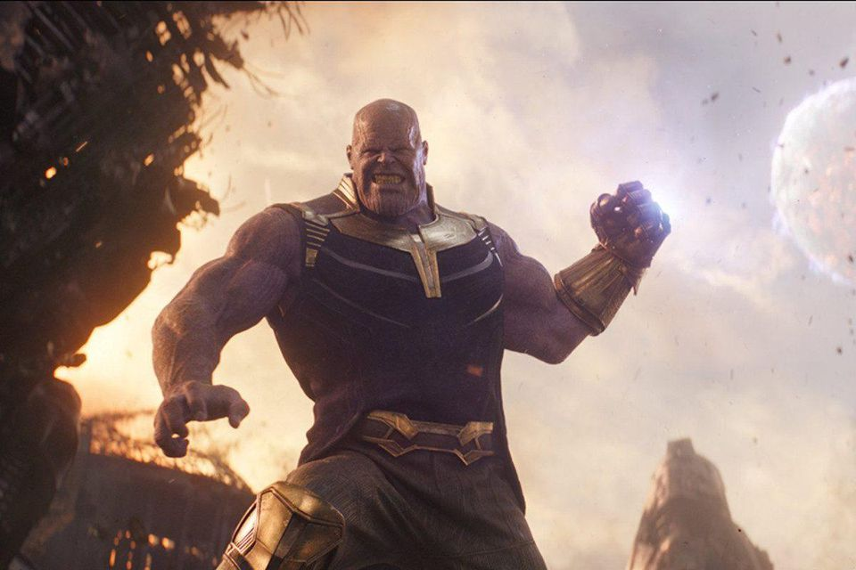
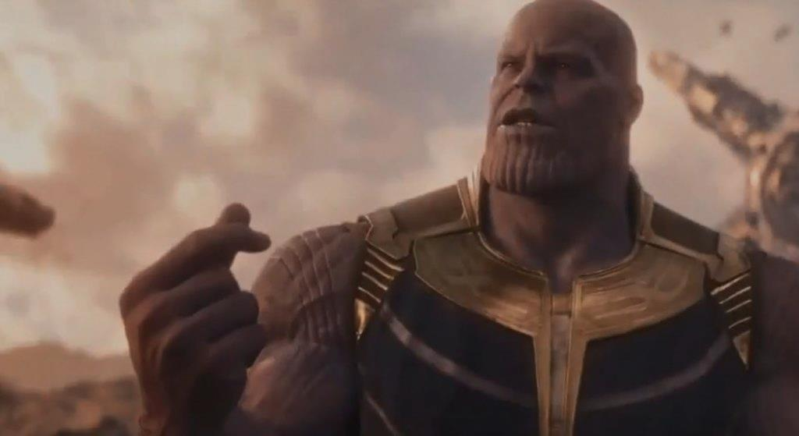
THERE MUST BE BALANCE
CHOOSE A NUMBER
1
2

Slide 9
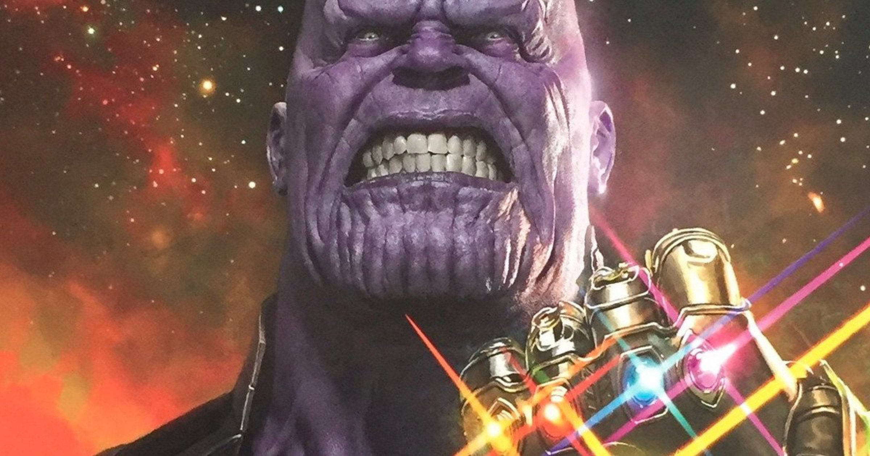
ALL TEAMS
LOSE 1/2 POINTS

Slide 10
TOP TWO TEAMS
LOSE ALL POINTS

Slide 11
Look at the light.
It’s red. Let’s stop...

Slide 12
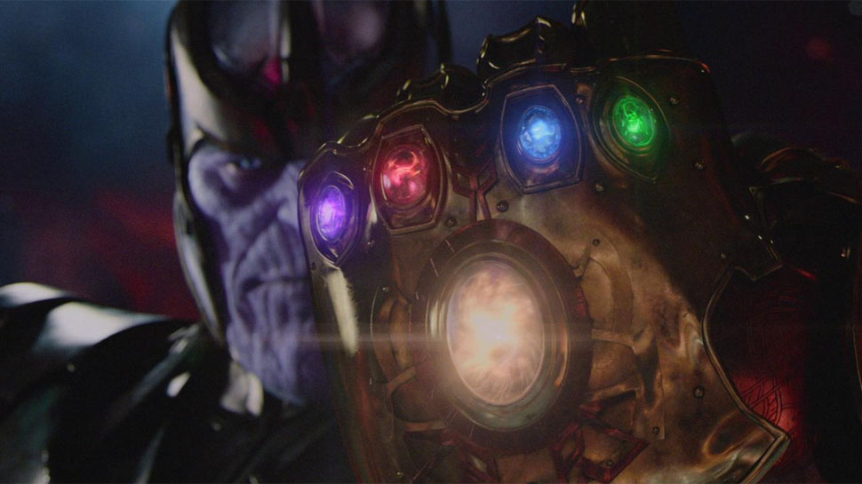
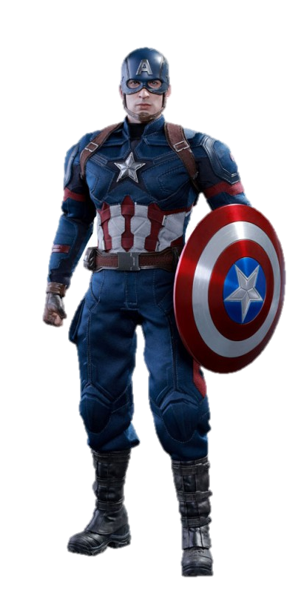
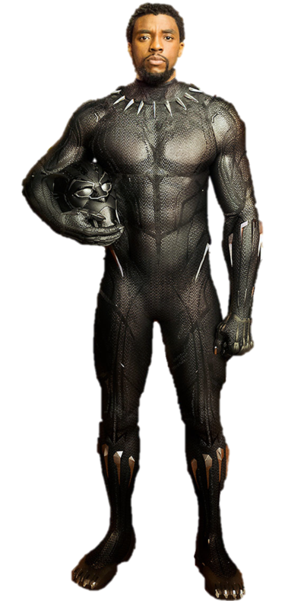
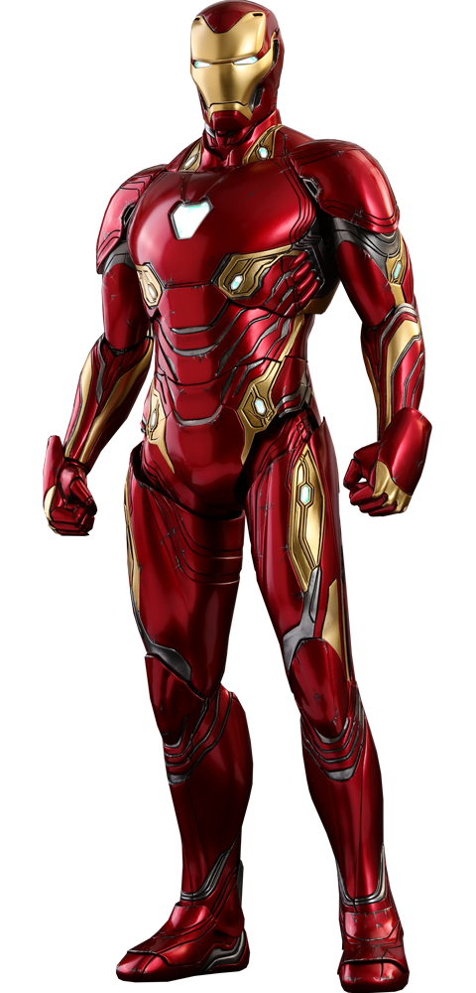
You have to fight Thanos!
Choose a hero…

Slide 13
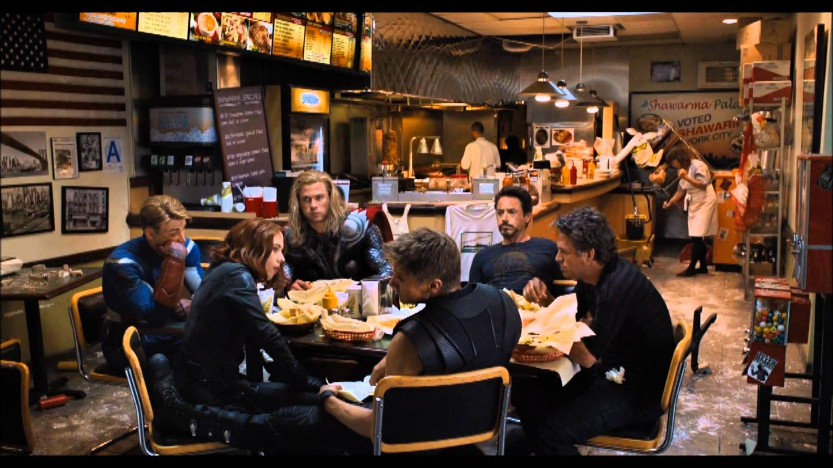
WENT TO EAT INSTEAD!
9 POINTS!

Slide 14
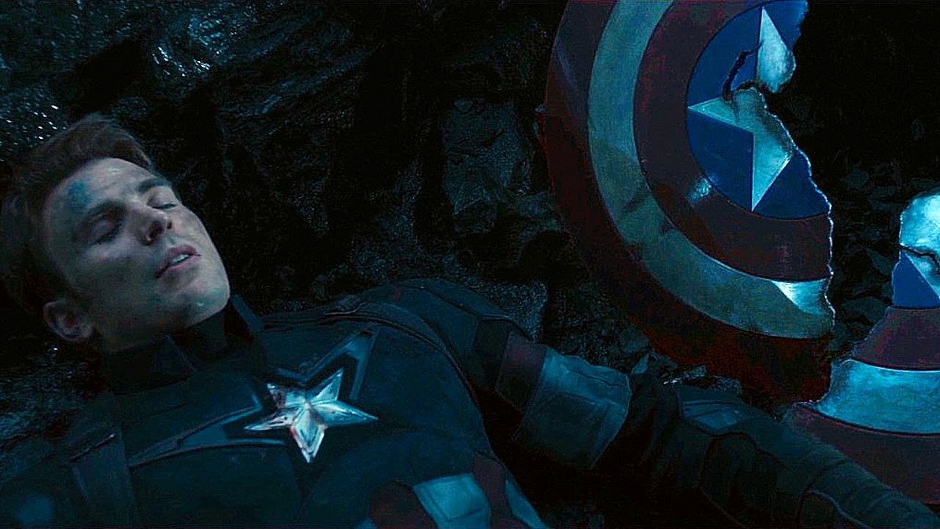
YOU LOST!
LOSE ½ YOUR POINTS!

Slide 15
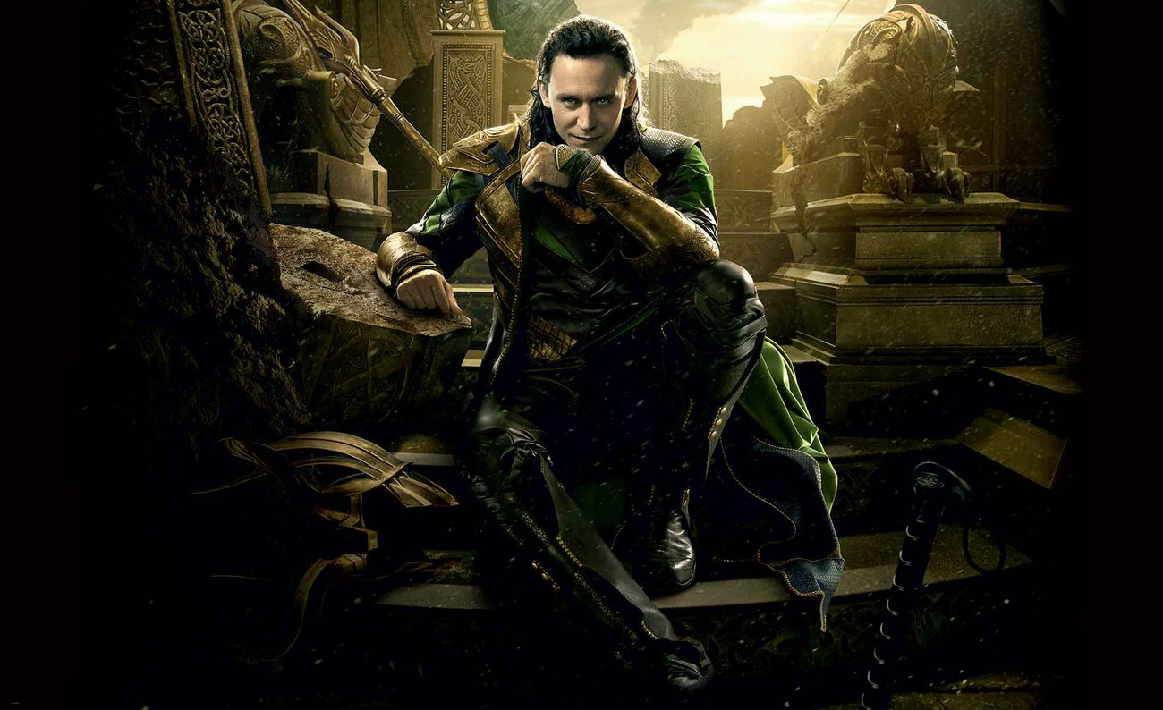
LOKI TRICKED YOU!
CHANGE POINTS!

Slide 16
Look at the light.
It’s yellow. Let’s wait...

Slide 17
5 POINTS!

Slide 18
Look at the light.
It’s green. Let’s go...

Slide 19
6 POINTS!

Slide 20
What season is it?
Spring

Slide 21
2 POINTS!

Slide 22
What season is it?
Summer

Slide 23
4 POINTS!

Slide 24
What season is it?
Autumn

Slide 25
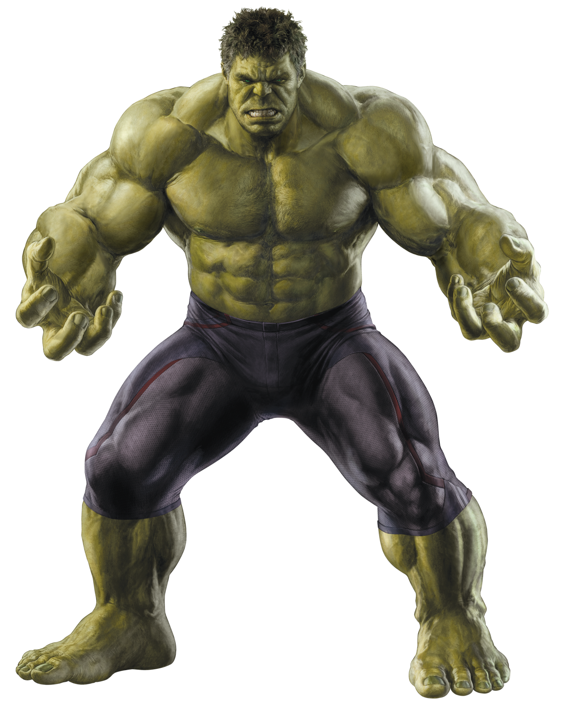
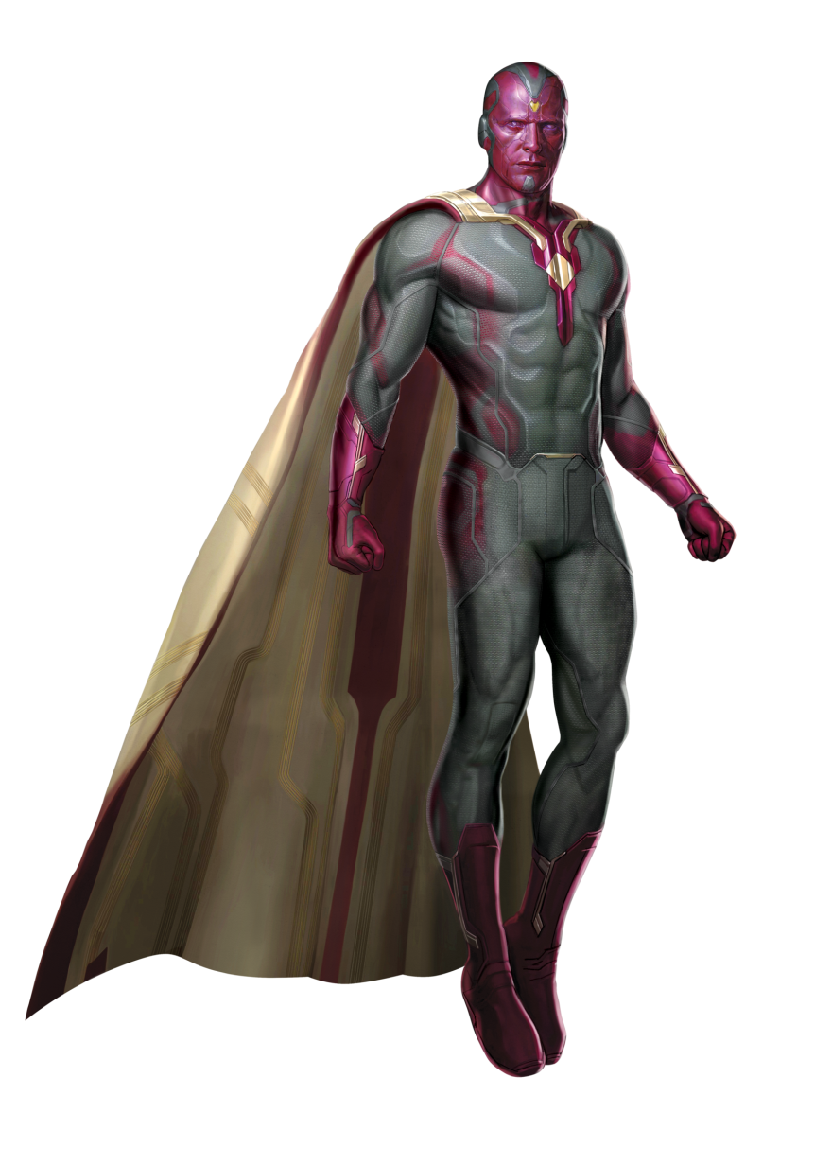
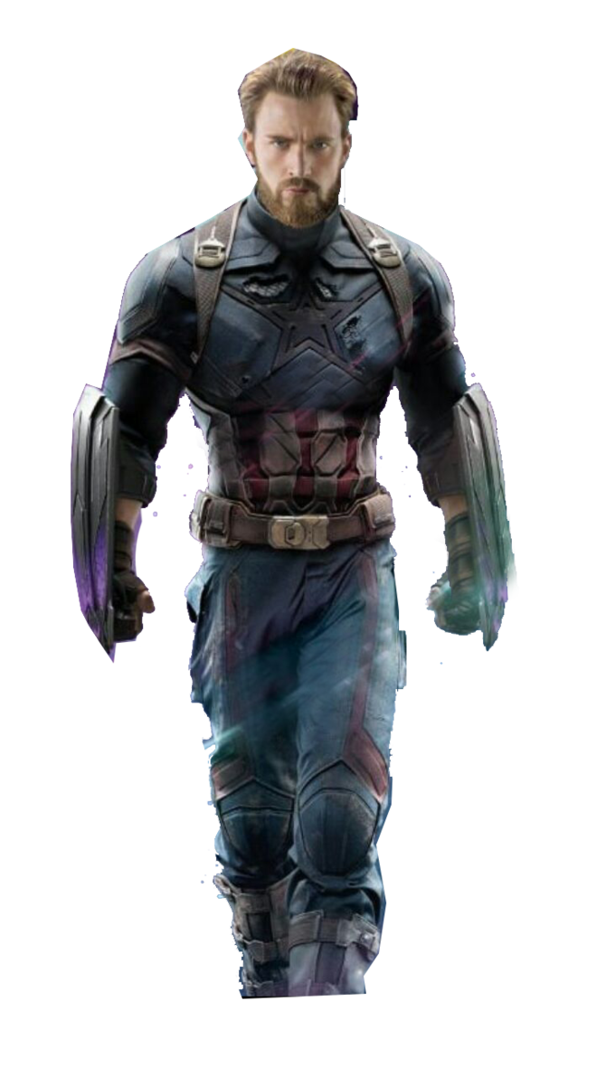
You have to fight Thanos!
Choose a hero…

Slide 26
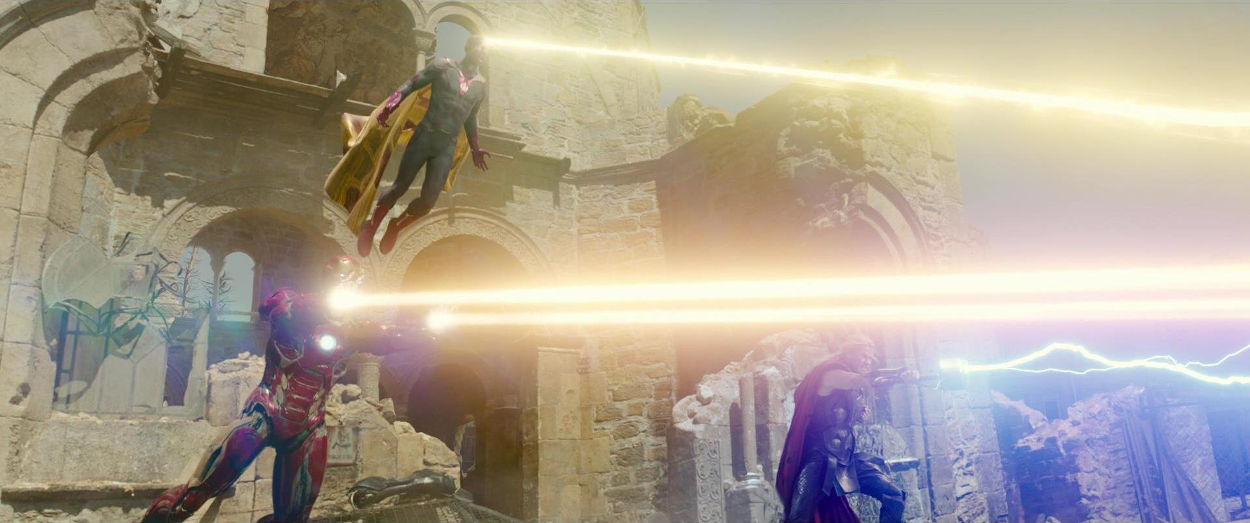
WORKED WITH YOUR FRIENDS!
ALL TEAMS +3 POINTS!

Slide 27
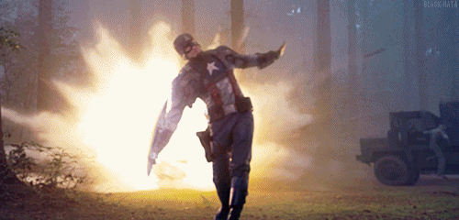
THREW YOUR SHIELD!
7 POINTS!

Slide 28
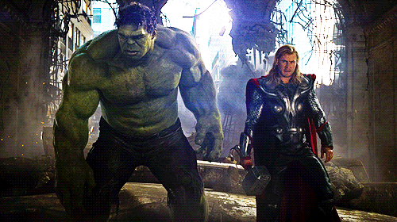
YOU PUNCHED THOR!
-5 TO ANOTHER TEAM!

Slide 29
What season is it?
Winter

Slide 30
5 POINTS!

Slide 31
What season is Easter in?
Spring

Slide 32
1 POINT!

Slide 33
What season is Christmas in?
Winter

Slide 34
5 POINTS!

Slide 35
What season is Halloween in?
Autumn

Slide 36
2 POINTS!

Slide 37
What season is New Year in?
Winter

Slide 38
You have to fight Thanos!
Choose a hero…

Slide 39
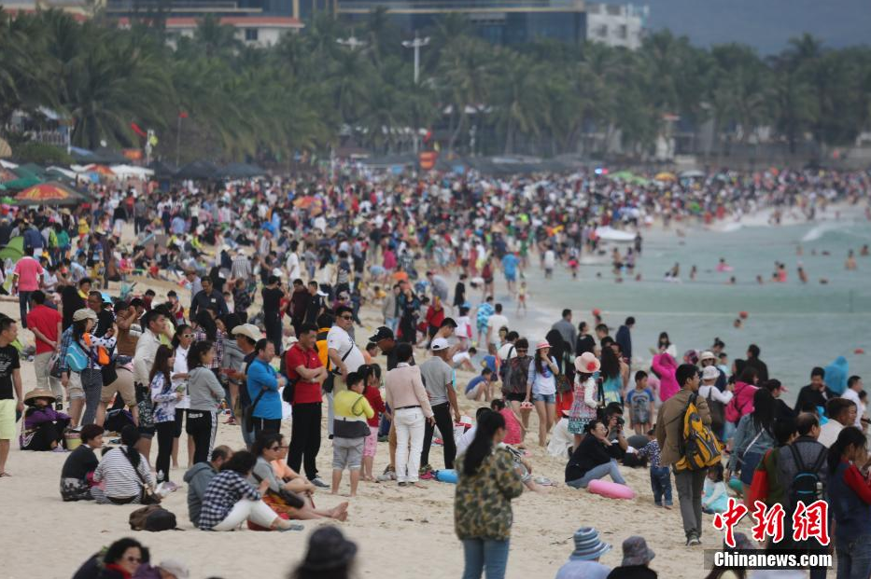
What season is the long school vacation in?
Summer

Slide 40
4 POINTS!

Slide 41
What season is it?
Autumn

Slide 42
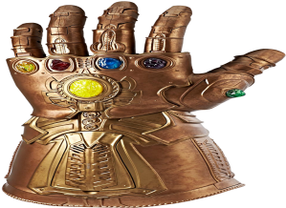
12 POINTS!

Slide 43
What season is it?
Winter

Slide 44
5 POINTS!

Slide 45
What season is it?
Spring

Slide 46
4 POINTS!

Slide 47
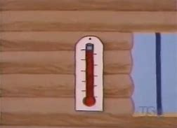
What season is it?
Summer

Slide 48
2 POINTS!

Slide 49
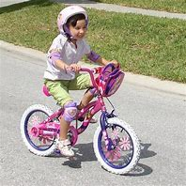
It is spring, I…
Ride a bicycle

Slide 50
4 POINTS!

Slide 51
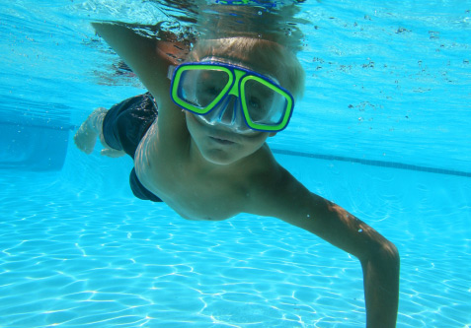
It is summer. I
swim

Slide 52
5 POINTS!

Slide 53
It is autumn. I …
Fly a kite.

Slide 54
You have to fight Thanos!
Choose a hero…

Slide 55
WENT TO EAT INSTEAD!
9 POINTS!

Slide 56
THANOS WINS!
LOSE ½ YOUR POINTS!

Slide 57
LOKI TRICKED YOU!
CHANGE POINTS!

Slide 58
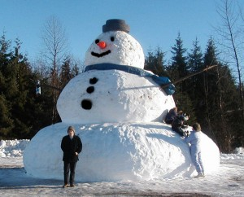
It is winter. I…
Make a snowman.

Slide 59
4 POINTS!

Slide 60
How many season are there?
There are four seasons.

Slide 61
3 POINTS!

Slide 62
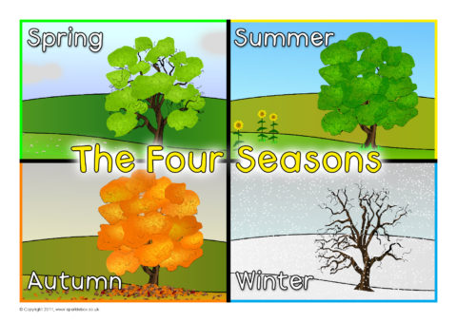
What season do you like?
I like…

Slide 63
5 POINTS!

Slide 64
gioithieu.azota.vn

