Slide 1
WELCOME TO MY CLASS
Good afternoon Everybody

Slide 2
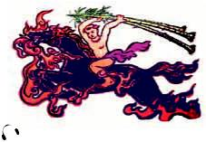
* WARM UP: CHATTING
* Look at the picture and answer the questions.
1. Who is Saint Giong?
2. What did he do for the country?
He is considered a mythical hero because he grew from3 year – old child into a giant overnight.
He defended the country from foreign invaders – the An.

Slide 3
Date
UNIT FIVE
FESTIVALS IN VIET NAM
Period 42
SKILLS 2

Slide 4
I. VOCABULARY
- Mythical (adj)
: (thuộc) thần thoại
- Commemorate (v)
: kỷ niệm
- Commune (n)
: xã, công xã
- Invader (n)
: kẻ xâm lược
- Motherland
: quê hương, tổ quốc
- Preservation (n)
: sự bảo tồn
- Defend (v)
: bảo vệ

Slide 5
II. LISTENING
1. Listen and circle the correct answer A,B, or C. (Ex. 2/p. 55)
1. The Giong Festival is held in ________ District, Ha Noi.
A. Dong Anh B. Soc Son C. Dong Da
2. This festival is held to commemorate Saint Giong who defeated ________.
A. the An B. the Ming C. the Mongols
3. The festival is held ________.
A. on the 6th day of the 4th lunar month
B. on the 12th day of the 4th lunar month
C. from the 6th to the 12th of the 4th lunar month

Slide 6
2. Listen to the talk again and write answers to the questions below.
(Ex. 3/p. 55)
1. How different is Saint Giong from other heroes in Viet Nam?
2. When do the preparations for the festival begin?
3. What kind of ceremony takes place after the procession?
4. What happens when night fall?
5. How important is this festival?
He is considered a mythical hero because he grew from3 year – old child into a giant overnight.
One month before the festival.
A religious ceremony.
There is a cheo performance.
This festival shows the love for our motherland and the preservation of our cultural heritage.

Slide 7
III. WRITING
1. Ask Ss to work in pairs. Discuss with your partner the festival in Viet Nam that you like best. Use the web below to take notes.
(Ex. 4/p. 55)
It’s held on _______
It’s held in _______
It worships _______
I LIKE
…………
FESTIVAL
It commemorates _______
The main activities are
___________
___________
___________
It’s impressive because _______
I like this festival because _______
I also like it because _______

Slide 8
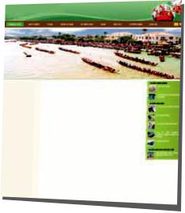
2. Now use the notes to write an article about this festival for the school website. Remember to add any necessary connectors below to make compound and complex sentences.
(Ex. 5/p. 55)
when while because
and but so
first then moreover

Slide 9
IV. AT HOME
Learn by heart new words.
Complete the notes to write an article about this festival the school website.
Prepare LOOKING BACK AND PROJECT.

Slide 10
The bye bye song
Bye, bye.
See you tomorrow.
Bye, bye.
See you tomorrow.
Bye, bye.
See you tomorrow.
Bye, bye. Bye, bye.
The bye bye
song
Notes:
10

