Slide 1

Unit 6: Be green
Lesson 6a: Reading
Page 96

Slide 2
Lesson Outline
Warm-up
Vocabulary
Reading
Consolidation
Wrap-up

Slide 3
Objectives
By the end of this lesson, students will be able to…
scan a text, to listen and read for details.
learn and talk about school green activities.
make suggestions.
learn prepositional phrases.
compare schools.
prepare a poster about making your school more eco-friendly.
develop vocabulary: install, compost, greenhouse, organic, energy-efficient bulb, recycled materials.

Slide 4

WARM-UP

Slide 5
Answer the question.
What are you doing at school to “go green” these day?

Slide 6
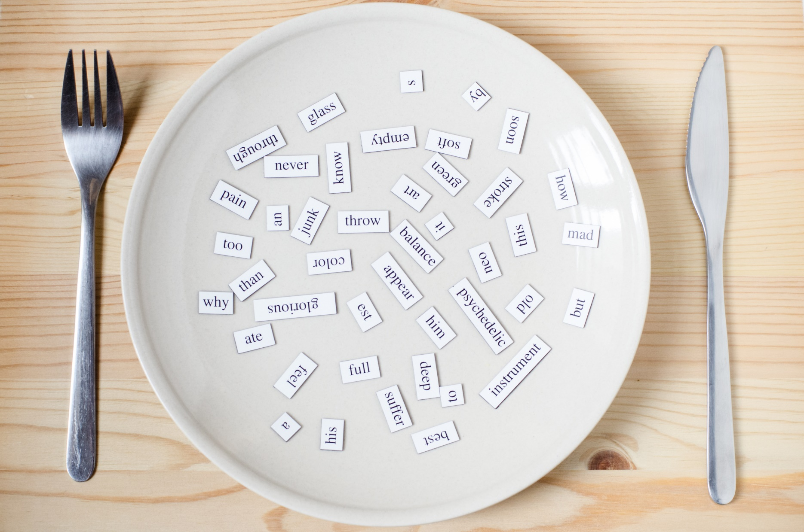
New words
• install
• energy-efficient bulb
• recycled materials
• compost
• organic
• greenhouse

Slide 7

Listen and repeat. Click each phrase to hear the sound.
install (v) /ɪnˈstɔːl/ cài đặt, lắp đặt
energy-efficient bulb (n. phr) /ˈenərdʒi ɪˈfɪʃnt bʌlb/ bóng đèn tiết kiệm năng lượng
recycled materials (phr) /ˌriːˈsaɪkld məˈtɪriəlz/ các vật liệu tái chế
compost (n) /ˈkɒmpɒst/ phân hữu cơ (làm từ rác, lá cây...)
organic (adj) /ɔːrˈɡænɪk/ hữu cơ
greenhouse (n) /ˈɡriːnhaʊs/ nhà kính

Slide 8
Unscramble the words.
sailltn _________________
neergy-feficenit ubbl _________________
cyrecedl ametrilsa _________________
cmopsot _________________
ogaricn _________________
hrgueseeno _________________
install
energy-efficient bulb
recycled materials
compost
organic
greenhouse

Slide 9
Please complete the sentences with the given words.
The trees will be cut up and used to make _____________.
They’ve ______________ some new ____________________.
There are some common ________________ such as paper, glass, plastic, etc.
The shop sells ___________ food.
Lisa grows a lot of tomatoes in her ________________.
energy-efficient bulbs organic greenhouse Compost installed recycled materials
compost
installed
energy-efficient bulbs
recycled materials
organic
greenhouse

Slide 10

Reading

Slide 11

Pre-Reading
Read the instruction quickly. Underline the key words. What are we going to do?

Slide 12
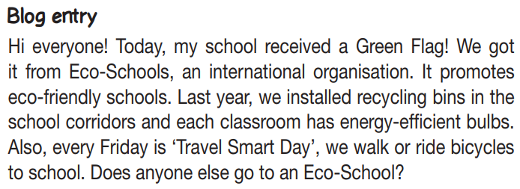
Pre-Reading
Read the text quickly. Find all the words in the blog related to school areas.

Slide 13
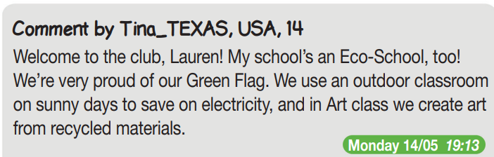
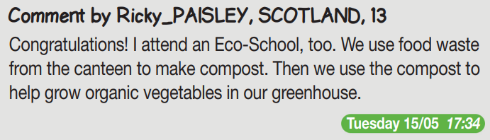
Pre-Reading
Read the text quickly. Find all the words in the blog related to school areas

Slide 14

Pre-Reading
Read the reviews quickly. What are we going to do?
Decide if the statements (1-5) are R (right), W (wrong) or DS (doesn’t say).

Slide 15

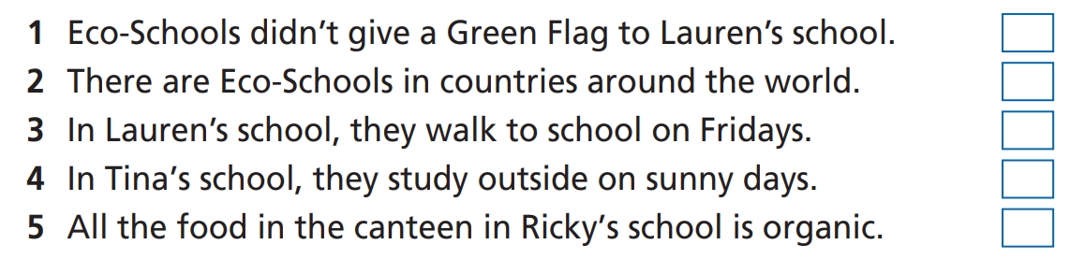
While-Reading

Slide 16
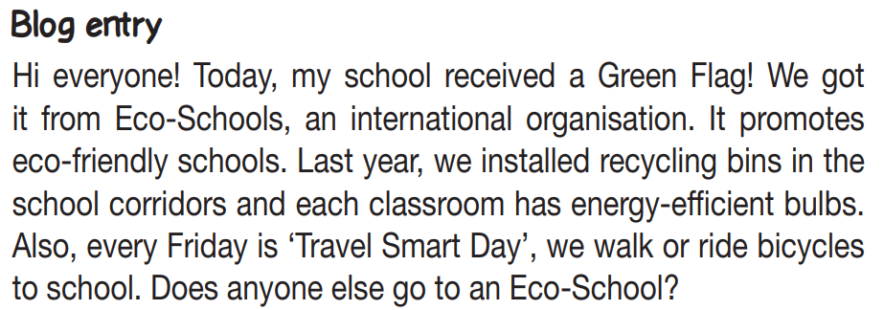
While-Reading
Scan the text. Decide if the statements are R/W/DS
W
Eco-Schools gave a Green Flag to Lauren’s school.

Slide 17
While-Reading
Scan the text. Decide if the statements are R/W/DS
R

Slide 18
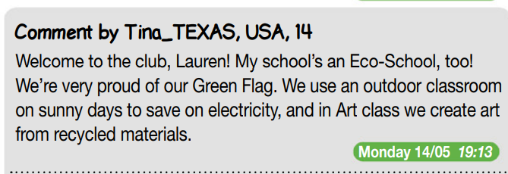
While-Reading
Scan the text. Decide if the statements are R/W/DS
R

Slide 19
While-Reading
Scan the text. Decide if the statements are R/W/DS
R
R

Slide 20
While-Reading
Scan the text. Decide if the statements are R/W/DS
DS

Slide 21
Extra-Practice
Pre-Reading
Read the instruction quickly. Underline the key words, the words before and after each gap.
Fill in the blanks with NO MORE THAN THREE WORDS to complete the summary.
Lauren, Tina and Ricky all attend Eco-Schools, which received a 1) ___________ from Eco-Schools. It is an international organization which promotes 2) __________ schools.
In Lauren’s school, 3) _________________ are installed in the school corridors and each classroom has 4) ___________________.
In Tina’s school, to save on electricity, an outdoor classroom is used, and the students use 5) ______________ to create art in Art class.
Ricky’s school, similarly, makes 6) _______ from food waste from the canteen to help grow organic vegetables.

Slide 22
Extra-Practice
Fill in the blanks with NO MORE THAN THREE WORDS to complete the summary.
Lauren, Tina and Ricky all attend Eco-Schools, which received a 1) _________ from Eco-Schools. It is an international organization which promotes 2) __________ schools.
In Lauren’s school, 3) ________________ are installed in the school corridors and each classroom has 4) ___________________.
In Tina’s school, to save on electricity, an outdoor classroom is used, and the students use 5) ________________ to create art in Art class.
Ricky’s school, similarly, makes 6) __________________ from food waste from the canteen to help grow organic vegetables.
Green Flag
eco-friendly
recycling bins
energy-efficient bulbs
recycled materials
compost

Slide 23

Post-Reading
Work in pairs and then share your idea with the class.
In my school, we have recycling bins in the corridors, but we don’t have energy-efficient light bulbs in the classrooms.
We create art from recycled materials, too, but we don’t have lessons outside on sunny days.

Slide 24

CONSOLIDATION

Slide 25
Describe your own one-week “go-green” plan to make your school more eco-friendly. Please write at least 40 words.
E.g.
I am going to save paper and go digital. And I am going to create art from recycled materials. Also, I am going to ride a bike to school.

Slide 26

WRAP-UP

Slide 27
Today’s lesson
Vocabularies
install
energy-efficient bulb
recycled materials
compost
organic
greenhouse
Reading
Scan a text, read for details

Slide 28
Homework
Learn by heart vocabularies and make sentences using them.
Do the exercises in TA 7 Right On Notebook on pages 44 & 45.
Do the exercises in TA 7 Right on Workbook on page 43.
Prepare the next lesson (page 97 SB).

Slide 29

Enjoy your day!

