Slide 1
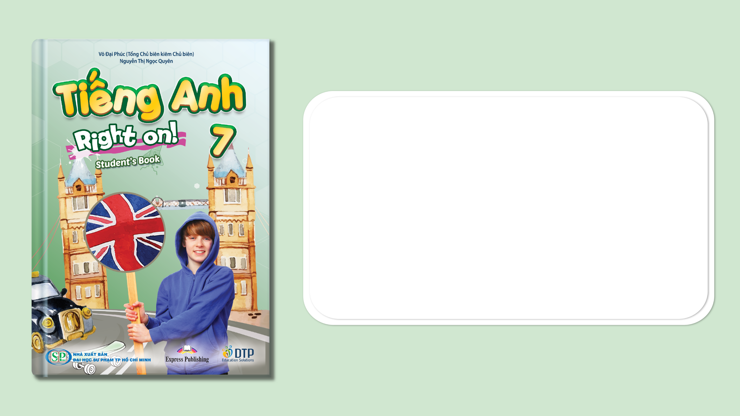
Unit 4: All things high-tech
Lesson 4e: Grammar
Page 70

Slide 2
Lesson Outline
Warm-up
Grammar
Consolidation
Wrap-up

Slide 3
Objectives
By the end of this lesson, students will be able to…
- use to-infinitive and infinitive without to correctly.

Slide 4

WARM-UP

Slide 5

Work in pairs.
MATCHING
Match questions in column A with correct answers in column B.
A | B
1. What are you doing? | a. I’m uploading my assignment to the school portal.
2. Can you fix it? | b. Sorry. I’m busy now. Is 30 minutes later ok?
3. Where can I put this? | c. Yes, sure.
4. When can you help me? | d. Put it on the table. Thank you.

Slide 6

It’s time to learn …

Slide 7

Presentation

Slide 8
Examples
1. We decided to spend a day at the exhibition.
2. She can do it.

Slide 9
Lead in
1. What kind of verbs is after “decided” in sentence 1?
to-infinitive.
2. When do we use to-infinitive?
- after would love, would like, etc.
- after the verbs agree, ask, decide, hope, manage, need, promise, want, etc.

Slide 10
Lead in
1. What kind of verbs is after “can” in sentence 2?
infinitive without to. (Bare-infinitive)
2. When do we use infinitive without to?
→ after modals (can, could, must, etc.)

Slide 11
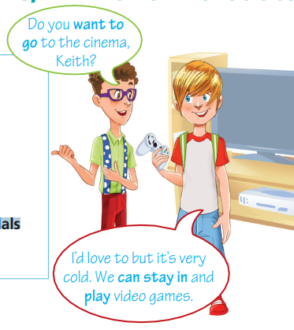
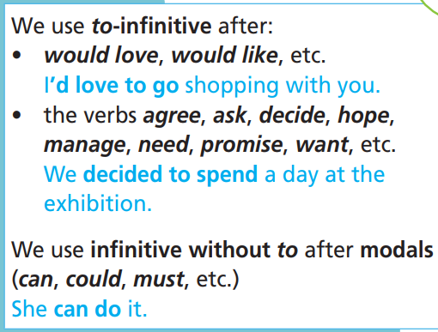

Slide 12

Practice

Slide 13
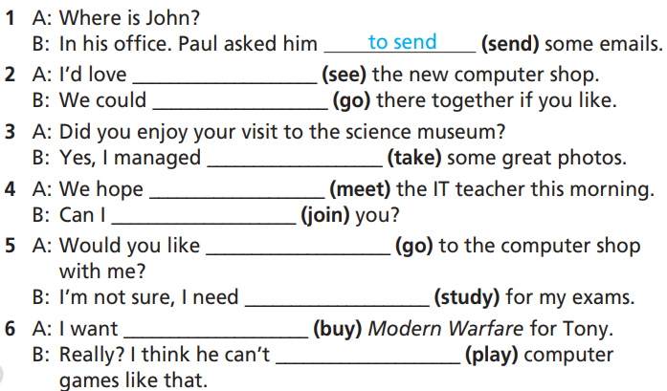
Practice
1 Put the verbs in brackets into to-infinitive or infinitive without to.
How many sentences are there?
→ There are 6.
What are you going to do?
Put the verbs in brackets into to-infinitive or infinitive without to.

Slide 14
Practice
1 Put the verbs in brackets into to-infinitive or infinitive without to.
1. A: Where is John?
B: In his office. Paul asked him __________ (send) some emails.
2. A: I’d love ___________ (see) the new computer shop.
B: We could ___________ (go) there together if you like.
3. A: Did you enjoy your visit to the science museum?
B: Yes, I managed ___________ (take) some great photos.
to send
to see
go
to take

Slide 15
Practice
1 Put the verbs in brackets into to-infinitive or infinitive without to.
4. A: We hope ___________ (meet) the IT teacher this morning.
B: Can I ___________ (join) you?
5. A: Would you like ___________ (go) to the computer shop with me?
B: I’m not sure, I need ___________ (study) for my exams.
6. A: I want ___________ (buy) Modern Warfare for Tony.
B: Really? I think he can’t ___________ (play) computer games like that.
to meet
join
to go
to study
to buy
play

Slide 16
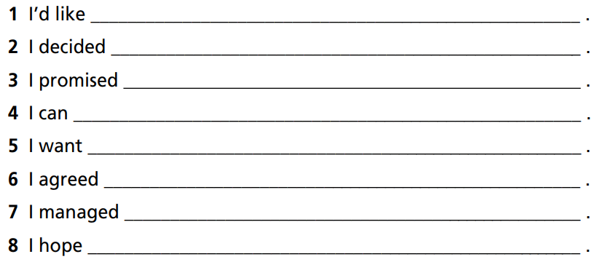
Practice
2 Complete the sentences. Then practise with your partner.
How many sentences are there?
→ There are 8.
What will you do?
Complete and practise with a partner.

Slide 17
Practice
2 Complete the sentences. Then practise with your partner.
1. I’d like ___________________________________________ .
2. I decided _________________________________________ .
3. I promised _______________________________________ .
4. I can ____________________________________________.
to buy a new video game
to use my smartphone less often
to show my mum how to use her tablet
play tennis very well

Slide 18
Practice
2 Complete the sentences. Then practise with your partner.
5. I want ___________________________________________ .
6. I agreed _________________________________________ .
7. I managed _______________________________________ .
8. I hoped __________________________________________ .
to learn Spanish
to share my games console with my brother
to do well in my history test yesterday
to get a virtual reality headset for my birthday

Slide 19
Extra Practice
WB, page 36
Put the verbs in brackets into to-infinitive, infinitive without to.
A: Hi. How are things? I want (1) ___________ (find out) about your new laptop. Did you manage (2) ___________ (get) it working?
B: No, I didn’t. I decided (3) ___________ (take) it back to the shop.
to find out
to get
to take

Slide 20
Extra Practice
WB, page 36
Put the verbs in brackets into to-infinitive, infinitive without to.
A: Can they (4) ___________ (repair) it this week?
B: No, but they promised (5) _________ (have) it ready by next week.
A: You can (6) ___________ (use) my old laptop if you like. I don’t need it.
B: Thanks. I am coming round to your house tonight. I will
(7) ___________ (collect) it if that’s OK.
A: Sure.
repair
to have
use
collect

Slide 21

Production

Slide 22

Use these verbs + to-infinitive and modals + infinitive without to make a conversation about future.

Slide 23
STUDENT A
STUDENT B
What do you want to be in the future?
I want to be an IT technician.
What do you do to be a game designer?
I try to study hard and hope to pass the university entrance exam.
You should also learn more about computer, right?
Totally correct.

Slide 24

CONSOLIDATION

Slide 25

WRAP-UP

Slide 26
Work in pairs.
Practise the conversation with your partner.
A: Hi. How are things? I want to find out about your new laptop. Did you manage to get it working?
B: No, I didn’t. I decided to take it back to the shop.
A: Can they repair it this week?
B: No, but they promised to have it ready by next week.
A: You can use my old laptop if you like. I don’t need it.
B: Thanks. I am coming round to your house tonight. I will collect it if that’s OK.
A: Sure.

Slide 27
Today’s lesson
Grammar: Practise and use to-infinitive and infinitive without to correctly.

Slide 28
Homework
Practise the structure and make sentences using them.
Do the exercises in TA 7 Right on WB (page 36).
Prepare the next lesson (page 71 SB).
Do the exercise in TA 7 Right on Notebook (page 32).

Slide 29

Enjoy your day!

