Slide 1

Unit 9: Houses in the Future
Lesson 1.1: Vocabulary & Listening
Page 70

Slide 2
Lesson Outline
Warm-up
Vocabulary
Listening
Consolidation
Wrap-up

Slide 3
Objectives
By the end of this lesson, students will be able to…
- Use the vocabulary in the lesson to talk about homes in the future.
- Know how to show they don’t understand what they heard using the Conversation Skill.

Slide 4

WARM-UP

Slide 5
PAIR WORK
Tell your partner some places to live you know.
For example:
- houses
- apartments (US)/ flats (UK)
- …
- …
- …
- …

Slide 6

New words
earthscraper
eco-friendly
smart home
underground megacity

Slide 7
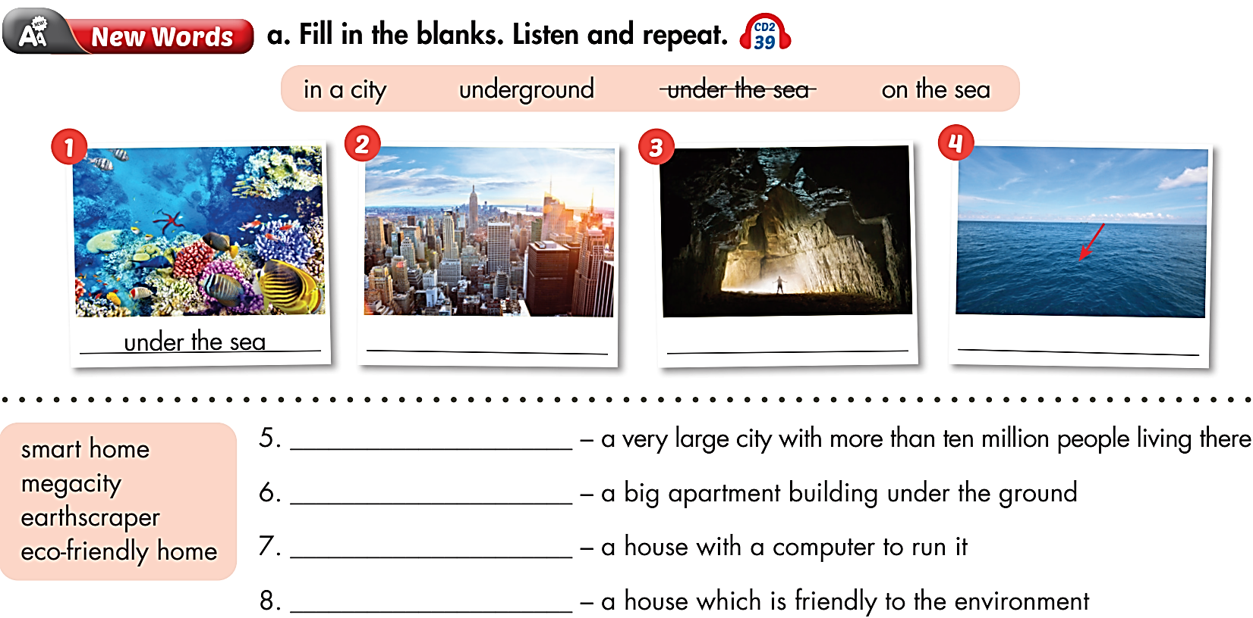


in a city
underground
on the sea
megacity
earthscraper
smart home
eco-friendly home

Slide 8
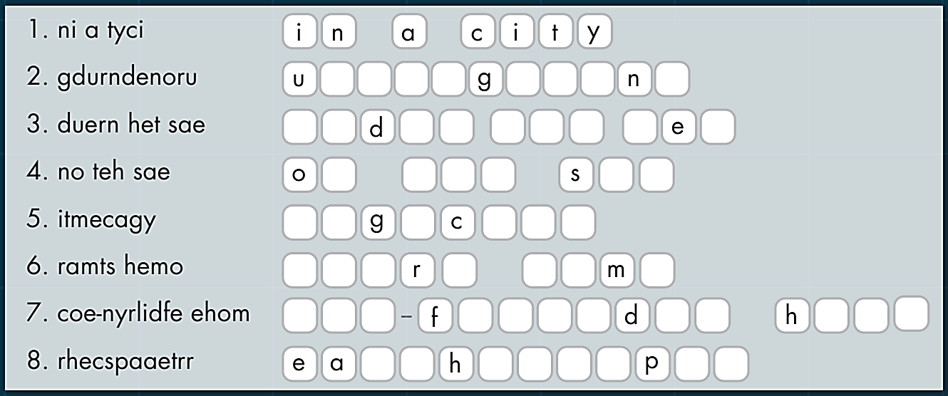
Extra Practice
WB page 50
Unscramble the words and phrases.
n d e r r o u d
u n e r t h e s a
n t h e e a
m e a i t y
s m a t h o e
e c o r i e n l y o m e
r t s c r a e r

Slide 9
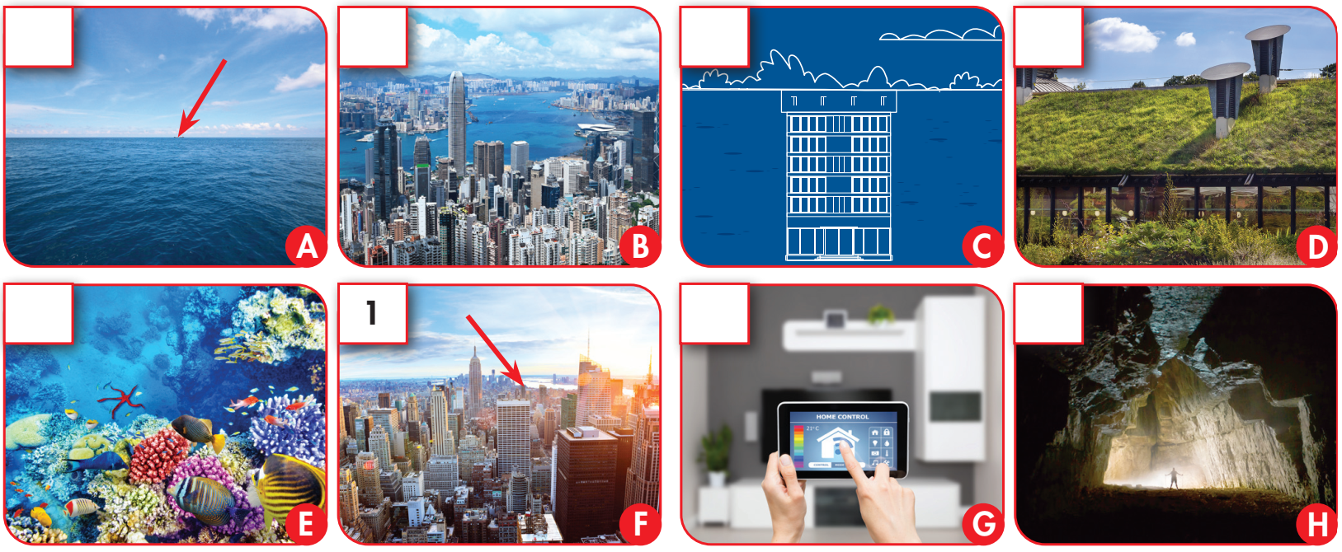
Match the phrases in the box with the pictures, then number them.
1. in a city 2. underground 3. under the sea 4. on the sea
5. megacity 6. smart home 7. eco-friendly home 8. earthscraper
4
5
8
7
3
6
2

Slide 10
Listen and repeat
earthscraper (n) /ˈɜːrθˌskreɪpər/ nhà nhiều tầng dưới lòng đất
eco-friendly home (adj) /iːkəʊ-ˈfrendli hoʊm/ nhà thân thiện với môi trường
smart home (n) /smɑːrt hoʊm/ nhà thông minh
underground (adv) /ˌʌndərˈɡraʊnd/ ngầm, dưới lòng đất
megacity (n) /ˈmeɡəsɪti/ siêu đô thị






Slide 11
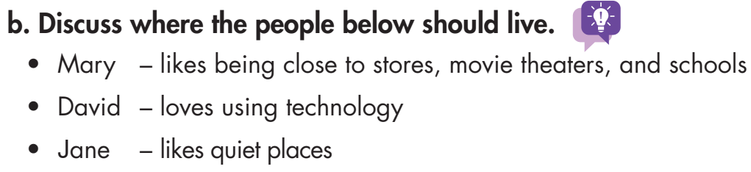
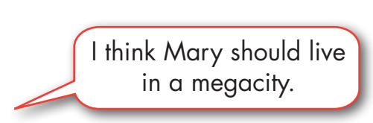

Slide 12

Listening

Slide 13
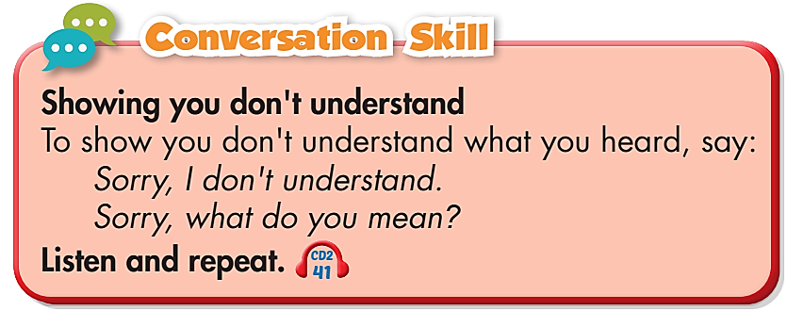
Pre-Listening



Slide 14
Pre-Listening
Where do you think people will live in the future?

Slide 15
While-Listening

Slide 16
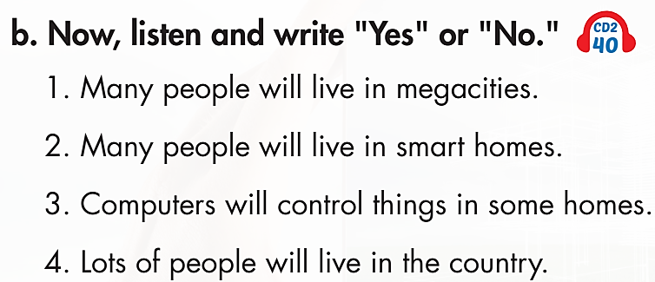
Yes
Yes
Yes
No

Slide 17
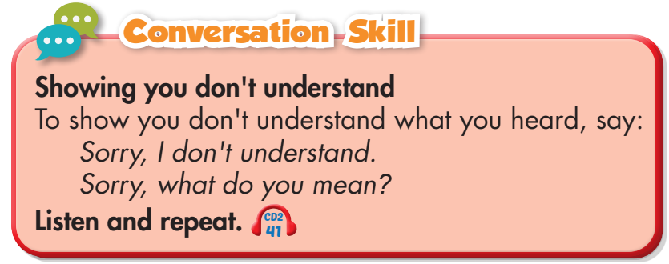
Post-Listening
Listen to the conversation again.
Pay attention to the Conversation Skill
and then practice it with a partner.
Click here to listen

Slide 18
John: Thanks for helping me with my
project, Professor Rendall.
Professor Rendall: You're welcome.
John: So, where do you think people
will live in the future?
Professor Rendall: A lot of people
will live in megacities. That's a city
with over ten million people.
John: Megacities? Wow! What do you
think their homes will be like?
Professor Rendall: Many people will
live in smart homes.
John: Smart homes? Sorry, I don’t
understand.
Professor Rendall: Computers control
lots of things in some homes. These
are called "smart homes.“
John: That's so cool! So will everyone
live in megacities and smart homes?
Professor Rendall: No. Some people
will live in eco-friendly homes in the
country. That's where I'd like to live.
John: OK, and…

Slide 19

CONSOLIDATION

Slide 20
Work in pairs.
- Where do people live in the future and what will their homes be like according to Professor Rendall?
- Where would you like to live in the future?

Slide 21

WRAP-UP

Slide 22
Today’s lesson
Vocabularies
earthscraper
eco-friendly
smart home
underground
megacity
Sentence patterns
Sorry, I don't understand.
Sorry, what do you mean?

Slide 23
Homework
Learn by hearts vocabularies and make sentences using them.
Do the listening exercises on page 50, WB
Do the exercises in Tiếng Anh 6 i-Learn Smart World Notebook on page 52
Prepare the next lesson (page 71 - SB)
Play the consolidation games in Tiếng Anh 6 i-Learn Smart World DHA App on www.eduhome.com.vn

Slide 24

Enjoy your day!

