Slide 1
1
Unit
Life stories we admire
Lesson 5: Listening
The father of Mickey Mouse

Slide 2
LESSON 5
LISTENING
WARM-UP
Guess the cartoon.
PRE-LISTENING
Task 1: Solve the crossword.
Vocabulary
Task 2: Listen and number.
Task 3: Choose the correct answer.
WHILE-LISTENING
POST-LISTENING
Task 4: ﻿Work in pairs and discuss.
CONSOLIDATION
Wrap-up
Homework

Slide 3

WARM-UP

Slide 4
Guess the cartoon!
Work in two teams.
There are 7 pictures of 7 famous cartoons.
You will see 3 clues of it. (Each clue is worth 1 point)
Each group use the clues to guess the name of the cartoon.
If the answer is correct → points for your team.
If the answer is incorrect → no point.
The team having more points is the winner of the game.

Slide 5
Ví dụ:
Nếu hs chỉ cần 1 gợi ý đã tìm ra đáp án → 3đ
Hs cần 2 gợi ý → 2d
Hs cần 3 gợi ý → 1d

Slide 6
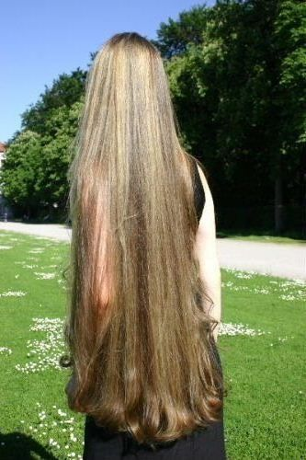

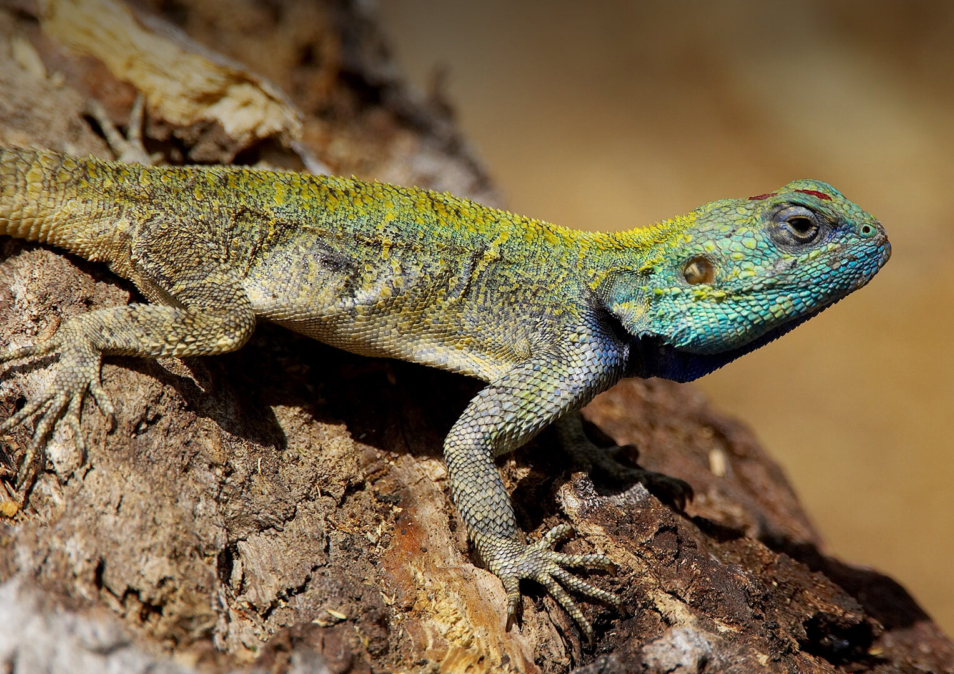

Slide 7
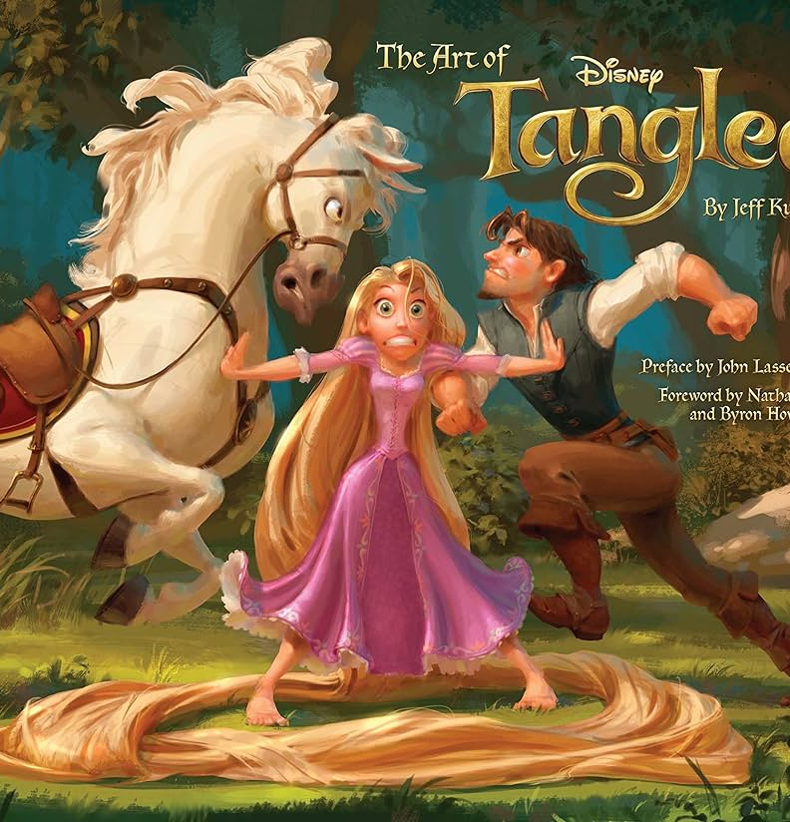
1
TANGLED

Slide 8
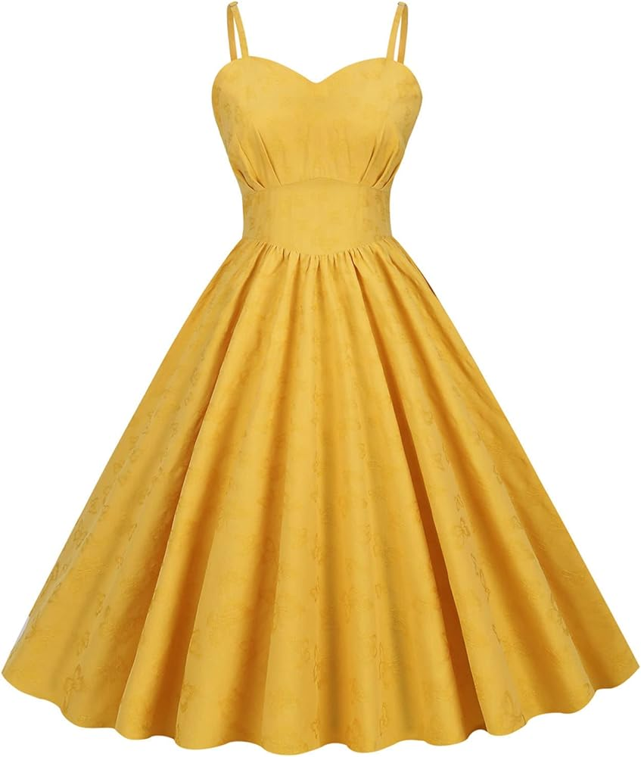
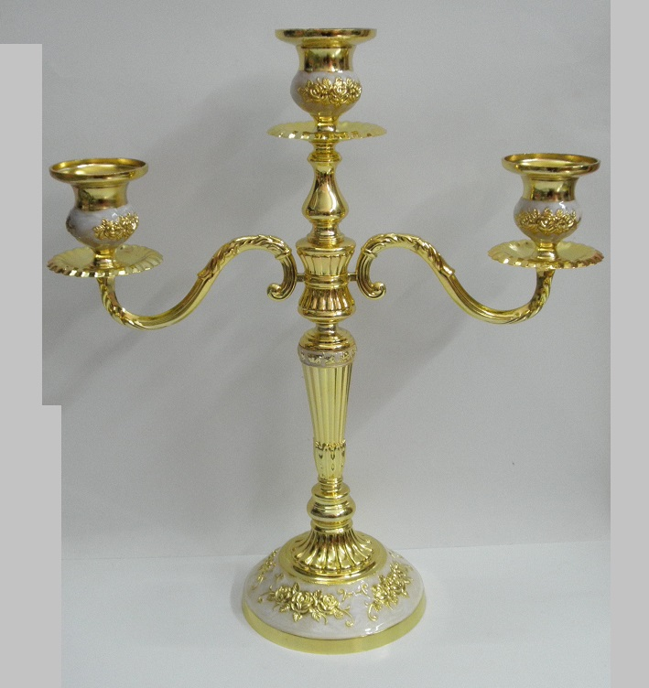
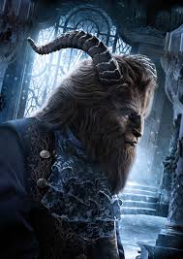

Slide 9

2
BEAUTY AND THE BEAST

Slide 10
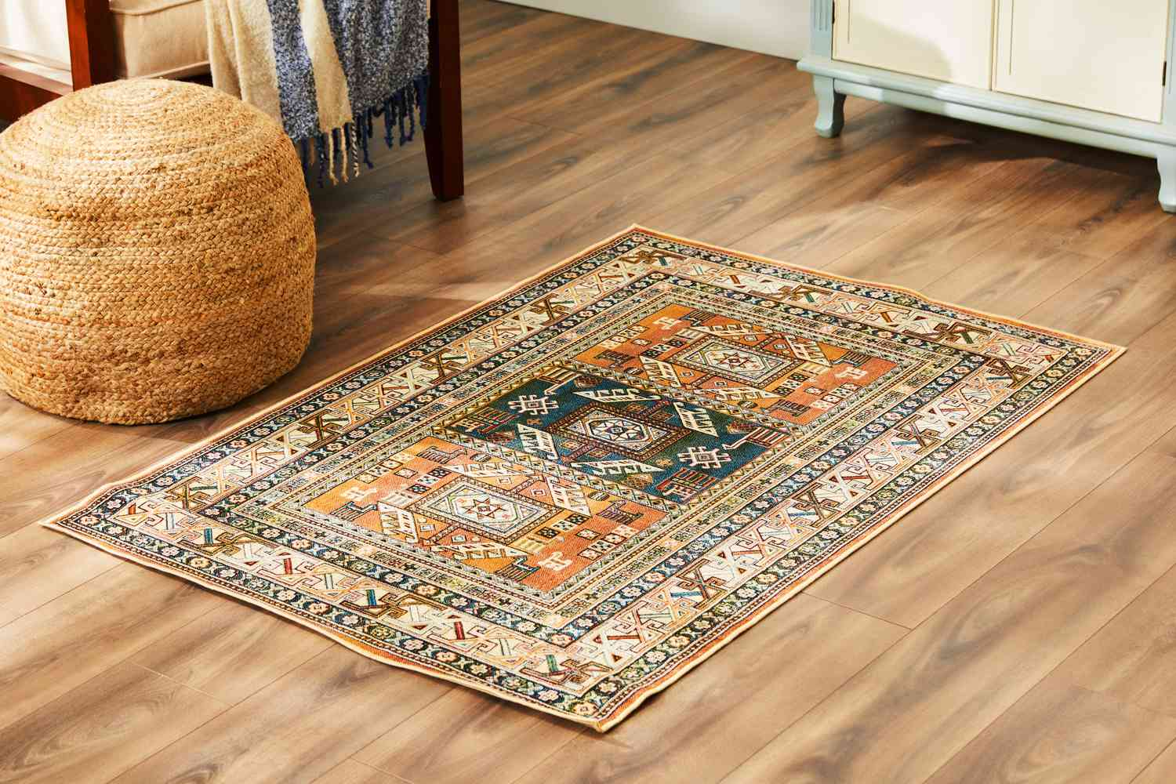
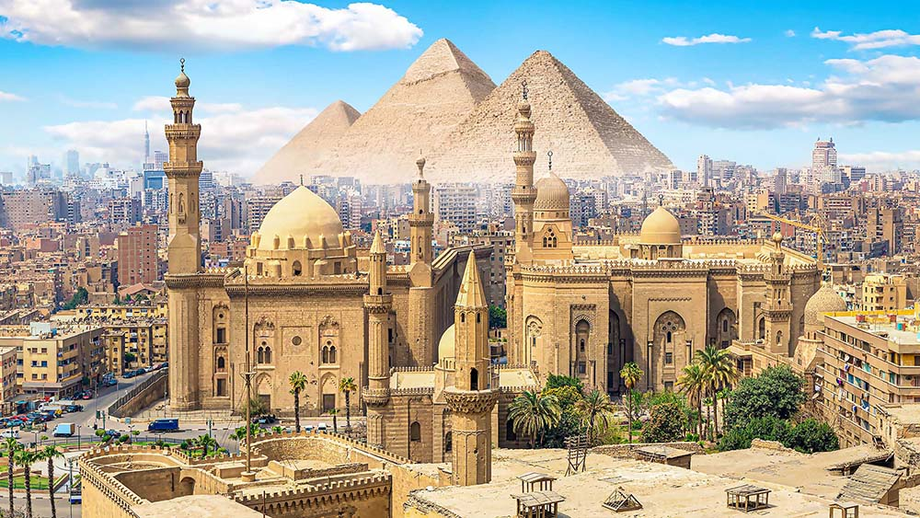
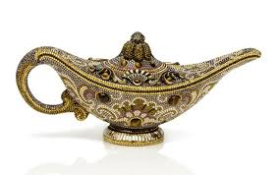

Slide 11
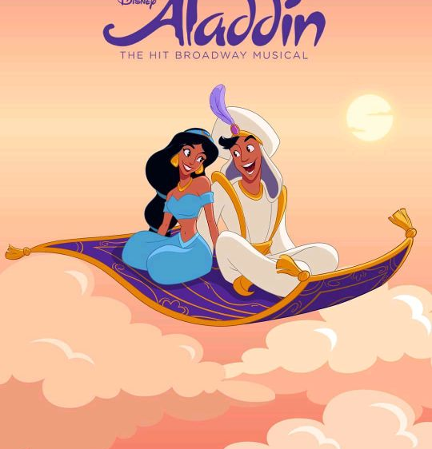
2
ALADIN

Slide 12

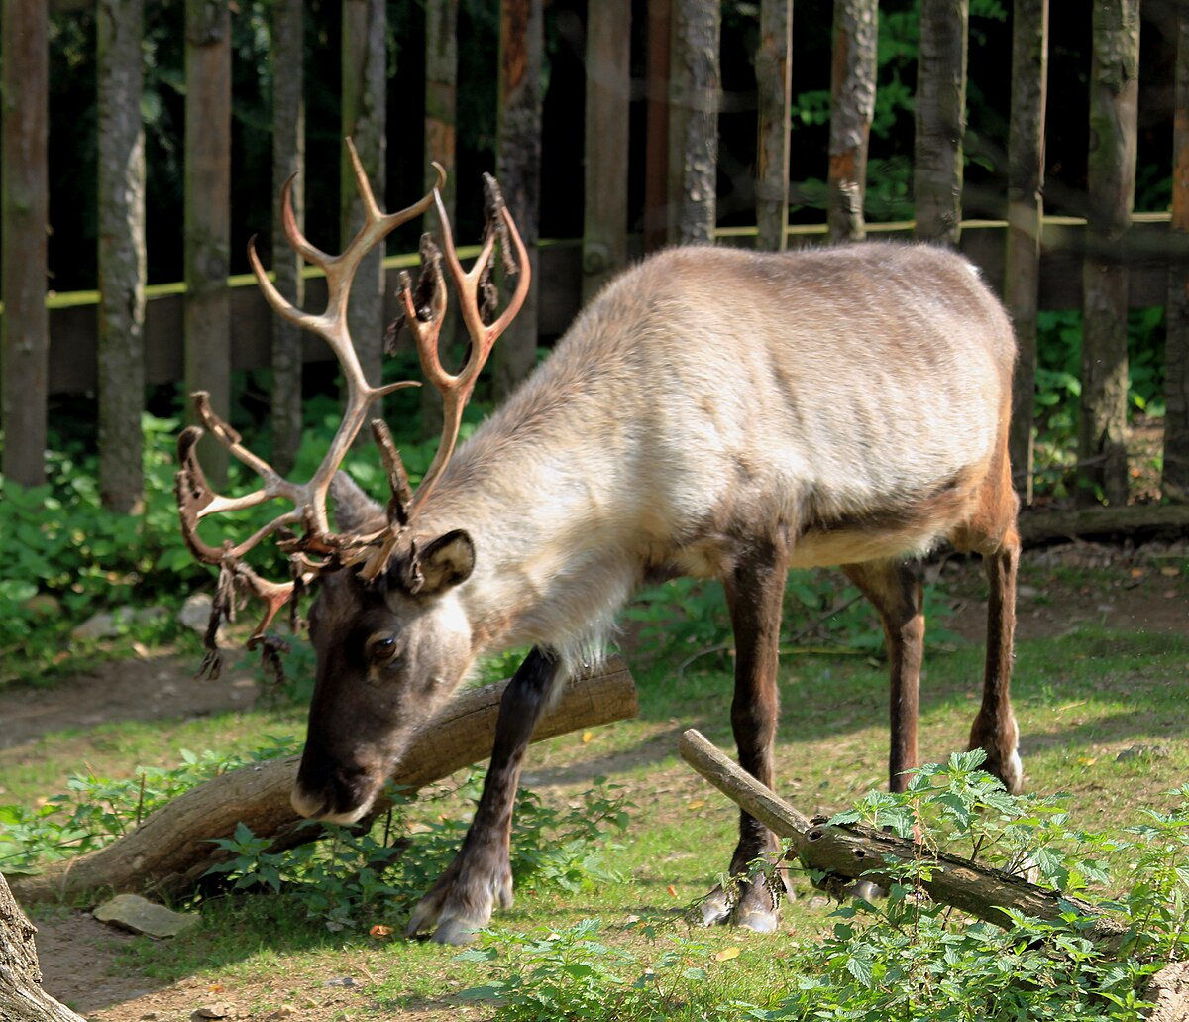


Slide 13
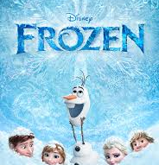
3
FROZEN

Slide 14
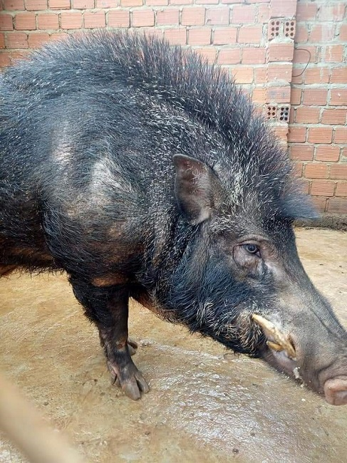
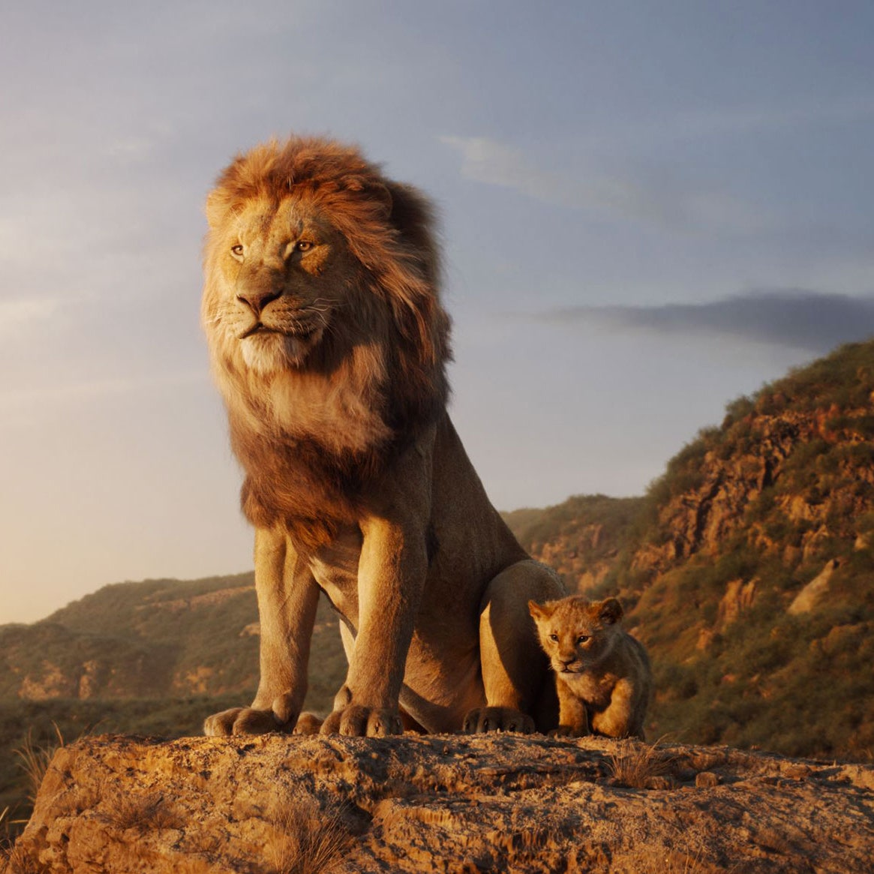
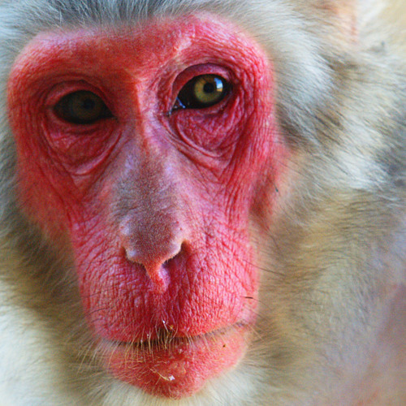

Slide 15
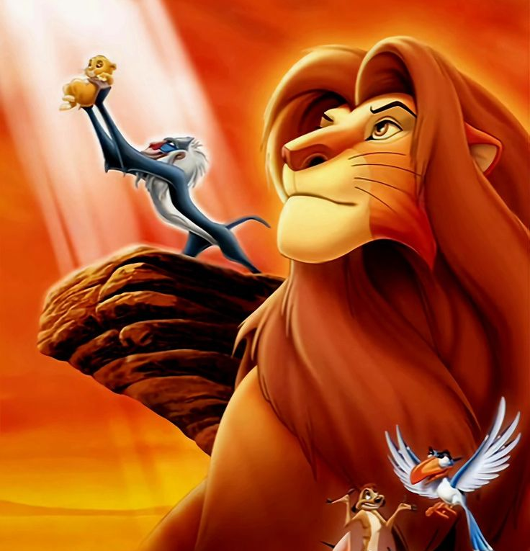
4
THE LION KING

Slide 16
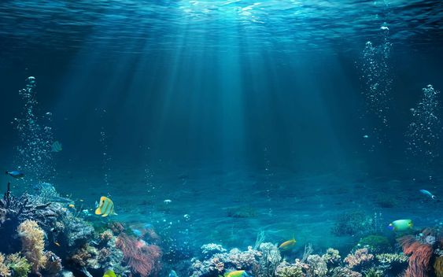
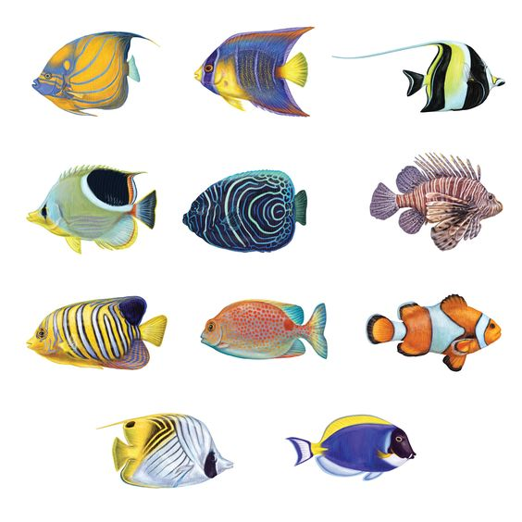
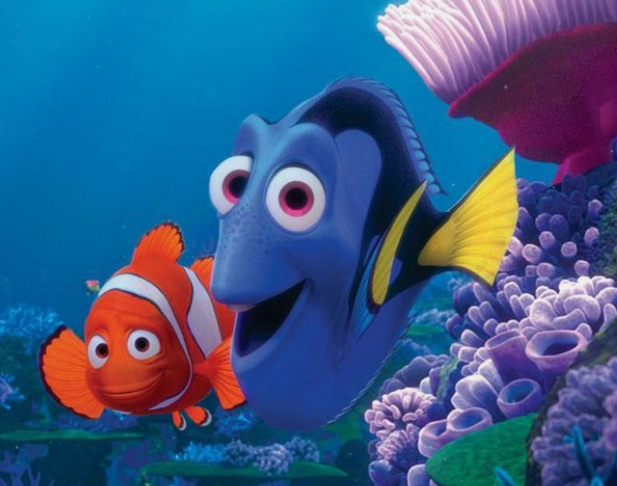

Slide 17

5
FINDING NEMO

Slide 18
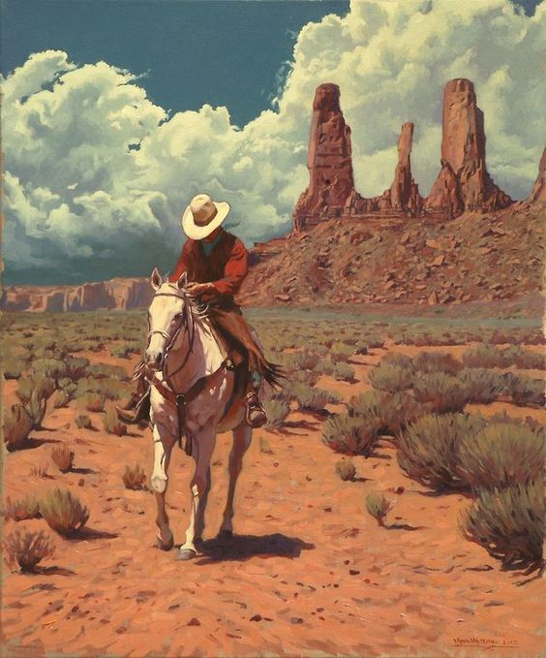



Slide 19
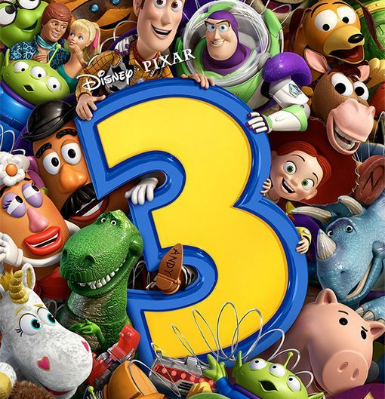
6
TOY STORY (3)

Slide 20
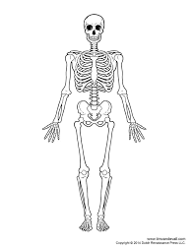
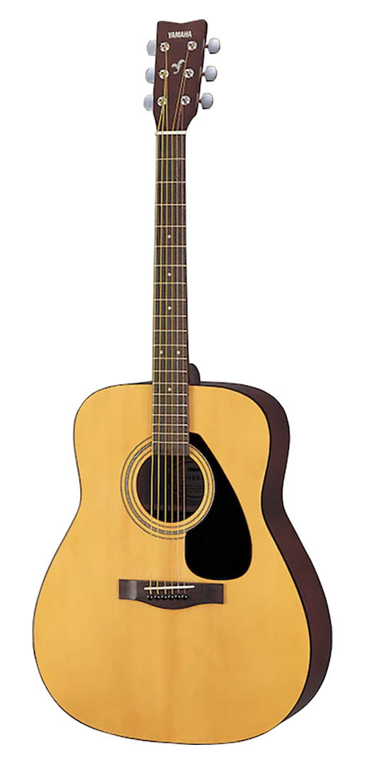
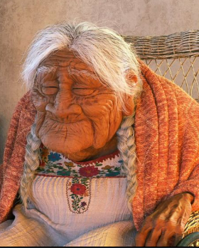

Slide 21
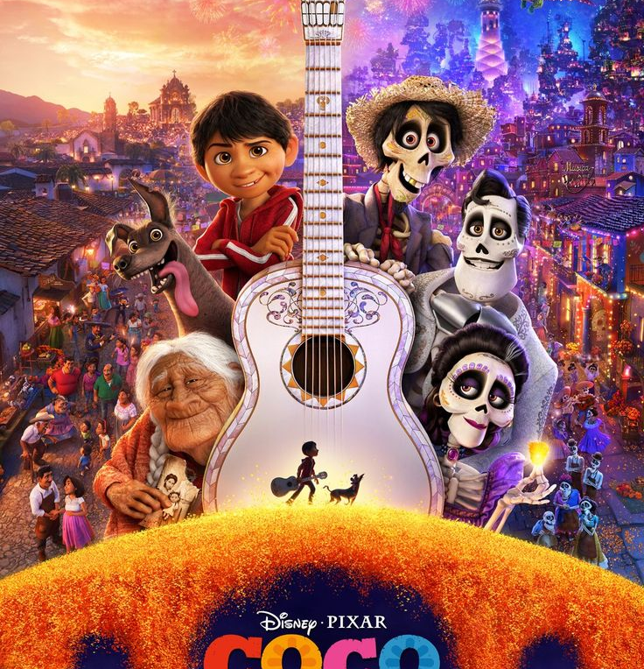
7
COCO

Slide 22
LESSON 5
LISTENING
WARM-UP
Guess the cartoon.
PRE-LISTENING
Task 1: Solve the crossword.
Vocabulary
Task 2: Listen and number.
Task 3: Choose the correct answer.
WHILE-LISTENING
POST-LISTENING
Task 4: ﻿Work in pairs and discuss.
CONSOLIDATION
Wrap-up
Homework

Slide 23

PRE-LISTENING

Slide 24
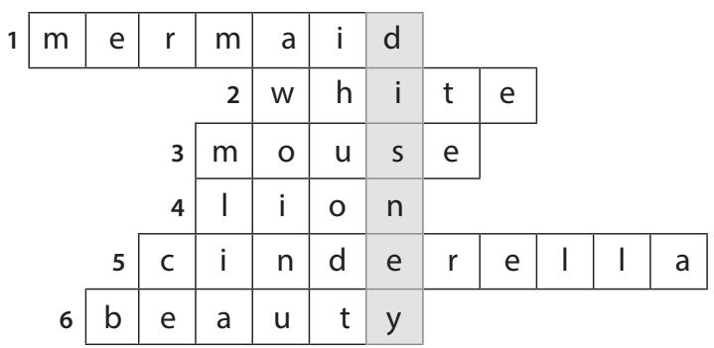

Solve the crossword to reveal the secret name. (P.14)
01

Slide 25


Slide 26


Profitable (adj)
/ˈprɒfɪtəbl/
that makes or is likely to make money
Có lợi nhuận

Slide 27
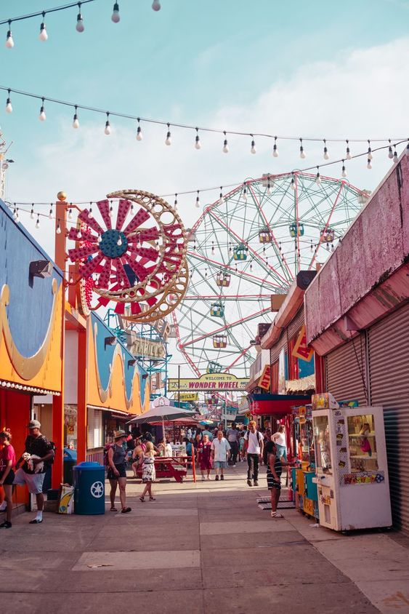
Theme park (n)
/ˈθiːm pɑːk/
a large park where people go to enjoy themselves
Công viên giải trí

Slide 28
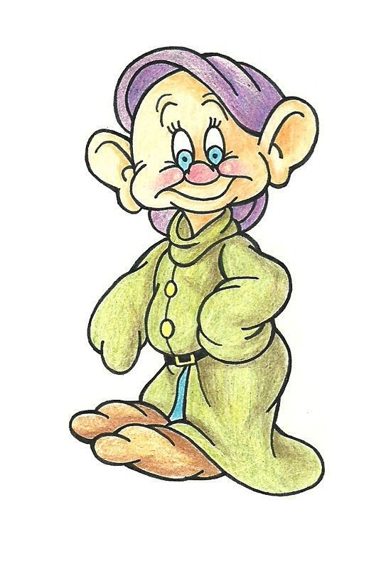
Dwarf (n)
/dwɔːf/
(in stories) a creature like a small man, who has magic powers and who is usually described as living and working under the ground, especially working with metal
Chú lùn (nhân vật hư cấu)

Slide 29
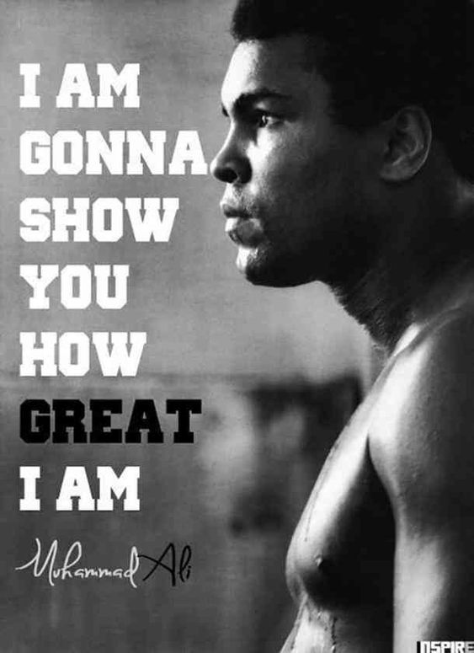
Inspire (v)
/ɪnˈspaɪə(r)/
to give somebody the desire, confidence or enthusiasm to do something well
Truyền cảm hứng

Slide 30
Form | Pronunciation | Meaning | Vietnamese equivalent
1.profitable (adj) | /ˈprɒfɪtəbl/ | that makes or is likely to make money | có lợi nhuận
2. theme park | /ˈθiːm pɑːk/ | a large park where people go to enjoy themselves | công viên giải trí
3. dwarf (n) | /dwɔːf/ | (in stories) a creature like a small man, who has magic powers and who is usually described as living and working under the ground, especially working with metal | chú lùn
4. inspire (v) | /ɪnˈspaɪə(r)/ | to give somebody the desire, confidence or enthusiasm to do something well | truyền cảm hứng

Slide 31

UNSCRAMBLE THE WORD

Slide 32


Slide 33
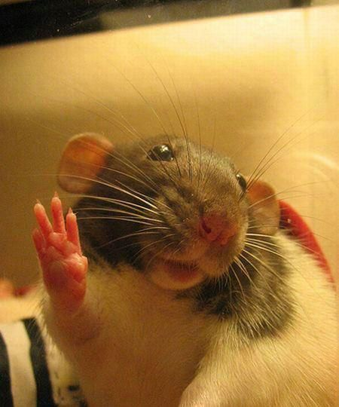
EHLOL
HELLO

Slide 34


Slide 35
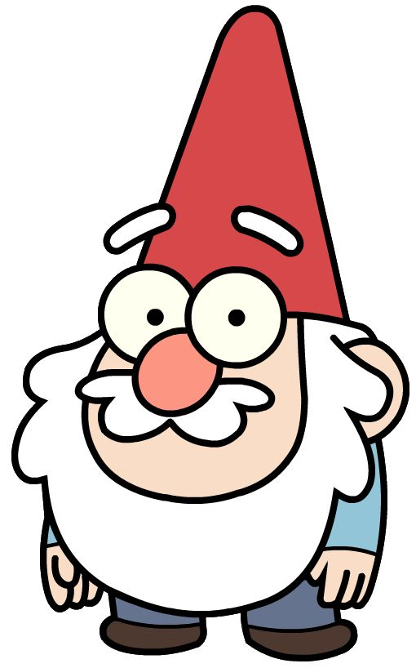
FARDW
DWARF

Slide 36
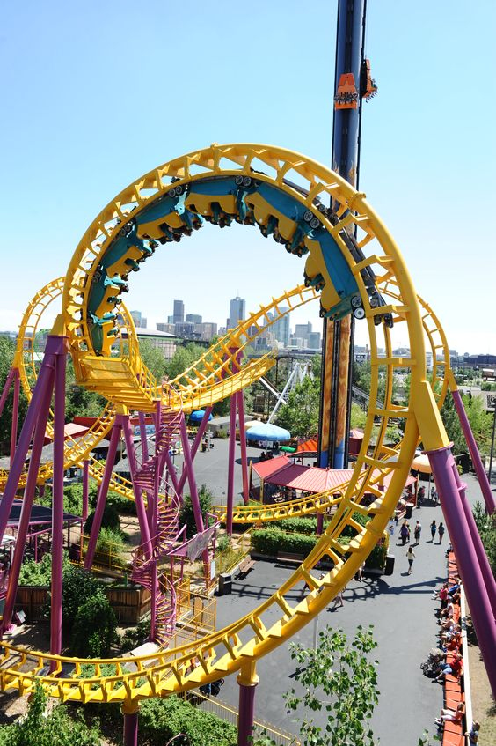
TMEHE RAKP
THEME PARK

Slide 37

IREPSNI
INSPIRE

Slide 38
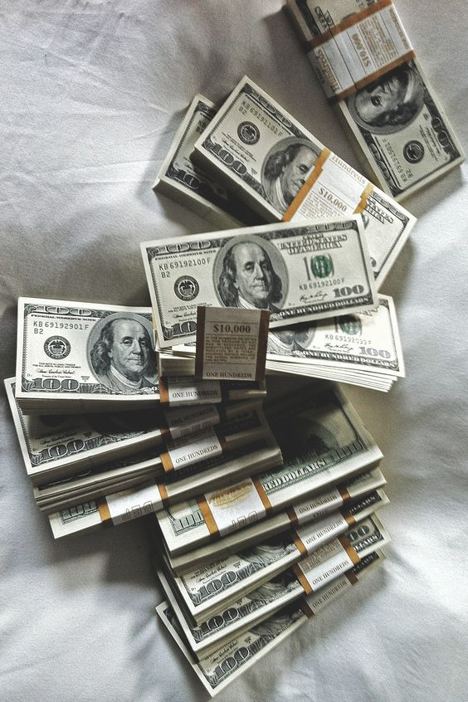
ELBAITFRPO
PROFITABLE

Slide 39
LESSON 5
LISTENING
WARM-UP
Guess the cartoon.
PRE-LISTENING
Task 1: Solve the crossword.
Vocabulary
Task 2: Listen and number.
Task 3: Choose the correct answer.
WHILE-LISTENING
POST-LISTENING
Task 4: ﻿Work in pairs and discuss.
CONSOLIDATION
Wrap-up
Homework

Slide 40

WHILE LISTENING

Slide 41
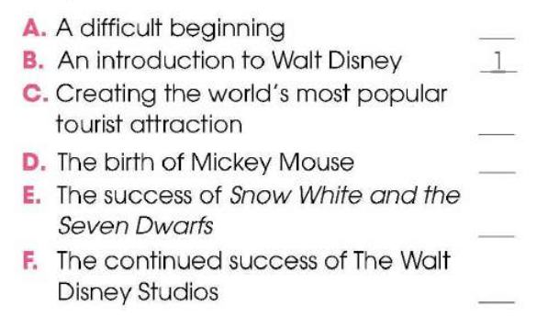
02
Listen to a talk about Walt Disney’s life. Number the events in the order they are mentioned. (P.15)

Slide 42
2
A. A difficult beginning
B. An introduction to Walt Disney
C. Creating the world’s most popular tourist attraction
D. The birth of Mickey Mouse
E. The success of Snow White and the Seven Dwarfs
F. The continued success of The Walt Disney Studios
1
5
3
4
6

Slide 43
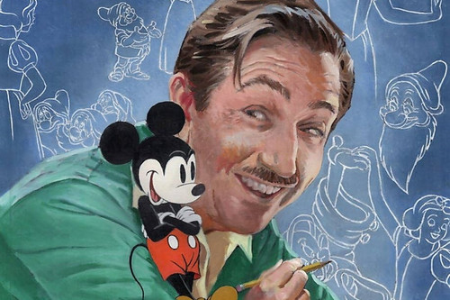
03
Listen to the talk again. Choose the correct answer A, B, or C (P.15)

Slide 44

1. Walt Disney moved to Hollywood because _______.
A. his parents moved to work there
B. he wanted to start his career again
C. his company became very successful
2. Which is true about Mickey Mouse?
A. It was based on a real pet.
B. It was first voiced by a famous actor.
C. It was not very popular.

Slide 45
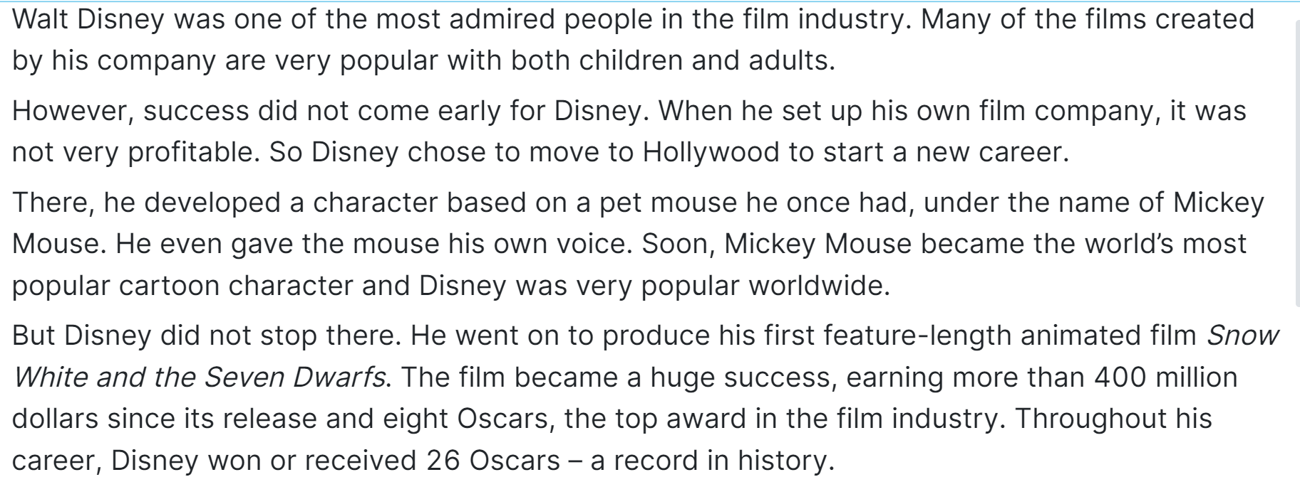
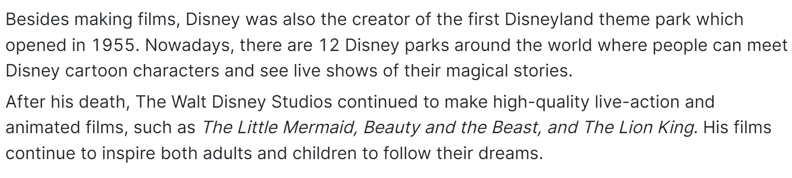
_______________________
_______________________
_______________________ 1
_______________________________________________ 2

Slide 46
3. What is NOT mentioned as an achievement of Snow White and the Seven Dwarfs?
A. It earned more than 400 million dollars.
B. It won several Oscars.
C. It was the best movie in the film industry.
4. What is true about Disney’s achievements?
A. He created the first animated cartoon.
B. He holds the record for the most Oscars in history.
C. He designed all the Disneyland theme parks.

Slide 47
__________________________________ 3
_____________________ 3
_____________________________ 4

Slide 48
5. Why did he create Disneyland theme parks?
A. So that visitors can share their magical stories with Disney characters.
B. So that fans can see Disney characters live on stage and interact with them.
C. So that visitors can learn to make animated films.

Slide 49
___________________________________
_____________________________________ 5

Slide 50
LESSON 5
LISTENING
WARM-UP
Guess the cartoon.
PRE-LISTENING
Task 1: Solve the crossword.
Vocabulary
Task 2: Listen and number.
Task 3: Choose the correct answer.
WHILE-LISTENING
POST-LISTENING
Task 4: ﻿Work in pairs and discuss.
CONSOLIDATION
Wrap-up
Homework

Slide 51

POST LISTENING

Slide 52
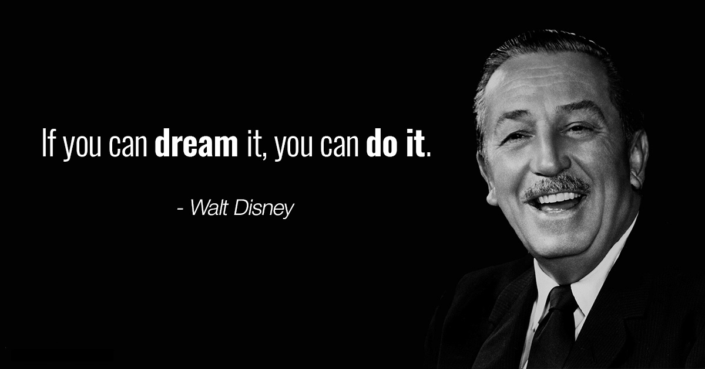
04
Work in pairs. Discuss the question. (P.15)
What do you think is most impressive about Walt Disney’s life and achievements?

Slide 53
LESSON 5
LISTENING
WARM-UP
Guess the cartoon.
PRE-LISTENING
Task 1: Solve the crossword.
Vocabulary
Task 2: Listen and number.
Task 3: Choose the correct answer.
WHILE-LISTENING
POST-LISTENING
Task 4: ﻿Work in pairs and discuss.
CONSOLIDATION
Wrap-up
Homework

Slide 54

CONSOLIDATION

Slide 55
01
Wrap up
What have you learnt today?
- An overview about Walt Disney’s life;
- Listening skills for general ideas and for specific information

Slide 56
02
Homework
Do exercises in the workbook.
Prepare for Lesson 6 - Writing.

Slide 57
Thanks!

