Slide 1

Unit 4: All things high-tech
Lesson 4a: Reading
Page 65

Slide 2
Lesson Outline
Warm-up
Vocabulary
Speaking
Writing
Consolidation
Wrap-up

Slide 3
Objectives
By the end of this lesson, students will be able to…
- develop speaking and writing skills.
- learn and use some vocabulary related to the topic.

Slide 4

WARM-UP

Slide 5

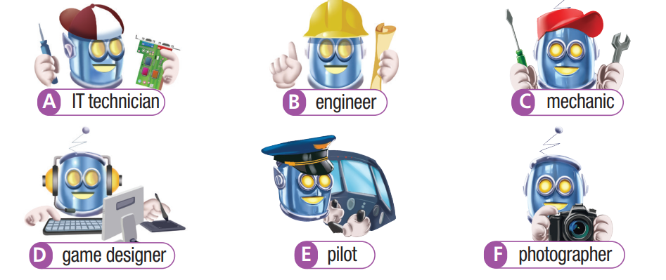
Work in pairs.
Match the words with correct pictures.
IT technician game designer photographer
engineer pilot mechanic

Slide 6
ANSWERS
IT technician
engineer
mechanic
game designer
pilot
photographer

Slide 7

It’s time to learn …

Slide 8

Vocabulary
Listen and repeat. Click each phrase to hear the sound.
IT technician /aɪtiː tekˈnɪʃən/ (n) kỹ thuật viên công nghệ thông tin
photographer /fəˈtɒɡrəfər/ (n) người chụp ảnh, nhiếp ảnh gia
engineer /ˌendʒɪˈnɪər/ (n) kỹ sư
mechanic /məˈkænɪk/ (n) thợ máy, công nhân cơ khí
game designer /ɡeɪm dɪˈzaɪnər/ (n. phr) người thiết kế trò chơi
pilot /ˈpaɪlət/ (n) phi công

Slide 9
Look at the IPA and the meaning of each word to read out the word.
/aɪtiː tekˈnɪʃən/ (n) kỹ thuật viên công nghệ thông tin
/ fəˈtɒɡrəfər/ (n) người chụp ảnh, nhiếp ảnh gia
/ˌendʒɪˈnɪər/ (n) kỹ sư
/məˈkænɪk/ (n) thợ máy, công nhân cơ khí
/ɡeɪm dɪˈzaɪnər/ (n) người thiết kế trò chơi
/ˈpaɪlət/ (n) phi công

Slide 10
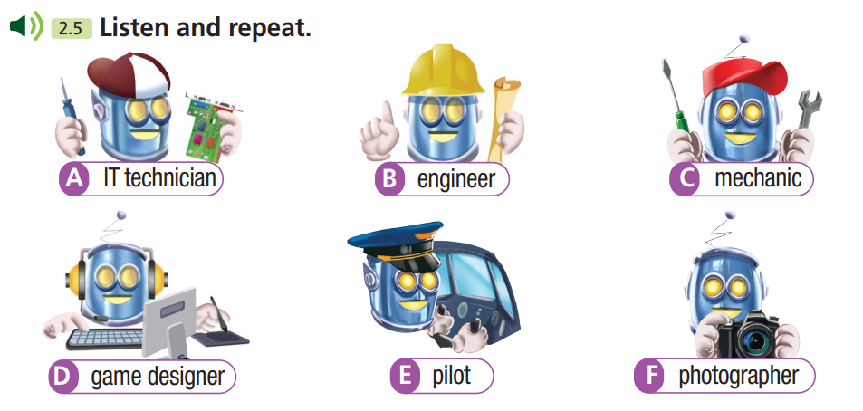

Slide 11
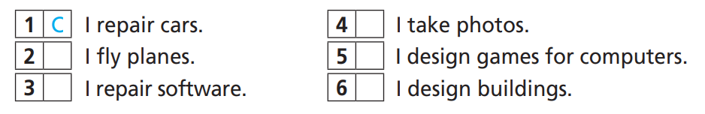
7 Match the sentences (1-6) to the jobs (A-F) in Exercise 6, then make sentences as in the example.
C
F
E
D
A
B
A mechanic repairs cars.
A pilot ﬂies planes.
An IT technician repairs software.
A photographer takes photos.
A game designer designs games for computers.
An engineer designs buildings.

Slide 12

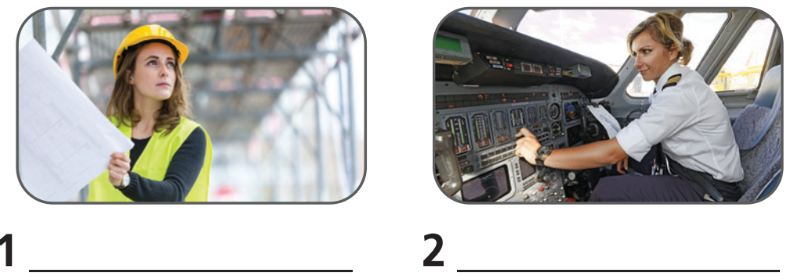
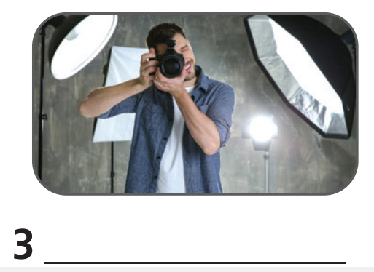
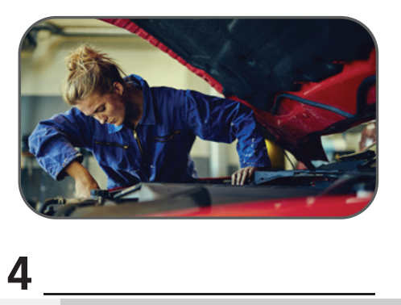
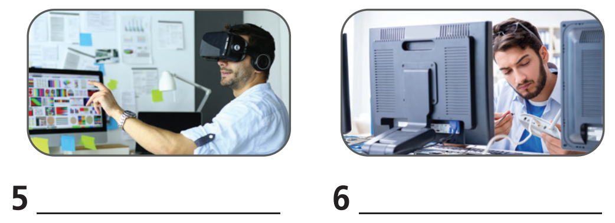
Extra Exercise
WB page 32
engineer
pilot
photographer
mechanic
game designer
IT technician

Slide 13

8 Which of the jobs in Exercise 6 will/won’t be in the
future? What jobs do you think will be the best jobs of the future? Tell the class.

Slide 14
STUDENT A
STUDENT B
Hi, B. Which of the jobs will be the best in the future?
I think IT technicians will be the best job in the future.
Why?
Because people are using more
software and applications.
Which of the jobs won’t be in the future?
I think they’re mechanics and pilots.
Why?
Because robots will do their work.

Slide 15

Speaking

Slide 16

9 Design your own droid for a science-fiction film. Decide what the droid will look like and what it can do.
Give the droid a name. Present your droid to the class.

Slide 17

Pre-Speaking
Work in groups.
Design your own droid for a science-fiction film. Decide what the
droid will look like and what it can do. Give the droid a name. Present your droid to the class.
Do you work in pairs or in groups?
→ In groups.
What are you going to do?
→ Design our own droid, name the droid and present.

Slide 18
While-Speaking
Suggested Answer Key
Our droid is called Ultra. It looks like a human. It has two arms and two legs, so it can walk and hold things – but it’s got a square head and square eyes. Ultra can repair spaceships and speak many alien languages.

Slide 19
Post - Speaking
10 Find another film with a robot/robots. Write a paragraph
about it (about 60-80 words). Include the name of the film, the name(s) of the robot(s) and what it/they can do.
Suggested Answer Key
WALL-E
WALL-E is a robot in the film WALL-E in 2008. It is cute, but it is not very high-tech. Its main job is to clean up rubbish. It can collect rubbish and make square blocks of rubbish. In the film, WALL-E goes on an adventure in space with another robot. He ends up saving the human race!

Slide 20

CONSOLIDATION

Slide 21
Work in pairs.
In pairs, ask and answer about your favourite film with
a robot.

Slide 22
STUDENT A
STUDENT B
Hi, B. What is your favourite film with a robot?
I like A Space Odyssey.
In 2001.
When was it produced?
They are brilliant and wonderful human in their actions.
What can robots do?
What do you think about the film?
It’s great.

Slide 23

WRAP-UP

Slide 24
Today’s lesson
Vocabularies
IT technician
photographer
engineer
mechanic
game designer
pilot
Speaking: develop creativity.
Writing: develop observation and collection skills.

Slide 25
Homework
Practise the vocabularies and make sentences using them.
Do the exercises in TA 7 Right on WB (page 32).
Prepare the next lesson (page 66 SB).
Do the exercise in TA 7 Right on Notebook (Page 28)

Slide 26

Enjoy your day!

