Slide 2
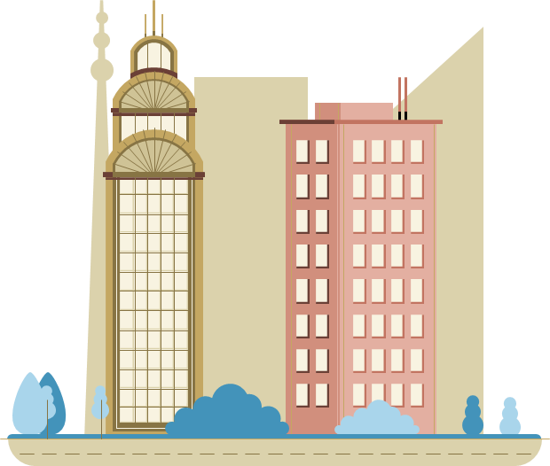
Unit 4
urbanization
LANGUAGE
Urban Development

Slide 3
LESSON 2
LANGUAGE
WARM-UP
Game: Matching game
PRONUNCIATION
Task 1: Listen and repeat.
Task 2: Listen and repeat.
Task 1: Match the words and phrases with their meanings.
Task 2: Complete the sentences.
VOCABULARY
Task 1: Find the mistake and correct it.
Task 2: Choose the best option.
Task 3: Work in pairs. Make true sentences
GRAMMAR
CONSOLIDATION
Wrap-up
Homework

Slide 4
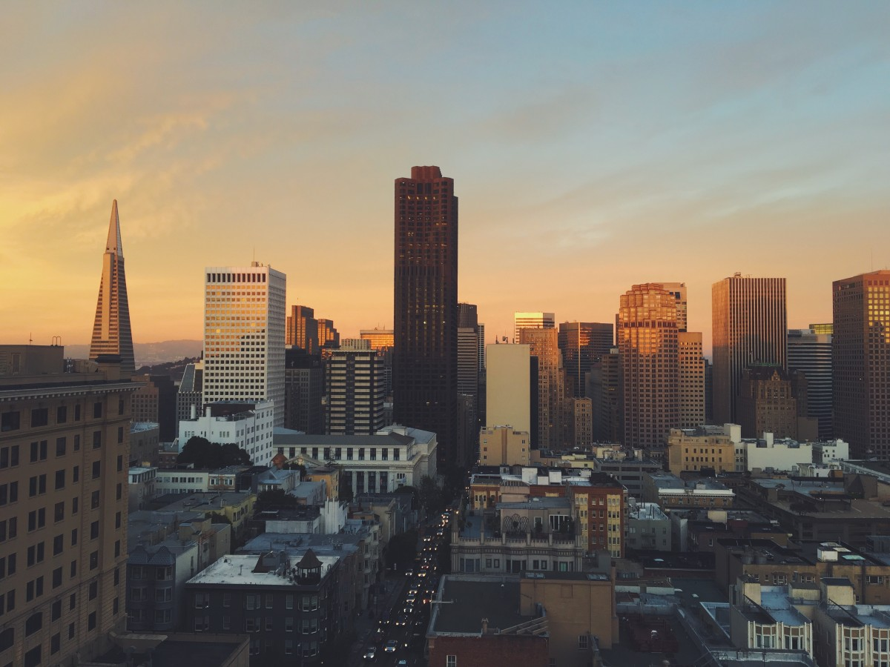
WARM-UP
WARM-UP
MATCHING
Work in 4 groups.
Match the diphthongs to the right word.

Slide 5
WARM-UP
MATCHING
/ɪə/
/ʊə/
/eə/
poor
air conditioners
idea
Ecotourism
volunteers
awareness

Slide 6

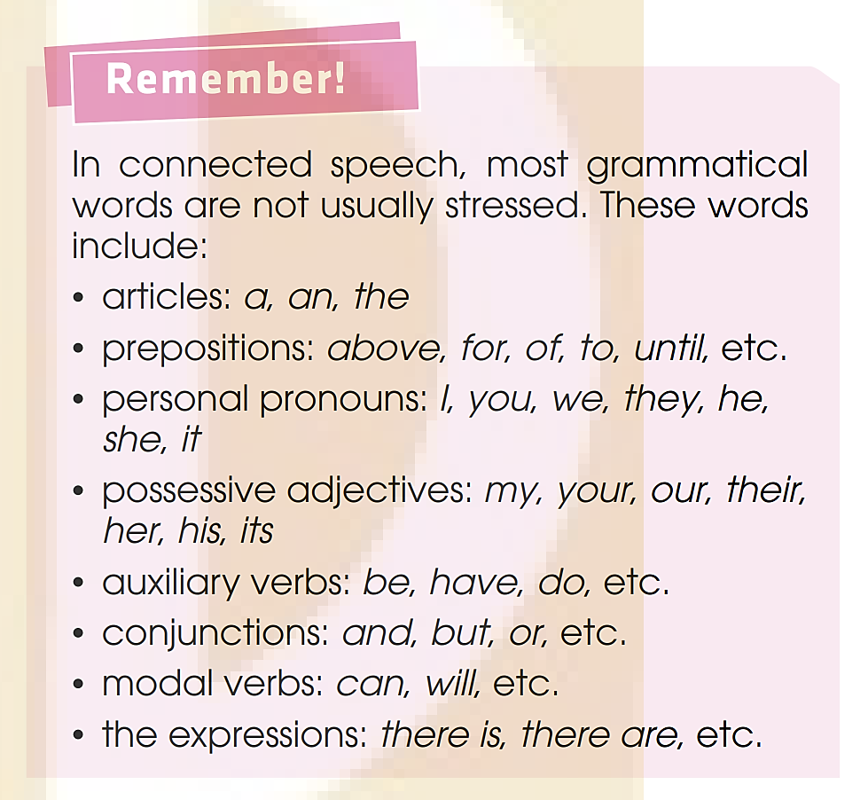
PRONUNCIATION
1
Listen and repeat. Pay attention to the pronunciation of the unstressed words.
1. It’s been three years since your last visit.
2. Fresh air and a walk sound nice.
3. It’s the first time I’ve been on an electric bus.
4. I guess urbanisation can also cause problems.

Slide 7

PRONUNCIATION
2
Listen and identify the unstressed words in the following sentences. Then practice saying the sentences in pairs.
1. A new convenience store has been opened near my house.
2. There are still a lot of problems in our cities
today.
3. It is much more expensive to buy a house
in a big city.
4. My father was offered a new job and his
office will be in a high-rise building.

Slide 8
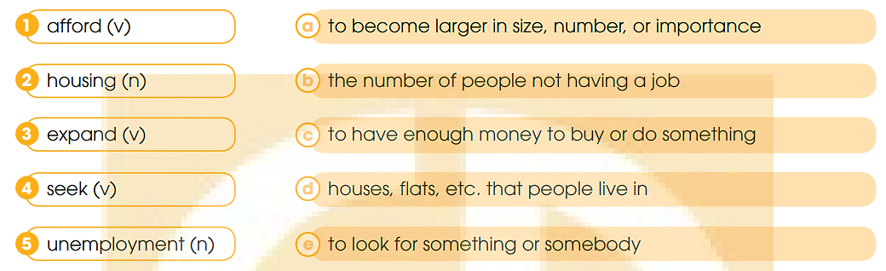
VOCABULARY
1
Match the word and phrases with their meanings.

Slide 9
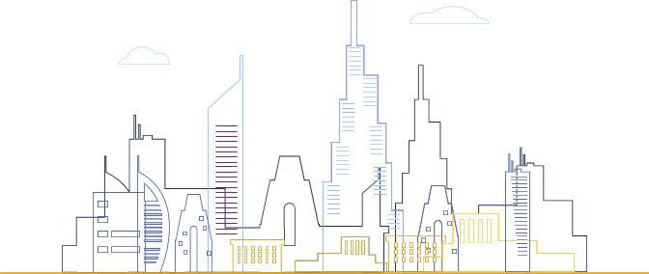
VOCABULARY
2
Complete the sentences using the word and phrases in Task 1.
1. Higher _____________ can result in increasing crime rates in big cities.
2. Not many young couples can _____ to buy their own house in big cities.
3. There is a shortage of affordable _______ in big cities.
unemployment
afford
housing

Slide 10
VOCABULARY
2
Complete the sentences using the word and phrases in Task 1.
4. Since they started using farmland for building houses, many towns have _________ into cities.
5. Not many young couples can ____ to buy their own house in big cities.
expanded
seek

Slide 11
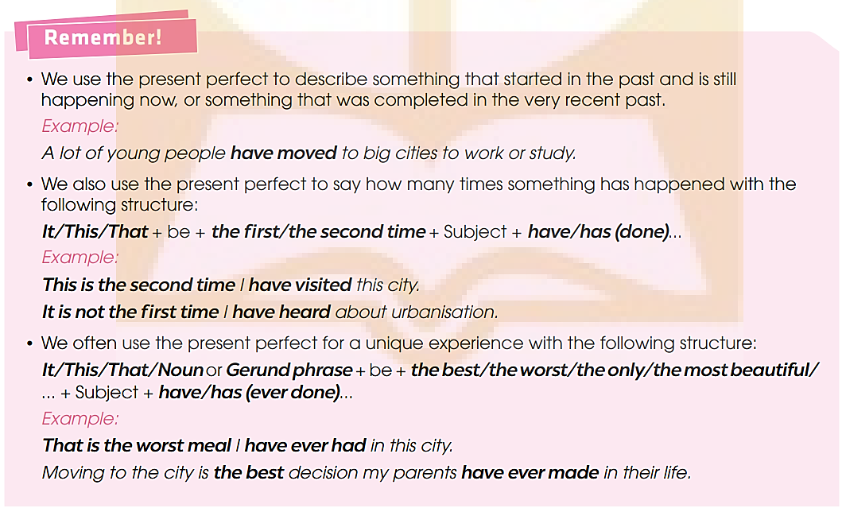
GRAMMAR

Slide 12
GRAMMAR
1
Circle the underlined part that is incorrect in each of the following sentences. Then correct it.
This is the first time I saw such a tall building in
A B C D
my life.
2. Mount Fuji in Japan is the most beautiful place we
A B
had ever visited.
C D
1. saw -> have seen
2. had -> have

Slide 13
GRAMMAR
1
Circle the underlined part that is incorrect in each of the following sentences. Then correct it.
3. This has been the second time my mother has
warned me not to spend all my money on clothes.
3. has been -> is

Slide 14
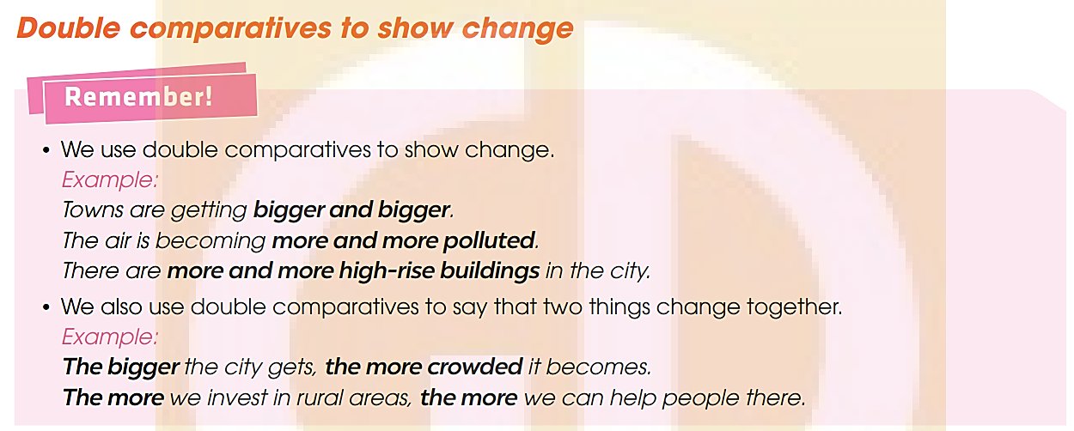
GRAMMAR

Slide 15
GRAMMAR
2
Choose the best option to indicate the sentence that is closest in meaning to the sentence given.
1. Housing is getting more and more expensive in big cities, so many local residents can’t afford to buy their own place.
  A. Many local residents in big cities can’t buy their own place because housing is becoming more expensive every day.
  B. More and more local residents can’t afford their own place in big cities because housing is too expensive.
  C. Housing is getting affordable enough for many local people to buy their own place.
  D. Housing in big cities has become the most expensive these days, so many local residents can’t afford their own place.

Slide 16
GRAMMAR
2
Choose the best option to indicate the sentence that is closest in meaning to the sentence given.
2. The more people move into big cities, the higher the unemployment is.
  A. The higher the unemployment is, the more people move into big cities.
  B. More people moving into big cities causes higher unemployment.
  C. More people move into big cities despite the high rate of unemployment.
  D. More people move into big cities because there are more employment opportunities there.

Slide 17
GRAMMAR
2
Choose the best option to indicate the sentence that is closest in meaning to the sentence given.
3. The more houses are built, the less space we have for plants and trees.
  A. Although more houses are built, we still have some space for plants and trees.
  B. The fewer houses we build, the less space we have for plants and trees.
  C. We have less space for plants and trees because more houses are built.
  D. Plants and trees are the reasons why more houses can’t be built.

Slide 18
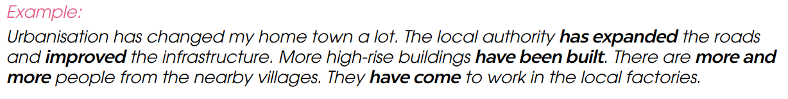
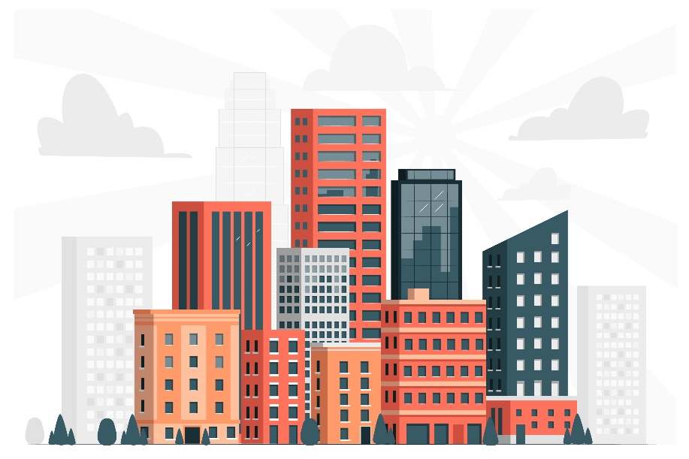

GRAMMAR
3
Work in pairs. Make true sentences about urbanisation in an area that you know, using double comparatives and the present perfect.

Slide 19

GRAMMAR
3
Work in pairs. Make true sentences about urbanisation in an area that you know, using double comparatives and the present perfect.
My hometown has changed a lot over the past ten years. The urban area has been expanded, and there is less and less land for agriculture. More and more people have moved in. More new houses have been built. The life is getting more and more modern.

Slide 20

CONSOLIDATION
1
Wrap-up
What have you learnt today?
Identify and pronounce words with unstressed words in sentences.
Understand and use perfect tense.
Use double comparatives to show change.

Slide 21

CONSOLIDATION
2
Homework
Do exercises in the workbook.
Prepare for Lesson 3 - Unit 4.

Slide 22
Website: hoclieu.vn
Fanpage: facebook.com/www.tienganhglobalsuccess.vn

