Slide 1


Slide 2


Unit
12
CAREER CHOICES
LESSON 6: SKILLS 2

Slide 3

OBJECTIVES
By the end of the lesson, students will be able to:
Listen for specific information in two talks about career paths.
Write an email about their favourite future job.

Slide 4
LESSON 6: SKILLS 2
LESSON 1: GETTING STARTED
WARM-UP
Miming
Task 1: Work in pairs. Which of the reasons below is the most important to you when choosing a job?
- Task 2: Listen to two people talking about their career paths and tick (√) T (True) or F (False).
- Task 3: Listen again and choose the correct answers.
LISTENING
Task 4: Work in pairs. Ask and answer the following questions.
Task 5: Write an email (100 - 120 words) to your friend telling him/her about your future favorite job. You can use the ideas from 4.
WRITING
CONSOLIDATION
Wrap-up
Homework

Slide 5
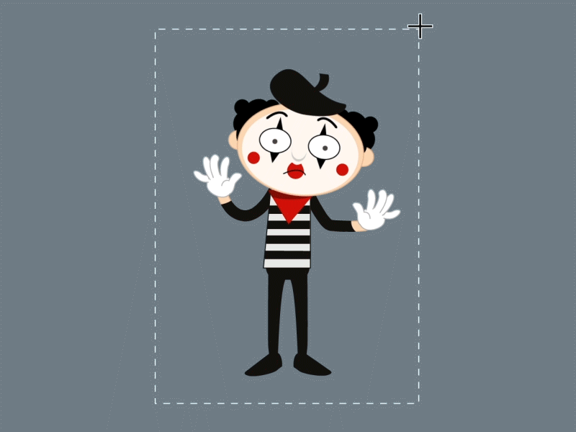
WARM-UP
OPTION 1
MIMING

Slide 6
WARM-UP
OPTION 1
- Go to the board. Mime some jobs. Other Ss to guess the jobs.
MIMING

Slide 7
LISTENING
1
Work in pairs. Which of the reasons below is the most important to you when choosing a job?
- Work in pairs.
- Look at the list of reasons and choose the one most important to them when choosing a job.
- Explain why you choose that reason.
1. passion 2. family tradition 3. ability
4. salary 5. opportunity to travel

Slide 8
LISTENING
- The reasons:
1. passion 2. family tradition 3. ability
4. salary 5. opportunity to travel
Example:
Picking a job might feel like choosing a superpower, but you need to focus on your ability (what you good at, what makes you tick, what challenges you to tackle). That’s your secret weapon. When you pick a job that lets you use those powers, you’ll feel awesome at work, learn faster, work better. Remember, future you will thank you for choosing a job that fits your abilities like a perfectly-suited costume.

Slide 9

LISTENING
2
Listen to two people talking about their career paths and tick (√) T (True) or F (False).
 | T | F
1. Minh’s parents were farmers.
2. Minh is now working for an agricultural company.
3. Ann first learnt cooking from a family member.
4. Ann is now a chef in a famous restaurant.
√
√
√
√

Slide 10
LISTENING
3
Listen again and choose the correct answers.
1. Why did Minh decide to learn agriculture engineering?
A. Because he wanted to help the farmers.
B. Because he could get a well-paid job.
C. Because he had no other choice for university.
2. What does Minh’s job involve?
A. Using technology in farming.
B. Solving problems among farmers.
C. Creating new kinds of plants.

Slide 11
LISTENING
3
Listen again and choose the correct answers.
3. How did Ann earn her cooking certificate?
A. By taking a short course in cooking.
B. By attending a vocational college.
C. By enrolling in an online course.
4. In the future, Ann wants to ______.
A. work in a hotel restaurant
B. get another cooking certificate
C. open her own restaurant

Slide 12
Transition from Listening to Writing
- Answer the questions below with information of Minh and Ann that you can remember from the listening
+ What is his/her job?
+ What training did they have?
+ What does his/her job involve?
+ What skills does the job need?
+ How is the job?
 | Minh | An
+ What is his/her job? + What training did they have? + What does his/her job involve? + What skills does the job need? + How is the job?

Slide 13
Transition from Listening to Writing
 | Minh | An
+ What is his/her job? + What training did they have? + What does his/her job involve? + What skills does the job need? + How is the job?
Agricultural engineer
Chef
University
Vocational training
help farmers grow better crops by using farming technology
make tasty and healthy food
farming technology; persuading skill
cooking skills
demanding
well-paid

Slide 14
LESSON 6: SKILLS 2
LESSON 1: GETTING STARTED
WARM-UP
Miming
Task 1: Work in pairs. Which of the reasons below is the most important to you when choosing a job?
- Task 2: Listen to two people talking about their career paths and tick (√) T (True) or F (False).
- Task 3: Listen again and choose the correct answers.
LISTENING
Task 4: Work in pairs. Ask and answer the following questions.
Task 5: Write an email (100 - 120 words) to your friend telling him/her about your future favorite job. You can use the ideas from 4.
WRITING

Slide 15
WRITING
4
Work in pairs. Ask and answer the following questions.
- Work in pairs to ask and answer the given questions.
- You can refer to the reading text in Communication lesson, and/or the listening passage for ideas.
1. What is your favourite job?
2. What does this job involve?
3. What skills does this job need?
4. What personal qualities do you need to have for this job?
- Present your outlines.

Slide 16
WRITING
5
Write an email (100 - 120 words) to your friend telling him/her about your future favorite job. You can use the ideas from 4.
- Use the ideas in Activity 4 for your writing.
Dear ______,
It’s nice to hear from you again.
Let me tell you about _____________________________________
____________________________________________________________________________________________________________________________________________________________________
Write to me soon.
Cheers
Dear Tom,
It’s nice to hear from you again. Let me tell you about the job I want to do in the future.
When I was a child, I decided that I would be a teacher like my mother. Now I’m sure that teaching English is my favourite future job. As a teacher, I will prepare interesting lessons, explain difficult concepts to my students, mark their exams and help them to make progress in English. I will need excellent knowledge of English and good skills of reading, listening, speaking and writing in English. I also need teaching skills and time management skills. I think this is the job for me because I’m confident, creative and persuasive.
How about your future job?
Write to me soon.
Cheers,

Slide 17
WRITING
Example:
Dear Tom,
It’s nice to hear from you again. Let me tell you about the job I want to do in the future.
When I was a child, I decided that I would be a teacher like my mother. Now I’m sure that teaching English is my favourite future job. As a teacher, I will prepare interesting lessons, explain difficult concepts to my students, mark their exams and help them to make progress in English. I will need excellent knowledge of English and good skills of reading, listening, speaking and writing in English. I also need teaching skills and time management skills. I think this is the job for me because I’m confident, creative and persuasive.
How about your future job?
Write to me soon.
Cheers,

Slide 18
LESSON 6: SKILLS 2
LESSON 1: GETTING STARTED
WARM-UP
Miming
Task 1: Work in pairs. Which of the reasons below is the most important to you when choosing a job?
- Task 2: Listen to two people talking about their career paths and tick (√) T (True) or F (False).
- Task 3: Listen again and choose the correct answers.
LISTENING
Task 4: Work in pairs. Ask and answer the following questions.
Task 5: Write an email (100 - 120 words) to your friend telling him/her about your future favorite job. You can use the ideas from 4.
WRITING
CONSOLIDATION
Wrap-up
Homework

Slide 19

CONSOLIDATION
1
Wrap-up
What have we learnt in this lesson?
Listen for specific information in two talks about career paths.
Write an email about their favourite future job.

Slide 20

CONSOLIDATION
2
Homework
- Rewrite the paragraph in the notebooks.
- Do exercises in the workbook.

Slide 21
Website: hoclieu.vn
Fanpage: facebook.com/www.tienganhglobalsuccess.vn/

