Slide 1

Unit 1: Free Time
Lesson 2.2: Grammar
Page 8

Slide 2


LESSON OUTLINE
Consolidation

Slide 3
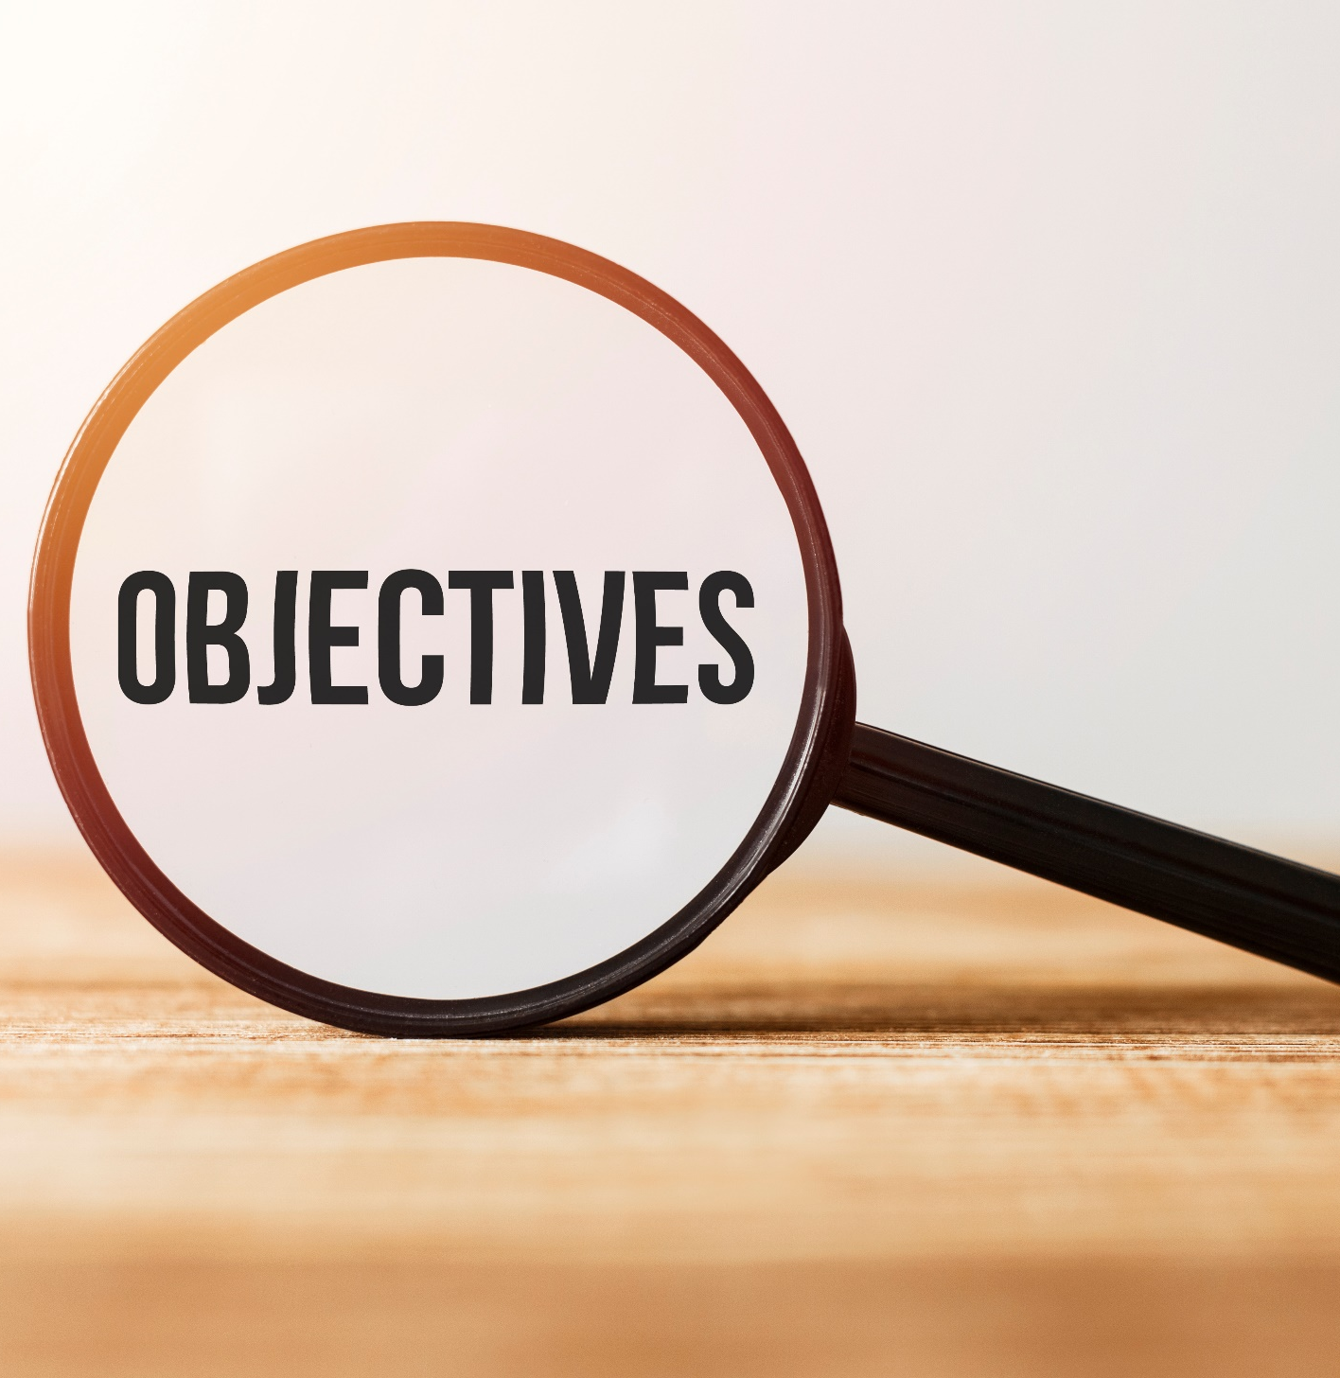
By the end of this lesson, students will be able to…
- talk about future plans.
- use the Present Continuous tense and prepositions of place correctly.
- write and answer questions about next week’s plan.

Slide 4
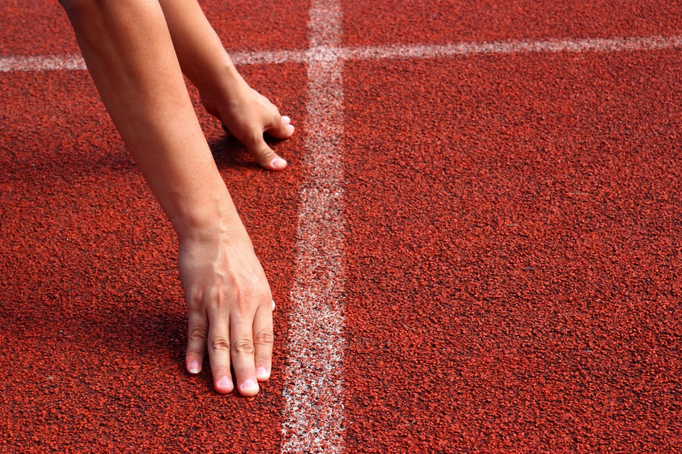
WARM-UP

Slide 5
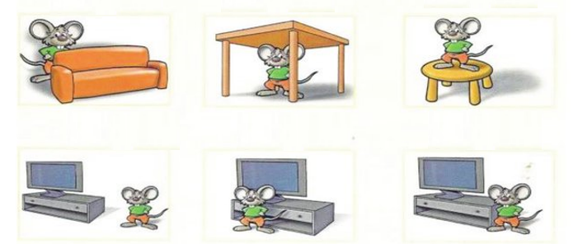
Review: Prepositions of place
1. behind 2. under 3. on
4. near 5. in front of 6. next to

Slide 6



Slide 7
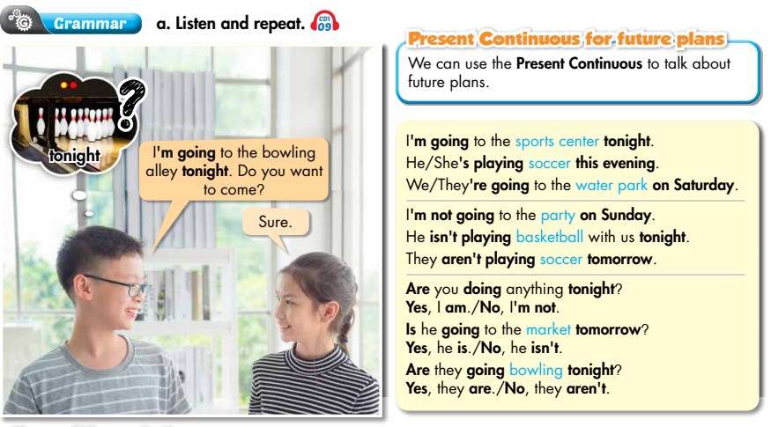


Slide 8
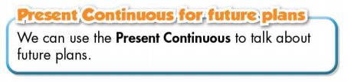
Form:
(+) S + am / is / are + V-ing …
(-) S + am / is / are + not + …
(?) Am / Is / Are + S + V-ing …
Usage: to talk about future plans.

Slide 9
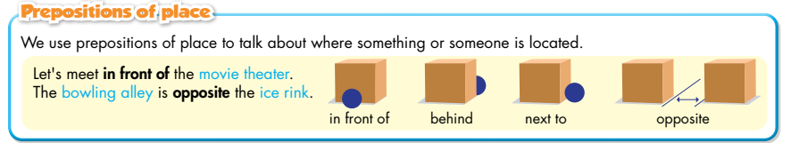

Slide 10
b. Circle the correct words.
1. I'm watch/I'm watching a movie tonight.
2. She is going/going bowling on Sunday night.
3. Let's meet in/on front of the theater.

Slide 11
b. Circle the correct words.
4. I'm meet/meeting Sam at the water park tomorrow.
5. Is/Are you going shopping this evening?
6. We're meeting at the theater next/opposite the restaurant on Wednesday at 6 p.m.

Slide 12
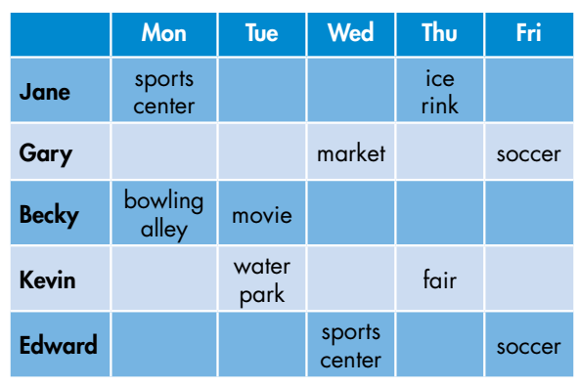
c. Write, then answer the questions.
1. When/Jane/go/ice rink/?
2. What/Becky/do/Tuesday/?
3. When/Gary and Edward/play/soccer/?
4. When/Kevin/go/fair/?
5. What/Gary/do/Wednesday/?
How many questions are there?
There are 5.
What are you going to do?
Write and answer the questions.

Slide 13
c. Write, then answer the questions.
1. When/Jane/go/ice rink/?
2. What/Becky/do/Tuesday/?
3. When/Gary and Edward/play/soccer/?
When is Jane going to the ice rink?
She is going to the ice rink on Thursday.
What is Becky doing on Tuesday?
She is watching a movie.
When are Gary and Edward playing soccer?
They are playing soccer on Friday.

Slide 14
4. When/Kevin/go/fair/?
5. What/Gary/do/Wednesday/?
c. Write, then answer the questions.
When is Kevin going to the fair?
He is going to the fair on Thursday.
What is Gary doing on Wednesday?
He is going to the market.

Slide 15
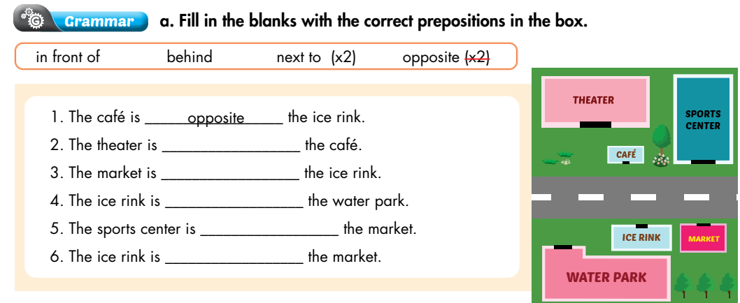
Extra Practice
WB, page 5
1. The café is ________ the ice rink.
2. The theater is ________ the café.
3. The market is ________ the ice rink.
4. The ice rink is _________ the water park.
5. The sports center is ________ the market.
6. The ice rink is ________ the market.
opposite
behind
next to
in front of
opposite
next to

Slide 16
Write sentences using Present Continuous and the
prompts.
Extra Practice
WB, page 5
1. My brother/play/soccer/next Saturday.
2. She/have/party/the weekend.
3. We/going/swimming/Sunday?
4. I/go shopping/friends/shopping mall/tonight.
My brother is playing soccer next Saturday.
She is having a party at the weekend.
Are we going swimming on Sunday?
I am going shopping with my friends at the shopping mall tonight.

Slide 17
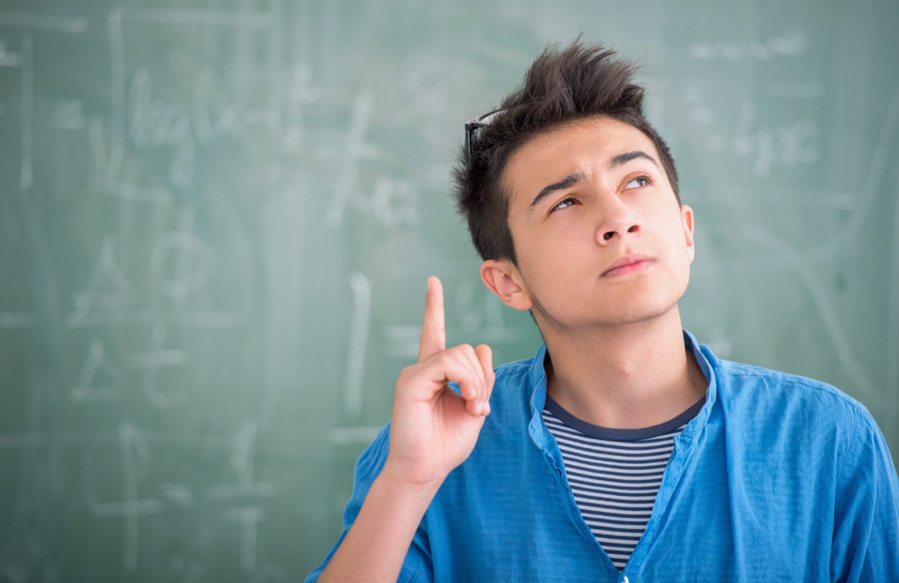
PRODUCTION

Slide 18


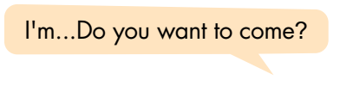
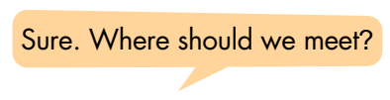

d. In pairs: Make a plan to go out with your friend.

Slide 19

CONSOLIDATION

Slide 20
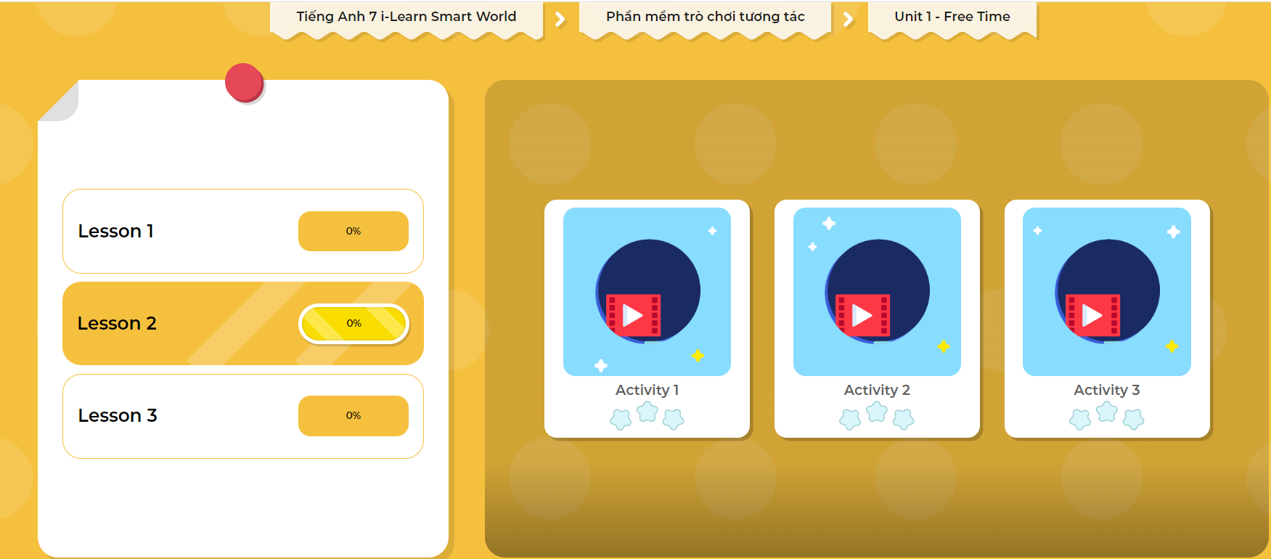
Extra Practice
DHA App
Let’s play!
Click here to play the game

Slide 21

What do you like doing in your free time?
Why do you like doing it?
Write 60 to 80 words.

Slide 22

WRAP-UP

Slide 23
Today’s lesson
Grammar:
Use the Present Continuous tense to talk about future plans.
Prepositions of place: in front of, behind, next to, opposite, on, under, …
Speaking & Writing:
Talk and write about what you like doing in your free time
and why you like doing it.

Slide 24
Homework
Make 2 sentences, using the Present Continuous tense to talk about your future plans.
Make 2 sentences, using prepositions of place.
Complete the grammar notes in Tiếng Anh 7 i-Learn Smart World Notebook (page 7).
Prepare: Lesson 2 – Pronunciation and Speaking (page 9 – SB).
Play the consolidation games in Tiếng Anh 7 i-Learn Smart World DHA App on www.eduhome.com.vn

Slide 25

Lesson 3
Stay positive and have a nice day!

