Slide 1


Slide 2

Unit
10
1
Unit
FAMILY LIFE
ECOTOURISM
LESSON 6
WRITING
Writing a website advertisement for an ecotour

Slide 3

Unit
1
1
FAMILY LIFE
Family Life
Unit
OBJECTIVES
Use the lexical items related to the topic “Ecotourism”
Write a website advertisement for an ecotour

Slide 4
LESSON 6
WRITING
WARM-UP
Video watching
PRE-WRITING
Task 1: Look at the photos and complete the notes.
Task 2: Rewrite the sentences.
WHILE-WRITING
Task 3: Write a website advertisement for an ecotour to Hoi An villages.
POST-WRITING
Peer check
CONSOLIDATION
Wrap-up
Homework

Slide 5
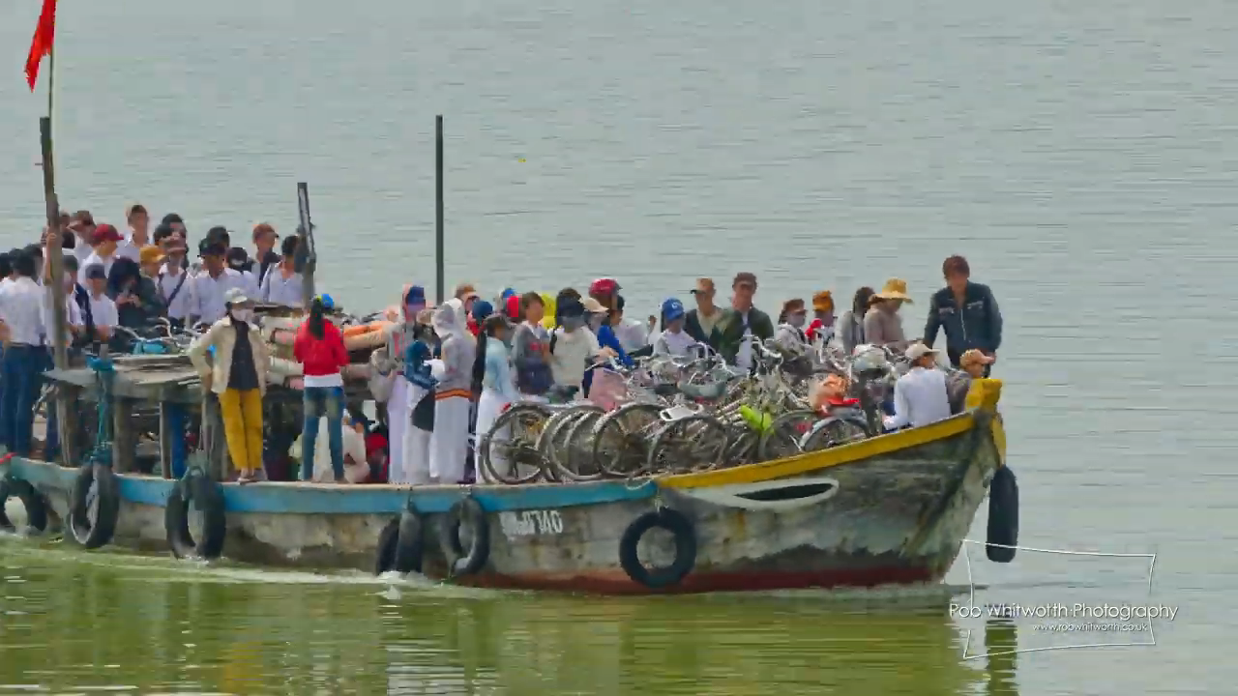
VIDEO WATCHING
GUESS THE PLACE!
Notes:
https://www.youtube.com/watch?v=ZSyoQflfkyU

Slide 6
LESSON 6
WRITING
WARM-UP
Video watching
PRE-WRITING
Task 1: Look at the photos and complete the notes.
Task 2: Rewrite the sentences.

Slide 7
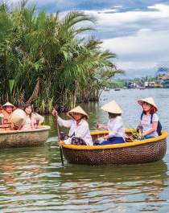
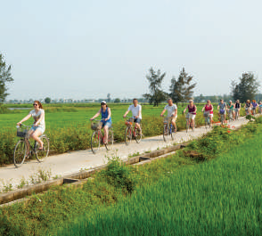
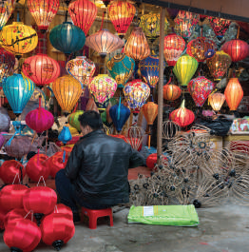
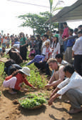
PRE-WRITING
1
Look at the photos of an ecotour to Hoi an villages (Da Nang, Viet Nam), and complete the notes below. Then discuss your ideas in pairs.

Slide 8
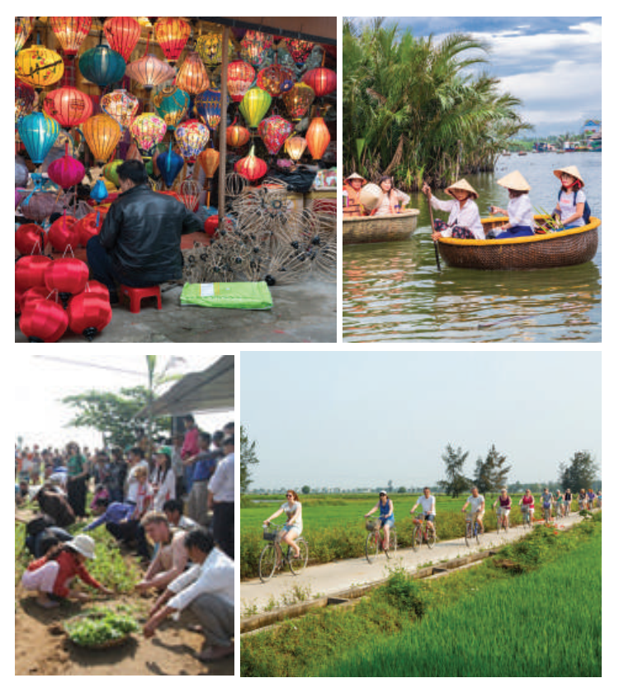
PRE-WRITING
1
Look at the photos of an ecotour to Hoi an villages (Da Nang, Viet Nam), and complete the notes below. Then discuss your ideas in pairs.
What do you think is special about
Hoi An villages?
beautiful vegetable and herb garden
coconut palms near Thu Bon River
traditional crafts such as colourful paper lanterns

Slide 9
PRE-WRITING
1
Look at the photos of an ecotour to Hoi An villages (Da Nang, Viet Nam), and complete the notes below. Then discuss your ideas in pairs.
What do you think tourists can do there?
work on a local farm
do the gardening at a local farm
ride bicycles through the villages
travel on basket boats
visit craft villages

Slide 10
PRE-WRITING
1
Look at the photos of an ecotour to Hoi An villages (Da Nang, Viet Nam), and complete the notes below. Then discuss your ideas in pairs.
What can tourists do to make their trip more eco-friendly?
buy handmade products to help local businesses
use eco-friendly transport such as bicycles
buy traditional crafts to help local people

Slide 11
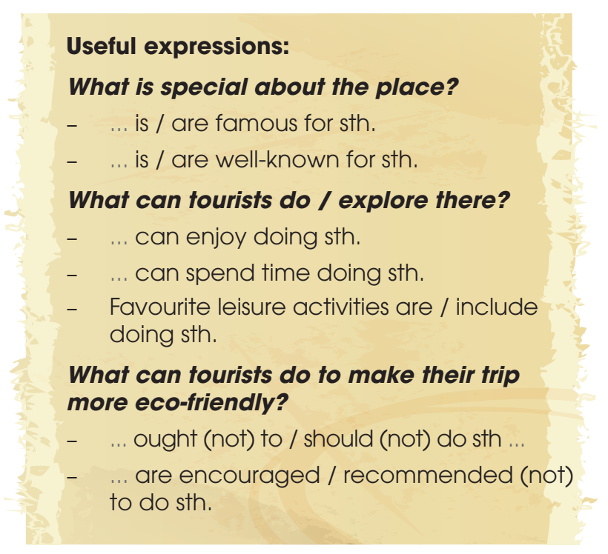
PRE-WRITING
2
Rewrite these sentences about Hoi An villages. Use the expressions below to help you.
1. Hoi An villages are famous for their beautiful vegetable and herb gardens.
→ _________ well-known ___________________.
2. Tourists can work on a local farm in the morning.
→ _________ spend _______________________.
3. Tourists should buy handmade products to help local businesses.
→ _________ recommended ______________.

Slide 12
PRE-WRITING
2
Rewrite these sentences about Hoi an villages. use the expressions below to help you.
1. Hoi An villages are famous for their beautiful vegetable and herb gardens.
→ ___________________ well-known _________________________________________.
Hoi An villages are
for their beautiful vegetable and herb gardens

Slide 13
PRE-WRITING
2
Rewrite these sentences about Hoi an villages. use the expressions below to help you.
2. Tourists can work on a local farm in the morning.
→ _______________________ spend ________________________________________.
Tourists can
the morning working on a local farm

Slide 14
PRE-WRITING
2
Rewrite these sentences about Hoi an villages. use the expressions below to help you.
3. Tourists should buy handmade products to help local businesses.
→ ______________ recommended ___________________________________________.
Tourists are
to buy handmade products to help local businesses

Slide 15
LESSON 6
WRITING
WARM-UP
Video watching
PRE-WRITING
Task 1: Look at the photos and complete the notes.
Task 2: Rewrite the sentences.
WHILE-WRITING
Task 3: Write a website advertisement for an ecotour to Hoi An villages.

Slide 16
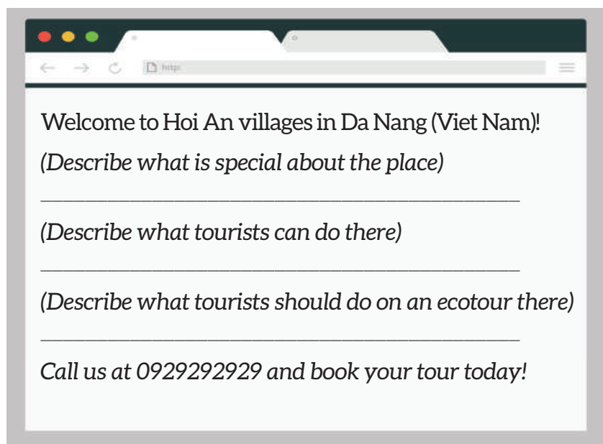
WHILE-WRITING
Write a website advertisement (120 – 150 words) for an ecotour to Hoi An villages. Use what you have learnt in Task 1 and Task 2 and the suggested outline below to help you.
3

Slide 17
LESSON 6
WRITING
WARM-UP
Video watching
PRE-WRITING
Task 1: Look at the photos and complete the notes.
Task 2: Rewrite the sentences.
WHILE-WRITING
Task 3: Write a website advertisement for an ecotour to Hoi An villages.
POST-WRITING
Peer check

Slide 18

POST-WRITING
Peer check

Slide 19
POST-WRITING
Sample answer:
Welcome to Hoi An villages in Da Nang, Viet Nam!
Hoi An villages are famous for their beautiful vegetable and herb gardens. They are also well-known for the coconut palms near the Thu Bon River and traditional crafts such as colourful paper lanterns.
Here in Hoi An villages, you can spend the morning gardening on the local farms. Other leisure activities include riding bicycles through the villages, travelling on basket boats and visiting craft villages.
We offer an ecotour to Hoi An villages, and tourists are encouraged to use eco-friendly transport such as bicycles to avoid polluting the environment. You can also buy local products and beautiful crafts to help local businesses!
Call us at 0929292929 and book your tour today!

Slide 20
LESSON 6
WRITING
WARM-UP
Video watching
PRE-WRITING
Task 1: Look at the photos and complete the notes.
Task 2: Rewrite the sentences.
WHILE-WRITING
Task 3: Write a website advertisement for an ecotour to Hoi An villages.
POST-WRITING
Peer check
CONSOLIDATION
Wrap-up
Homework

Slide 21
CONSOLIDATION
1
Wrap-up
Use the lexical items related to the topic “Ecotourism”
Write a website advertisement for an ecotour

Slide 22
CONSOLIDATION
2
Homework
Prepare for the next lesson: Unit 10 – Communication and Culture/ CLIL
2. Do exercises in the workbook
3. Rewrite the website advertisement in the notebooks.

Slide 23

Website: hoclieu.vn
Fanpage: facebook.com/tienganhglobalsuccess.vn/

