Slide 1

Unit 3: Music and Arts
Review
Pages 88 & 89

Slide 2
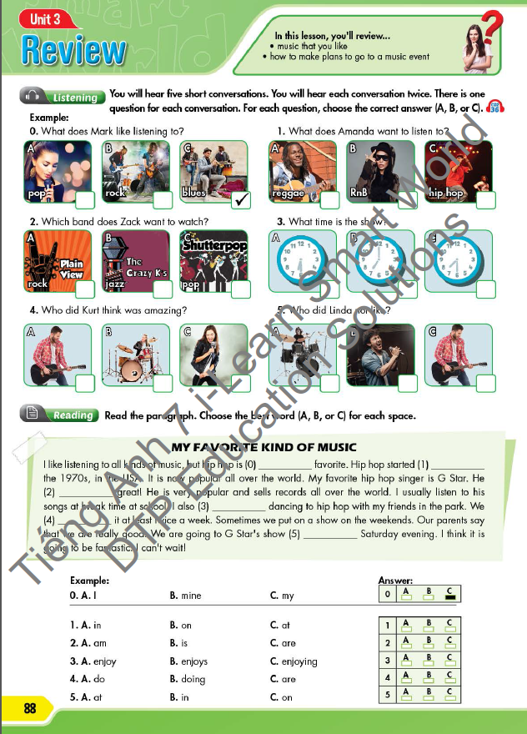
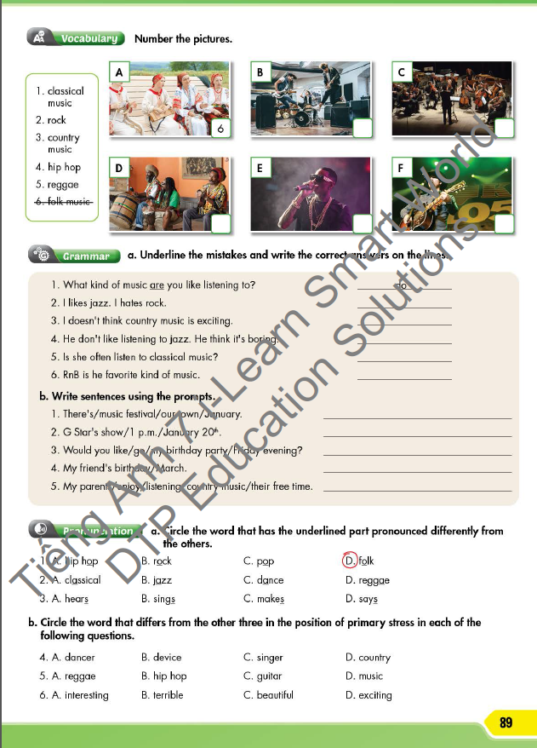






LESSON OUTLINE
Consolidation

Slide 3

By the end of this lesson, students will be able to…
- review vocabulary and grammar points.
- talk about music that you like.
- practice listening, reading and speaking.

Slide 4

WARM-UP

Slide 5




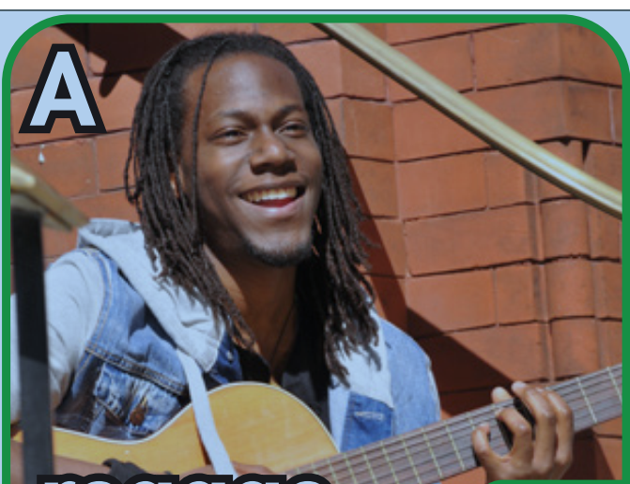
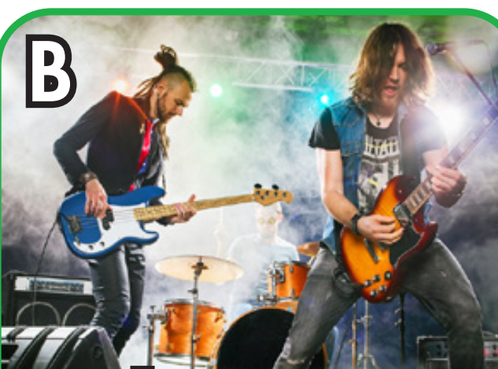
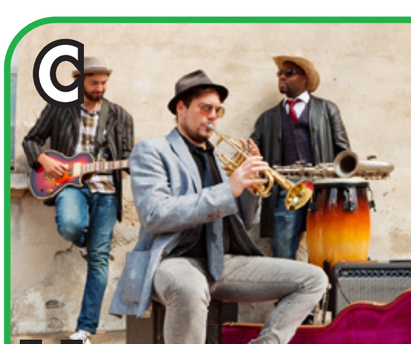
Work in pairs
Name the type of music for each picture.
pop
RnB
hip hop
reggae
rock
blues

Slide 6
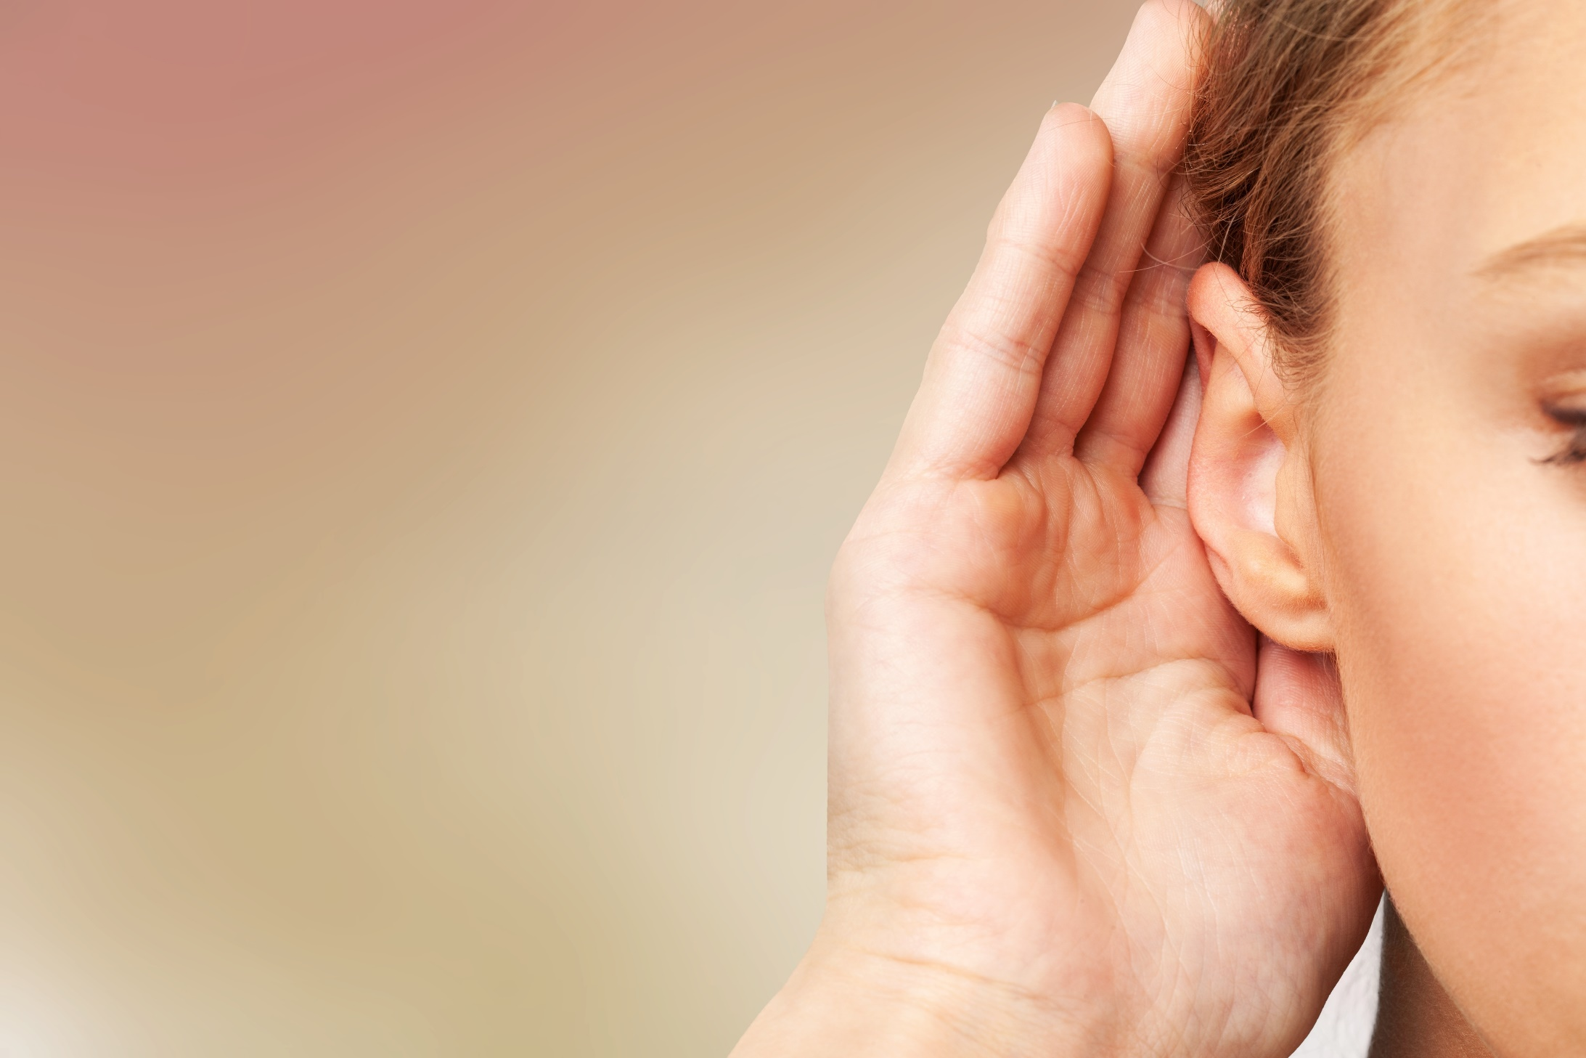

It’s listening time….

Slide 7
Pre - listening
Read the instruction quickly. What are we going to do?
Listen and choose the correct answers

Slide 8
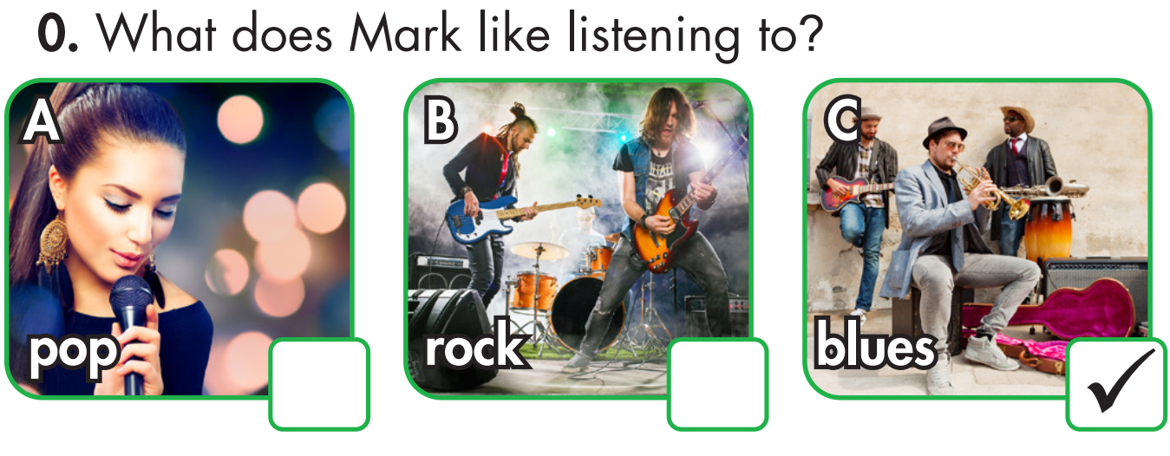
Pre - listening
Underline the key words in the questions.

Slide 9
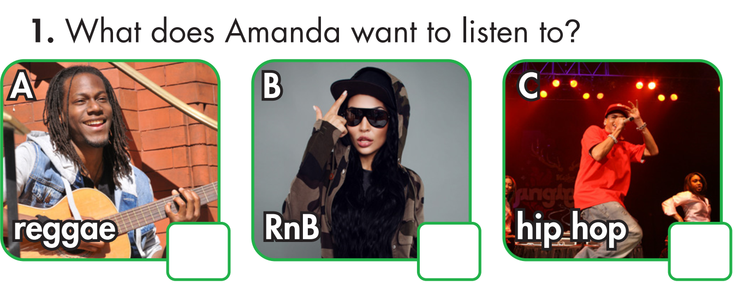

Slide 10
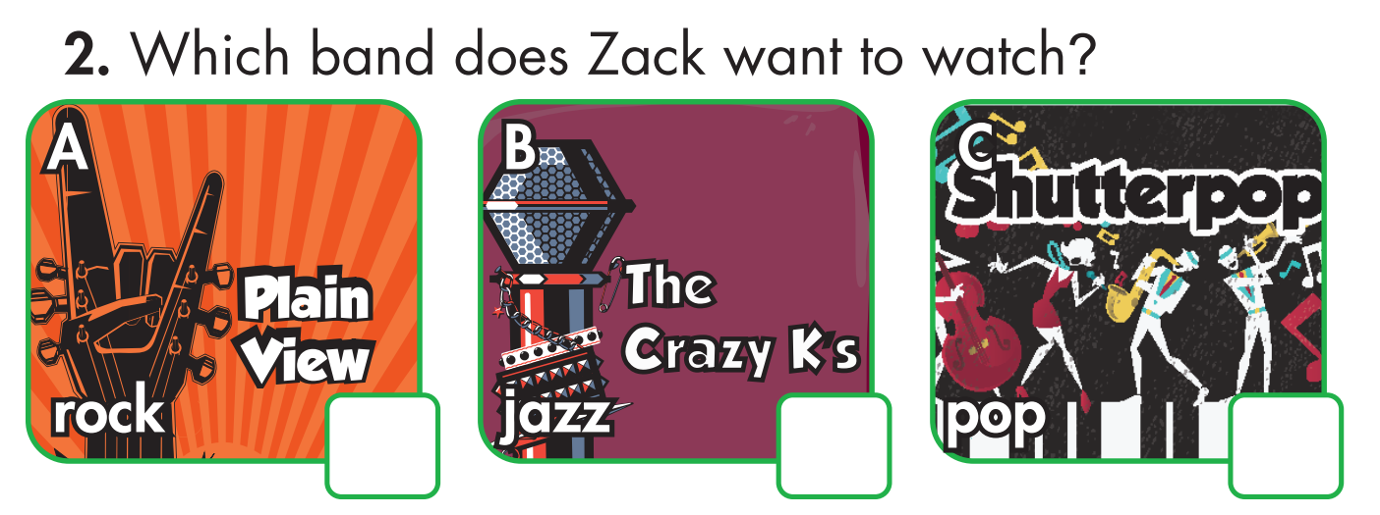

Slide 11
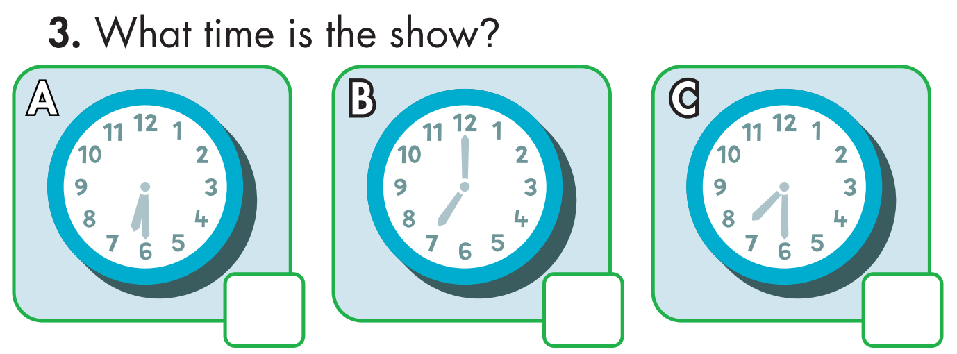

Slide 12
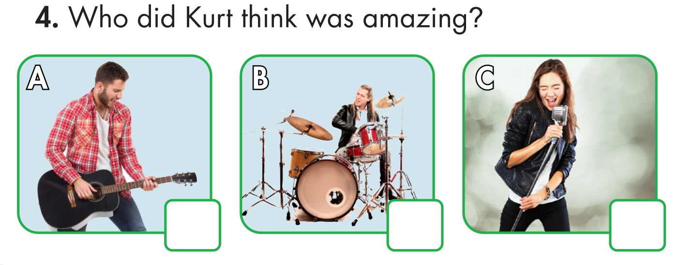

Slide 13
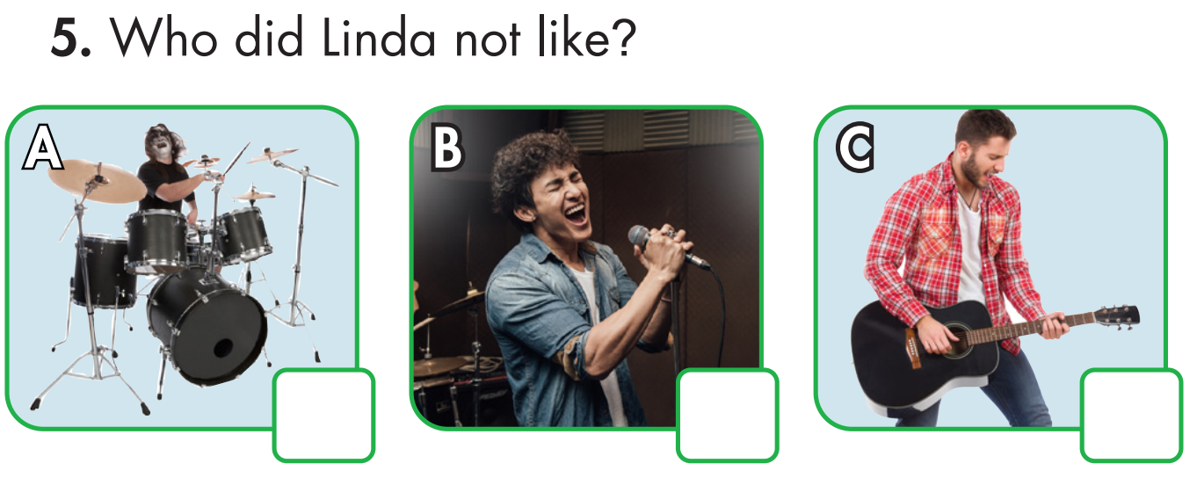

Slide 14

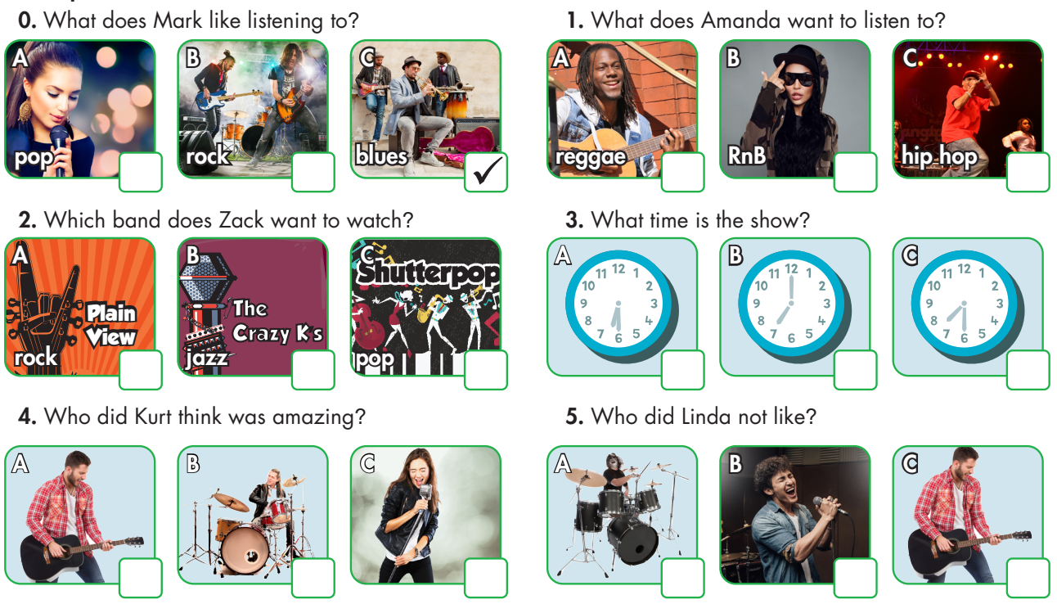
While - listening
Listen and choose the correct answer.
☞ FIRST TIME

Slide 15
While - listening
☞ SECOND TIME
Now listen again and check.
Mark: Let's go to the festival tomorrow night, Sally.
Sally: Hmm. OK. Are there any pop singers playing?
Mark: Yes, there's Tom Love.
Sally: Great. What kind of music do you like listening to?
Mark: I used to really like rock music, but now I prefer blues.

Slide 16

Amanda: I don't really like rock.
Kyle: Do you like hip hop?
Amanda: Not really.
Kyle: How about RnB?
Amanda: It's OK, but I prefer reggae.

Slide 17
Zack: I don't really like The Crazy K's, Jessie.
Jessie: I want to see Shutterpop.
Zack: Can we see someone else? What about Plain View?
Jessie: The rock band? OK.

Slide 18
Rachel: What time does the festival start?
Cory: It starts at seven o'clock.
Rachel: What time's Modern Soul's show?
Cory: 7:30 p.m.
Rachel: OK, what time should we leave?
Cory: About 6:30.

Slide 19
Kurt: The Morente Trio was great.
Amy: Yeah. They were cool.
Kurt: I like the guitarist.
Amy: I like the drummer.
Kurt: Yeah, and the singer was amazing.

Slide 20
Frank: What did you think of Marcus And Sons, Linda?
Linda: They were good! The singer was great!
Frank: Yeah, and the guitarist was amazing.
Linda: I didn't really like him.
Frank: Oh really?
Linda: Yeah, he was a bit boring. But the drummer was good.

Slide 21
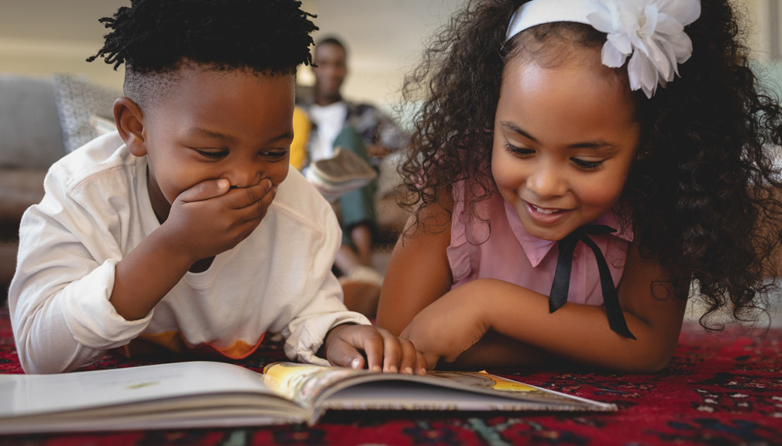

It’s reading time….

Slide 22
Read the paragraph. Choose the best word (A, B, or C) for each space.
MY FAVORITE KIND OF MUSIC
I like listening to all kinds of music, but hip hop is (0) ___________ favorite. Hip hop started
(1) ___________ the 1970s, in the USA. It is now popular all over the world. My favorite hip hop singer is G Star. He (2) ___________ great! He is very popular and sells records all over the world. I usually listen to his songs at break time at school. I also (3) ___________ dancing to hip hop with my friends in the park. We (4) ___________ it at least twice a week. Sometimes we put on a show on the weekends. Our parents say that we are really good. We are going to G Star's show (5) ___________ Saturday evening. I think it is going to be fantastic. I can't wait!
Example:
0. A. I B. mine C. my
1. A. in B. on C. at
2. A. am B. is C. are
3. A. enjoy B. enjoys C. enjoying
4. A. do B. doing C. are
5. A. at B. in C. on

Slide 23



Slide 24
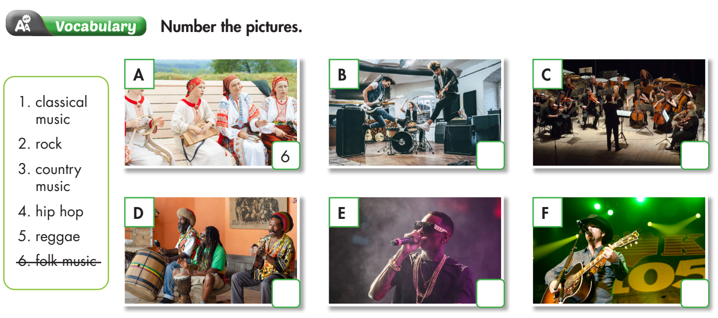
2
1
5
4
3

Slide 25


Slide 26
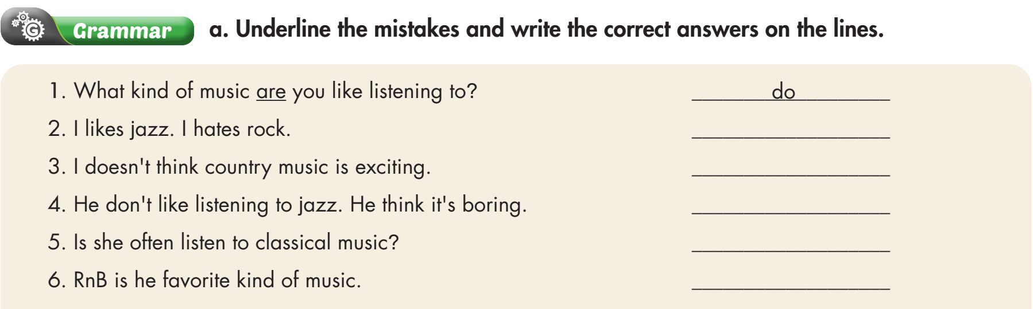
like - hate
don’t
doesn’t - thinks
Does
his

Slide 27
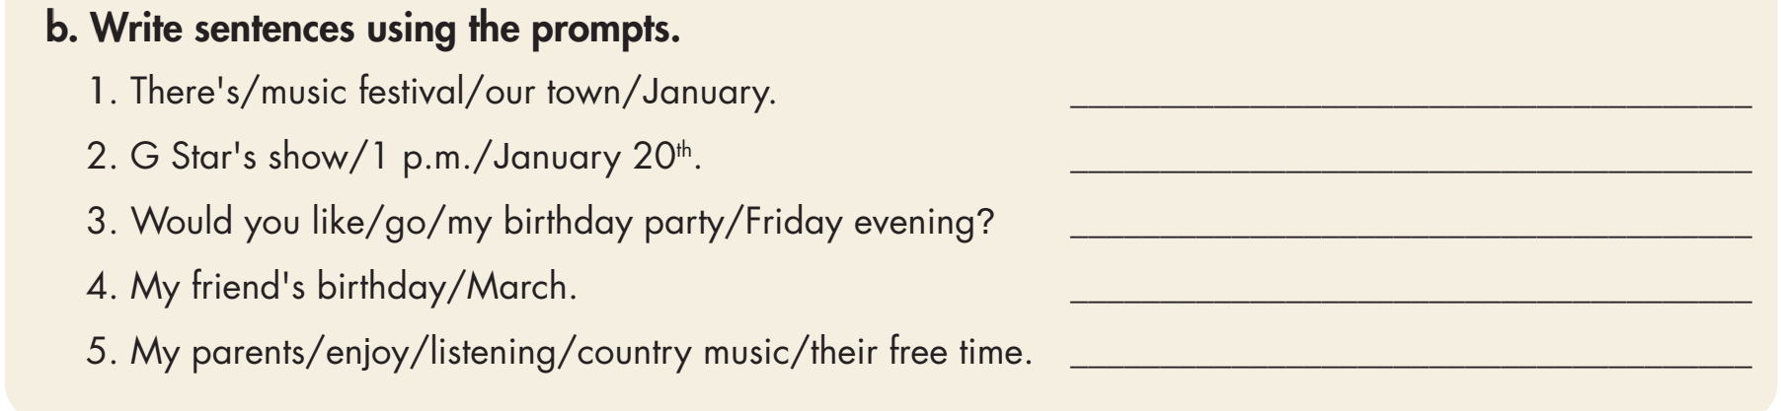
There's a music festival in our town in January.
G Star's show is at 1 p.m. on January 20th.
Would you like to go to my birthday party
on Friday evening?
My friend's birthday is in March.
My parents enjoy listening to country music
in their free time.

Slide 28



Slide 29
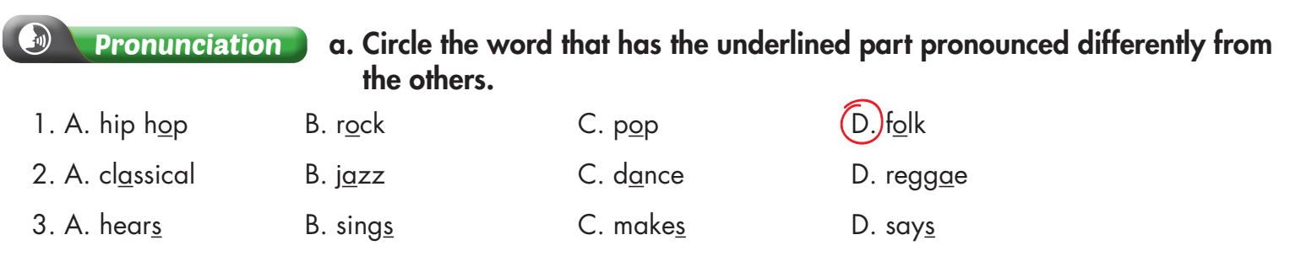

Slide 30
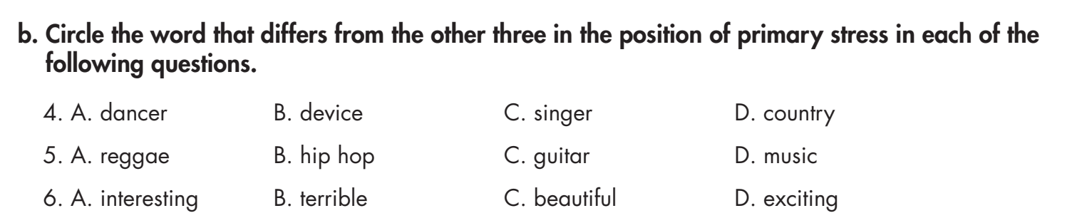

Slide 31

CONSOLIDATION

Slide 32

Work in pairs
Work with a partner. Discuss about the type of music you and your partner like. List the reason(s).

Slide 33

WRAP-UP

Slide 34
Today’s lesson
Reading & Listening:
- Understand instructions.
Practice reading and listening for general and specific information.
Speaking:
Talk about music that you like.

Slide 35
Homework
Do the exercises on page 64 WB.
Review all vocabulary and grammar points in Unit 3.
Practice presenting about the music and movie you like.
Review the vocabulary exercises and grammar/ writing notes in Tiếng Anh 7 i-Learn Smart World Notebook (pages 14 – 19).
Prepare the next lesson (Page 28 SB).
Play the consolidation games in Tiếng Anh 7 i-Learn Smart World DHA App on www.eduhome.com.vn

Slide 36

Lesson 3
Stay positive and have a nice day!

