Slide 1
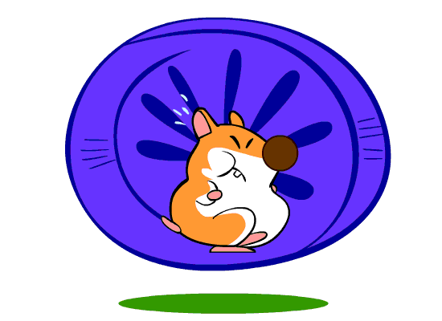
TRÒ CHƠI
2
C N BỌ
DESIGN BY TRO GIANG
youtube.com/trogiang
VO VAN XIN EM
HAMSTER GAME

Slide 2
QUESTION 1
1
8
2
CORRECT ANSWER
ANSWER 2
7
3
ANSWER 3
ANSWER 4
6
4
ANSWER 5
5
ANSWER 6
ANSWER 7
ANSWER 8

Slide 3
QUESTION 2
1
8
2
ANSWER 1
CORRECT ANSWER
7
3
ANSWER 3
ANSWER 4
6
4
ANSWER 5
5
ANSWER 6
ANSWER 7
ANSWER 8

Slide 4
QUESTION 3
1
8
2
ANSWER 1
ANSWER 2
7
3
CORRECT ANSWER
ANSWER 4
6
4
ANSWER 5
5
ANSWER 6
ANSWER 7
ANSWER 8

Slide 5
QUESTION 4
1
8
2
ANSWER 1
ANSWER 2
7
3
ANSWER 3
CORRECT ANSWER
6
4
ANSWER 5
5
ANSWER 6
ANSWER 7
ANSWER 8

Slide 6
QUESTION 5
1
8
2
ANSWER 1
ANSWER 2
7
3
ANSWER 3
ANSWER 4
6
4
CORRECT ANSWER
5
ANSWER 6
ANSWER 7
ANSWER 8

Slide 7
QUESTION 6
1
8
2
ANSWER 1
ANSWER 2
7
3
ANSWER 3
ANSWER 4
6
4
ANSWER 5
5
CORRECT ANSWER
ANSWER 7
ANSWER 8

Slide 8
QUESTION 7
1
8
2
ANSWER 1
ANSWER 2
7
3
ANSWER 3
ANSWER 4
6
4
ANSWER 5
5
ANSWER 6
CORRECT ANSWER
ANSWER 8

Slide 9
QUESTION 8
1
8
2
ANSWER 1
ANSWER 2
7
3
ANSWER 3
ANSWER 4
6
4
ANSWER 5
5
ANSWER 6
ANSWER 7
CORRECT ANSWER

Slide 10
ĐĂNG KÝ TRỢ GIẢNG
GẮN KẾT CỘNG ĐỒNG GIÁO VIÊN
SUBSCRIBE MY CHANNEL, please

