Slide 1
Unit 1
A long and healthy life

Slide 2
LESSON 3 : READING
How to live a long and healthy life

Slide 3
LESSON 3 : READING
Game Fresh Juice
WARM-UP
Vocabulary
PRE-READING
- Task 2. Read the article. Solve the crossword with words and phrases from it.
- Task 3. Match the section with the heading.
- Task 4. Complete the diagrams with information from the text.
WHILE-READING
POST-READING
Discussion
Wrap-up
Homework
CONSOLIDATION

Slide 4
WARM UP

Slide 5





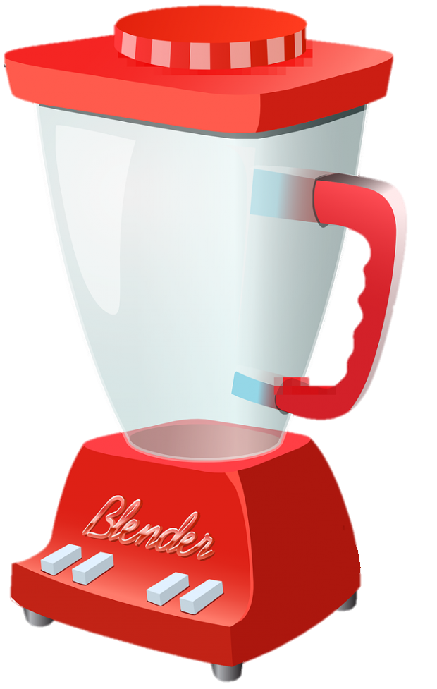
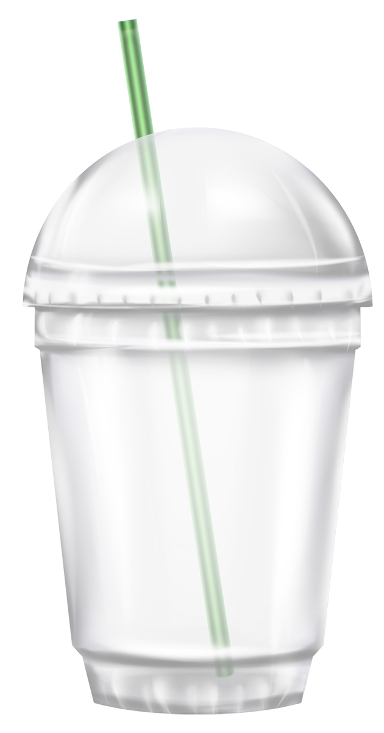

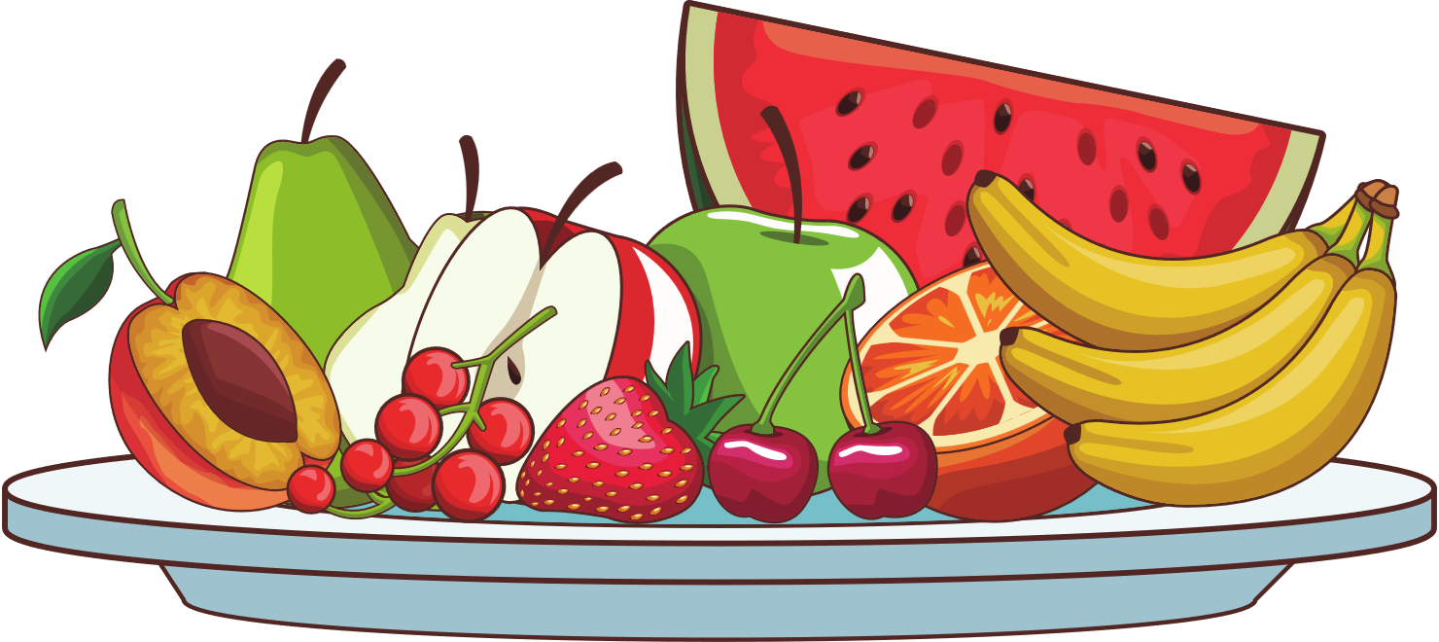
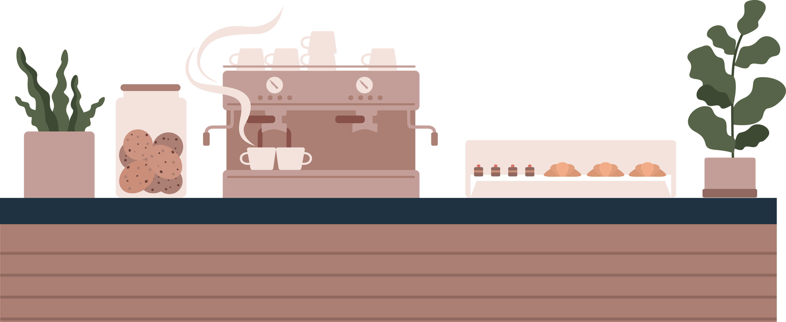

PLAY

Slide 6


RULE
Choose "PLAY" to start the game.
Choose any number to display the corresponding question and find the correct answer.
Choose the to make a drink for the customer.
Choose the to go back.
Choose "EXIT" to end the game.

Slide 7












Slide 8

He _______ (see) the doctor yesterday because he had a headache.
A. is seeing
B. has seen
C. saw

Slide 9

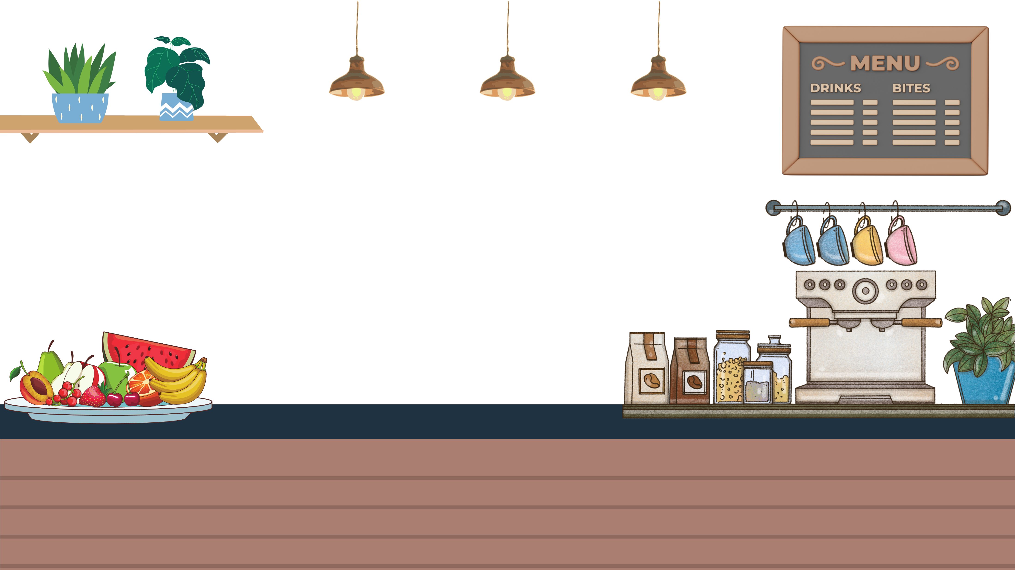



Slide 10
Our fitness level _______ (improve) a lot in the last few months.
A. has improved
B. improves
C. improved

Slide 11


Slide 12
To stay healthy, it is important to eat a ________ diet that includes vegetables and fruits.
A. fit
B. balanced
C. work out

Slide 13


Slide 14
She _______ (not eat) junk food since she started her healthy diet.
A. didn’t eat
B. isn’t eating
C. hasn’t eaten

Slide 15


Slide 16
Bananas are _______ vitamins, which is good for your heart.
A. full of
B. diet
C. fit

Slide 17


Slide 18
I _______ (do) yoga for 3 years and I feel much healthier now.
A. do
B. have done
C. did

Slide 19


Slide 20
She works out every morning because she wants to be _______ and strong.
A. work out
B. balanced
C. fit

Slide 21


Slide 22
I _______ (feel) tired yesterday after the long hike.
A. felt
B. feel
C. have felt

Slide 23


Slide 24
It is helpful to _______ regularly to improve your overall health and strength.
A. diet
B. work out
C. fit

Slide 25
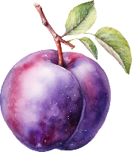

Slide 26
She _______ (have) a cold last week, but now she feels better.
A. has
B. is having
C. had

Slide 27


Slide 28
READING

Slide 29
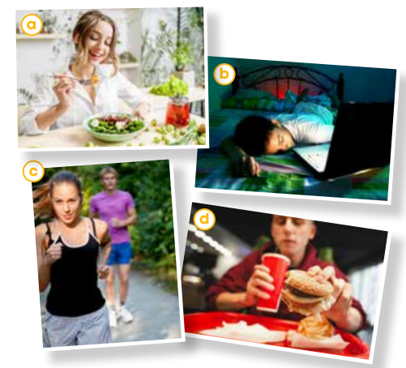
PRE-READING
1
Work in pairs. Look at the photos and discuss the questions.
Which photos show healthy habits?
A,C
Which ones show unhealthy habits?
B,D

Slide 30
VOCABULARY

Slide 31

PRE-READING
life expectancy (n)
/ˈlaɪf ɪkspektənsi/
tuổi thọ
the number of years that a person is likely to live

Slide 32
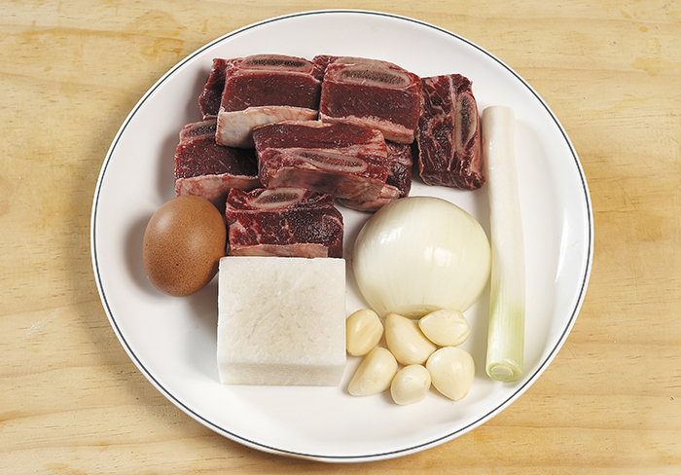
PRE-READING
ingredient (n)
/ɪnˈɡriːdiənt/
nguyên liệu
one of the things from which something is made, especially one of the foods that are used together to make a particular dish

Slide 33
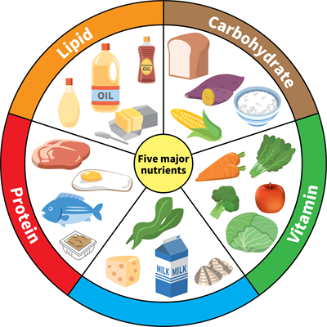
PRE-READING
nutrient (n)
/ˈnjuːtriənt/
chất dinh dưỡng
a substance that is needed to keep a living thing alive and to help it to grow

Slide 34

PRE-READING
(to) give off
/ɡɪv ɒf/
phát ra, tỏa ra
to produce something such as a smell, heat, light, etc.

Slide 35
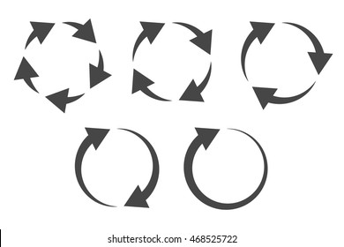
PRE-READING
repetitive (adj)
/rɪˈpetətɪv/
lặp đi lặp lại
repeated many time

Slide 36
PRE-READING
Form | Pronunciation | Meaning | Vietnamese equivalent
1. life expectancy (n) | /ˈlaɪf ɪkspektənsi/ | the number of years that a person is likely to live | tuổi thọ
2. ingredient (n) | /ɪnˈɡriːdiənt/ | one of the things from which something is made, especially one of the foods that are used together to make a particular dish | nguyên liệu
3. nutrient (n) | /ˈnjuːtriənt/ | a substance that is needed to keep a living thing alive and to help it to grow | chất dinh dưỡng
4. (to) give off | /ɡɪv ɒf/ | to produce something such as a smell, heat, light, etc. | phát ra, tỏa ra
5. repetitive (adj) | /rɪˈpetətɪv/ | repeated many time | lặp đi lặp lại

Slide 37
REVIEW
VOCABULARY

Slide 38

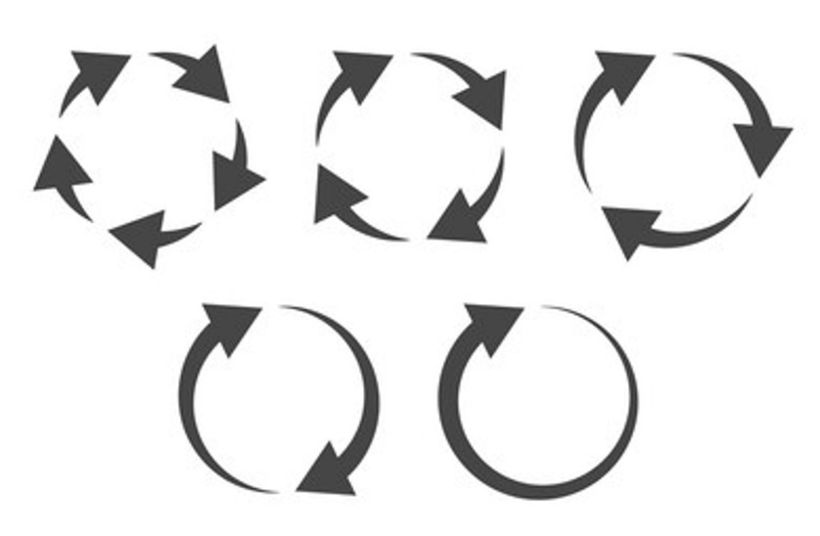
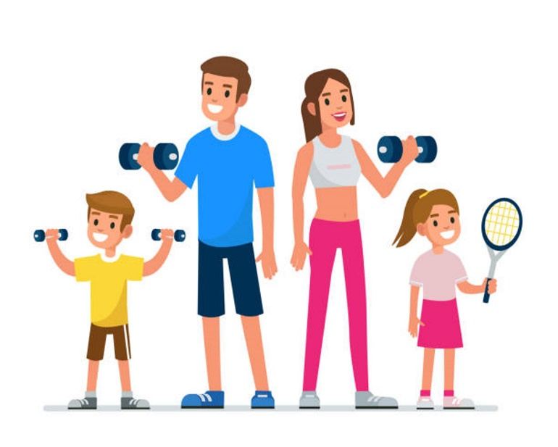
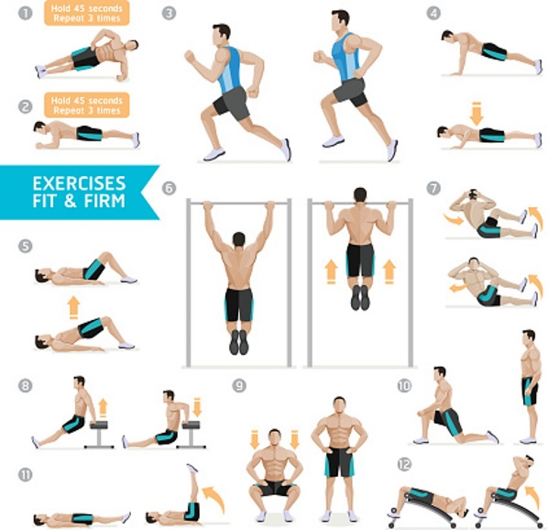
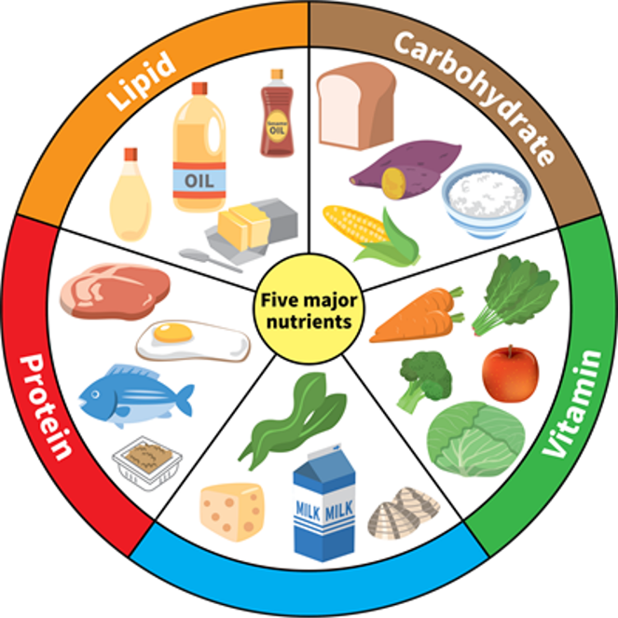
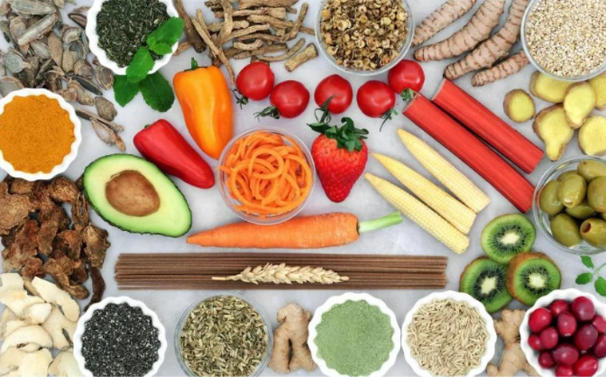
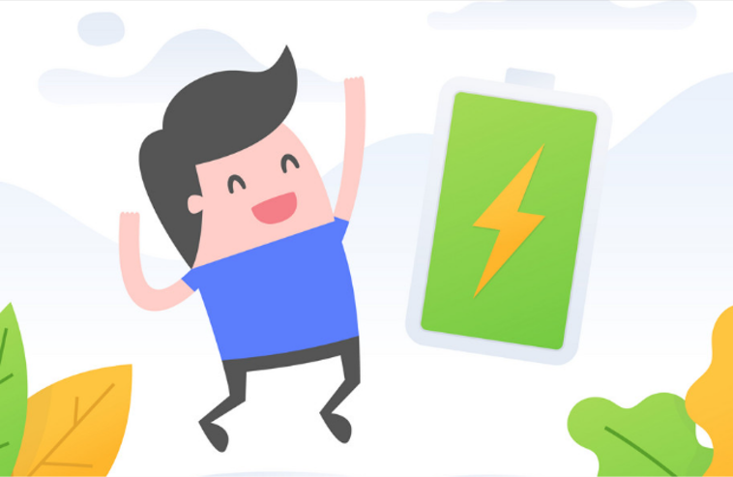




SPIN
nutrient
CHECK

Slide 39
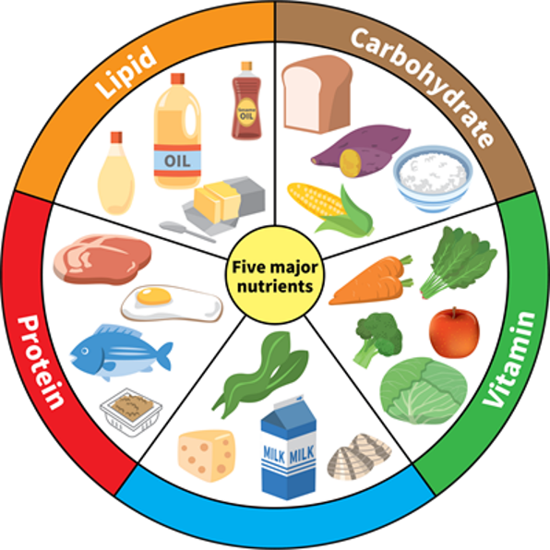
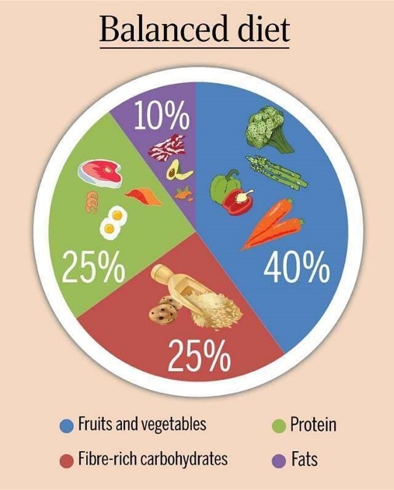

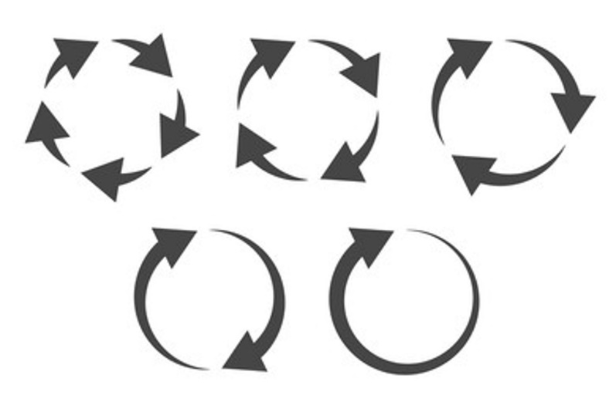


SPIN
life expectancy
CHECK

Slide 40


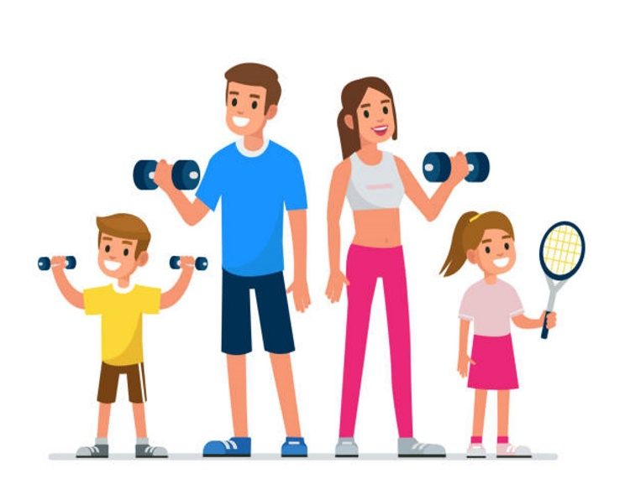



SPIN
repetitive
CHECK

Slide 41
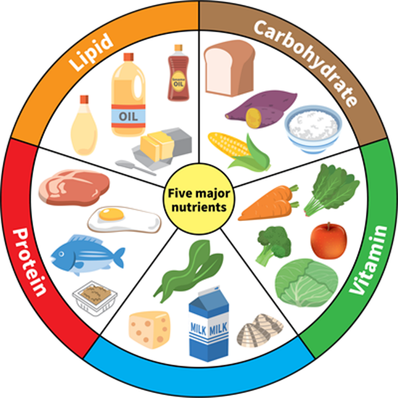





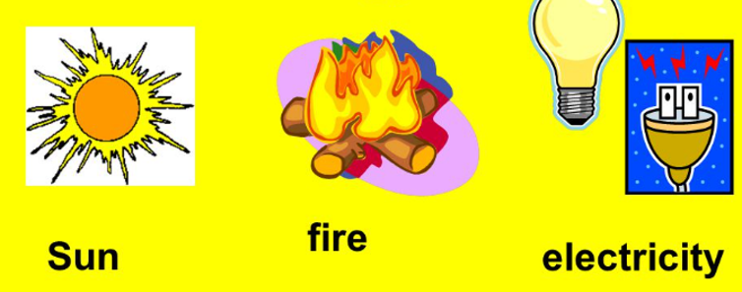
SPIN
ingredient
CHECK

Slide 42





SPIN
give off
CHECK

Slide 43
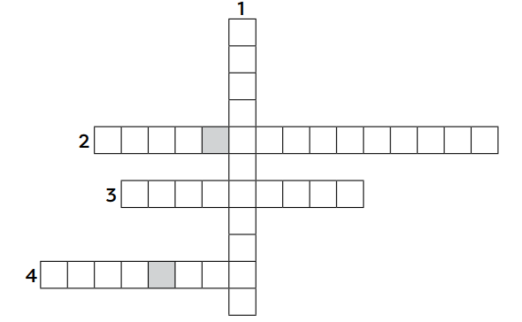
WHILE-READING
2
Read the article. Solve the crossword with words and phrases from it.
I
N
G
R
L
I
F
E
E
X
P
E
C
T
A
N
C
Y
D
N
U
T
R
I
E
N
T
S
E
N
W
O
R
K
O
U
T
S

Slide 44
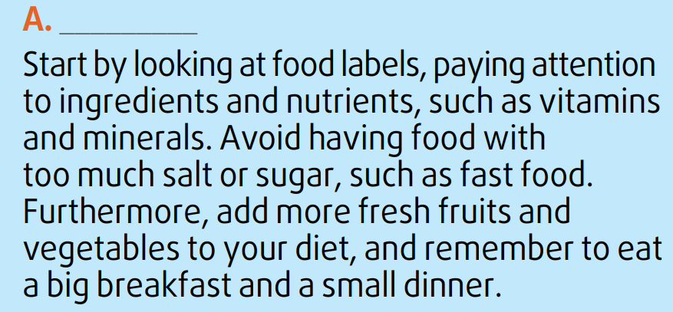
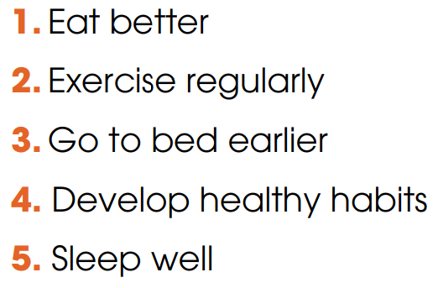
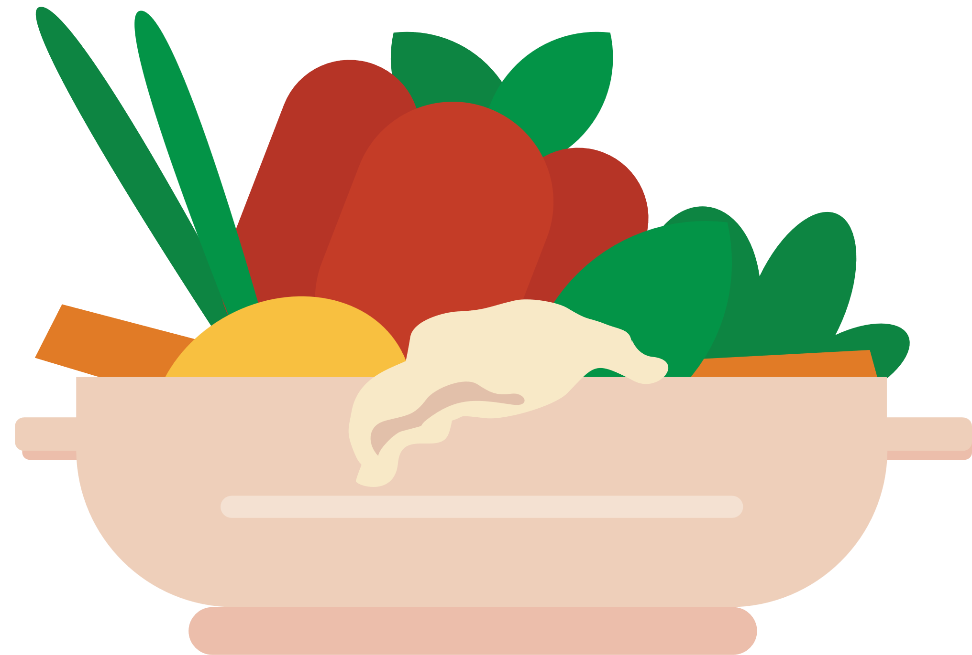

WHILE-READING
3
Read the article again. Match the section (A-C) with the heading (1-5) below. There are TWO extra headings.
1. Eat better

Slide 45
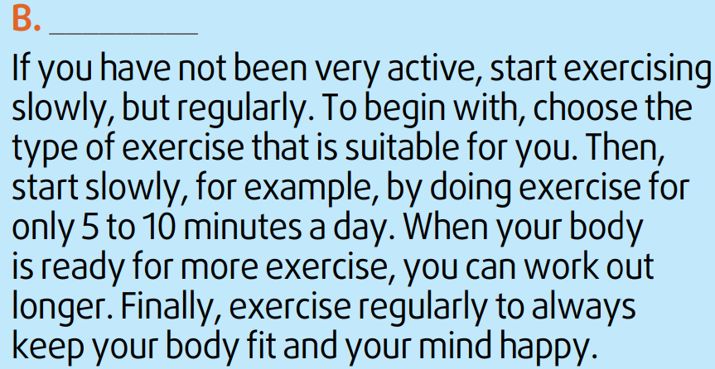
WHILE-READING
2. Exercise regularly

Slide 46
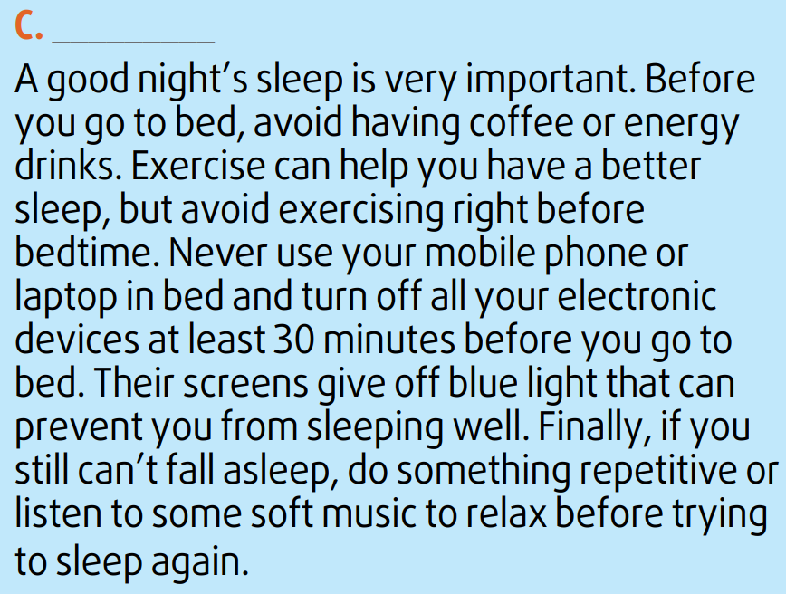
WHILE-READING
5. Sleep well

Slide 47
WHILE-READING
4
Read the article again. Complete the diagrams with information from the text. Use no more than two words for each gap.
Study food labels
Avoid too much salt or sugar
Add fresh fruits and vegetables
Eat a big (1) __________
A
breakfast
Choose
(2) ________ exercise
Start slowly
Work out longer
Exercise
(3) __________
B
suitable
regularly
Before bed:
Avoid having coffee or (4) _____________________
Turn off (5) _________________
Unable to sleep: do something repetitive or listen to music
C
energy drinks / exercising
electronic devices

Slide 48
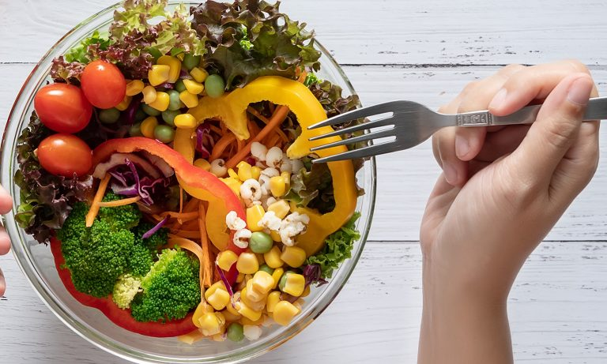
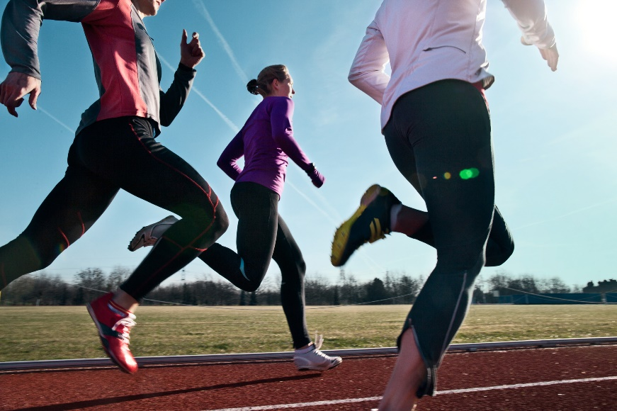
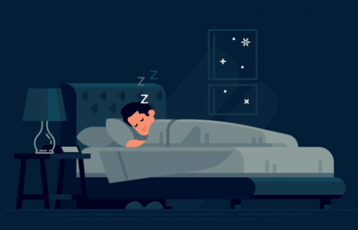
POST-READING
5
Discussion
Do you find the advice in the article useful?

Slide 49
Check food labels: vitamins, minerals.
Avoid too much salt & sugar (fast food).
Add fresh fruits & vegetables.
Big breakfast, small dinner
Eat Better
Start slowly if inactive.
Choose suitable exercise.
Begin with 5-10 minutes/day.
Gradually increase duration.
Exercise regularly for body & mind.
Healthy Lifestyle Advice
Exercise Regularly
Avoid coffee/energy drinks before bed.
Exercise helps but not right before sleep.
Turn off electronic devices 30 mins before bed.
Avoid blue light from screens.
Use relaxing activities if unable to sleep
Sleep Well

Slide 50
POST-READING
5
Discussion
Have you tried following any of the suggestions above?
→ Yes, I’ve tried some of the suggestions. I eat more fruits and vegetables, avoid too much salt and sugar, exercise regularly, and turn off my phone before bed to sleep better.

Slide 51
CONSOLIDATION
1
Wrap-up
What have you learnt today?
Some lexical items about healthy lifestyle
Reading for main ideas and specific information

Slide 52
CONSOLIDATION
2
Homework
Do exercises in the workbook.
Prepare for Lesson 4 - Unit 1.

Slide 53
THANK YOU

