Slide 1

Unit 6: Entertainment
Lesson 6a: Vocab Expansion
Page 105

Slide 2
Lesson Outline
Warm-up
Vocabulary
Speaking
Writing
Consolidation
Wrap-up

Slide 3
Objectives
By the end of this lesson, students will be able to…
learn vocabulary about places of entertainment.
practise speaking about their favourite amusement park.
practise writing a text message.

Slide 4

WARM-UP

Slide 5
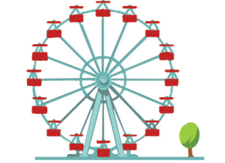
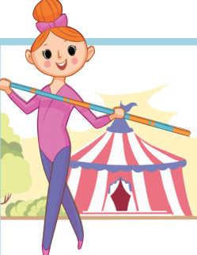
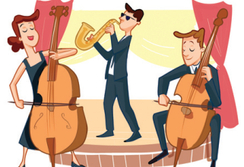
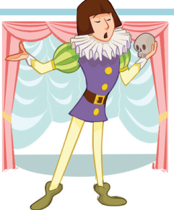
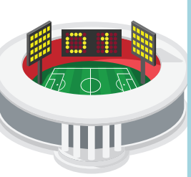
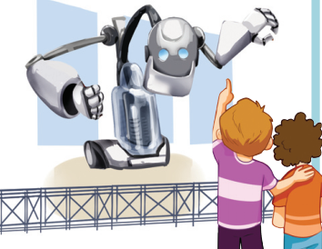
Match the places of entertainment with the pictures.
stadium
concert hall
circus
amusement park
theatre
exhibition centre
Which places of entertainment do you usually visit?

Slide 6
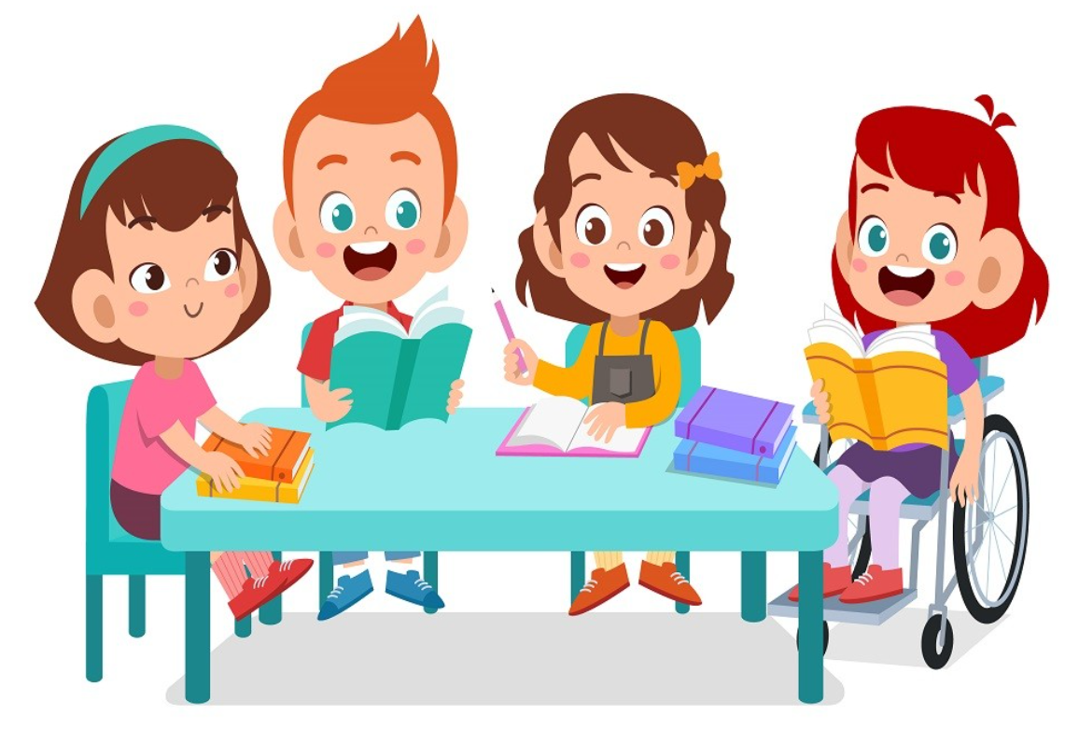
It’s time to learn …

Slide 7
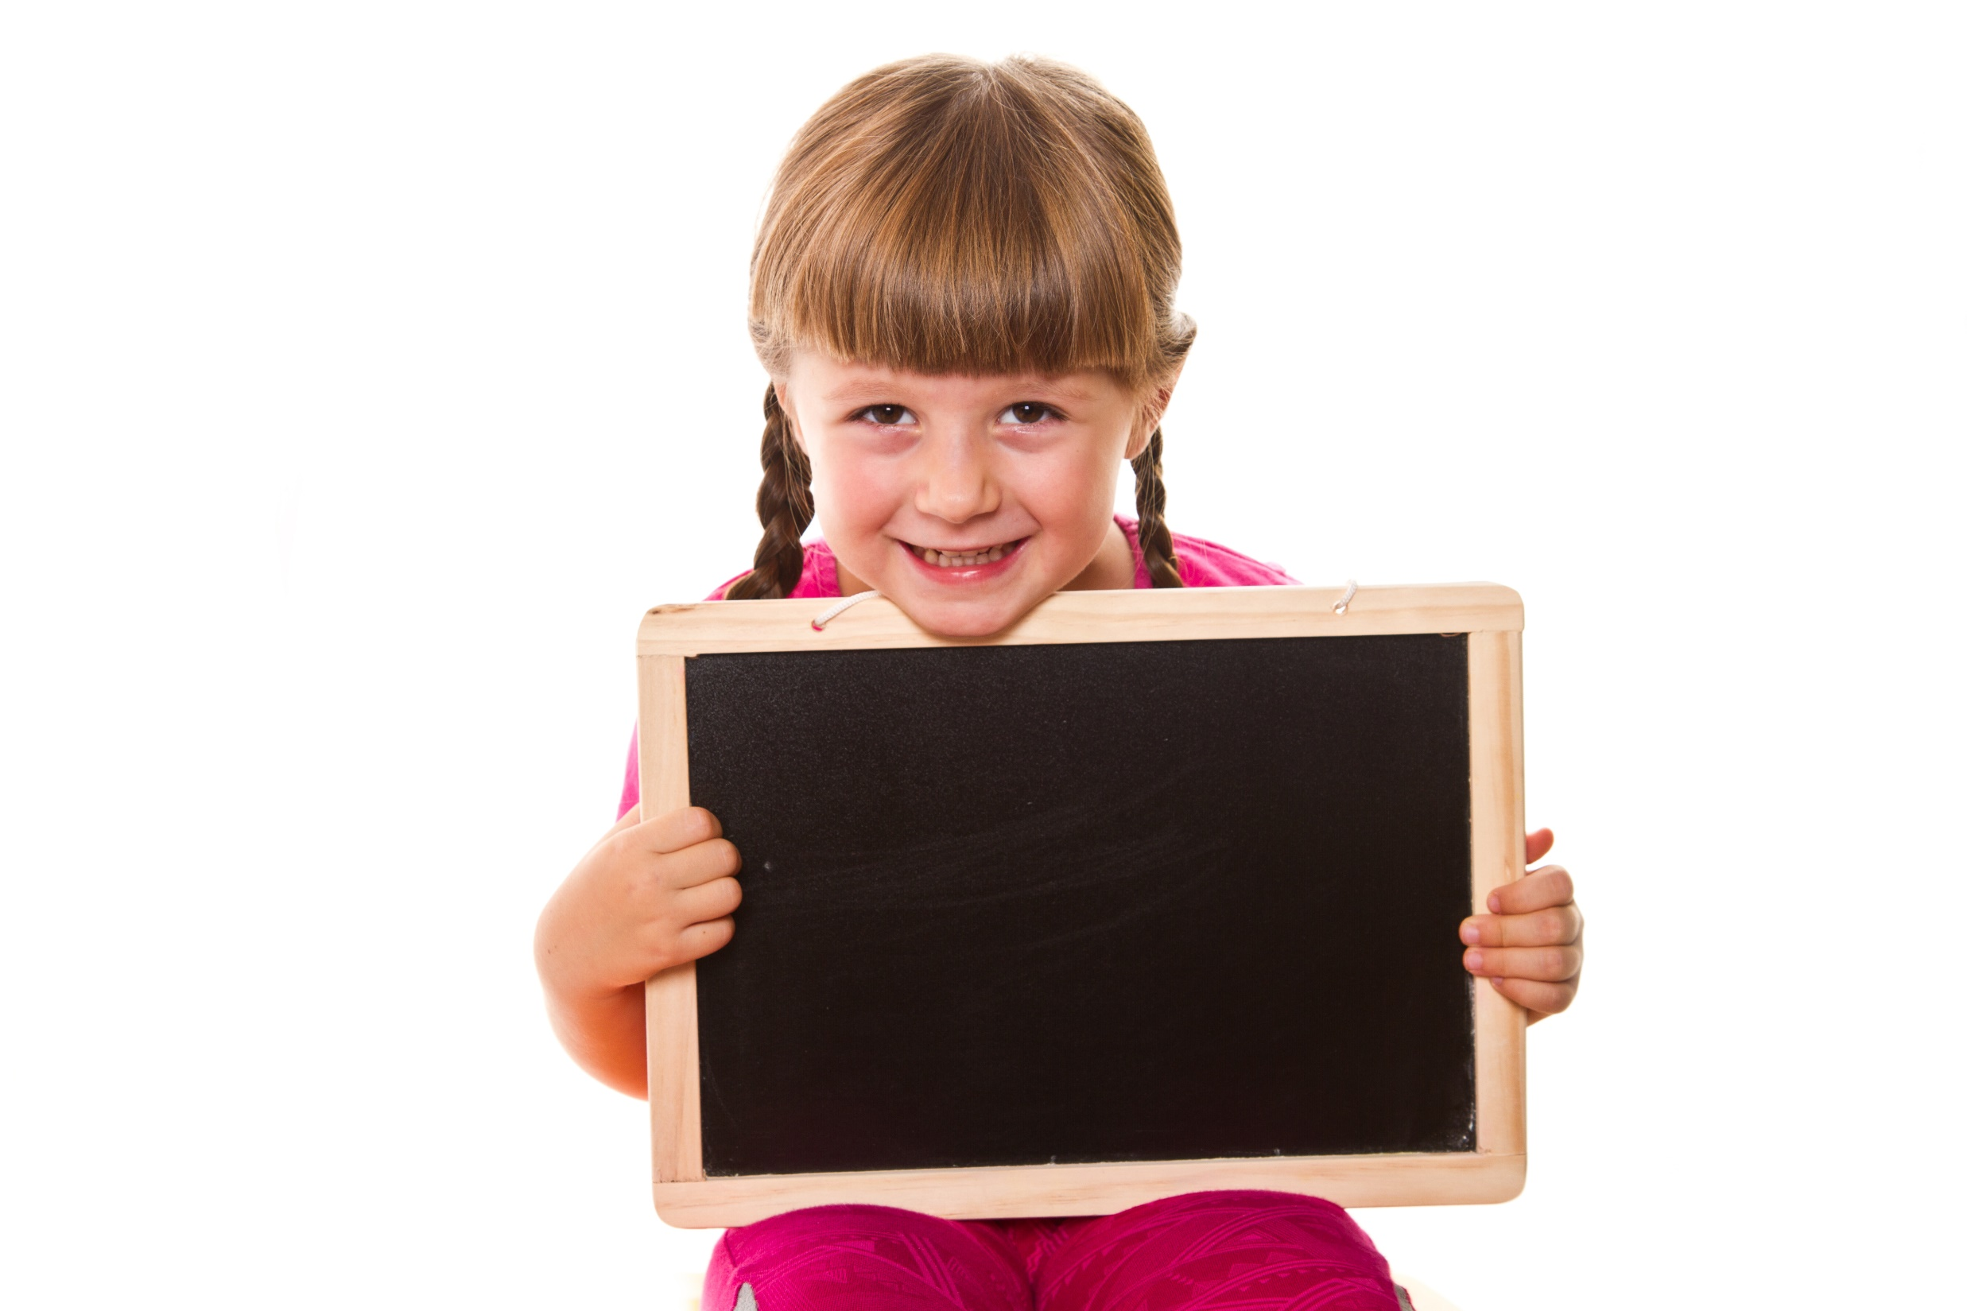
Presentation

Slide 8
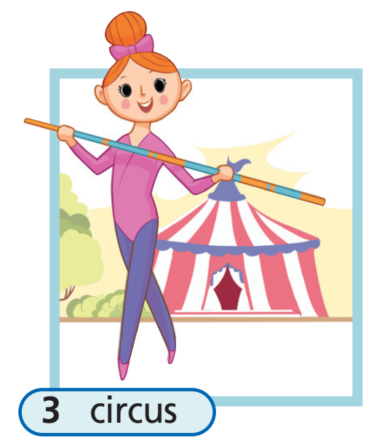

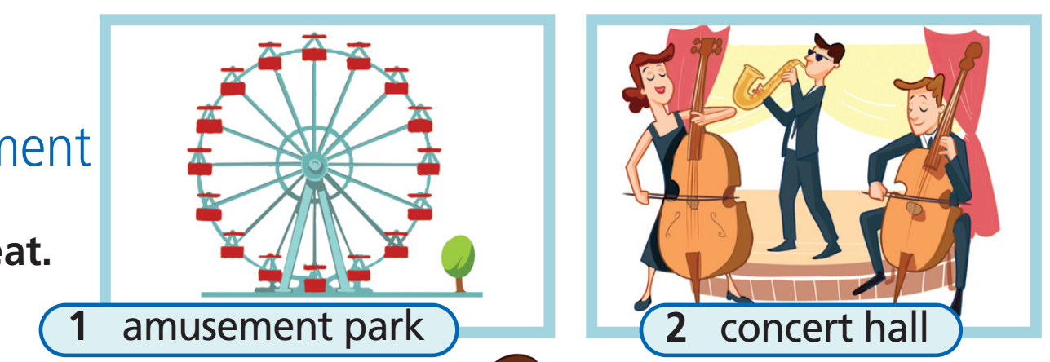
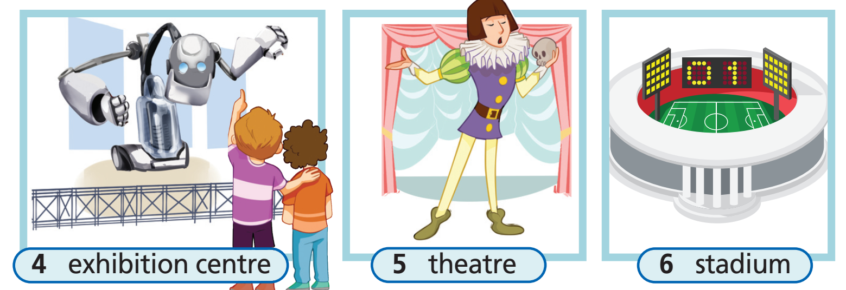
4 Listen and repeat.

Slide 9
Vocabulary
amusement park /əˈmjuːzmənt pɑːk/ (n): công viên giải trí
concert hall /ˈkɒnsət hɔːl/ (n): phòng hòa nhạc
circus /ˈsɜːkəs/ (n): rạp xiếc
exhibition centre /ˌeksɪˈbɪʃən ˈsentə/ (n): trung tâm triển lãm
theatre /ˈθɪətə/ (n): rạp hát, nhà hát
stadium /ˈsteɪdiəm/ (n): sân vận động

Slide 10
Vocabulary (stress)
•
amusement park /əˈmjuːzmənt pɑːk/ (n): công viên giải trí
•
concert hall /ˈkɒnsət hɔːl/ (n): phòng hòa nhạc
•
circus /ˈsɜːkəs/ (n): rạp xiếc
•
•
exhibition centre /ˌeksɪˈbɪʃən ˈsentə/ (n): trung tâm triển lãm
•
theatre /ˈθɪətə/ (n): rạp hát, nhà hát
•
stadium /ˈsteɪdiəm/ (n): sân vận động

Slide 11
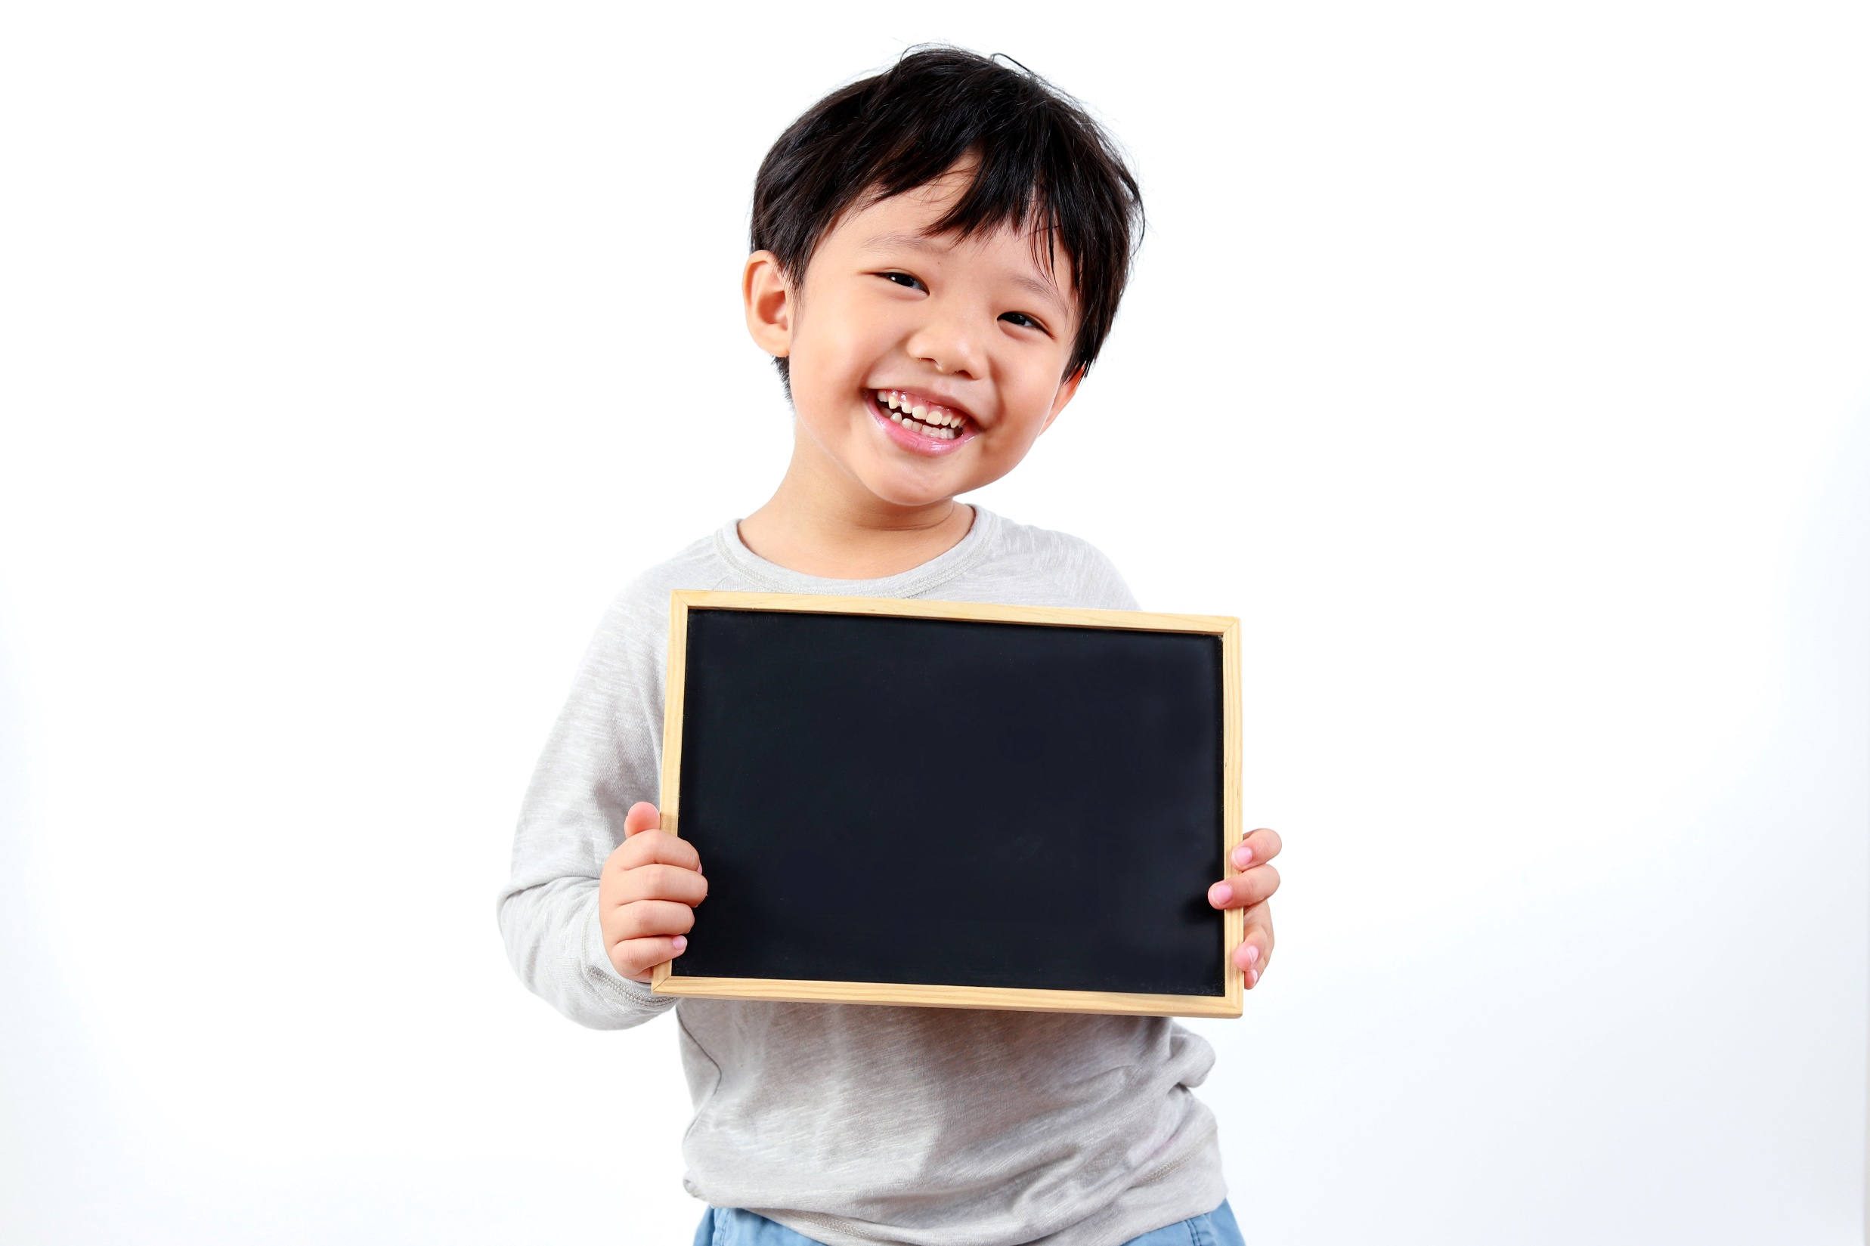
Practice

Slide 12
5 What can you do in the places in Exercise 4? Choose from the list. Tell your partner.
• attend a performance • see a sports event • listen to classical music
• go on a roller coaster • see clowns and acrobats • see a robotics exhibition
Example
You can go on a roller coaster at an amusement park.

Slide 13
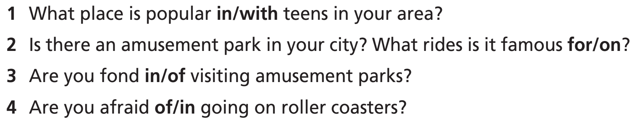
6 Choose the correct preposition. Then answer the questions.

Slide 14
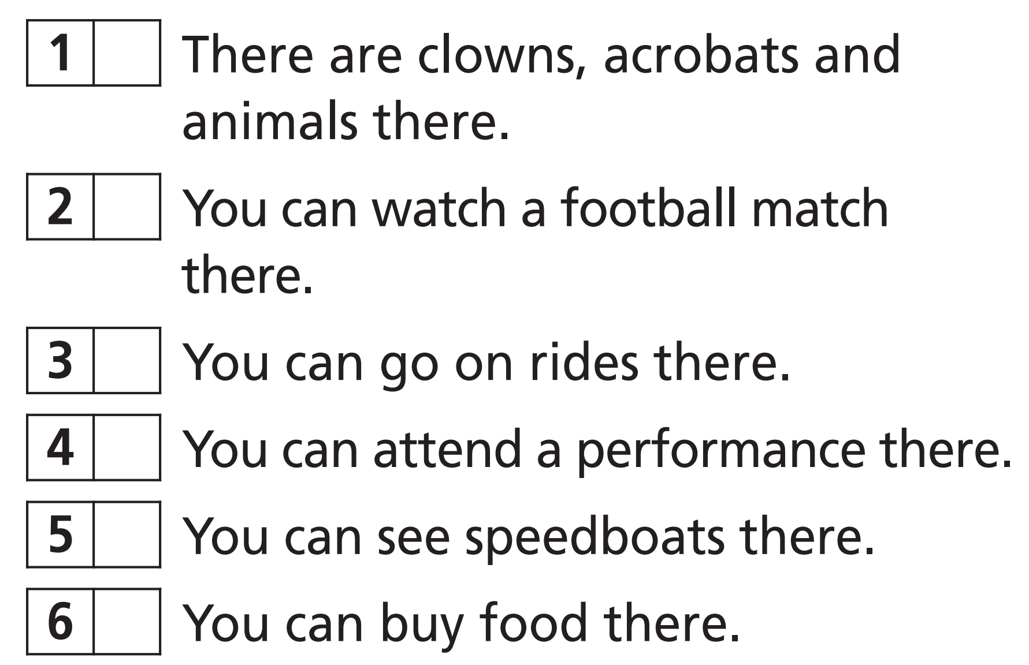
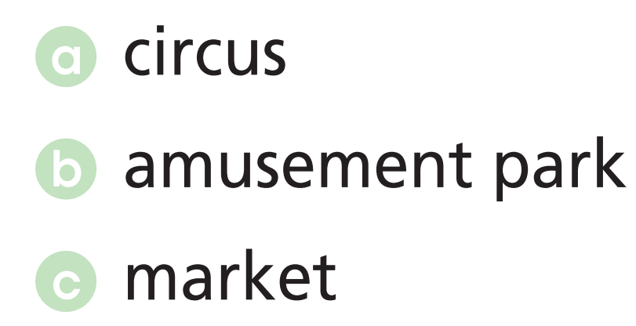
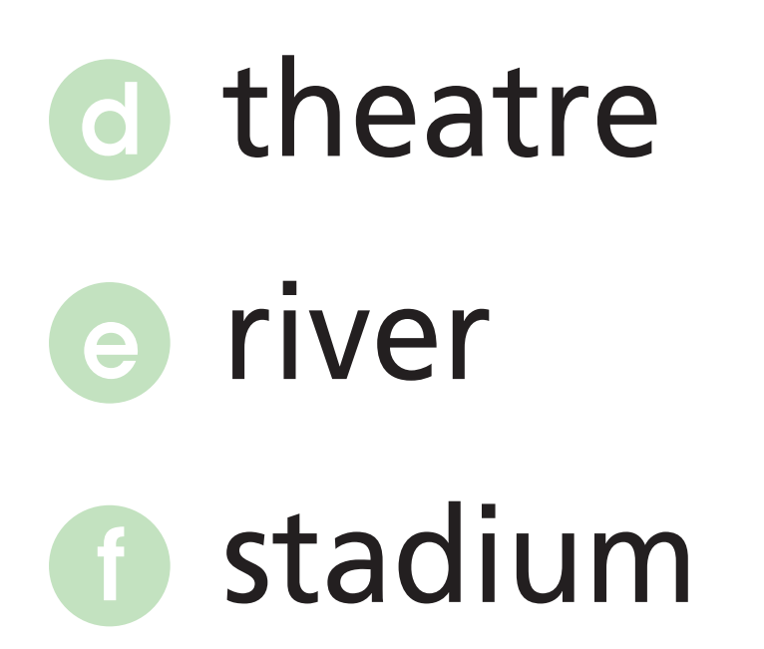
Further practice
Match the sentences (1-6) to the places (a-f).
a
f
b
d
e
c

Slide 15

Production

Slide 16
Make at least four sentences, using the vocabulary you have learnt.

Slide 17

Speaking

Slide 18

Pre-speaking
7 What is your favourite amusement park? Write about its name, place, opening hours, special attractions and tickets.
Sample
Name: Asterix Park
Place: Outside Paris, France
Opening hours: 10:00 a.m. to 6:00 p.m., seven days a week
Special attractions: based on a comic book series, Goudurix - a large multi-looping roller coaster, Tonerre de Zue - a large wooden roller coaster
Ticket: €41 for adults, €38 for children.

Slide 19
While-speaking
Now, practise in groups to talk about your favourite amusement park.
Sample
Asterix Park is an amazing amusement park outside Paris in France. It’s open from 10:00 a.m. to 6:00 p.m. seven days a week. This amusement park is based on a famous comic book series. Its attractions include Goudurix, a large multi-looping roller coaster, and Tonnerre de Zeus, a large wooden roller coaster. Tickets cost €41 for adults and €38 for children. It’s well worth a visit!

Slide 20
Post-speaking
Present the amusement park to the class.

Slide 21
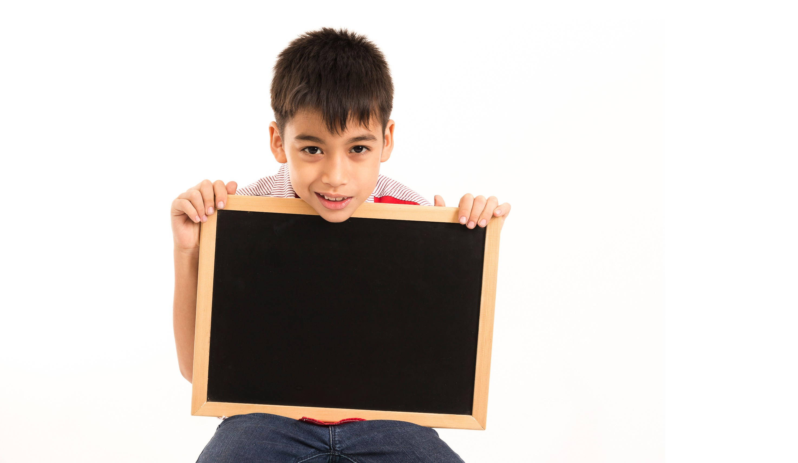
Writing

Slide 22
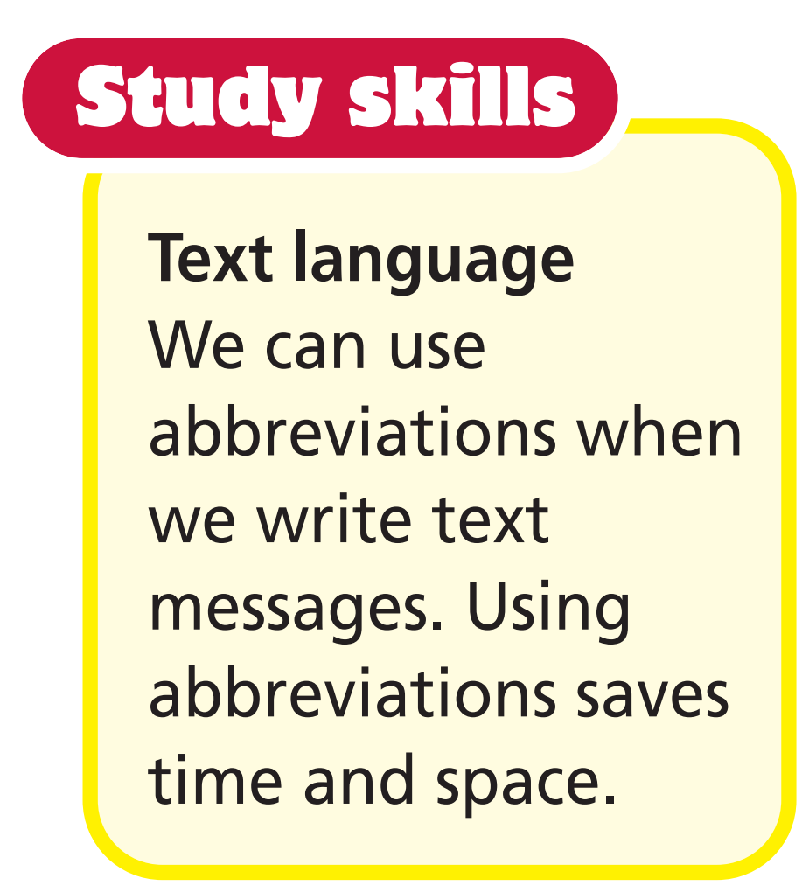
Pre-writing
8 Match the abbreviations to what they mean.

Slide 23
9 Imagine you are at one of the places in the texts in Exercise 1. Send a text message to your friend (about 50-60 words). Write about where you are, who you are with and what the roller coaster is like. You can use abbreviations.
1. Where are you?
at one of the places in the texts in Exercise 1 (Ferrari World, Cosmo World).
2. What are you going to write?
a text message.
3. What should you write about?
where you are, who you are with, what the roller coaster is like.
4. What can you use to write faster?
abbreviations.

Slide 24
While-writing
9 Imagine you are at one of the places in the texts in Exercise 1. Send a text message to your friend (about 50-60 words). Write about where you are, who you are with and what the roller coaster is like. You can use abbreviations.
Example
Hi Bill! You won’t believe it. I’m at Ferrari World with John. We went on the Formula Rossa roller coaster. It is the fastest roller coaster in the world. It goes up to 240 kilometres per hour and has lots of bends. You have to wear safety glasses to protect your eyes. It was amazing! B4N!

Slide 25
Post-writing
Change your papers and check spelling and grammar in your friend’s writing.

Slide 26

CONSOLIDATION

Slide 27
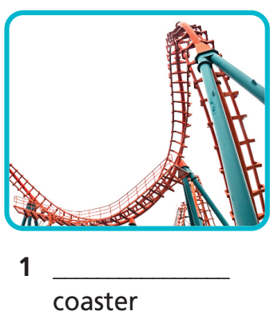
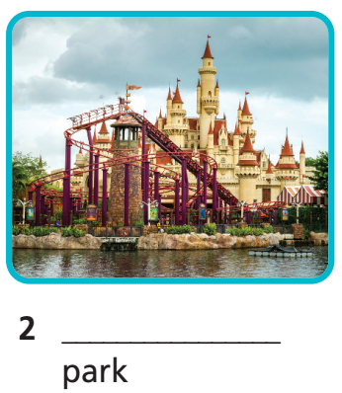
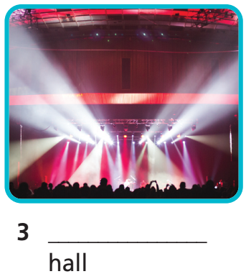
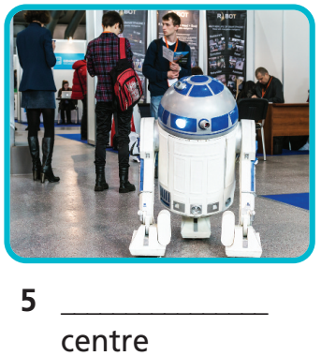
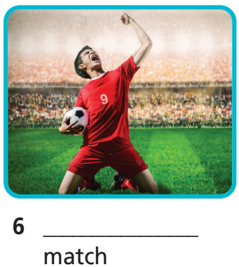
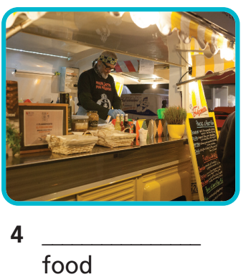
Fill in the gaps with football, street, exhibition, amusement, concert or roller
roller
amusement
concert
street
exhibition
football

Slide 28
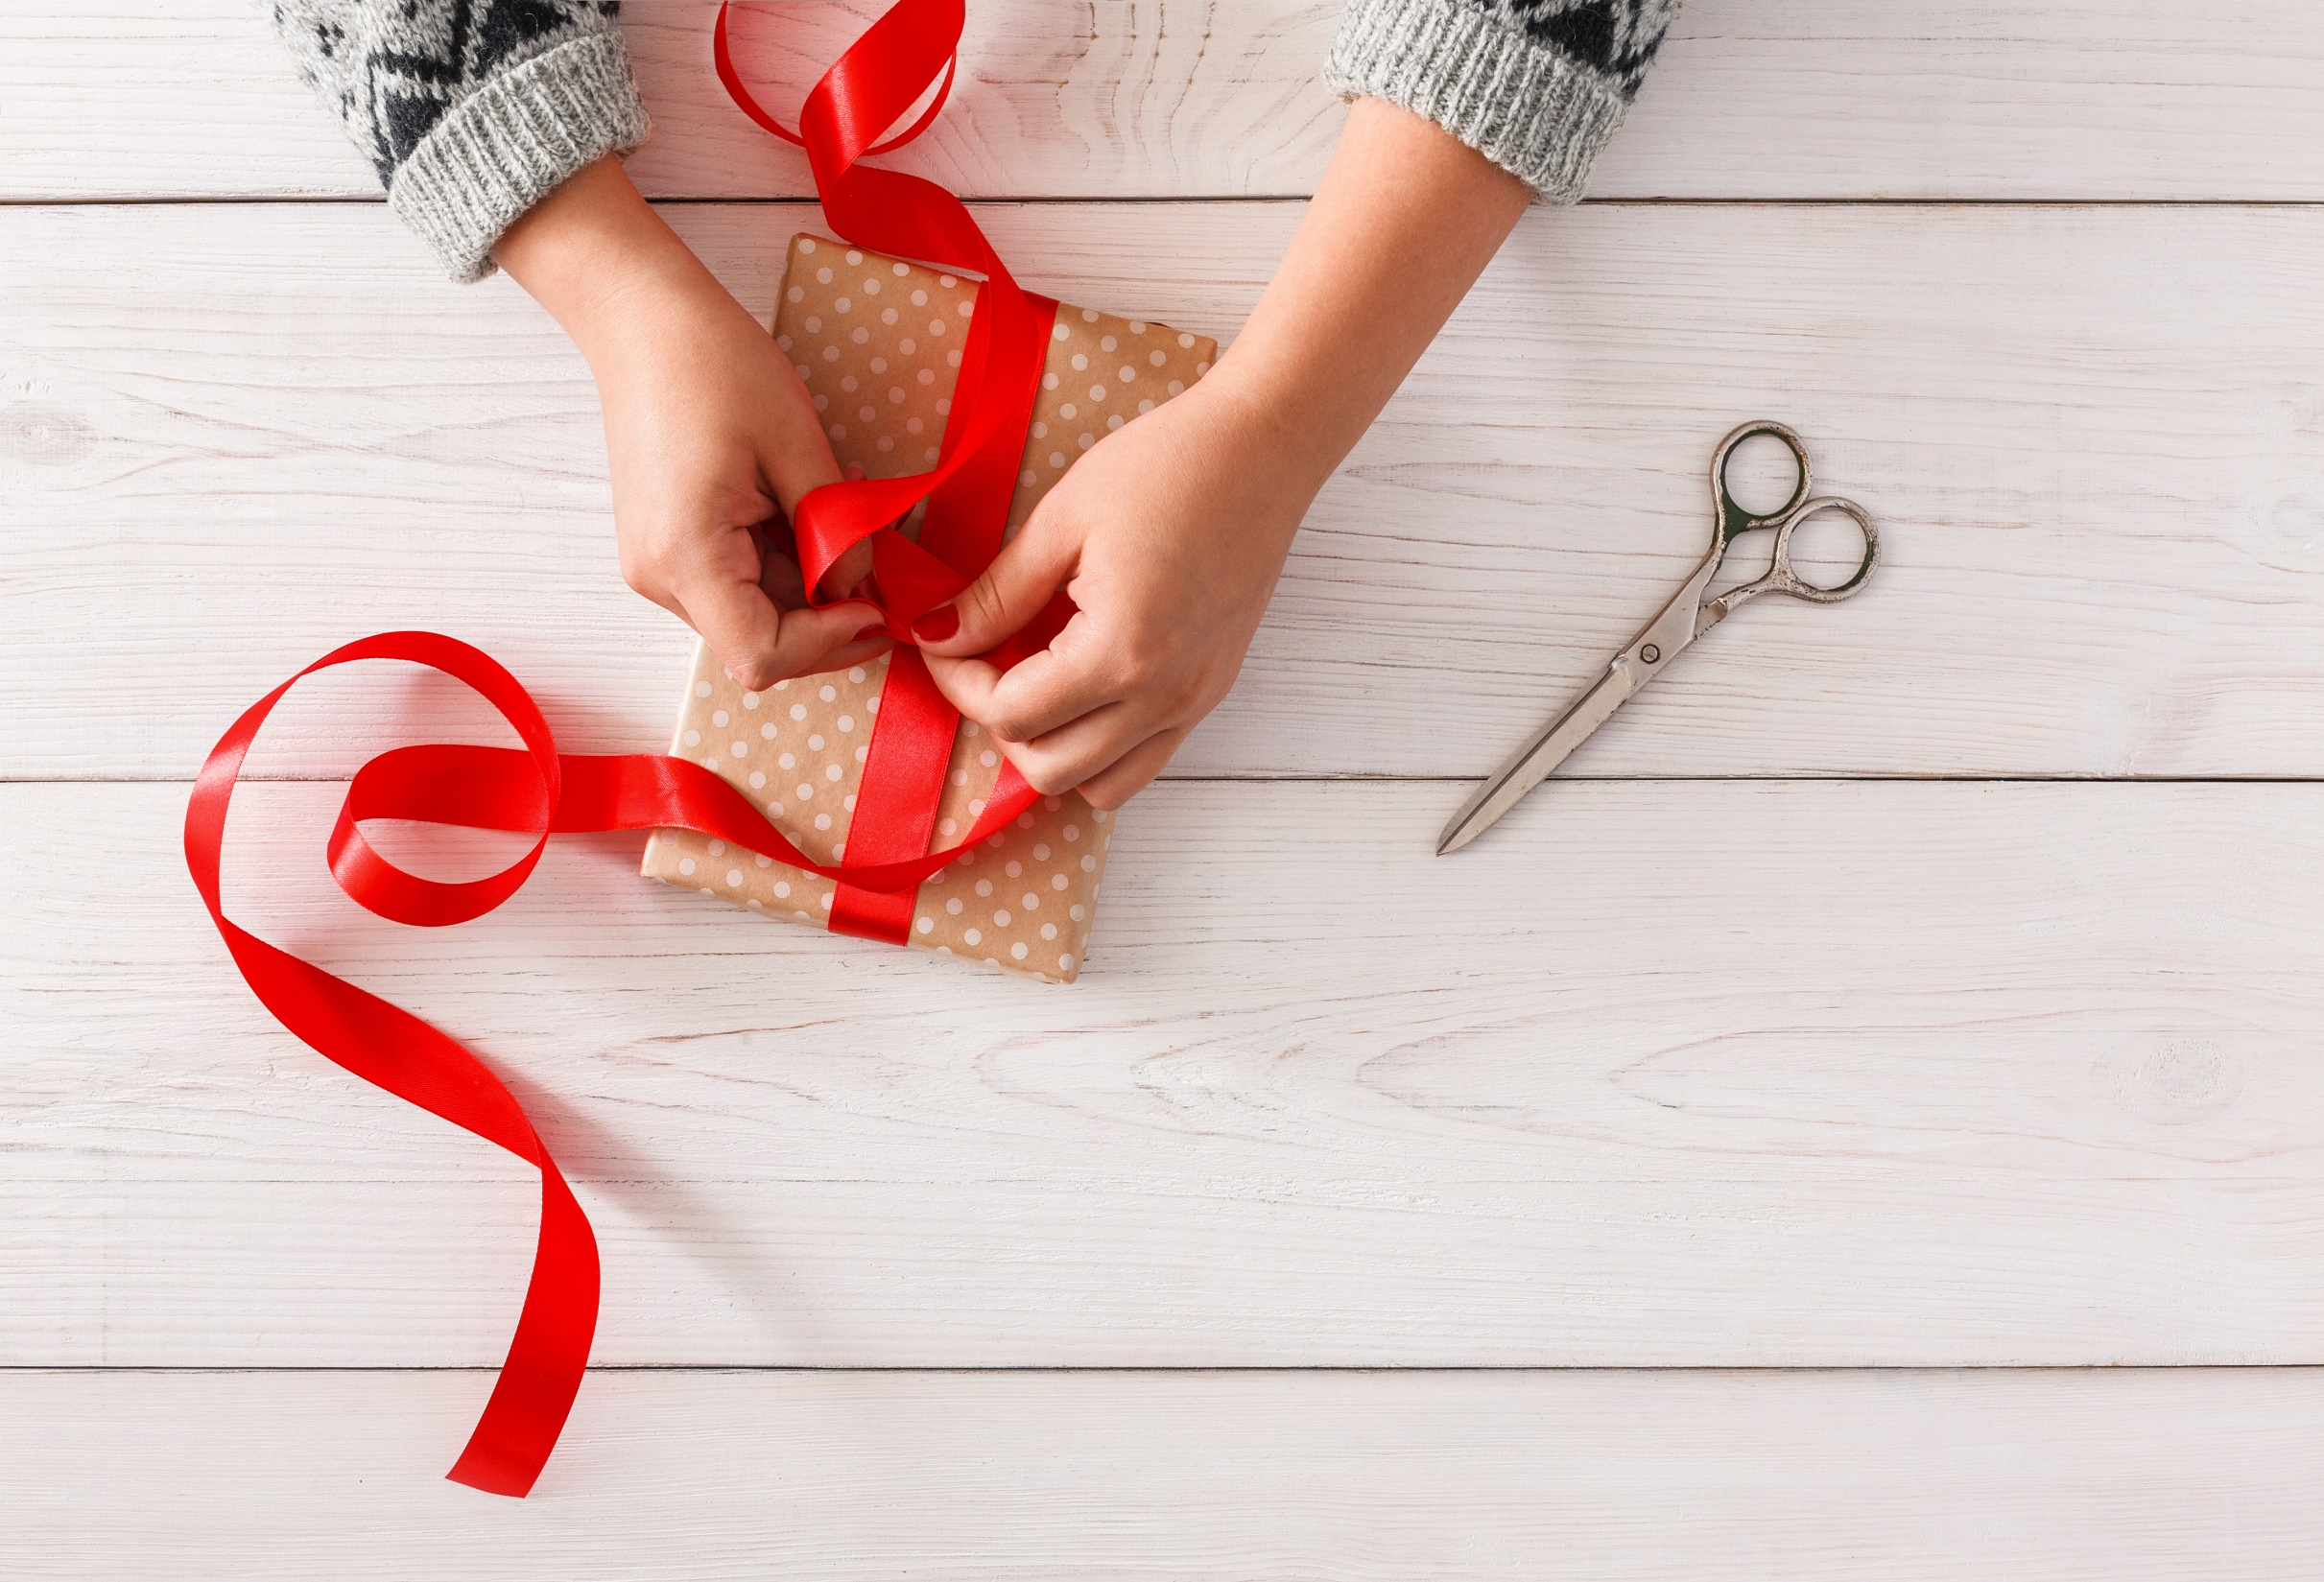
WRAP-UP

Slide 29
Today’s lesson
Vocabularies
Places of entertainment

Slide 30
Homework
Practise the vocabularies and make sentences using them.
Do the exercises in TA 6 Right on WB (p. 54).
Do the exercises in TA 6 Right on Notebook (pp. 54 & 55).
Prepare the next lesson (p. 106 SB).

Slide 31
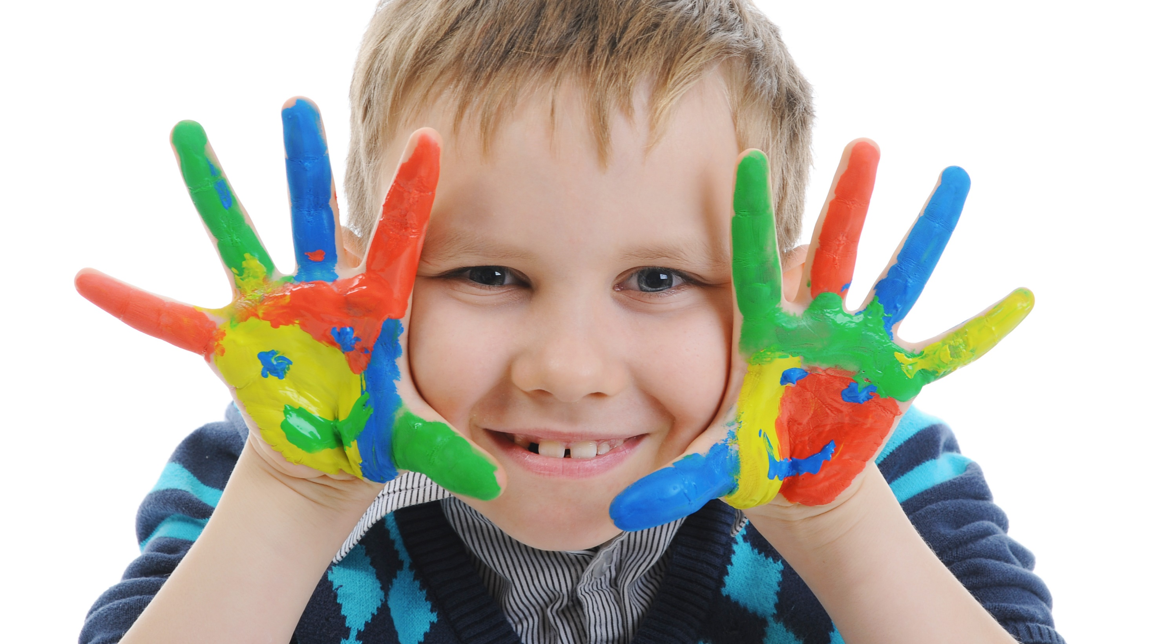
Enjoy your day!

