Slide 1


Slide 2

Unit
4
1
Unit
FAMILY LIFE
FOR A BETTER COMMUNITY
LESSON 4
SPEAKING
Benefits of volunteering activities

Slide 3

Unit
1
1
FAMILY LIFE
Family Life
Unit
OBJECTIVES
Talk about the benefits of volunteering activities

Slide 4
LESSON 4
SPEAKING
WARM-UP
Jumbled words
Task 1: Choose the THREE most important benefits of volunteering activities.
Task 2: Complete the diagram.
PRE-SPEAKING
WHILE-SPEAKING
Task 3: Presentation
CONSOLIDATION
Wrap-up
Homework

Slide 5
LESSON 4
SPEAKING
WARM-UP
Jumbled words

Slide 6
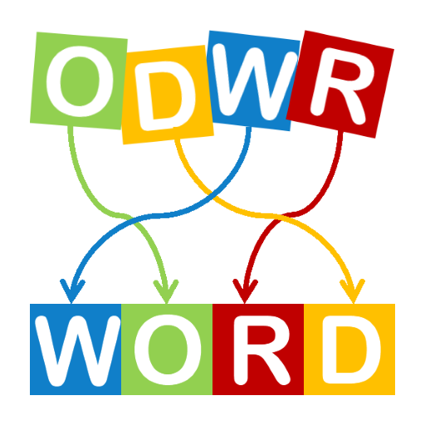
WARM-UP
JUMBLED WORDS
anitondo
donation
revloetun
volunteer
dnuf
fund
temero
remote
tbosot
boost

Slide 7
LESSON 4
SPEAKING
WARM-UP
Jumbled words
Task 1: Choose the THREE most important benefits of volunteering activities.
Task 2: Complete the diagram.
PRE-SPEAKING

Slide 8
PRE-SPEAKING
1
Choose the THREE most important benefits of volunteering activities.
Coming into contact with other teenagers with similar interests
Improving essential life skills, such as skills that will get you a job, or time management skills
Appreciating the good things in life and being positive
Helping teenagers find a sense of purpose in life
Gaining life experiences

Slide 9
PRE-SPEAKING
2
Complete the diagram with examples and details that explain the benefits of volunteering activities.
coming into contact with other teenagers with similar interests
sharing common interests and values
helping you become more confident
…
learning good things from each other

Slide 10
PRE-SPEAKING
2
Complete the diagram with examples and details that explain the benefits of volunteering activities.
improving essential life skills
time management skills
communication skills
…
group working skills

Slide 11
PRE-SPEAKING
2
Complete the diagram with examples and details that explain the benefits of volunteering activities.
…
…
…
…
helping different people
gaining life experiences
going to different places
dealing with different situations

Slide 12
LESSON 4
SPEAKING
WARM-UP
Jumbled words
Task 1: Choose the THREE most important benefits of volunteering activities.
Task 2: Complete the diagram.
PRE-SPEAKING
WHILE-SPEAKING
Task 3: Presentation

Slide 13
WHILE-SPEAKING
3
Work in groups. Give a presentation about the benefits of volunteering activities.
Functions | Useful expressions
Order points and expressions | First of all, … Second, … Third, … Finally, …
Giving examples | For example, … For instance, … … such as …

Slide 14

WHILE-SPEAKING
3
Work in groups. Give a presentation about the benefits of volunteering activities.
Presentation about the benefits of volunteering activities

Slide 15
LESSON 4
SPEAKING
WARM-UP
Jumbled words
Task 1: Choose the THREE most important benefits of volunteering activities.
Task 2: Complete the diagram.
PRE-SPEAKING
WHILE-SPEAKING
Task 3: Presentation
CONSOLIDATION
Wrap-up
Homework

Slide 16
CONSOLIDATION
1
Wrap-up
Talk about the benefits of volunteering activities

Slide 17
CONSOLIDATION
2
Homework
Prepare for the next lesson: Unit 4: Listening
2. Do exercises in the workbook

Slide 18

Website: hoclieu.vn
Fanpage: facebook.com/www.tienganhglobalsuccess.vn

