Slide 3
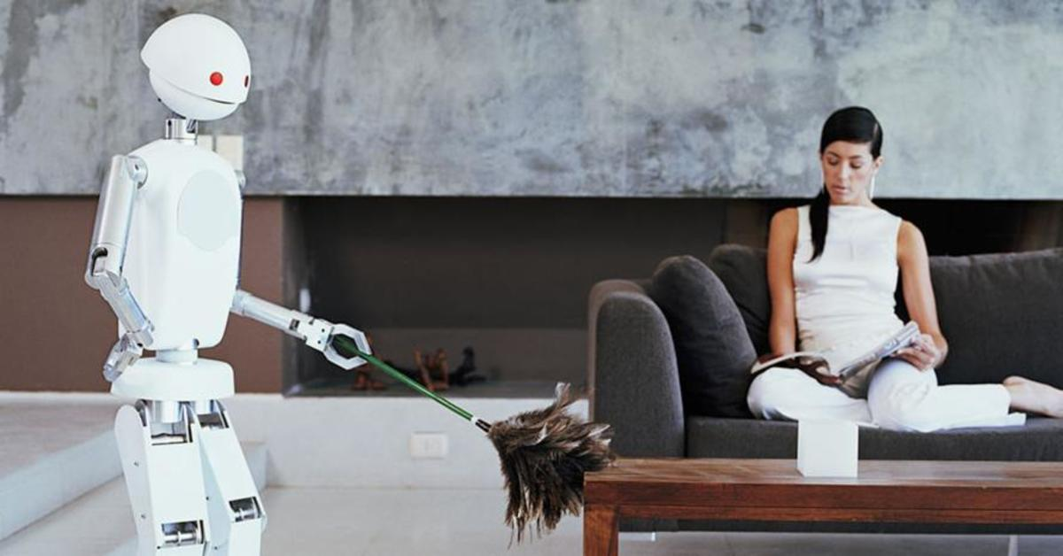
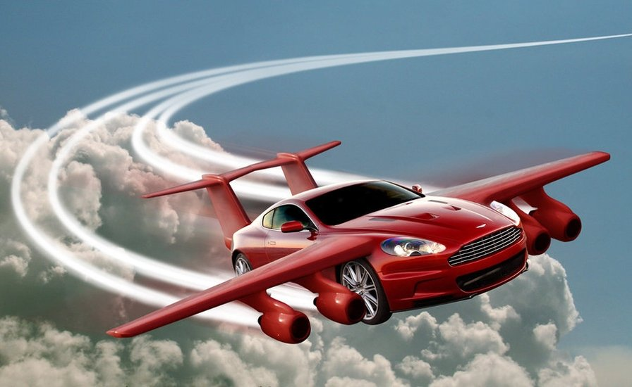
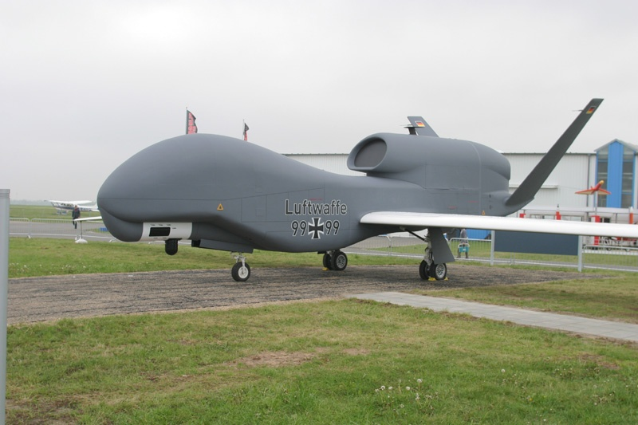
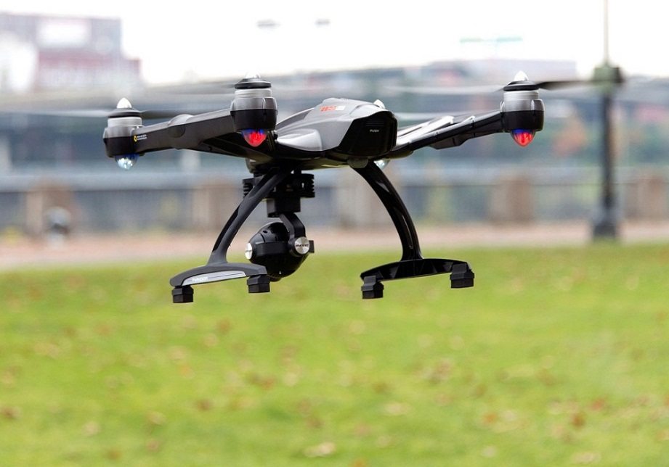
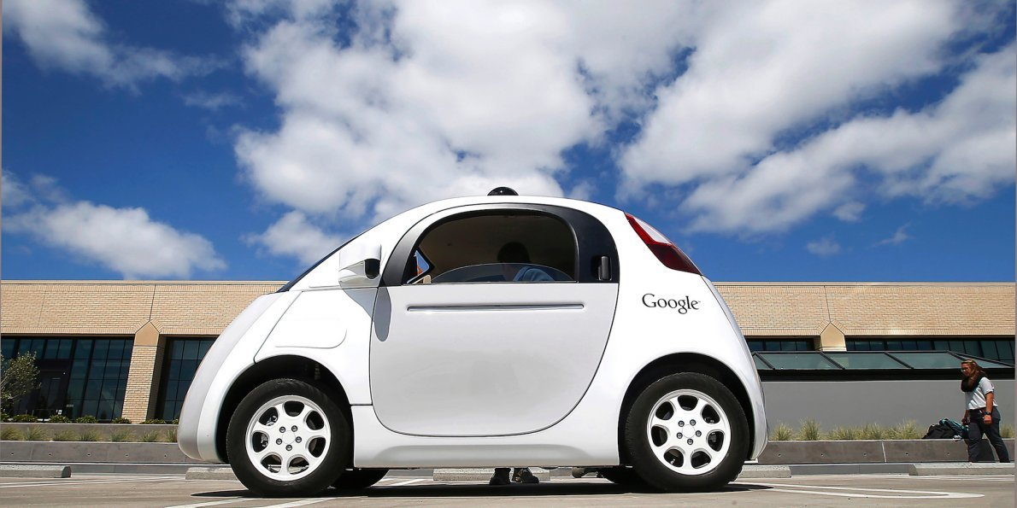
FLYING CAR
SPACESHIP
ROBOT
SMART CAR
DRONES
FLYING CAMERA

Slide 4
UNIT 11 :
SCIENCE AND TECHNOLOGY
LESSON 1 : GETTING STARTED
-At the science club

Slide 5
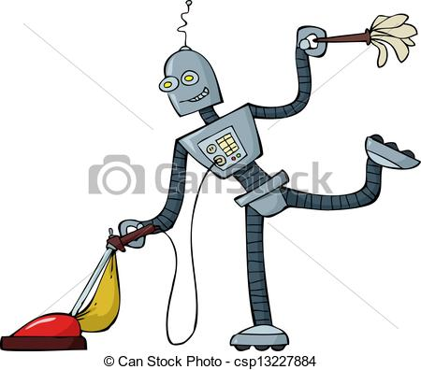
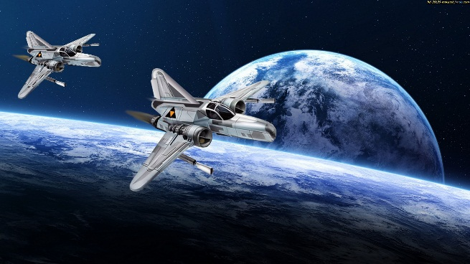
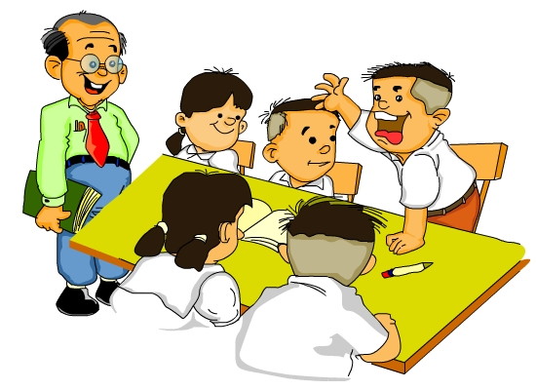
Activity 1. Listen and read
What can you see in the pictures?
Do you know these characters?
Where are they now?
What are they talking about? ...

Slide 6
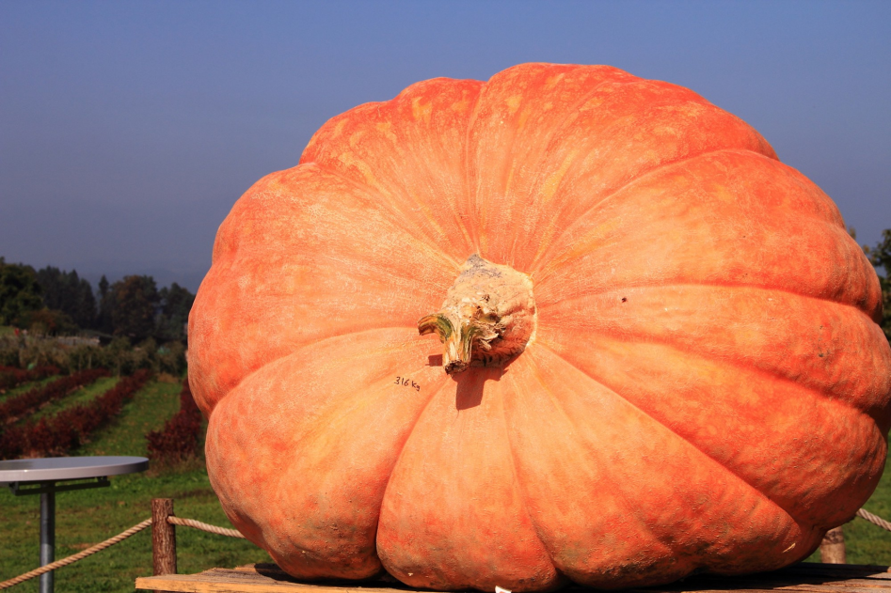
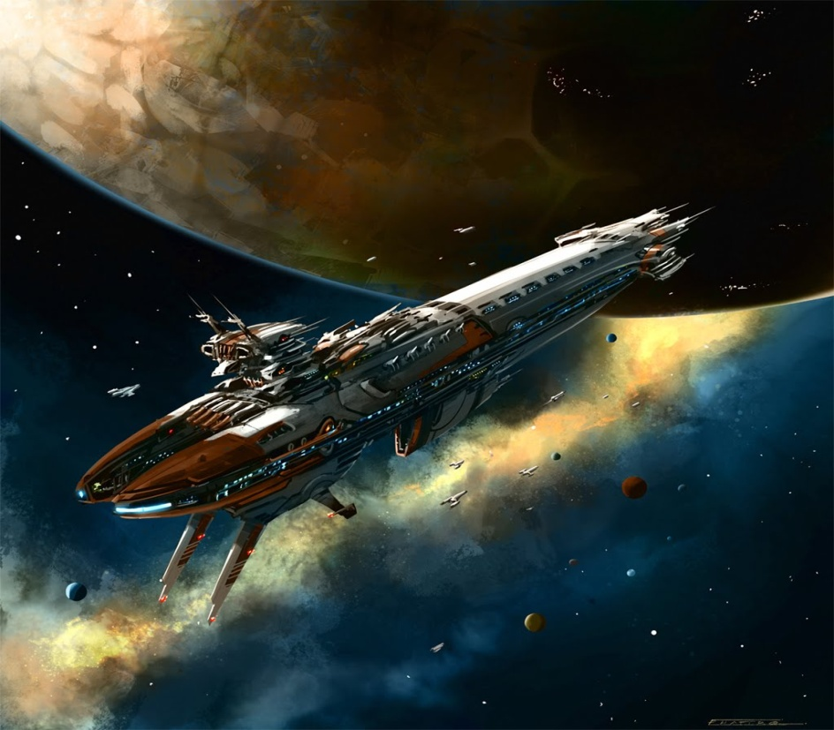
VOCABULARY
1. Enormous (adj):
to lớn, khổng lồ
2. Spaceship (n):
du thuyền không gian
3. Field (n):
lĩnh vực
4. Technique (n):
kỹ thuật
5. Crop yied (n):
năng suất cây trồng
6. Accurate measurement (n):
phương pháp đo lường chính xác
7. Telecommunications (n):
viễn thông

Slide 7
Activity 1.
a) Find the words in A in he conversation. Then match them to the words in B with similar meanings.
A | B
1.Developments | a. The answers
2. Field | b. Area
3.Enormous | c. Progress (n)
4. Economic | d. Big
5.The keys | e. Money-making
6. Benefits | f. Help
A | B
1: Developments | a. The answers
2. Field | b. Area
3.Enormous | c. Progress (n)
4. Economic | d. Big
5.The keys | e. Money-making
6. Benefits | f. Help

Slide 8
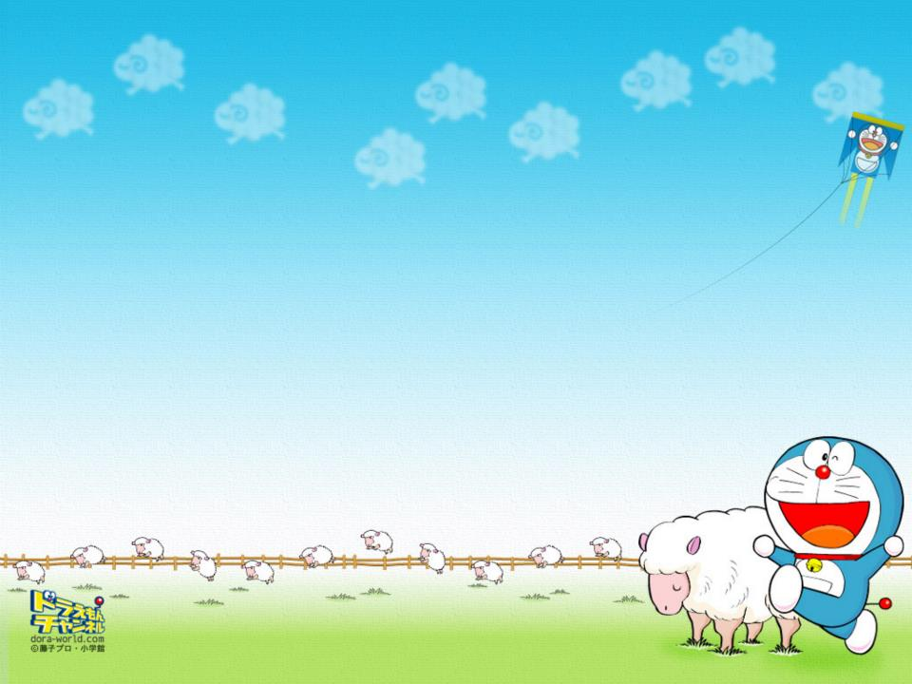
Activity 1. b) Answer the questions.
1. Where are Nick, Duong and Chau?
They are at the Science Club
2. What is the subject of Dr.Nelson’s talk?
It is the roles of science and technology in the 21st century.
3. What fields are science and technology greatly changing?
Science and technology are changing everything.
4. What did Nick’s dad tell him?
He told Mick that only robots would work in factories and clean our homes in the future.
5. What did Chau’s science teacher say?
Chau said that there would be no more schools: They’d just stay at home and learn on the internet.

Slide 9
Activity 1. c) Put a word/phrase from the box in each blank.
Flying cars
Economic Development
Field
Space
The key
1. Technology in the _____ of telecommunications has developed greatly over the last decade.
2. In the future, ordinary people may travel into _____ on spaceships.
3. He said he worked very hard and that was ______ to his success.
4. An international meeting on ___________________ took place in Singapore last week.
5. If we had __________ now, we could solve the problem of traffic jams.

Slide 10
Activity 2. Put one of the words/phrases from the box in each gap. There is one extra.
science subjects
technology
technique
machines
scientific progress
researchers
1. Her teacher said she was really good at ______________ , but she was not very good at English
2. Advances in __________ have improved crop yields by over 30%
3. Cancer ___________ have made great progress, but many aspects of this disease need further study.
4. Scientific will be trying to invent _______ to teach children at home.
5. Thanks to _________________. Our world will be transformed greatly.

Slide 11
Activity 3. Give the opposite of the words in brackets, using the prefix “un-” or “im-”
unknown
This is a species of insect previously (known) _______ to biologists.
2. I don’t like science fiction novels much. T think they are (realistic) ___________.
3. It is almost (possible) __________ to keep up with the latest developments in computing.
4. The teacher said that accurate measurement was (important) ___________ this experiment.
5. Fortunately, the river flowing through our town is (polluted) __________.
unrealistic
impossible
unimportant
unpolluted

Slide 12
AT HOME
Learn by heart new words.
Prepare next lesson 2. A closer look 1

