Slide 1
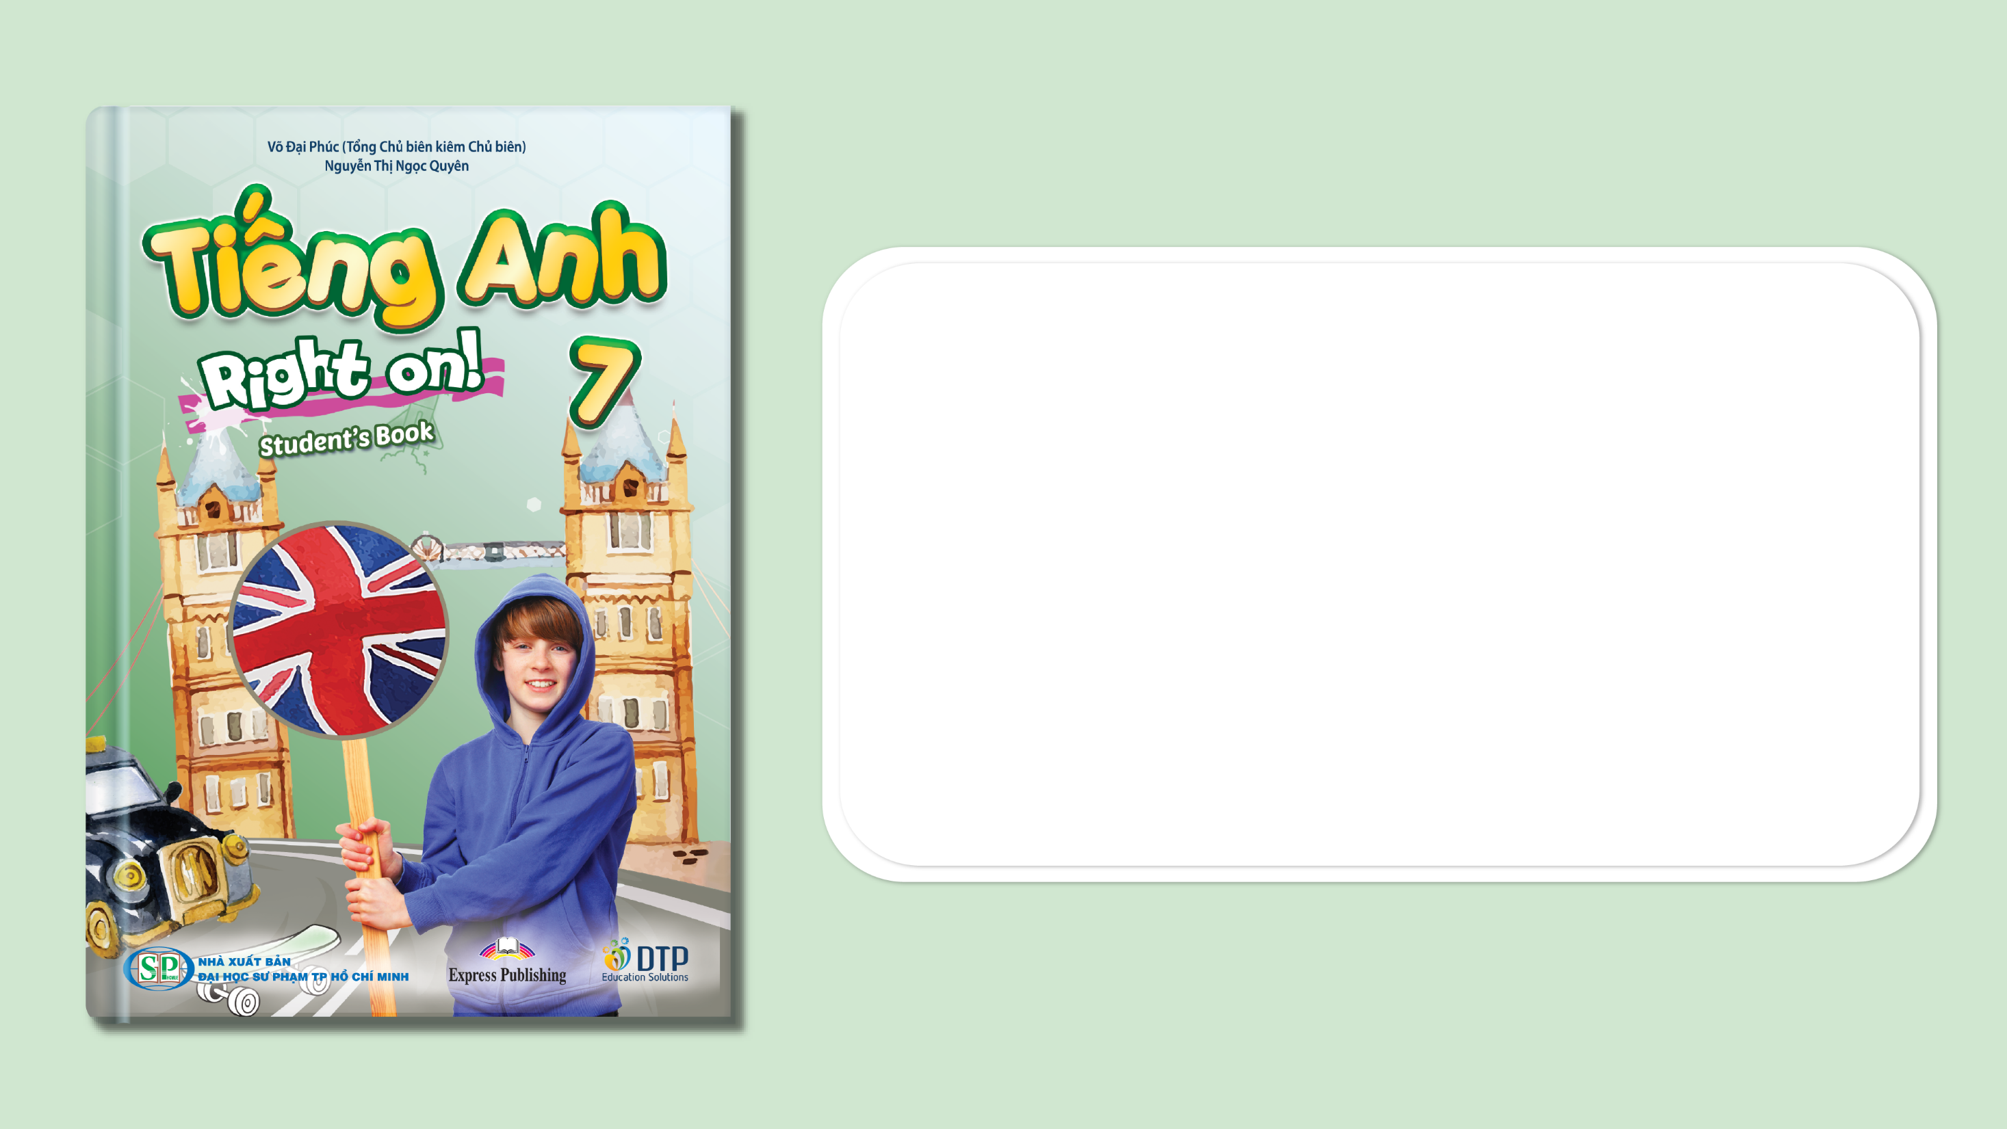
Unit 1: My World
Lesson 1f: Skills
(Cont.)
Page 23

Slide 2
Lesson Outline
Warm-up
Vocabulary
Listening
Writing
Consolidation
Wrap-up

Slide 3
Objectives
By the end of this lesson, students will be able to…
- learn about and enrich vocabularies to talk about cultural etiquette in the UK.
- practise listening for specific information.
- write a blog comment.

Slide 4

WARM-UP

Slide 5
Rearrange the letters to form the meaningful words/phrases.
g/a/c/a/k/c/k/b/i/p/n
g/u/h
u/r/e/d
b/u/h/t/s/m p/u
n/d/o
h/e/s/k/a
c/o/l/l/a
backpacking
hug
rude
thumbs up
nod
shake
local

Slide 6
Choose the word whose underlined part pronounced differently from that of the other words.
1. A. curtain B. cupboard C. suburb D. husband
/ˈkɜːtən/ /ˈkʌbəd/ /ˈsʌbɜːb/ /ˈhʌzbənd/
2. A. charity B. chemistry C. chocolate D. wheelchair
/'tʃæriti/ /ˈkemɪstri/ /ˈtʃɒklət/ /ˈwiːltʃeər/
3. A. nose B. bus C. snake D. surf
/nəʊz/ /bʌs/ /sneɪk/ /sɜːf/

Slide 7

It’s time to learn …

Slide 8


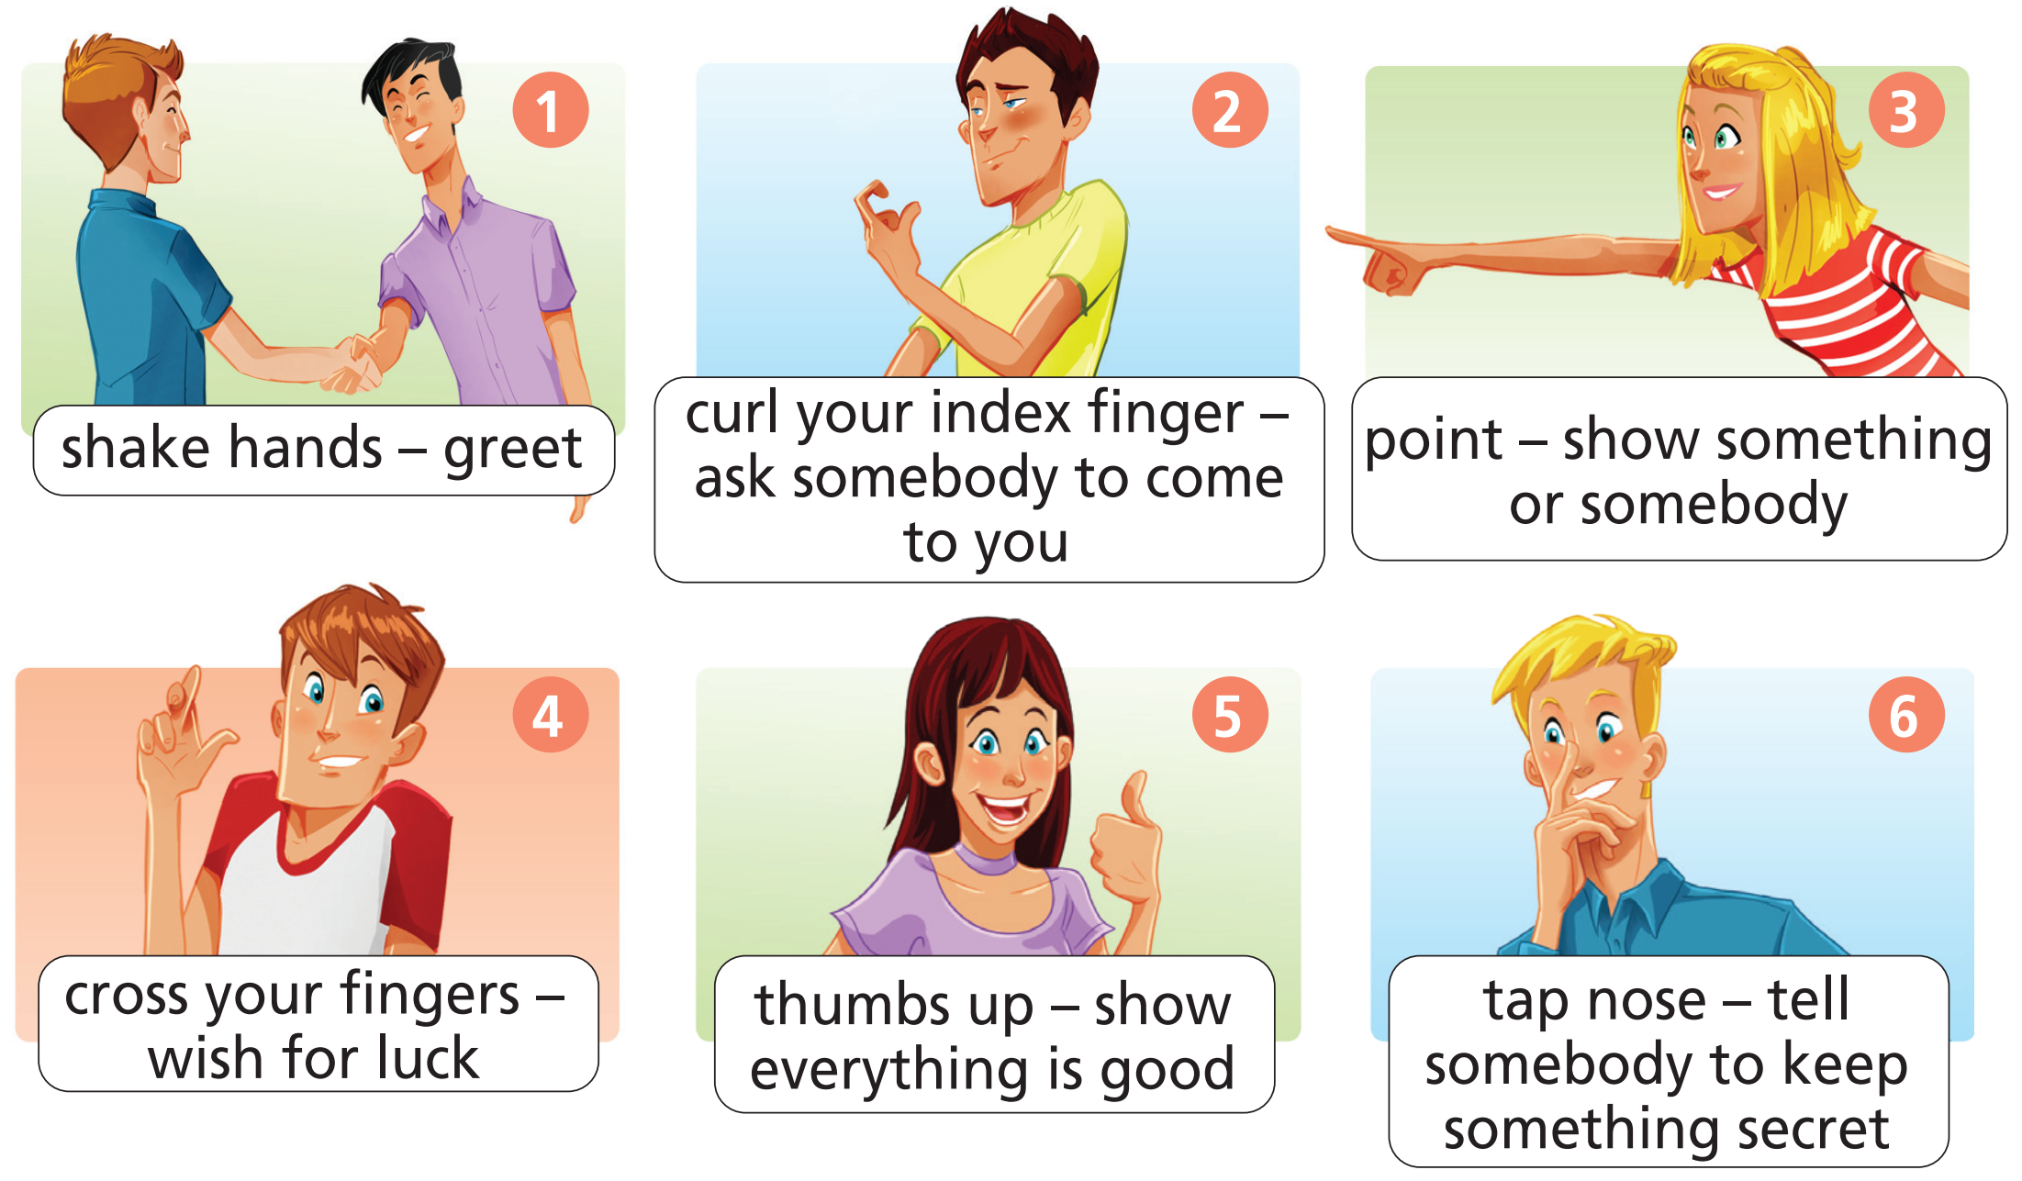
Vocabulary
5 a) Listen and repeat.

Slide 9
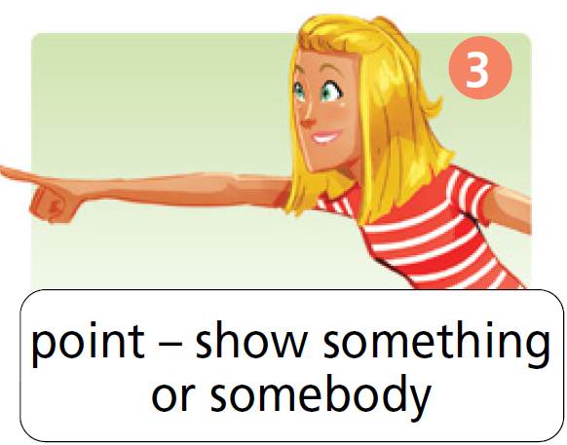
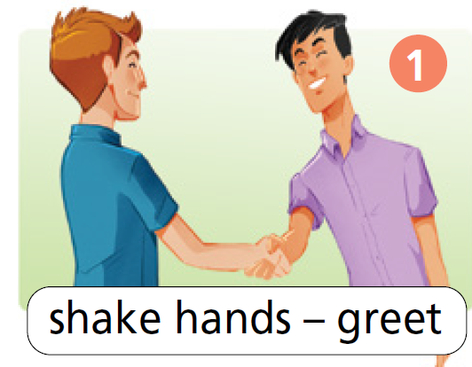
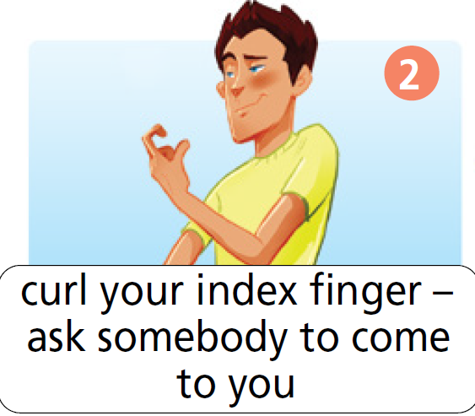
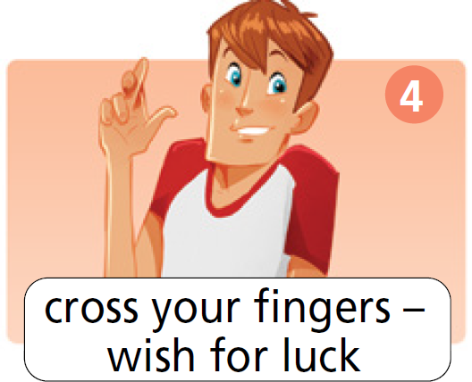
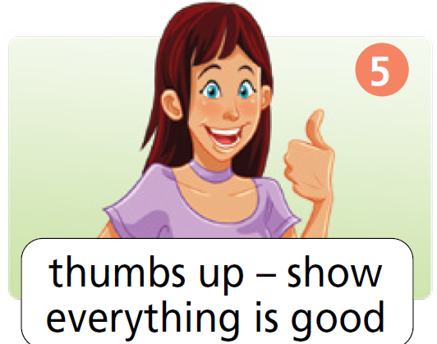
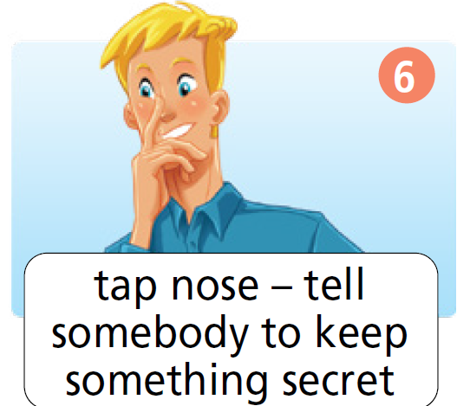
Vocabulary
Click on each phrase to hear the sound
5 a) Listen and repeat.

Slide 10
b) What do these gestures mean in the UK? Make sentences.
Example

Slide 11
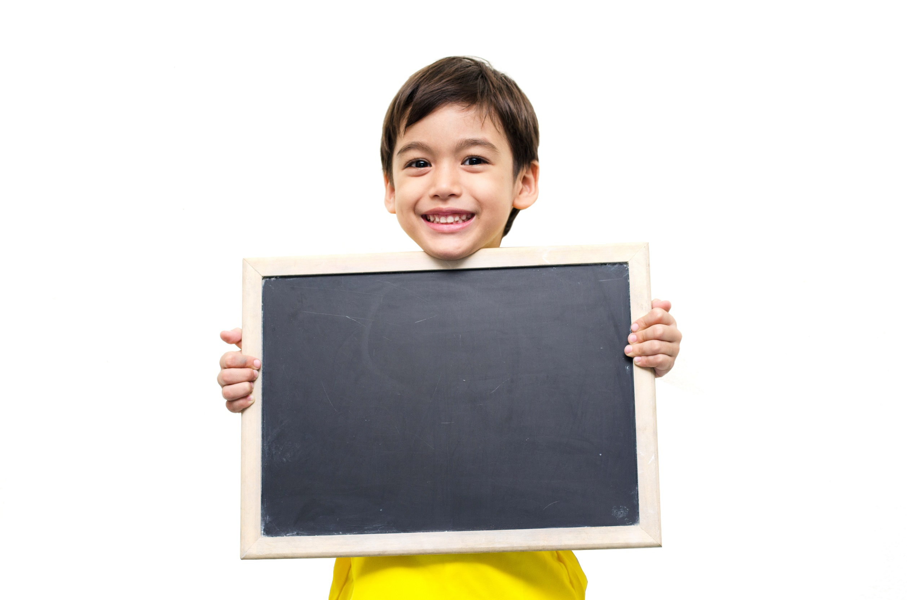
Speaking

Slide 12

Which of the gestures in Exercise 5a mean the same in your country?
shake hands curl your index finger point
cross your fingers thumbs up tap nose
Example
In Vietnam, we hardly tap our nose. We never curl the index finger or cross our fingers; both gestures are very rude. We also shake hands to greet someone. If you want to point at something, you should use your open hand. We usually use thumbs up to show everything is OK.

Slide 13

Listening

Slide 14

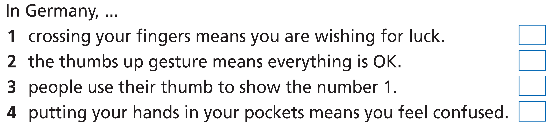
Pre-listening
Listen to Sam and Jessica talking about Jessica’s holiday to
Germany. Decide if the statements are R (right) or W (wrong).
First, underline the key words.

Slide 15
While-listening
Listen to Sam and Jessica talking about Jessica’s holiday to
Germany. Decide if the statements are R (right) or W (wrong).
Now, listen and choose the correct answers.

Slide 16
Listen to Sam and Jessica talking about Jessica’s holiday to
Germany. Decide if the statements are R (right) or W (wrong).
Now, listen again and check your answers.
W
Jessica: For example, you know how we cross our fingers to wish for luck here? Well, in Germany, people press their thumb into the middle of their hand and put their other fingers over the top.
W
R
Sam: So does thumbs up still means everything is OK in Germany?
Jessica: Actually, no. It’s how people show the number one when they’re counting.

Slide 17
Listen to Sam and Jessica talking about Jessica’s holiday to
Germany. Decide if the statements are R (right) or W (wrong).
Now, listen again and check your answers.
W
Sam: How confusing! If I go to Germany, I’m putting my hands in my pockets so I don’t make a mistake!
Jessica: Erm … that’s not a good idea either, Sam. Putting your hands in your pockets in Germany means you’re bored.

Slide 18
Audio script
Sam: Hi, Jessica! You’re back!
Jessica: Hi, Sam! Yes – what a great holiday!
Sam: What’s Germany like?
Jessica: Well, the weather is a lot like it is here in the UK, but the culture is different.
Sam: What do you mean?
Jessica: For example, you know how we cross our fingers to wish for luck here? Well, in Germany, people press their thumb into the middle of their hand and put their other fingers over the top.
Sam: Like giving the thumbs up, but with the thumb inside?
Jessica: Exactly!
Sam: So does thumbs up still means everything is OK in Germany?
Jessica: Actually, no. It’s how people show the number one when they’re counting.
Sam: How confusing! If I go to Germany, I’m putting my hands in my pockets so I don’t make a mistake!
Jessica: Erm … that’s not a good idea either, Sam. Putting your hands in your pockets in Germany
means you’re bored.
Sam: You’re joking!

Slide 19
Post-listening
Tell your partner some gestures people use in Germany. Explain their meanings.

Slide 20
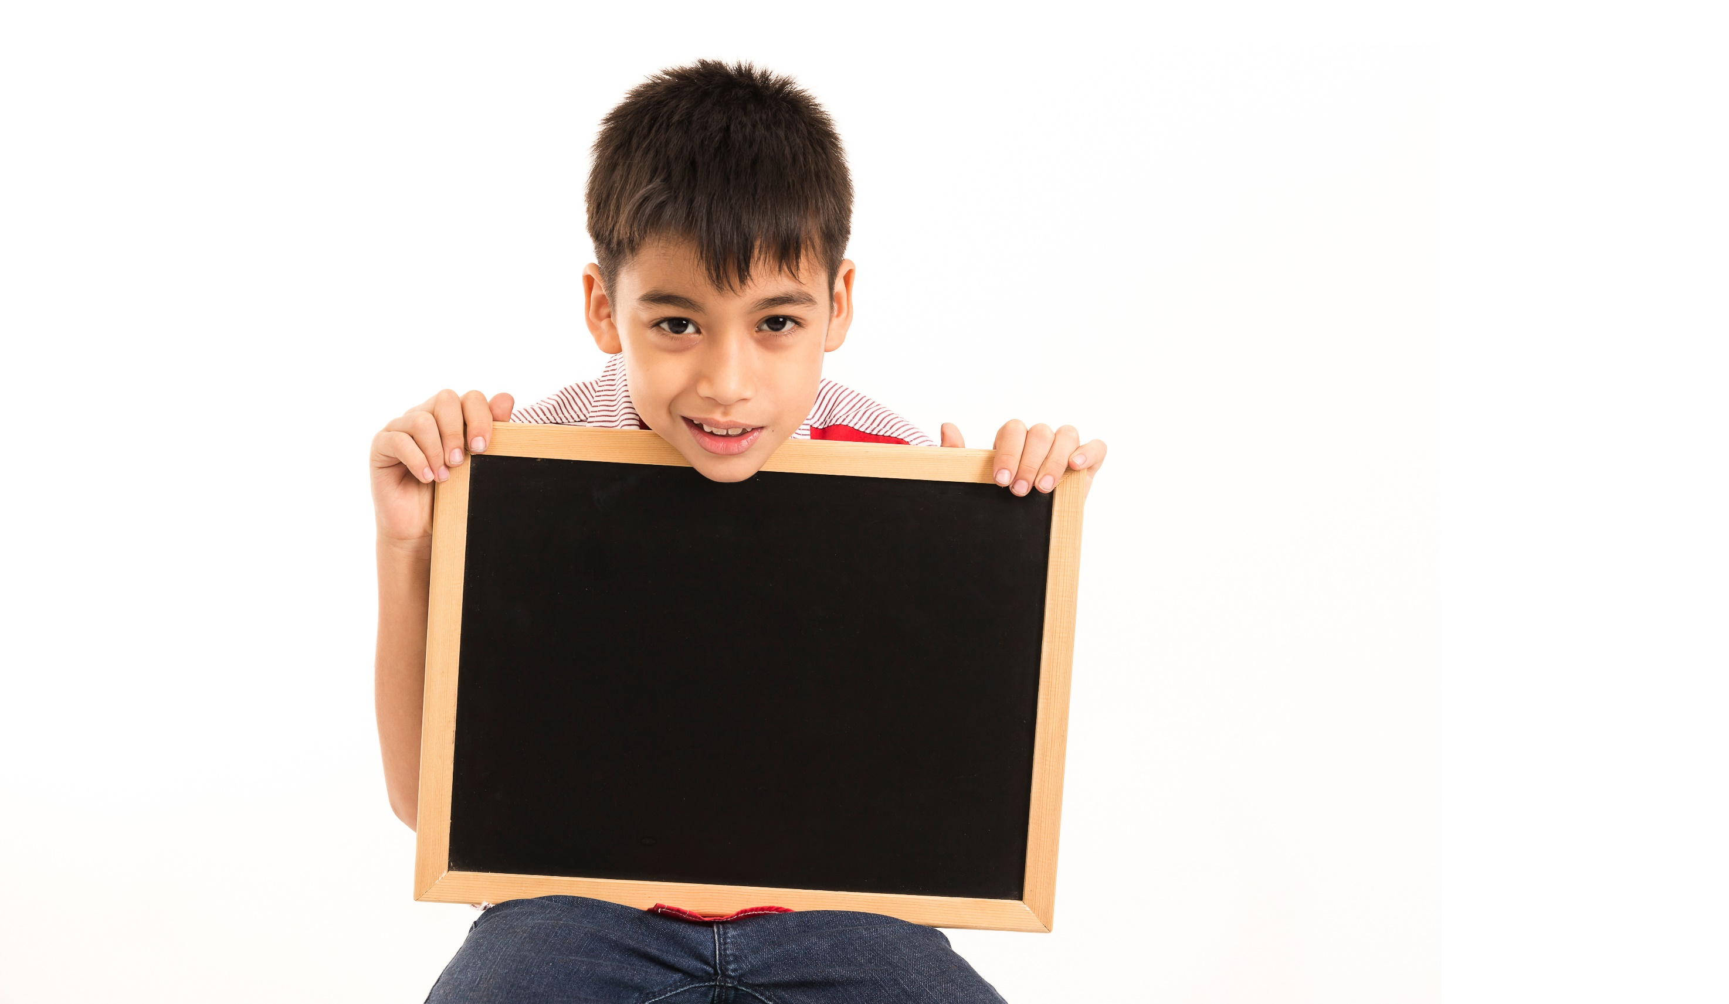
Writing

Slide 21

Pre-writing
Structure of a blog comment
Greet the blogger
Hey Phil! This is Hoa from Vietnam. I’m a big
fan of your blog! In my country, we never
curl our index finger because it is very rude.
However, in the UK and other countries, this
gesture means come here. So, if you ever
come to Asia, don’t curl your index finger to
anyone! Can’t wait for your next post!
Introduce yourself
Describe a gesture and say what it means

Slide 22
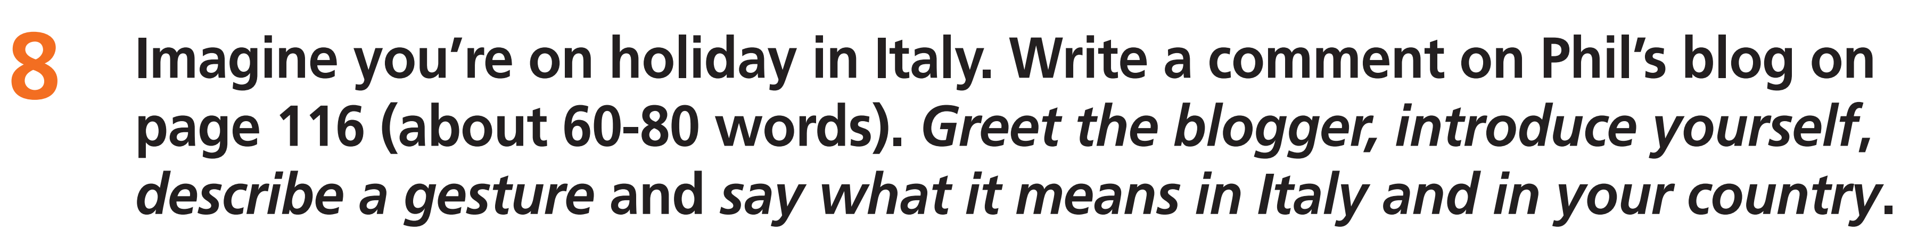
While-writing

Slide 23
Post-writing
Peer correction
Exchange your papers. Tick (✓) in the column “Yes” or “No“ if your friends’ writing meet the criteria.
Guideline
Criteria | Yes | No
Greeting the blogger
Introduce himself/herself
Describe the gestures
Explain the gestures’ meanings
Spelling mistakes | circle
Grammar mistakes | underline

Slide 24

CONSOLIDATION

Slide 25
Work in groups. Take turn to talk about gestures in different cultures around the world.

Slide 26

WRAP-UP

Slide 27
Today’s lesson
Vocabularies
Gestures
Structures/ Sentence patterns
Sentences to describe gestures

Slide 28
Homework
Practice the vocabularies and structure and make sentences using them.
Do the exercises in TA 7 Right on WB (page 15)
Prepare the next lesson (page 24 SB)
Do the exercise in TA 7 Right on Notebook (page 9)

Slide 29
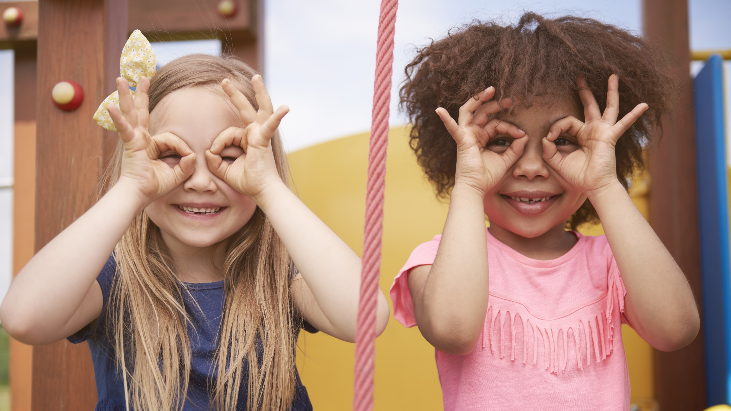
Enjoy your day!

