Slide 1

Unit 3: School
Lesson 2.1
Page 41

Slide 2
Lesson Outline
Warm-up
Vocabulary
Structure
Consolidation
Wrap-up

Slide 3
Objectives
By the end of this lesson, students will be able to identify 5 school subjects and use them in questions.
Vocabulary: math, English, art, P.E. (physical education), music
Structure: Do you like math?
- Yes, I do./No, I don't.

Slide 4

WARM UP

Slide 5

LET’S PLAY!
Stop the bus
letters | animals | School things | Family members
Notes:
Put the students into teams of four.
Draw on the board a table like the one above and get each team to copy it onto a piece of paper.
Students simply have to think of one item to go in each category beginning with the set letter.
Give an example line of answers for the first time you play with a new group.
The first team to finish shouts 'Stop the Bus!'.
Check their answers and write them up on the board and if they are all okay that team wins a point. If there are any mistakes in their words, let the game continue for another few minutes.

Slide 6

It’s time to learn …

Slide 7
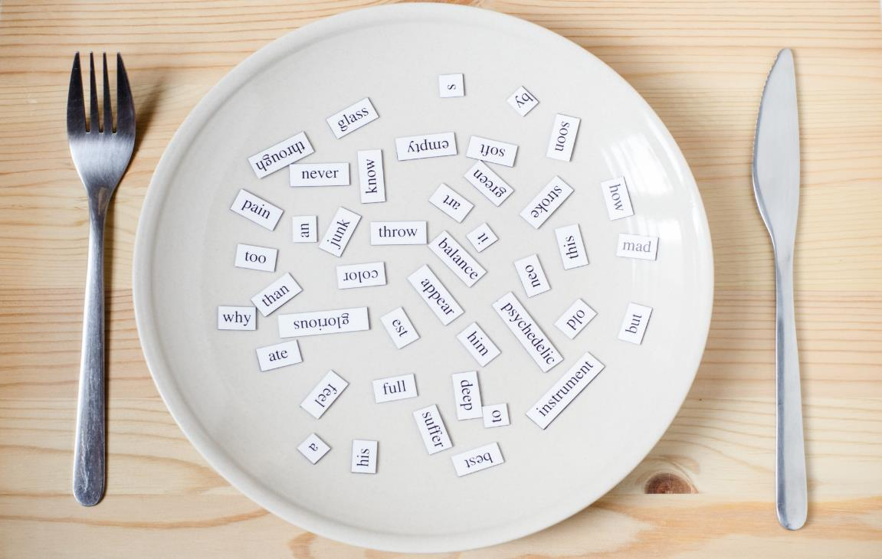
New words
math
English
P.E. (physical education)
art
music

Slide 8


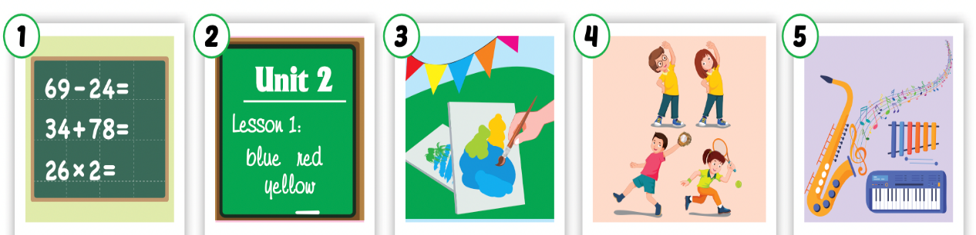
Click the icon to hear the sound.
Listen and point.

Slide 9
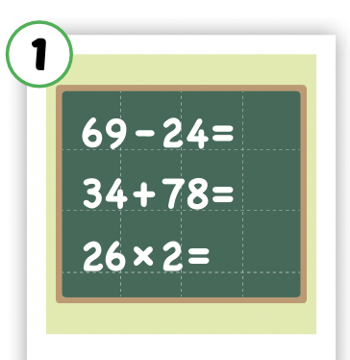
Listen and repeat.
Click each picture to hear the sound.
math
/mæθ/
môn toán

Slide 10

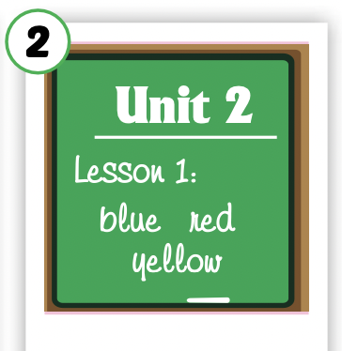
Listen and repeat.
Click each picture to hear the sound.
English
/ˈɪŋɡlɪʃ/
môn tiếng Anh

Slide 11
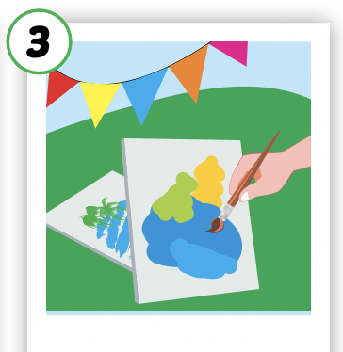
Listen and repeat.
Click each picture to hear the sound.
art
/ɑːrt/
môn mỹ thuật

Slide 12
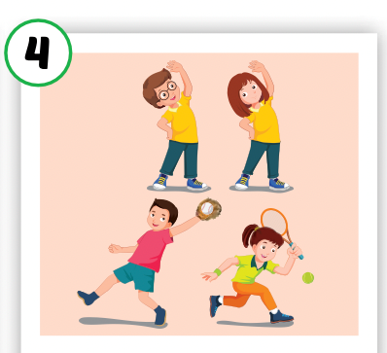
Listen and repeat.
Click each picture to hear the sound.
P.E.
(physical education)
/ˌpiː ˈiː/
môn thể dục

Slide 13
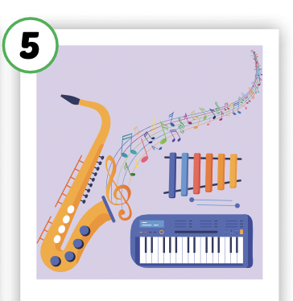
Listen and repeat.
Click each picture to hear the sound.
music
/ˈmjuːzɪk/
môn âm nhạc

Slide 14

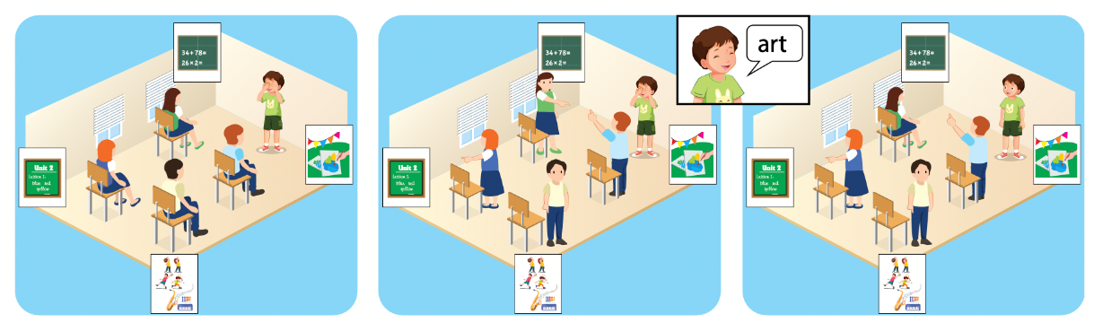

Slide 15
Let’s play!

Slide 16
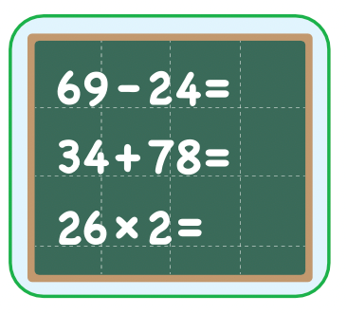
math
SHOW

Slide 17
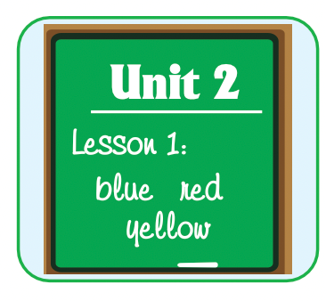
English
SHOW

Slide 18
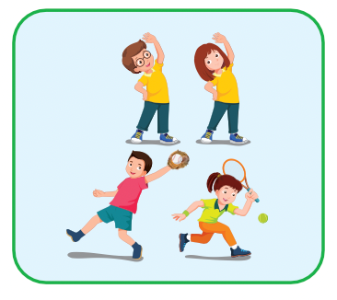
P.E.
SHOW

Slide 19
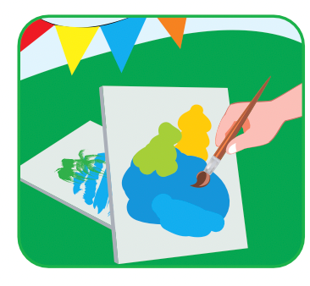
art
SHOW

Slide 20
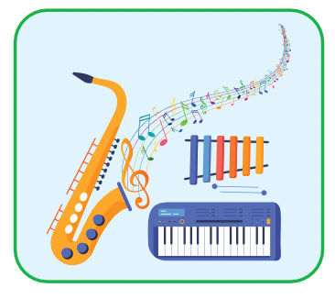
music
SHOW

Slide 21
math
SHOW

Slide 22
English
SHOW

Slide 23
P.E.
SHOW

Slide 24
art
SHOW

Slide 25
music
SHOW

Slide 26
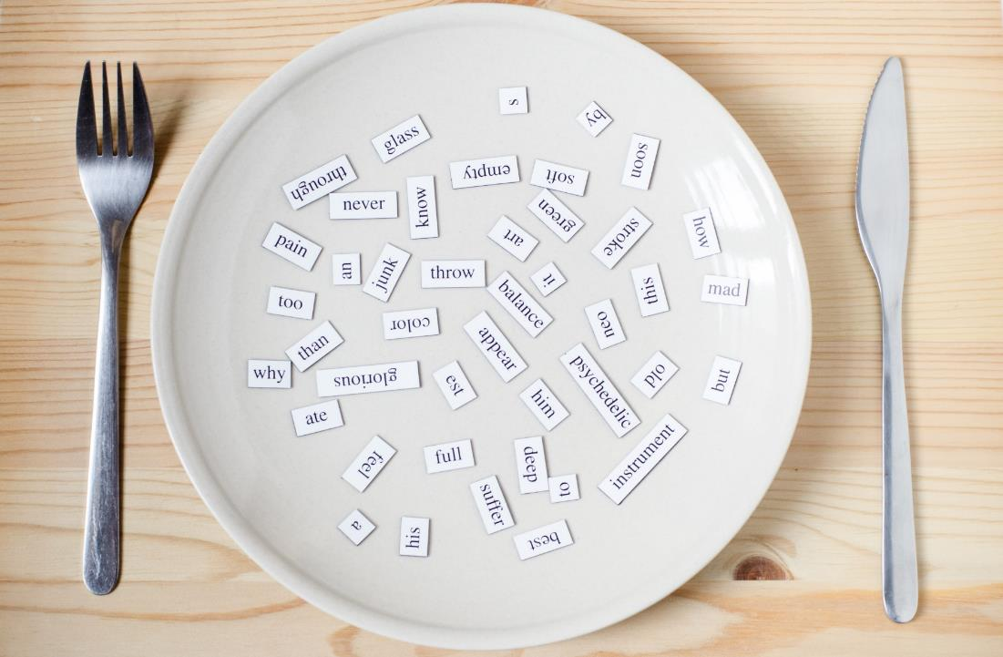
Structures
Do you like math?
Yes, I do./No, I don’t.

Slide 27

Presentation

Slide 28

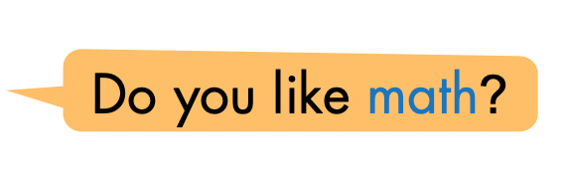
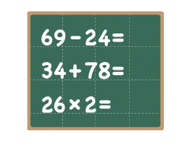
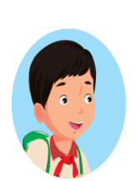
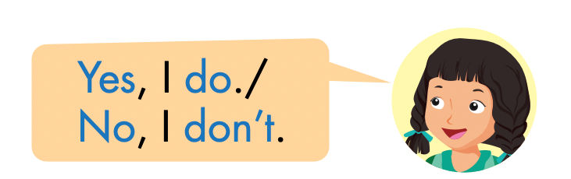
Click the icon to hear the sound.

Slide 29

Practice

Slide 30

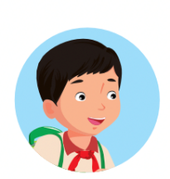

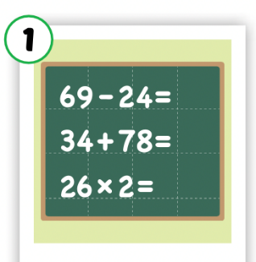
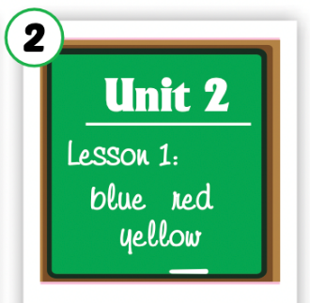
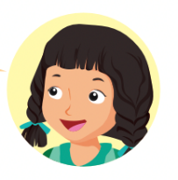
LET’S PRACTICE!
Do you like…………?
No, I don’t.
Yes, I do.
Yes, I do.
No, I don’t.
Yes, I do.

Slide 31

Production

Slide 32

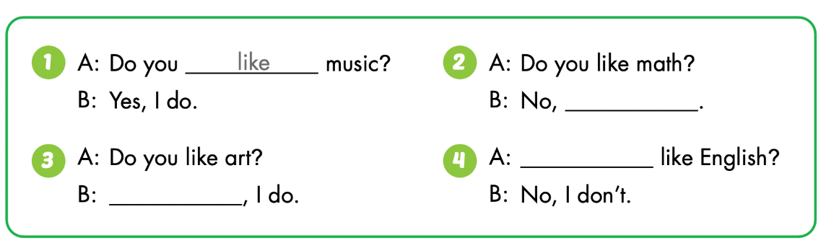

Slide 33
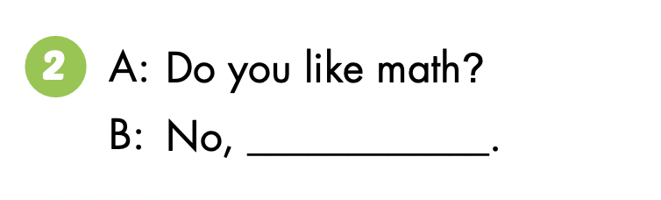
I don’t

Slide 34
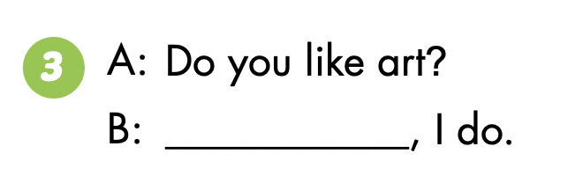
Yes

Slide 35
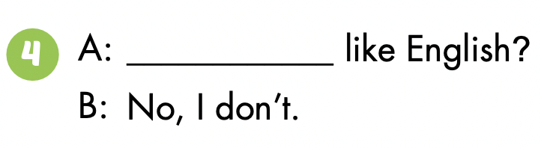
Do you

Slide 36

CONSOLIDATION

Slide 37

Let’s play!
Concentration
Notes:
Sit in a circle with your students and do the hand actions of lap (both hands to lap), clap, left click, right click. On the first finger click, you say your name, and on the second click you say the name of someone in the circle. You have passed the turn to the person you nominated on your second finger click. Then they say their own name on the first click and the name of another student on the second, and so it goes on. When they have got the idea, everyone says their favorite school subjects: I like math.

Slide 38

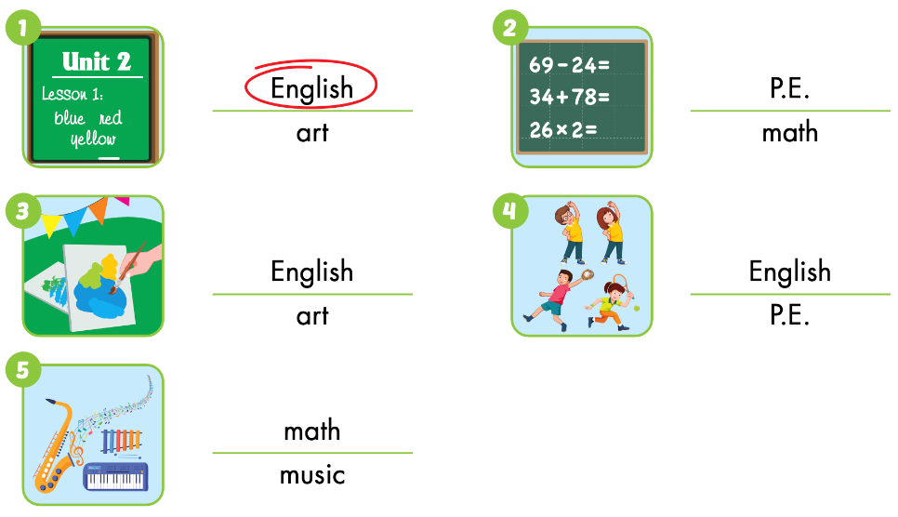
Extra Practice
WB p. 30

Slide 39
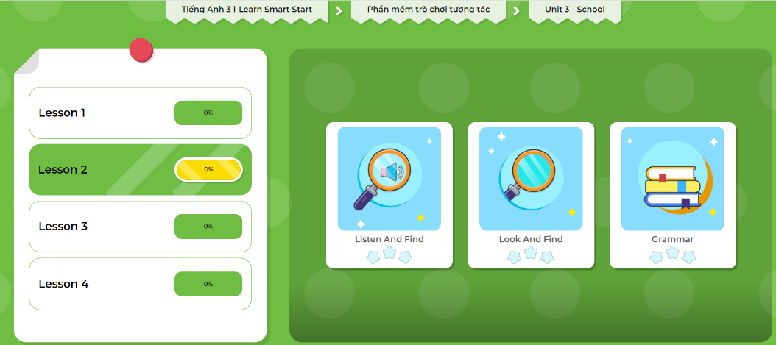
Extra Practice
DHA App
Let’s play!
Click on the picture below

Slide 40

WRAP-UP

Slide 41
Lesson 3
Today’s lesson
Vocabularies
math, English, art,
P.E. (physical education), music
Structures/ Sentence patterns
Do you like math?
- Yes, I do./No, I don't.

Slide 42
Lesson 3
Homework
Learn by hearts vocabularies and make sentences using them.
Do the exercises on page 30 WB
Do the exercises in Tiếng Anh 3 i-Learn Smart Start Notebook on page 23
Prepare the next lesson (page 42 SB)
Play the consolidation games in Tiếng Anh 3 i-Learn Smart Start DHA App on www.eduhome.com.vn

Slide 43
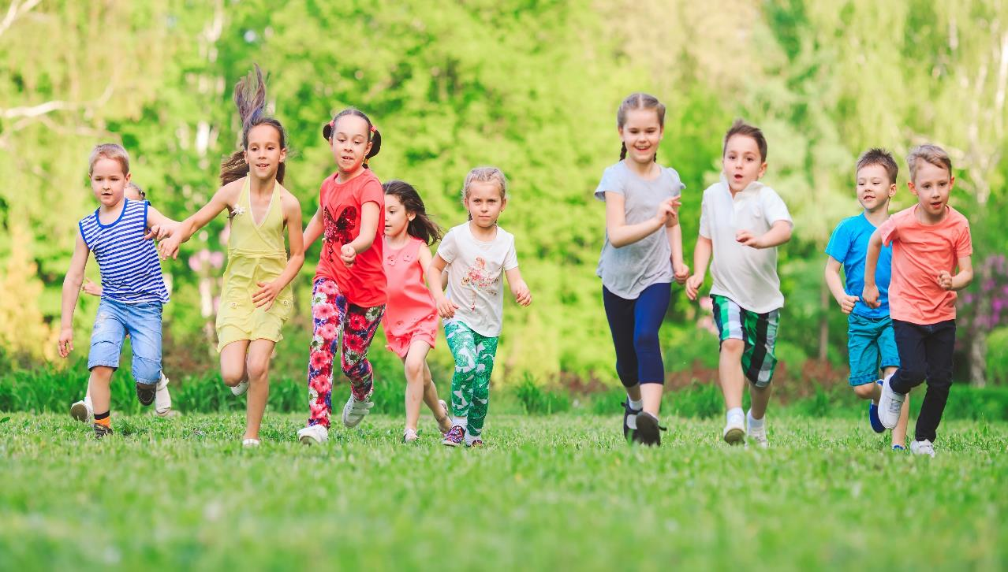
Have a nice day!

Slide 44

Lesson 3
Stay positive and have a nice day!

