Slide 1

Unit 8: The World around Us
Review
Pages 100 & 101

Slide 2
Lesson Outline
Warm-up
Listening
Reading
Vocabulary
Grammar
Pronunciation
Consolidation
Wrap-up

Slide 3
Objectives
By the end of this lesson, students will be able to…
Reading & Listening: Practice reading and listening for general and specific information.
Vocabulary: rafting, canyon, cave, hiking, kayaking, campsite, sleeping bag, flashlight, bottled water, tent, battery, pillow, towel, highland, beach, mountain, waterfall, bay, forest, island
Grammar: Modals (Should, can, can’t), Conjunction (so)
Speaking: Talk about the plan for a trip

Slide 4

WARM-UP

Slide 5
Find as many words as possible
What do we need for the trip? (The word with 4 letters)
We need to bring a ___________.
Food, tent, soap……….

Slide 6
Find as many words as possible
What do we need for the trip? (The word with 5 letters)
We need to bring a ___________.
Towel, knife, water, …….

Slide 7
Find as many words as possible
We should go to ___________ for our summer vacation. (A famous place in Vietnam)
Phú Quốc Island, Vũng Tàu Beach, Nha Trang Beach, Hạ Long Bay

Slide 8
Find as many words as possible
We should go to ___________ for our summer vacation. (A famous place in the world)
Table Mountain, Sunset Beach, Fuji Mountain, Niagara Waterfall……

Slide 9
Find as many words as possible
We go to Vũng Tàu beach this summer. We can ______________ (Activities you can do on the beach)
Go swimming, sunbathe, eat seafood….

Slide 10
Find as many words as possible
We go to Phú Quốc Island this summer. What is the best way to get there? (List the means of transportation)
Car, boat, plane, coach, ship, …

Slide 11

Listening

Slide 12

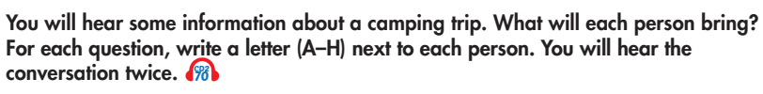
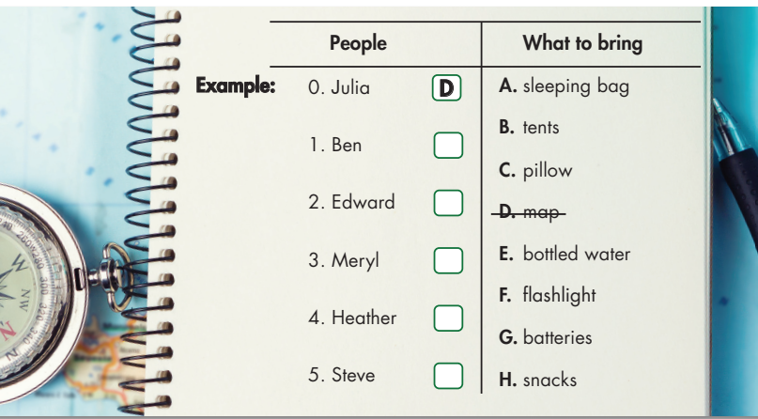

E
F
B
G
H

Slide 13
Teacher: Right, do we have everything for the camping trip tomorrow? Who's bringing the map?
Julia: I am!
Teacher: Thank you, Julia.
Ben: And I'm bringing some bottled water so we don't get thirsty?
Teacher: Good idea, Ben. That'll be useful for us when we go hiking.
Edward: Should I bring a sleeping bag?
Teacher: No, that's okay, Edward. I'll bring sleeping bags for everyone. Bring a flashlight so we can see at night.
Edward: OK.
Teacher: What about tents?
Meryl: I can bring the tents!
Teacher: Oh, thank you, Meryl. What will you bring, Heather?
Heather: I'll bring batteries for the flashlight!
Teacher: Oh, and someone needs to bring snacks so we don't get hungry on the bus.
Steve: I'll bring snacks.
Teacher: Thanks, Steve.

Slide 14

Reading

Slide 15
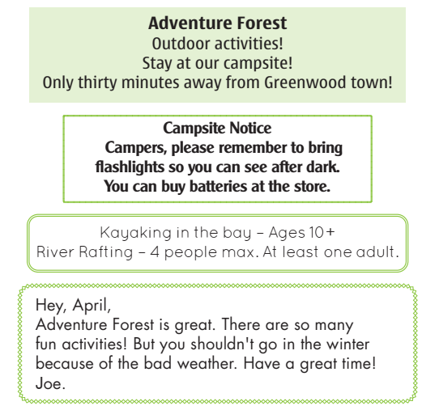
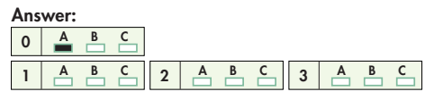
Example
0. Go to Adventure Forest if you want to...
A. go somewhere close to town.
B. sleep comfortably.
C. play indoor games.

Slide 16
1.
A. Campers have to bring batteries.
B. Campers can buy flashlights there.
C. Campers need flashlights to see at night.

Slide 17
2.
A. Anyone can do the activities.
B. Children under ten years old can't go kayaking.
C. River rafting is for adults only.

Slide 18
3.
A. The weather is very nice in the winter.
B. There isn't much to do.
C. Joe thinks April should go to Adventure Forest.

Slide 19

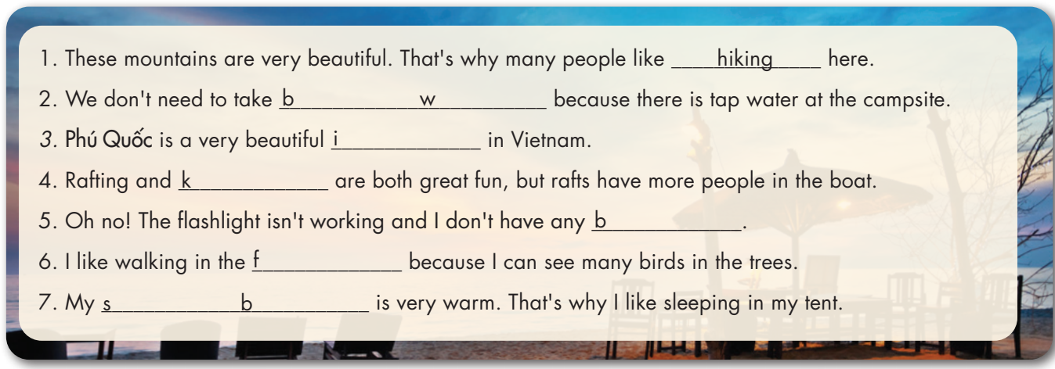
Fill in the blanks with words from the unit. The first letter is already there.
bottled water
island
kayaking
batteries
forest
sleeping bag

Slide 20

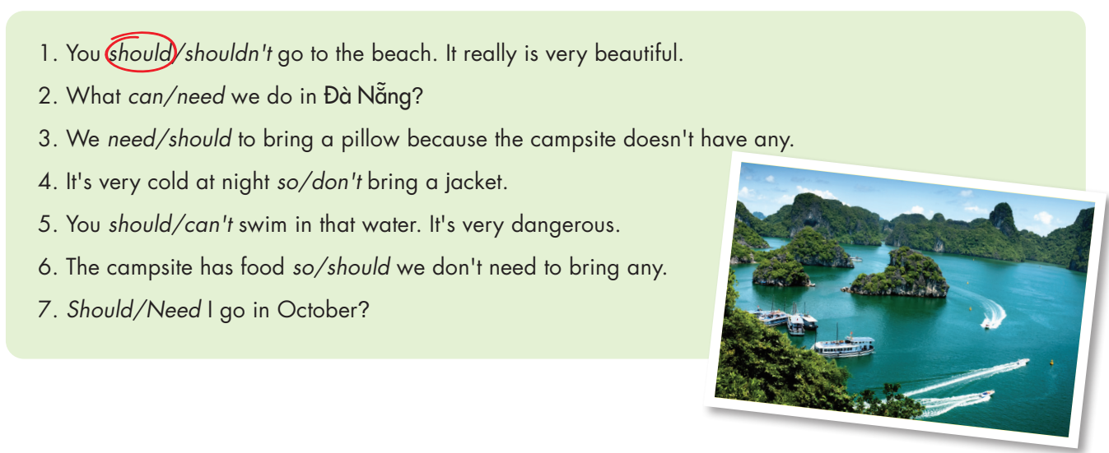
Circle the correct words.

Slide 21

Circle the word that has the underlined part pronounced differently from the others.
1. A. fishing B. highland C. swimming D. kicking
2. A. bay B. vacation C. jacket D. place
3. A. phone B. cold C. postcard D. forest
/ˈfɪʃɪŋ/
/ˈhaɪlənd/
/ˈswɪmɪŋ/
/ˈkɪkɪŋ/
/beɪ/
/vəˈkeɪʃn/
/ˈdʒækɪt/
/pleɪs/
/foʊn/
/koʊld/
/ˈpoʊstkɑːrd/
/ˈfɔːrɪst/

Slide 22
Circle the word that has the underlined part pronounced differently from the others.
4. A. hotel B. hour C. house D. hiking
5. A. garden B. car C. far D. bay
6. A. island B. scuba C. thirsty D. forest
/hoʊˈtel/
/ˈaʊr/
/haʊs/
/ˈhaɪkɪŋ/
/ˈɡɑːrdn/
/kɑːr/
/fɑːr/
/beɪ/
/ˈaɪlənd/
/ˈskuːbə/
/ˈθɜːrsti/
/ˈfɔːrɪst/

Slide 23

CONSOLIDATION

Slide 24
Work in groups
Your group will plan a trip for your summer vacation. You should think about the questions below.
Where should you go? Why?
What is the best way to go there? Why?
What do you need to bring? Why?

Slide 25

WRAP-UP

Slide 26
Lesson 3
Today’s lesson
Reading & Listening:
Practice reading and listening for general and specific information.
Vocabulary: rafting, canyon, cave, hiking, kayaking, campsite, sleeping bag, flashlight, bottled water, tent, battery, pillow, towel, highland, beach, mountain, waterfall, bay, forest, island
Grammar: Modals (Should, can, can’t), Conjunction (so)
Speaking:
- Talk about the plan for a trip

Slide 27
Homework
Review the vocabularies and grammar and make sentences using them.
Do the exercises on page 69 WB.
Prepare the next lesson (page 70 - SB)
Play the consolidation games in Tiếng Anh 6 i-Learn Smart World DHA App on www.eduhome.com.vn

Slide 28
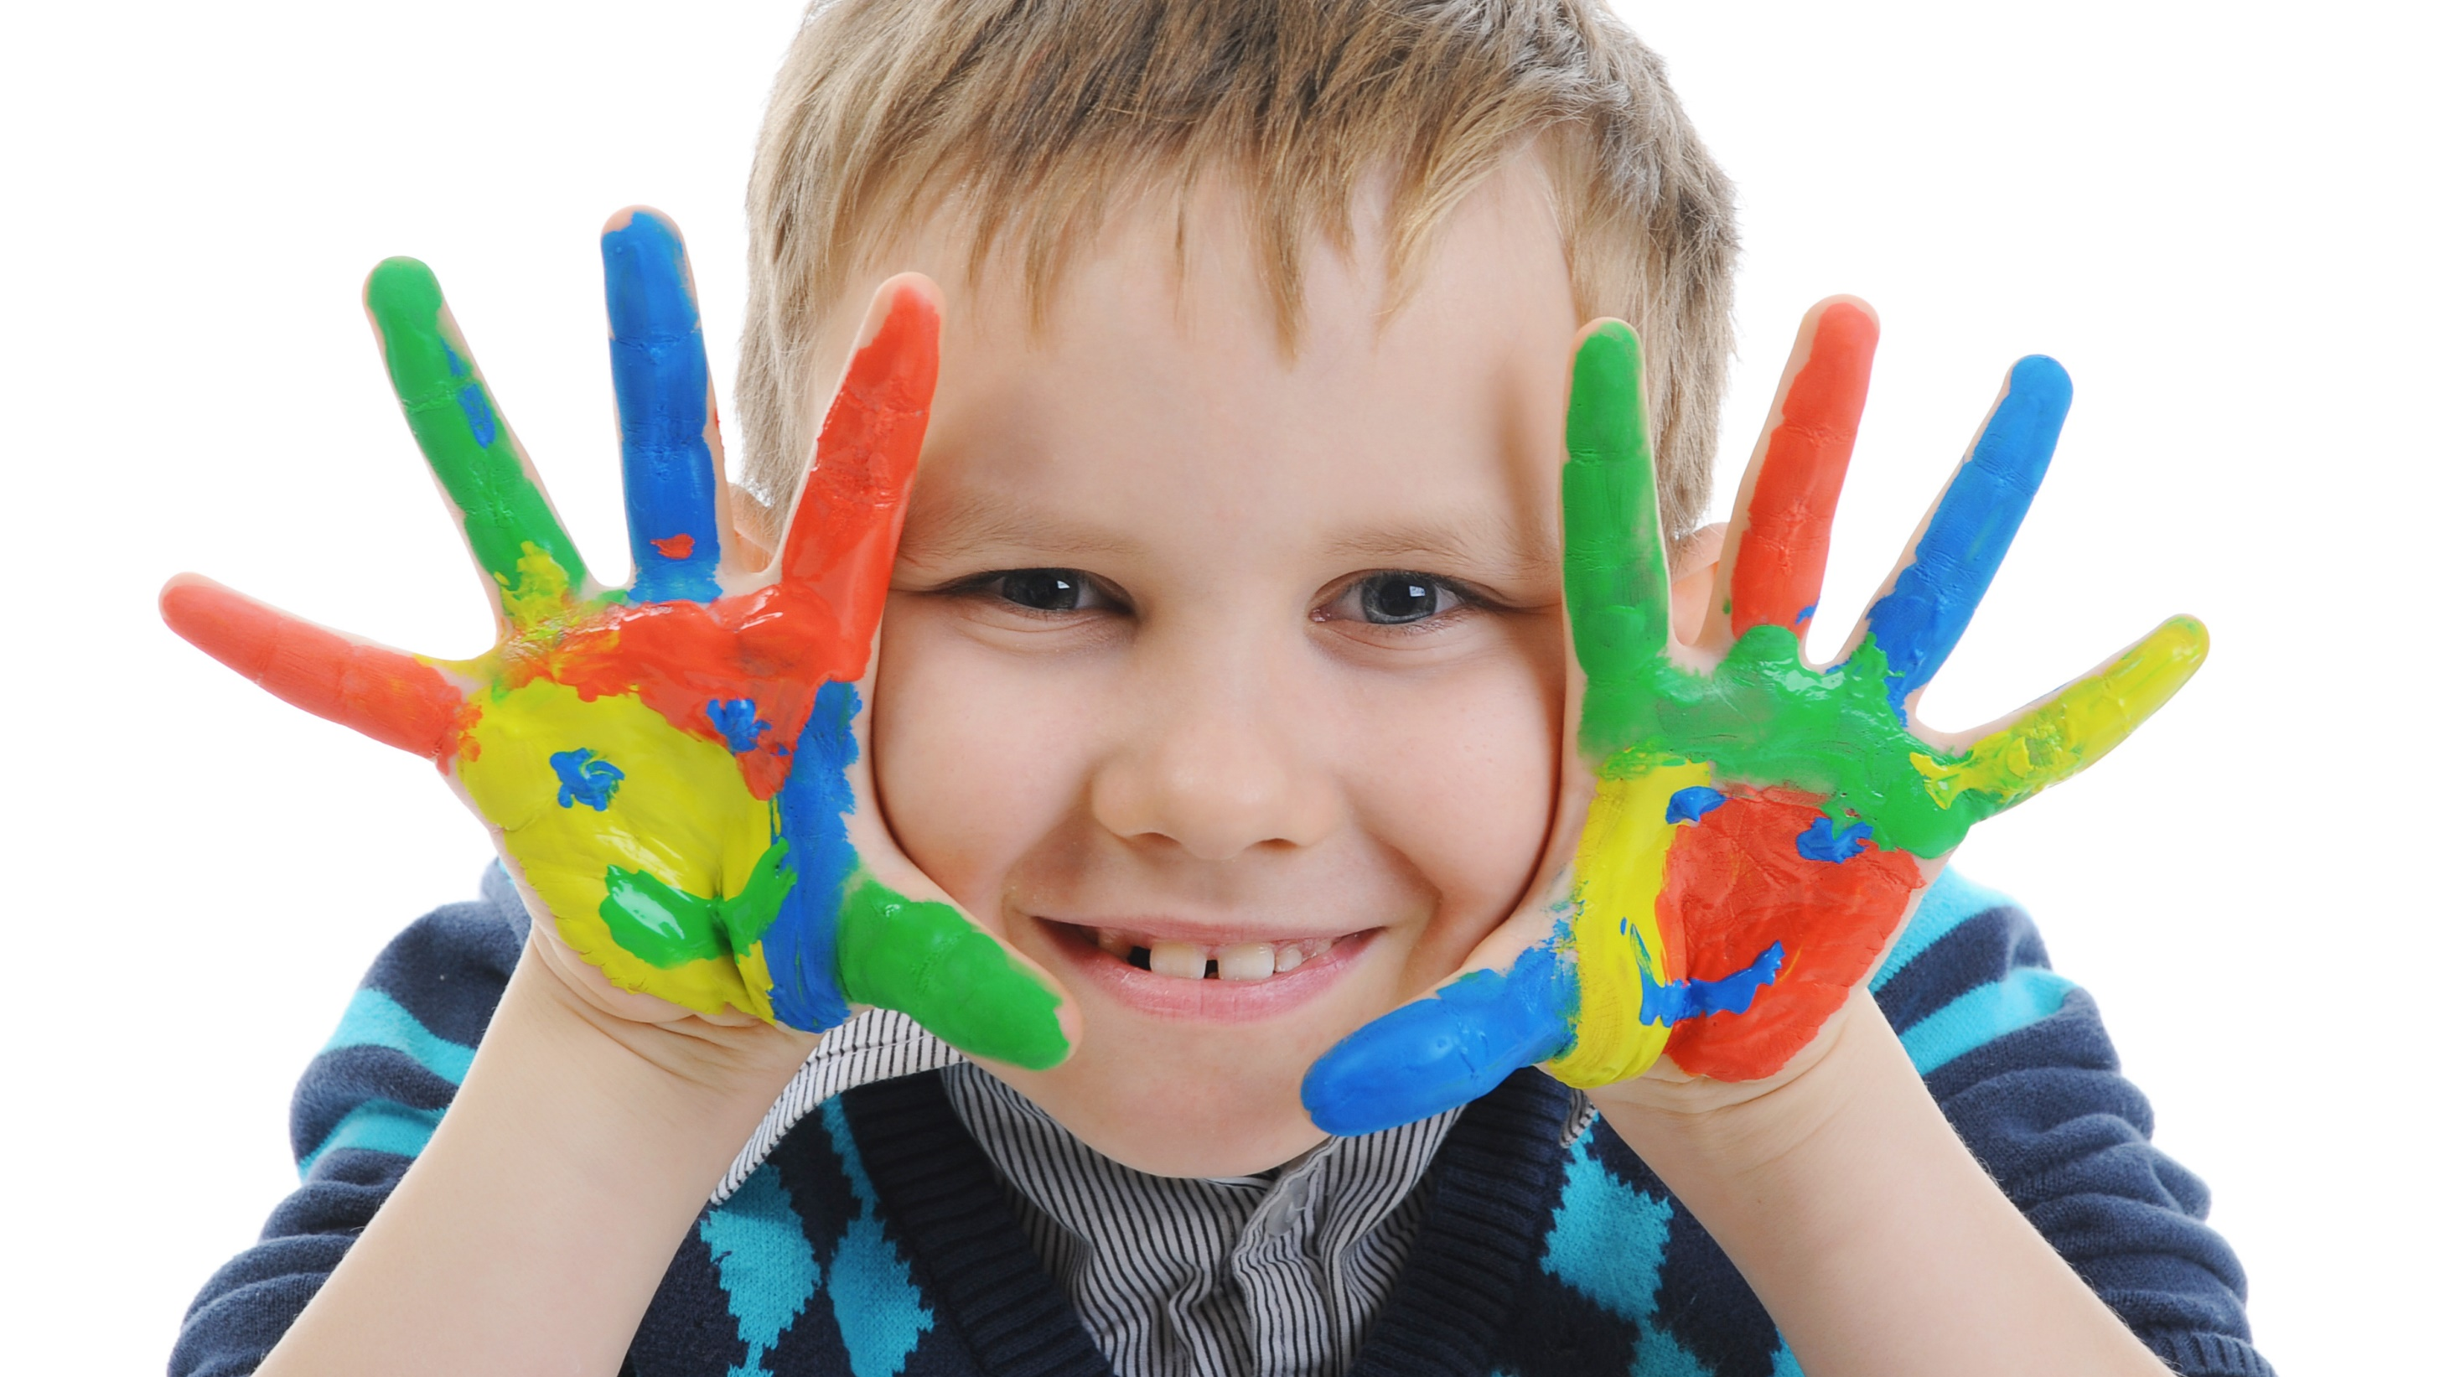
Enjoy your day!

