Slide 1
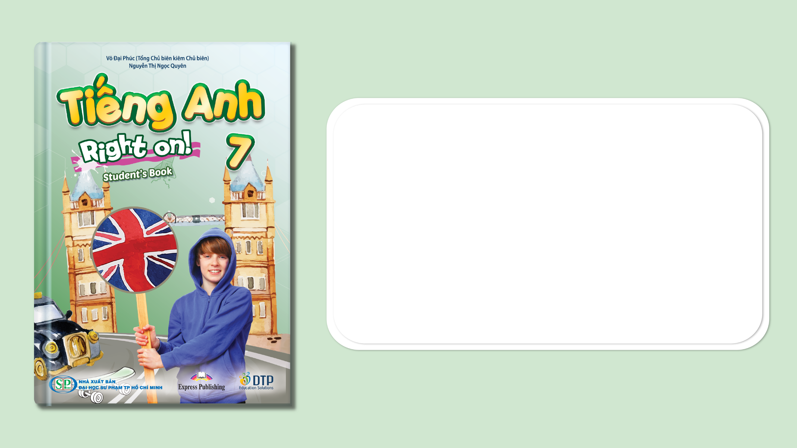
Unit 5: Travel & Transportation
Lesson 5a: Reading
Page 80

Slide 2
Lesson Outline
Warm-up
Vocabulary
Reading
Consolidation
Wrap-up

Slide 3
Objectives
By the end of this lesson, students will be able to…
learn and use some vocabulary related to transportation: double-decker bus, landmark, environmentally-friendly, cable car, sights, cruise, check out, tourist attraction.
read the text about transportation for important details.

Slide 4

WARM-UP

Slide 5

Work in pairs.
Answer the questions
Which is your favorite kind of transportation when travelling? Why?
Car Train
Bus Aeroplane
Ship Bicycle
…

Slide 6

It’s time to learn …

Slide 7
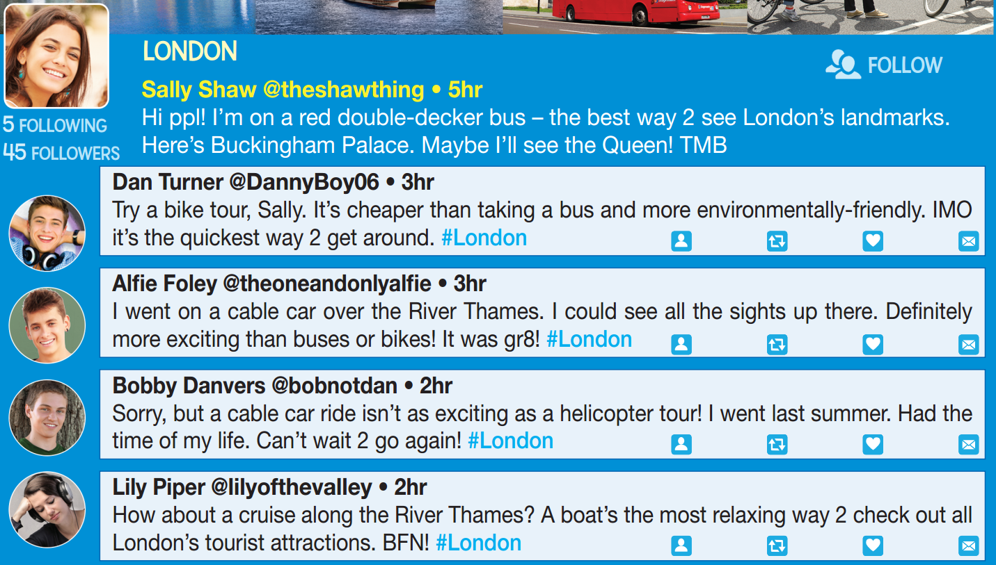
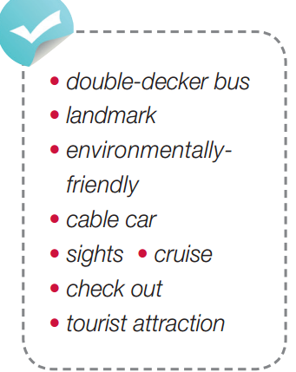
Pre-reading
Find these words in the text, try to guess their meanings.

Slide 8

Vocabulary
Listen and repeat.
double-decker bus /ˌdʌbl ˈdekər bʌs/ (n) xe buýt hai tầng
landmark /ˈlændmɑːk/ (n) danh lam thắng cảnh
environmentally-friendly /ɪnˌvaɪrənmentəli ˈfrendli/ (adj) thân thiện với môi trường
cable car /ˈkeɪbl kɑːr/ (n) cáp treo
sights /saɪts/ (pl n) phong cảnh
cruise /kruːz/ (n) chuyến đi chơi trên thuyền
check out /,tʃek’aʊt/ (v) tham quan
tourist attraction /ˈtʊərɪst əˈtrækʃən/ (n) điểm tham quan du lịch

Slide 9
Choose the suitable word for each gap.
* landmarks * environmentally-friendly * double-decker bus
* cable car * sights * cruise * check out * tourist attractions
sights
We're going to Hanoi for the weekend to see the ……………….
We got on the ……….…………………… to see Ho Chi Minh City’s ………………. like Ben Thanh market and the Central Post Office.
I'd love to go on around the world on a ………………. ship.
Travelling by bike is an ………………………..………….…… way to get around.
We are going to have two days in Vung Tau to ………………. famous restaurants there.
Nha Trang is one of the best ……………………..…….. in Vietnam.
We used the ………………. to go near the top of Fansipan Mountain, so we didn’t have to climb it.
double-decker bus
landmarks
cruise
environmentally-friendly
check out
tourist attractions
cable car

Slide 10
Pre-Reading
Read the instruction quickly. Underline the key words. What are we going to do?

Slide 11
While-reading
Five means of transport:
=> (double-decker) bus, bike, cable car, helicopter, boat
The text type:
=> The text is a social media website.

Slide 12

Pre - Reading
Read the instruction quickly. Underline the key words.
What are we going to do?
Match people’s names (1-5) with the means of transport (a-e) they used.

Slide 13
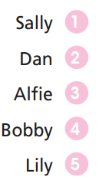
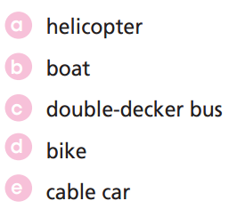
While-reading
Match people’s names (1-5) with the means of transport (a-e) they used.

Slide 14
Read the text and decide whether the following statements are True, False, or Doesn’t say:
Extra Practice
The best way to see London’s landmarks is travelling on a double-decker bus.
Travelling on a double-decker bus is the most environmentally-friendly in London.
There is a cable car service in London.
A helicopter tour is more expensive than a cable car ride.
A cruise ship is the most popular way for tourists to travel around London.

Slide 15
Now, read again to check the answers.
The best way to see London’s landmarks is travelling on a double-decker bus.
Taking a bus is the most environmentally-friendly in London.
True
False

Slide 16
Now, read again to check the answers.
True
3. There is a cable car service in London.
4. A helicopter tour is more expensive than a cable car ride.
Doesn’t say

Slide 17
Now, read again to check the answers.
5. A cruise ship is the most popular way for tourists to travel around London.
Doesn’t say

Slide 18

Post-reading
Example
A: I like to get around London by double-decker bus because it is one of the symbols of the UK.
B: I like to see London on a cruise because it’s very relaxing.

Slide 19

CONSOLIDATION

Slide 20
Write a paragraph (60-80 words) to introduce the kinds of transportation for tourists to see the sights around the place where you live.
Suggested answer.
I live in Hanoi. When you come here, you can see all the sights in Hanoi on a cyclo tour. It’s exciting! The sightseeing bus tour is also good. You will get a great view of some amazing buildings! Another way is to ride a motorbike around the city. It’s the most convenient way to travel in this crowded city. Most people love that.

Slide 21

WRAP-UP

Slide 22
Today’s lesson
Vocabularies
• double-decker bus
• landmark
• environmentally-friendly
• cable car
• sights
• cruise
• check out
• tourist attraction
Reading
Read the text about transportation for important details

Slide 23
Homework
Practise the vocabularies; and make sentences using them.
Do the exercises in TA 7 Right on WB (page 42)
Prepare the next lesson (page 81 SB)
Do the exercise in TA 7 Right on Notebook (page 36)

Slide 24
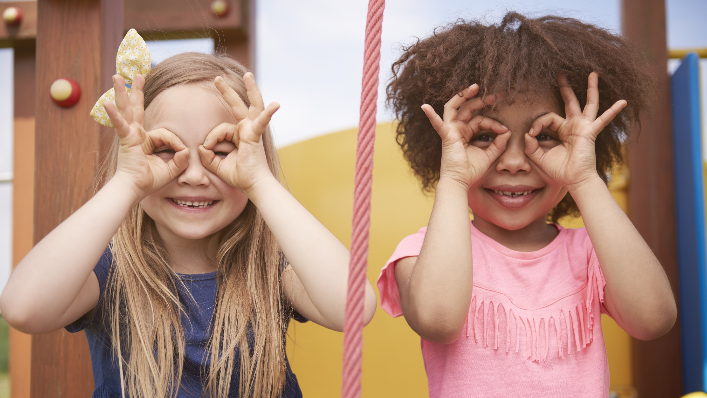
Enjoy your day!

