Slide 1

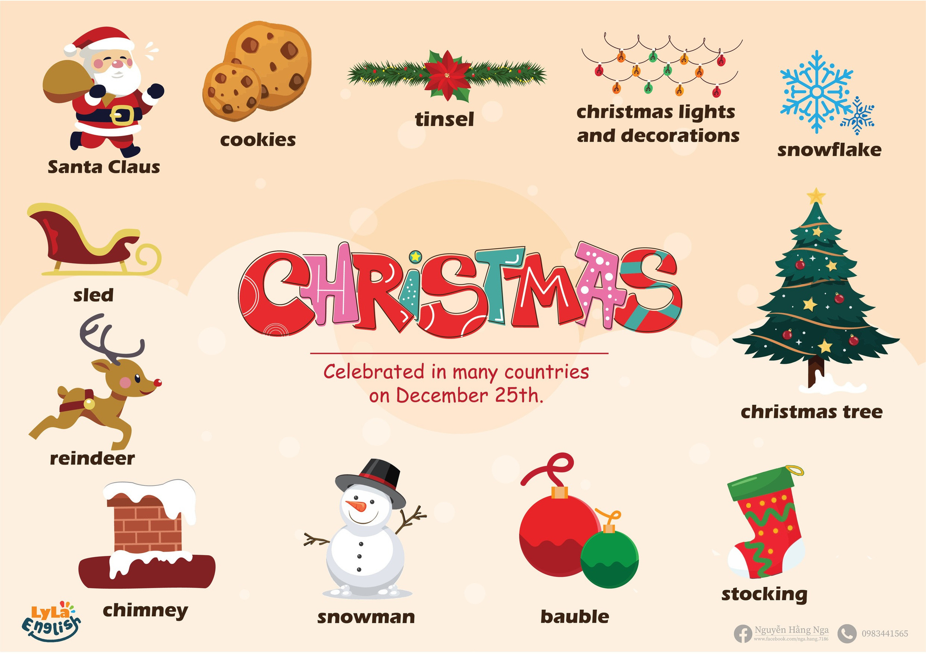






Slide 2

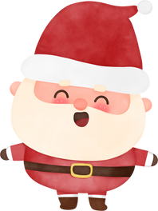

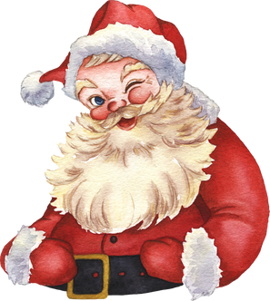


I. QUESTION
1.who do you see on Christmas? - I see....
2.What color is Santa Claus’s clothes? - It’s....
3.Can you sing a song about Santa?…

Slide 3



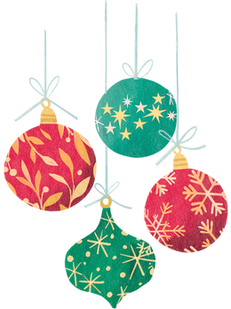


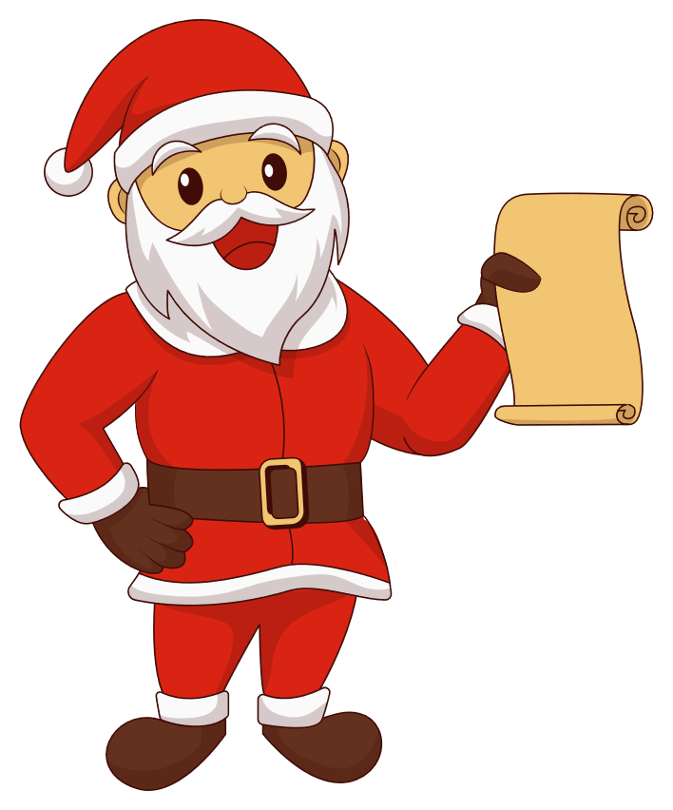

I. QUESTION
4.What tree do you see on Christmas tree? - It’s....
5. What do you decorate on Christmas tree? - I decorate..
...
6.Can you read a poem about Christmas tree?
- Yes/ No....

Slide 4

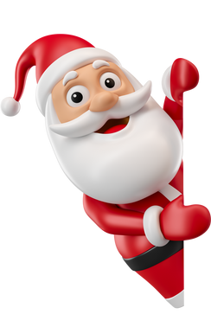

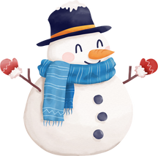


II. VOCABULARY
Santa Claus:.....................................................
Snowman:....................................................
Christmas tree:................................................
Reindeer:........................................................

Slide 5





II. VOCABULARY
Tinsel:...........................................................
Bauble:........................................................
Snowflake:.....................................................
Sled:...........................................................

Slide 6
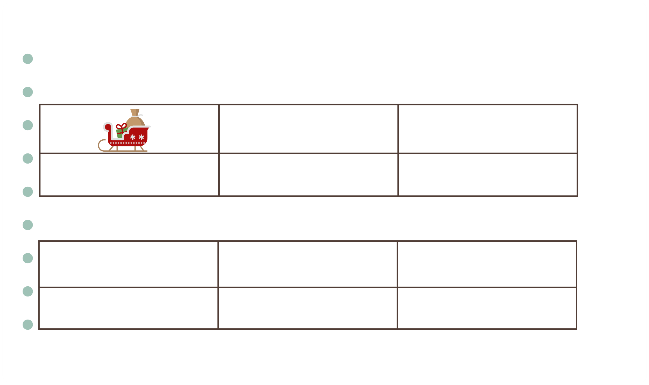

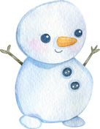


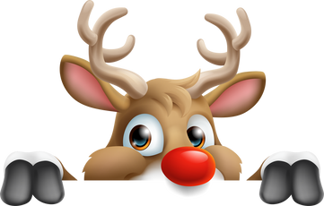


III. EXERCISES
1.Match the words with picture:
snowman tinsel
bauble reindeer
sled
snowflake

Slide 7


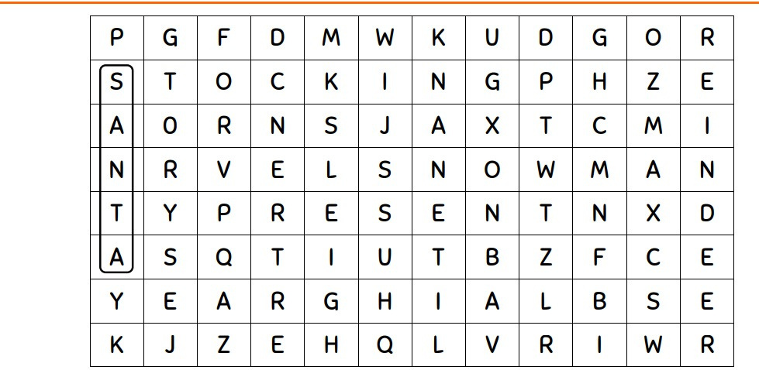

III. EXERCISES
2. Find the word: Tree, reindeer, snowman

Slide 8
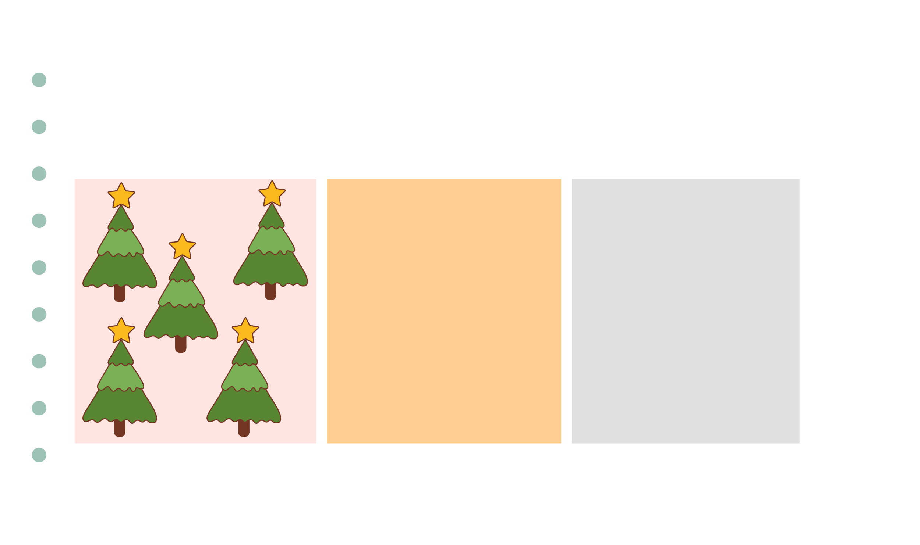



III. EXERCISES
3. Count and write number of objects:
....
....
....

Slide 9

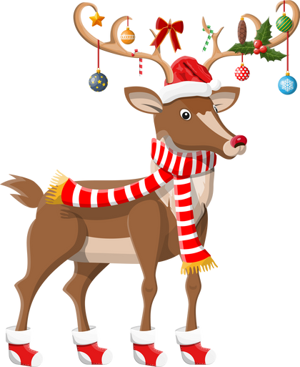

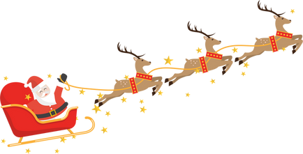


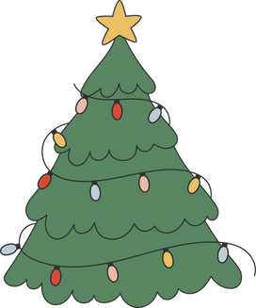


III. EXERCISES
4. Reorder the words:
t/n/i/e/l/s
.........
l/s/d/e .........
re/n/i/d/r/e /e
.........
t/e/r/e .......
b/a/b/u/l/e .....
s/n/w/o/m/n/a
.........

Slide 10
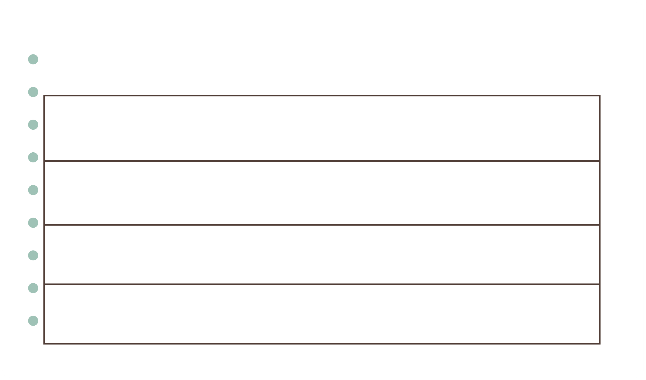


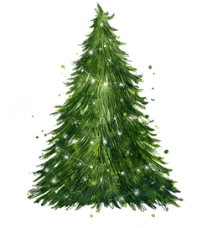
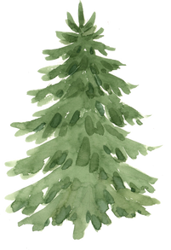


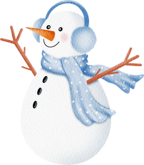
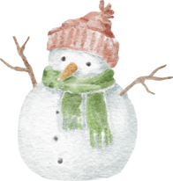




III. EXERCISES
5. Which is different?

Slide 11
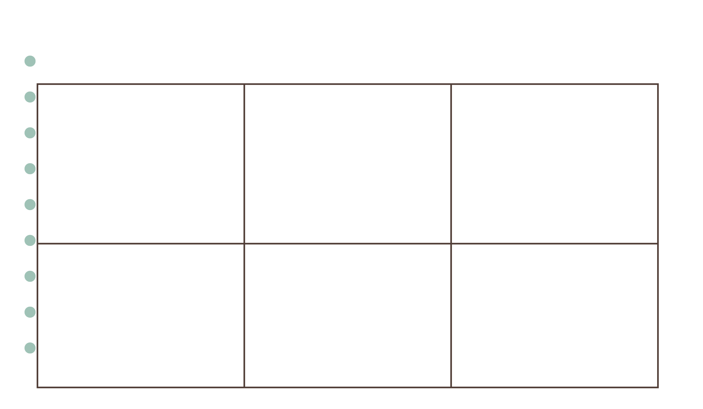
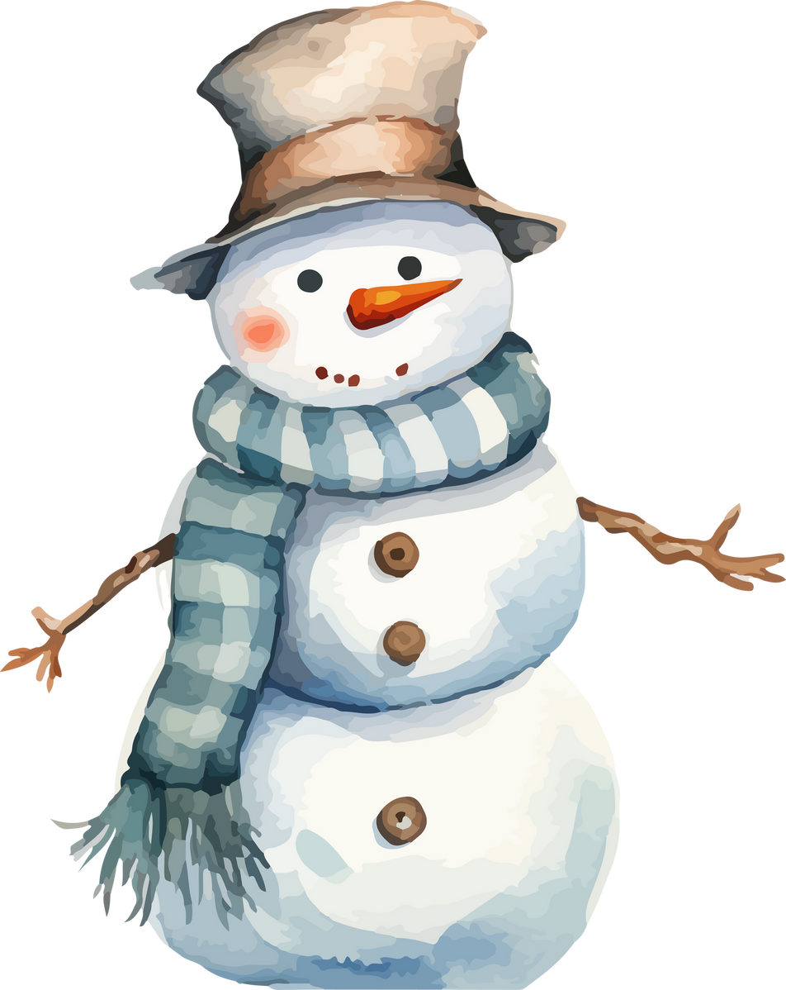
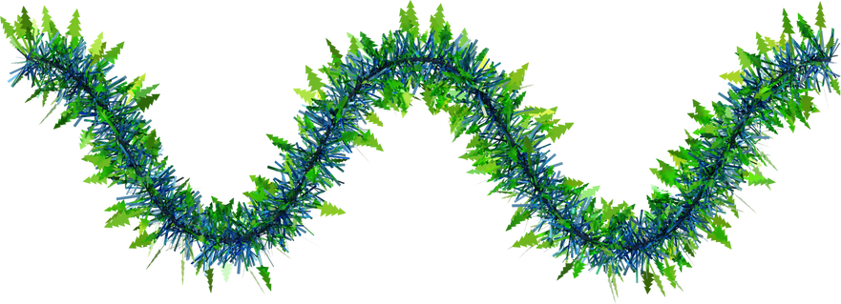




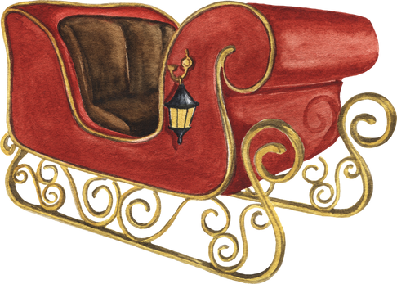
III. EXERCISES
6. Look at the picture and then guess the word:
What is this?
What is this?
What is this?
What is this?
What is this?
What is this?

Slide 12
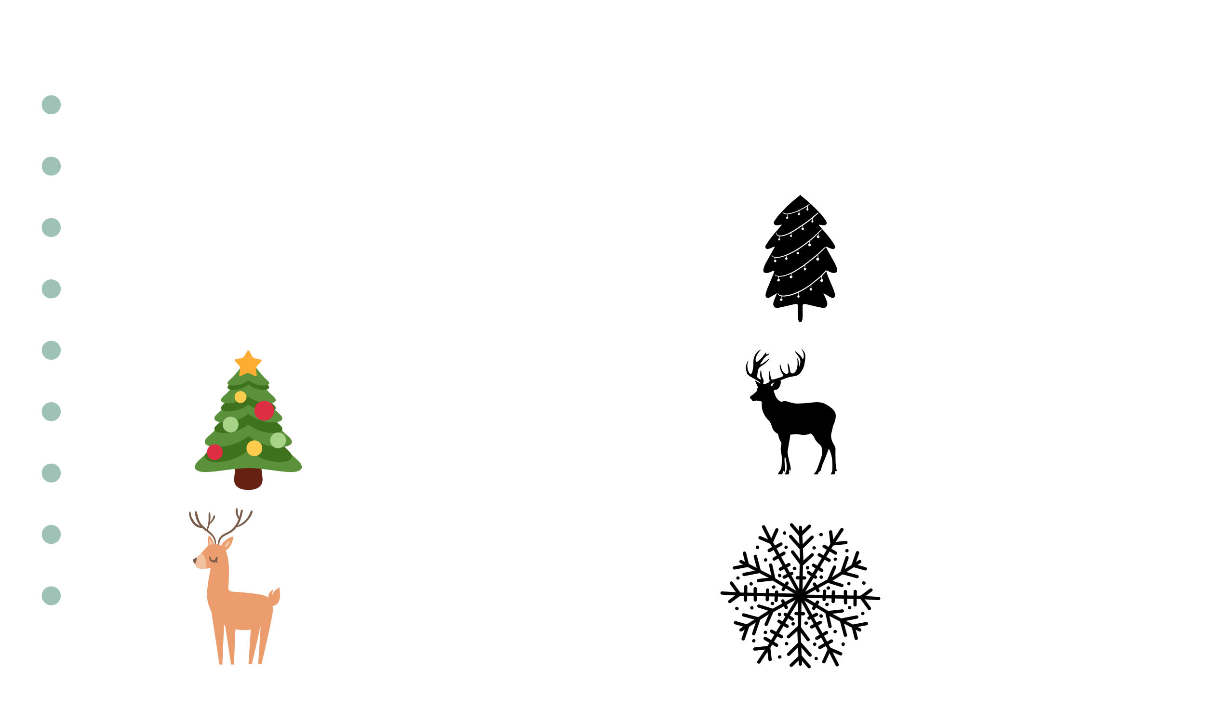



III. EXERCISES
7. Find the correct shadow:

Slide 13
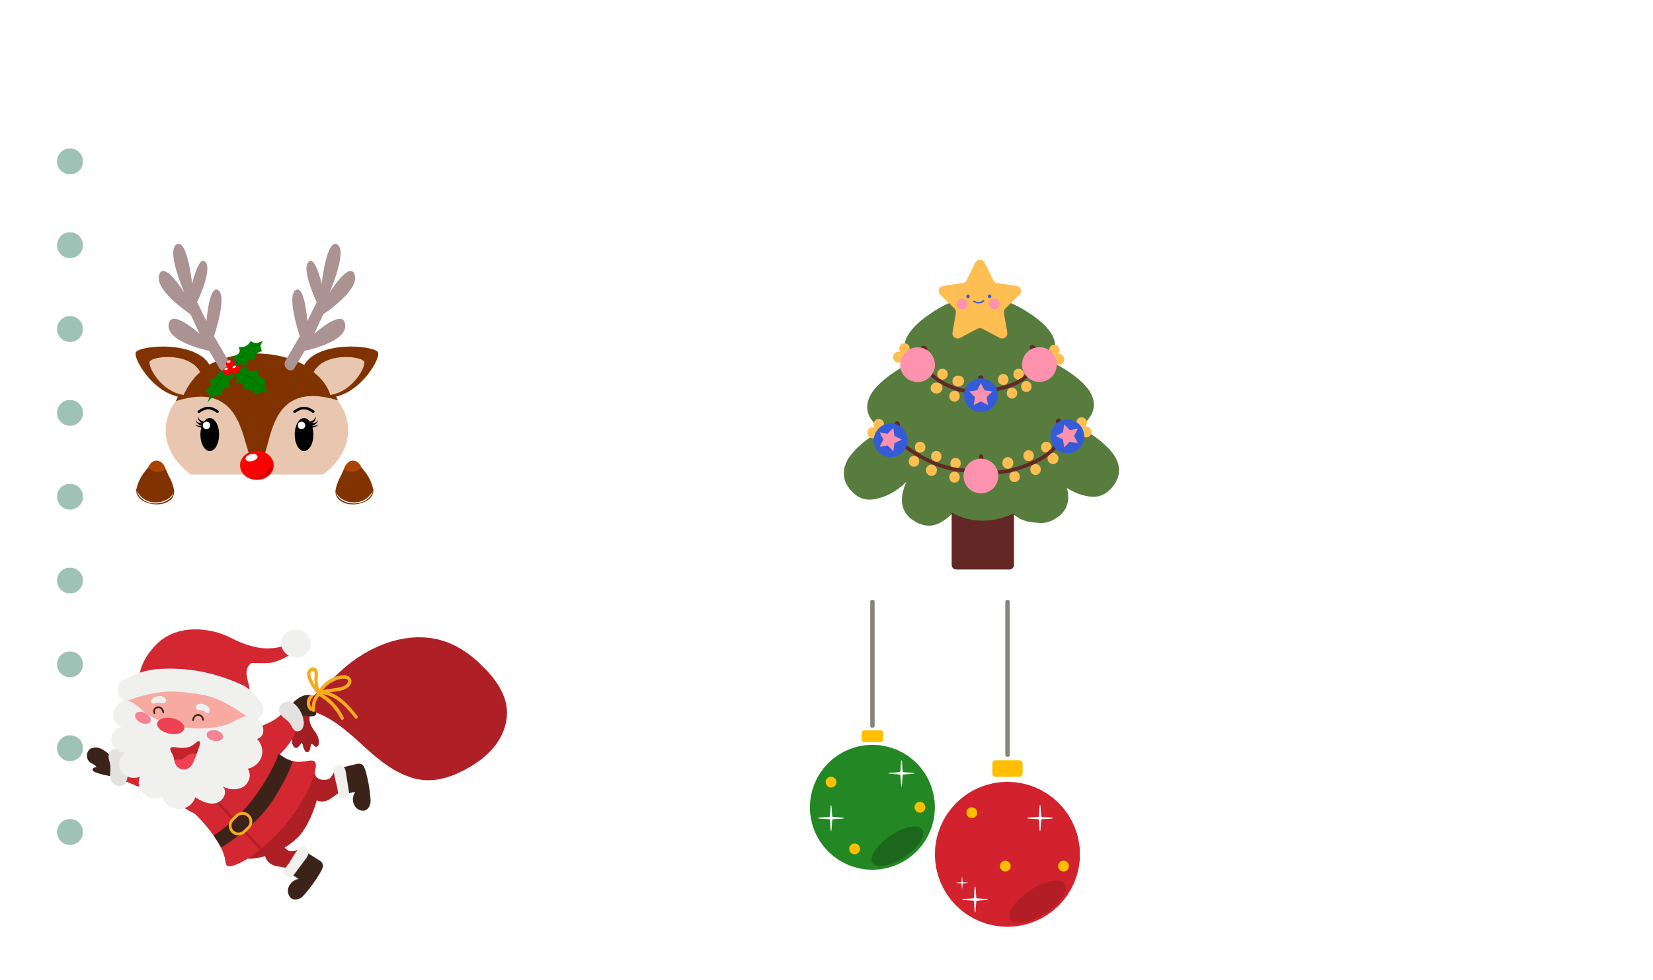

III. EXERCISES
8. Look at the picture and find the word:
R......
C....
B......
S.....

