Slide 1


Slide 2

Unit
8
1
Unit
FAMILY LIFE
NEW WAYS TO LEARN
LESSON 5
LISTENING
Blended learning

Slide 3

Unit
1
1
OBJECTIVES
FAMILY LIFE
Unit
Family Life
Knowledge
- Gain an overview about the topic Blended-learning class
- Expand vocabulary of the topic blended learning and talk about it.
- Listen for main idea and specific information in the task Chart completion and answering questions
2. Skills
- Develop listening skills
- Be collaborative and supportive in pair work and teamwork
3. Attitude
- Familiarize with blended-learning class
- Develop self-study skills

Slide 4
LESSON 5
LISTENING
GETTING STARTED
WARM-UP
Video Watching
PRE-LISTENING
Guess the words
Task 1: Tick what you often do to prepare before a new lesson.
Task 2: Listen and answer the questions.
Reorder the steps.
Task 3: Listen and complete the flow chart with no more than TWO words.
WHILE-LISTENING
POST-LISTENING
Discussion: Compare Blended learning and Traditional learning
Task 4: Discuss the questions.
CONSOLIDATION
Wrap-up
Homework

Slide 5
LESSON 5
LISTENING
GETTING STARTED
WARM-UP
Video Watching

Slide 6

LESSON 5
LISTENING
Unit
GETTING STARTED
*WARM-UP: Video Watching
https://www.youtube.com/watch?v=-bwhR1ZKGRE

Slide 7

LESSON 5
LISTENING
Unit
GETTING STARTED
face-to face
learning activities
digital learning objects
independent study time

Slide 8
LESSON 5
LISTENING
GETTING STARTED
WARM-UP
Video Watching
PRE-LISTENING
Guess the words
Task 1: Tick what you often do to prepare before a new lesson.

Slide 9
PRE-LISTENING
Vocabulary game: GUESS THE WORDS
- raise your hand
- say the word(s) out loud

Slide 10


PRE-LISTENING
upload
1. You can............ your own videos on YouTube.

Slide 11

PRE-LISTENING
2. Another word for ONLINE CLASS?

Slide 12

PRE-LISTENING
3. What is it?
A folder

Slide 13

PRE-LISTENING
4. What is he doing?
Taking notes/ take notes

Slide 14
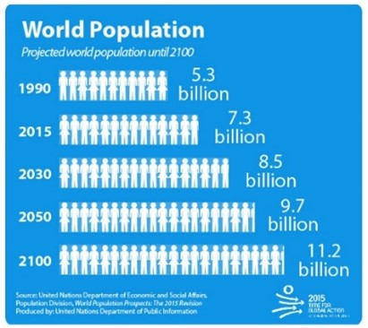
PRE-LISTENING
5. What does the picture describe?
population growth

Slide 15
PRE-LISTENING
6. To _ _ _ _ _ to your email, you need to type in your account and password.
log in

Slide 16
PRE-LISTENING
Vocabulary
1. upload (v) | 4. take notes (vp)
2. Eclass (n) | 5. population growth (np)
3. folder (n) | 6. log in (phrasal verb)

Slide 17

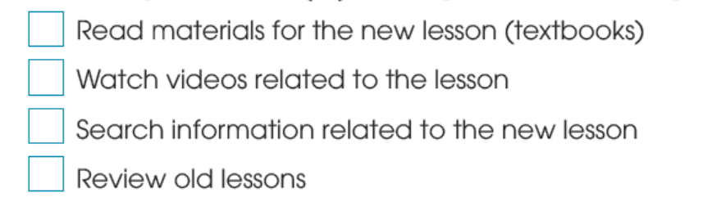
PRE-LISTENING
1
Work in pairs. Tick what you often do to prepare before a new lesson.

Slide 18
LESSON 5
LISTENING
GETTING STARTED
WARM-UP
Video Watching
PRE-LISTENING
Guess the words
Task 1: Tick what you often do to prepare before a new lesson.
Task 2: Listen and answer the questions.
Reorder the steps.
Task 3: Listen and complete the flow chart with no more than TWO words.
WHILE-LISTENING

Slide 19

WHILE-LISTENING
2
Listen to the first part of the conversation between a teacher and her students, then answer the following questions.
What is the teacher talking about?
What has she uploaded on Eclass?

Slide 20
WHILE-LISTENING
2
Listen to the first part of the conversation between a teacher and her students and answer the following questions.
What is the teacher talking about?
What has she uploaded on the Eclass?
1. She is talking about the homework given to the class.
2. She has uploaded materials and videos on Eclass.

Slide 21
WHILE-LISTENING
1
Match FOUR steps to do “fill-in-the-blank” listening task:
4
STEP 1
STEP 2
STEP 3
STEP 4
......???........
.......???.........
.......???.........
......???........
a. Decide what kind of information should be filled in the blank (noun, verb,….)
b. Predict answers
c. Read the question carefully and underline key words (verbs, nouns, …..)
d. Listen,
take notes

Slide 22
WHILE-LISTENING
4 steps to do “fill-in-the-blank” listening task
4
c. Read the question carefully and underline key words (verbs, nouns, …..)
a. Decide what kind of information should be filled in the blank (noun, verb,….)
b. Predict answers
d. Listen, take notes

Slide 23
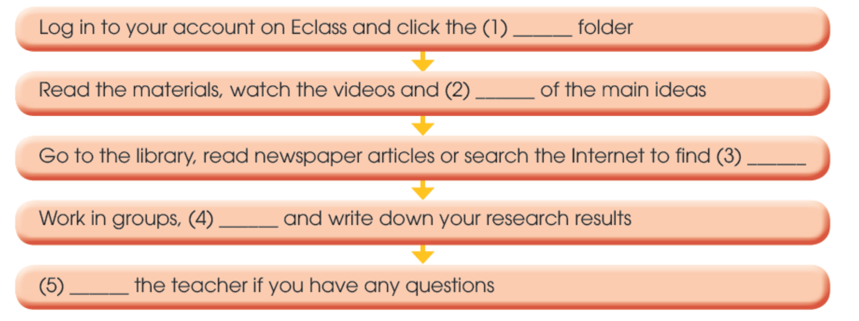
WHILE-LISTENING
3
Listen to the second part of the conversation and complete the flow chart with no more than TWO words (starting from 0:12s )
What type of word? (Noun/Verb/Adjective/Adverb)
1. an adj, noun | 2. a verb (infinitive) | 3. a noun/noun phrase | 4. a verb (infinitive) | 5. a verb (infinitive)

Slide 24
WHILE-LISTENING
3
Listen to the second part of the conversation and complete the flow chart with no more than TWO words (starting from 0:12s )
1. homework | 2. take notes | 3. information | 4. discuss | 5. email

Slide 25
LESSON 5
LISTENING
GETTING STARTED
WARM-UP
Video Watching
PRE-LISTENING
Guess the words
Task 1: Tick what you often do to prepare before a new lesson.
Task 2: Listen and answer the questions.
Reorder the steps.
Task 3: Listen and complete the flow chart with no more than TWO words.
WHILE-LISTENING
POST-LISTENING
Discussion: Compare Blended learning and Traditional learning
Task 4: Discuss the questions.

Slide 26
POST-LISTENING
DISCUSSION: Compare Blended Learning with Traditional Learning
Criteria | Blended Learning | Traditional Learning
Location | Eclass
Activities | Read materials, watch videos, take notes, mind-map, discuss
Sources of information | Libraries, newspapers, articles, Internet
Means of communication | Work in group, discuss with friends, email teacher

Slide 27
POST-LISTENING
DISCUSSION: Compare Blended Learning with Traditional Learning
Criteria | Blended Learning | Traditional Learning
Location | Eclass | In class
Activities | Read materials, watch videos, take notes, mind-map, discuss | Read materials, watch videos, take notes, mind-map, discuss
Sources of information | Libraries, newspapers, articles, Internet | Textbooks, library, materials given by teachers
Means of communication | Work in group, discuss with friends, email teacher | Work in group, discuss with friends

Slide 28

POST-LISTENING
4
Work in groups. Discuss the questions.
Which is more effective: blended or traditional learning? Why?

Slide 29
LESSON 5
LISTENING
GETTING STARTED
WARM-UP
Video Watching
PRE-LISTENING
Guess the words
Task 1: Tick what you often do to prepare before a new lesson.
Task 2: Listen and answer the questions.
Reorder the steps.
Task 3: Listen and complete the flow chart with no more than TWO words.
WHILE-LISTENING
POST-LISTENING
Discussion: Compare Blended learning and Traditional learning
Task 4: Discuss the questions.
CONSOLIDATION
Wrap-up
Homework

Slide 30
CONSOLIDATION
1
Wrap-up
What have we learnt today?
- Learn language items:
+ Words/phrases related to topic “Blended learning”
+ Listening for main idea and for specific information
- Be familiarized with blended learning and how they are done in and out of class.

Slide 31

CONSOLIDATION
2
Homework
Do the exercises: Unit 8 - Lesson 3, Workbook.

Slide 32

Website: hoclieu.vn
Fanpage: facebook.com/tienganhglobalsuccess.vn/

