Slide 2
Unit
7
Education options for school-leavers
Unit
FAMILY LIFE
LESSON I
GETTING STARTED
Planning our education

Slide 3
LESSON I
GETTING STARTED
WARM-UP
GAME: Guessing game
PRESENTATION
Vocabulary
Task 1: Listen and read.
Task 2. Read the conversation again. Decide whether the following statements are true (T) or false (F).
Task 3. Find phrases in the conversation that mean the following.
Task 4. Complete the sentences using phrases from the conversation.
PRACTICE
PRODUCTION
Role play
Wrap-up
Homework
CONSOLIDATION

Slide 4
WARM-UP
GUESSING GAME
Work in 4 groups.
Look at the pictures
Guess the name of the famous university in Vietnam
- The team with more correct answers is the winner

Slide 5
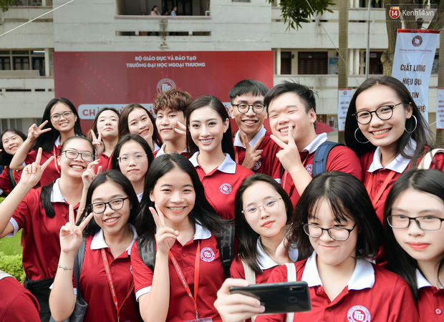
WARM-UP
GUESSING GAME
Foreign Trade University

Slide 6
WARM-UP
GUESSING GAME
University of Languages and International Studies

Slide 7
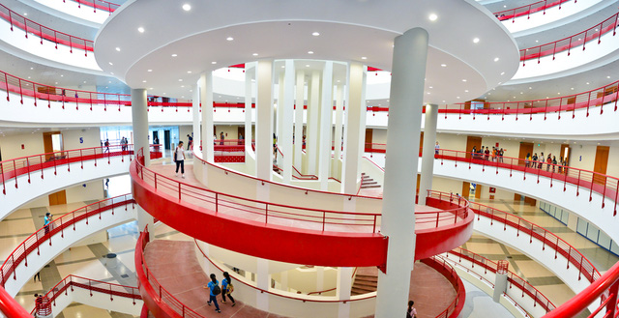
WARM-UP
GUESSING GAME
National Economics University

Slide 8
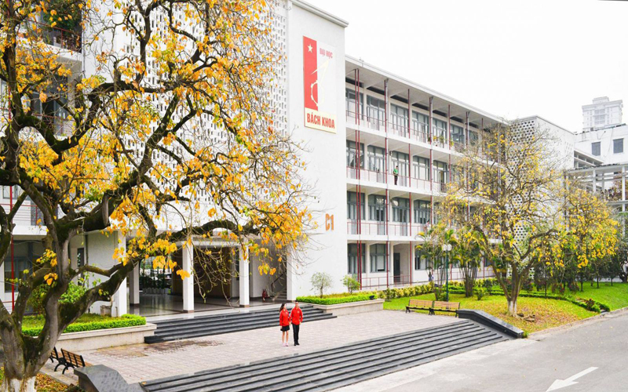
WARM-UP
GUESSING GAME
Hanoi University of Science and Technology

Slide 9
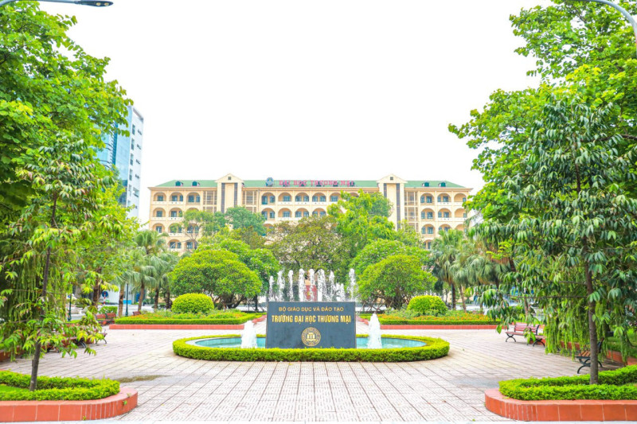
WARM-UP
GUESSING GAME
Thuongmai University

Slide 10
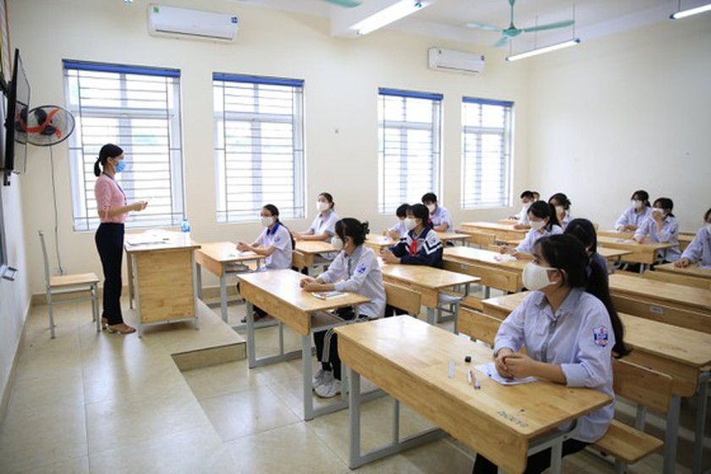
PRESENTATION
(university) entrance exam (n.ph)
/ˈen.trəns ɪɡˌzæm/
an exam that you take to be accepted into a university

Slide 11
PRESENTATION
option (n)
/ˈɒp.ʃən/
one thing that can be chosen from a set of possibility, or the freedom to make a choice

Slide 12
PRESENTATION
academic (adj)
/ˌæk.əˈdem.ɪk/
relating to schoold, colleges, and university, or connected with studying and thinking, not with practical skills

Slide 13
PRESENTATION
vocational (adj)
/vəʊˈkeɪ.ʃən.əl/
(of an educational course or a qualification) providing knowledge and skills that prepare you for a particular job

Slide 14
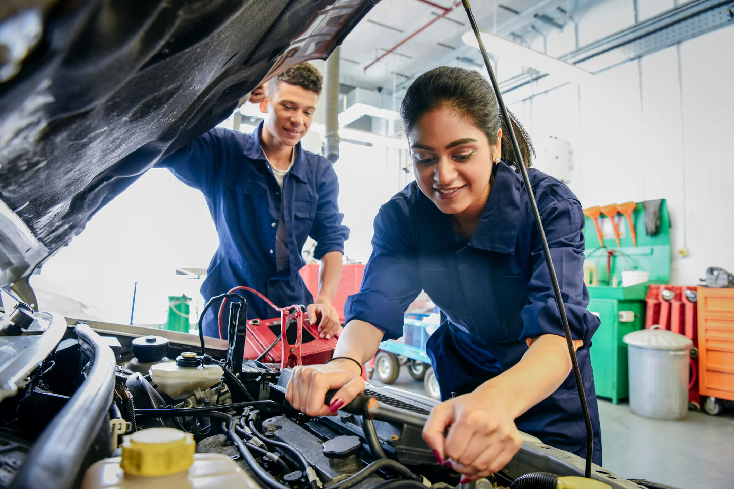
PRESENTATION
mechanic (n)
/məˈkæn.ɪk/
someone whose job is repairing the engines of vehicles and other engines

Slide 15
PRESENTATION
sensible (adj)
/ˈsen.sə.bəl/
based on or acting on good judgement and
practical ideas or understanding

Slide 16
PRESENTATION
1
Listen and read.
Ms Hoa: | Good morning, class. There was an education fair last weekend, you know. Did anyone go?
Nam: | Yes, Lan and I did. The fair was great and we got a lot of useful information.
Ms Hoa: | I’m glad to hear that. Would you like to share some of it with the class?
Lan: | Sure. After finishing school, we mainly have two education options. For example, we can get into university if we earn high grades or pass the university entrance exam.
Nam: | That’s true, but academic education isn’t everything. The other option is going to a vocational school where we can learn skills for particular jobs.
Ms Hoa: | That sounds interesting. So what are your plans for the future?
Lan: | I’m hoping to go to university. Having won several biology competitions, I want to study biology and become a scientist.
Ms Hoa: | Great! You need to follow your dreams.
Lan: | My mum still regrets not having gone to university. So I want to make her proud of me. How about you, Nam?
Nam: | Well, I don’t think university is for me. I want to go to a vocational school to train to become a car mechanic. My father owns a car repair shop. Having watched him work very hard for many years helped to me make my decision.
Ms Hoa: | That’s very sensible, Nam! I hope you can help him grow his business.

Slide 17
PRACTICE
2
Read the conversation again. Decide whether the following statements are true (T) or false (F).
 |  | True | False
1. | School-leavers only have the option of academic education.
2. | Good grades at school can help students get into university.
3. | Vocational schools are for those who want to develop job skills.
4 | Nam wants to work at his father’s car repair shop after leaving school.
✓
✓
✓
✓

Slide 18
PRACTICE
3
Find phrases in the conversation that mean the following.
1. an event at which students can talk to representatives of universities or vocational schools about their study options
2. an exam that someone takes to be accepted into a school or university
3. studying at school or university to gain knowledge and develop thinking skills
4. a place that teaches skills needed for particular jobs
education fair
entrance exam
academic education
vocational school

Slide 19
PRACTICE
4
Complete the sentences using phrases from the conversation.
1. ______________ several biology competitions, Mai wants to study biology and become a scientist.
2. Mai's mum still regrets not ______________ to university.
3. _______________ his father work very hard for many years
Having won
having gone
Having watched

Slide 20
PRODUCTION
Role play
- Ss work in groups of 4.
- In each group, one student plays the role of teacher, other students play the roles of students
- Teacher asks students to share their plans after school
- 3 minutes to prepare for the role play.
- 2 minutes for a performance.

Slide 21
CONSOLIDATION
1
Wrap-up
What have you learnt today?
Some lexical items about the education
Reading for specific information
Perfect gerund

Slide 22
CONSOLIDATION
2
Homework
Do exercises in the workbook.
Prepare for Lesson 2 - Unit 7.
Prepare materials for the project in lesson 8

Slide 23
Website: hoclieu.vn
Fanpage: facebook.com/sachmem.vn/

