Slide 1



Unit 3: On Screen
Lesson 3C: Listening

Slide 2


SLOGAN
QUIZ

Slide 3
HOW TO
PLAY
PAY ATTENTION TO THE TV ADVERTISING SLOGAN GIVEN
MATCH THE SLOGAN WITH ITS PRODUCT
GET YOUR BONUS

Slide 4

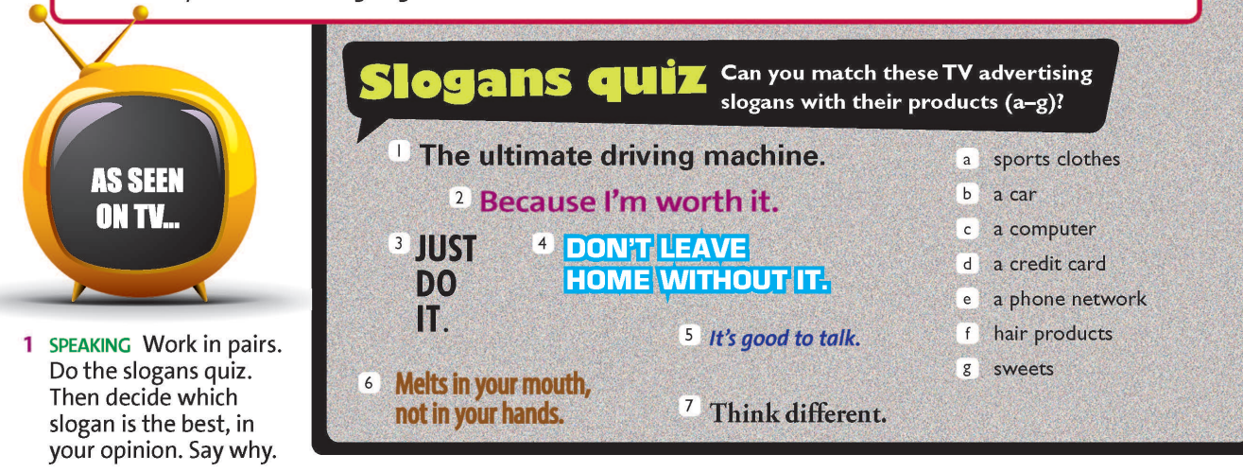
MATCH THE TV ADVERTISING SLOGAN BELOW
WITH ITS PRODUCT
A. a computer
B. a car
C. a credit card
D. a phone network

Slide 5
MATCH THE TV ADVERTISING SLOGAN BELOW
WITH ITS PRODUCT
A. hair products
B. sweets
C. a car
D. sports clothes

Slide 6
MATCH THE TV ADVERTISING SLOGAN BELOW
WITH ITS PRODUCT
A. a phone network
B. a credit card
C. sports clothes
D. a computer

Slide 7
MATCH THE TV ADVERTISING SLOGAN BELOW
WITH ITS PRODUCT
A. a credit card
B. a car
C. hair products
D. sweets

Slide 8
MATCH THE TV ADVERTISING SLOGAN BELOW
WITH ITS PRODUCT
A. a computer
B. a credit card
C. a car
D. a phone network

Slide 9
MATCH THE TV ADVERTISING SLOGAN BELOW
WITH ITS PRODUCT
A. hair products
B. sweets
C. sports clothes
D. a phone network

Slide 10
MATCH THE TV ADVERTISING SLOGAN BELOW
WITH ITS PRODUCT
A. a car
B. a phone network
C. a computer
D. a credit card

Slide 11
WHICH SLOGAN IS THE BEST IN YOUR OPINION? WHY?

Slide 12




www.phuongnam.edu.vn

Slide 13


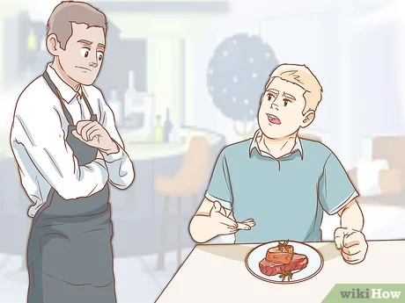


VOCABULARY
the position towards which someone
or something moves or faces
direction (n) /daɪˈrek.ʃən/
narrate (v) /nəˈreɪt/
to describe events as they happen
complain (v) /kəmˈpleɪn/
to say that something is wrong or not satisfactory
to make someone do or believe something
by giving them a good reason to do it
persuade (v) /pɚˈsweɪd/
amusing (a) /nəˈreɪt/
entertaining and funny
www.phuongnam.edu.vn

Slide 14
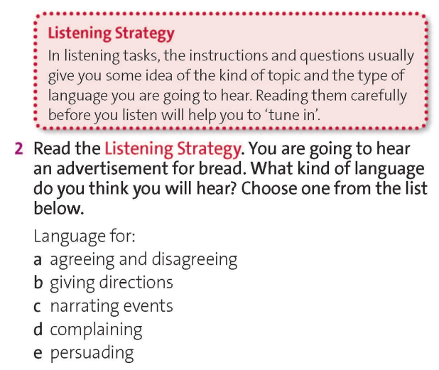
www.phuongnam.edu.vn

Slide 15
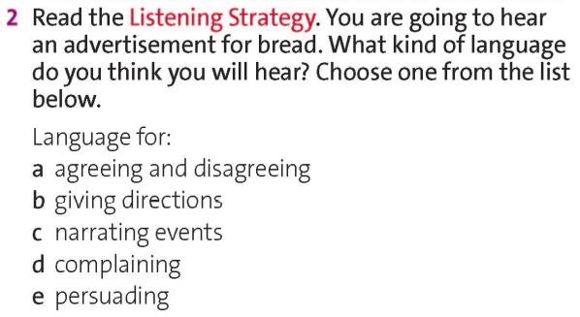



Choose one from the list below.
www.phuongnam.edu.vn

Slide 16
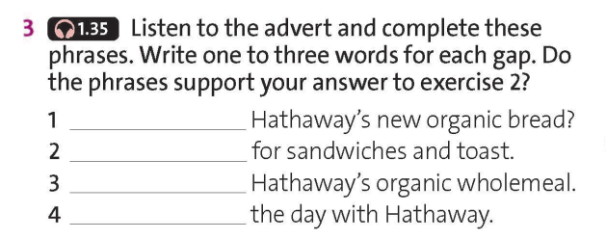


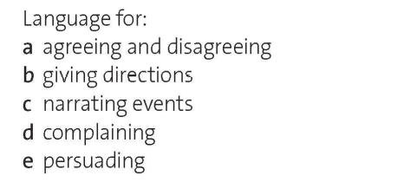
Why not try
It’s perfect
Ask for
Start
www.phuongnam.edu.vn

Slide 17
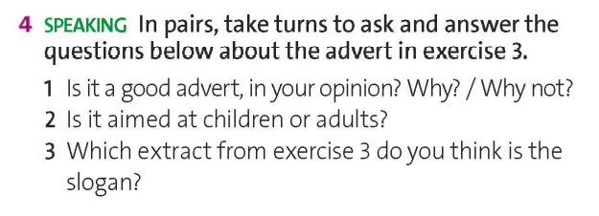

adults
Start the day with Hathaway.
www.phuongnam.edu.vn

Slide 18
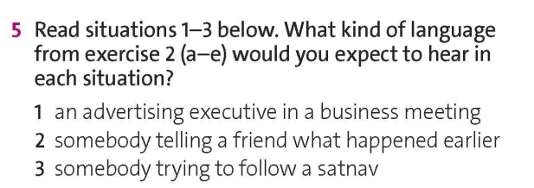
Situations
1
2
3
www.phuongnam.edu.vn

Slide 19
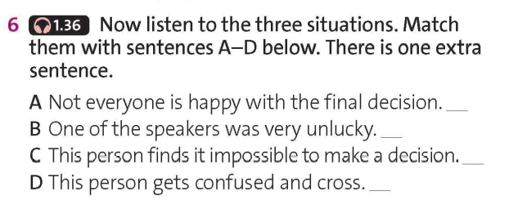
3
1
2
www.phuongnam.edu.vn

Slide 20
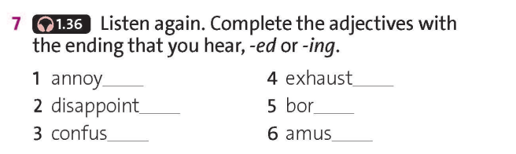
ing
ed
ed
ing
ing
ing
www.phuongnam.edu.vn

Slide 21


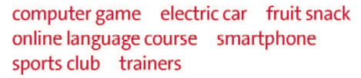

EX 8: PROJECT
Work in groups. Write and perform your own TV advert in groups.
Think of five adjectives to describe the product and make up a good slogan.
Choose from the products below or use your own ideas.
www.phuongnam.edu.vn

Slide 22
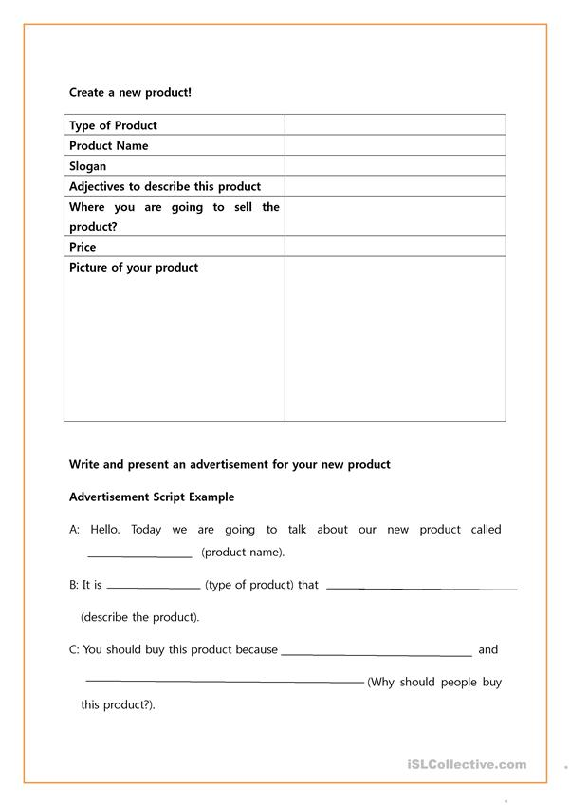
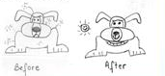
EX 8: PROJECT- SUGGESTION
Work in groups. Write and perform your own TV advert in groups.
Think of five adjectives to describe the product and make up a good slogan.
Advertisement Script Example
Create a new product!
Advertising Example
Flea-Free^{tm} is a brand new, effective flea collar that will help your beloved pet get rid of these annoying little beasts that cause irritation and itching.
Does not contain poisonous chemicals
yet remains active for at least 3 years.
Available now in 12 different colors.

Slide 23
01
Homework
02
03
1. Finish all the tasks
2. Prepare U3-D (P.38)
04
?
05
06

Slide 24

www.phuongnam.edu.vn

Slide 25



Thank you!
CTCP ĐẦU TƯ VÀ PHÁT TRIỂN GIÁO DỤC PHƯƠNG NAM

