Slide 2
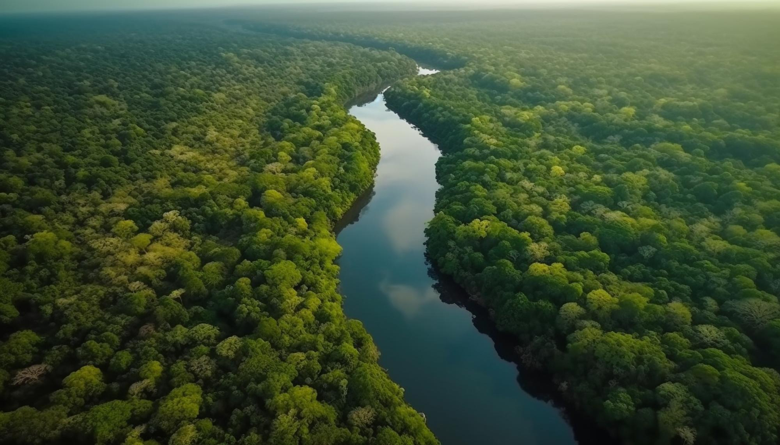


Unit
6
NATURAL WONDERS OF THE WORLD
LESSON 6: SKILLS 2

Slide 3

OBJECTIVES
By the end of the lesson, students will be able to:
Listen for specific information about the Amazon Rainforest;
Write about a natural wonder / beautiful landscape in their area.

Slide 4
LESSON 6: SKILLS 2
WARM-UP
Brainstorming
Task 1: Write a word from the box under the correct picture.
Task 2: Listen to the passage and tick (√) the things you hear.
Task 3: Listen again and choose the correct answers.
LISTENING
Task 4: Work in pairs. Brainstorm ideas about a natural wonder/beautiful landscape in your area. Ask and answer about it, using the following prompts.
Task 5: Write a paragraph (100 - 120 words) about the natural wonder/ beautiful landscape you have talked about in 4.
WRITING
CONSOLIDATION
Wrap-up
Homework

Slide 5

WARM-UP
OPTION 1
BRAINSTORMING

Slide 6
WARM-UP
OPTION 1
Questions:
- Are there any beautiful places or landscapes in your neighbourhood?
- Is there a beautiful park with many colourful flowers and tranquil ponds in your neighbourhood? If so, what are your favourite things about it?
BRAINSTORM
- Does your neighbourhood have a view of the towering skyscrapers and twinkling lights?

Slide 7
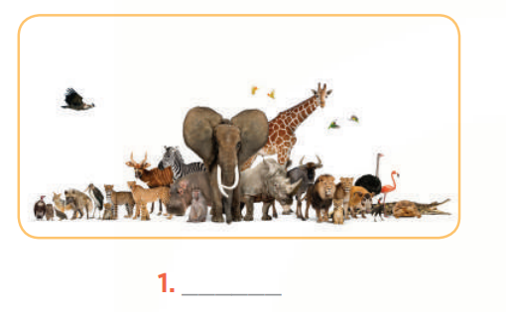
LISTENING
1
Write a word from the box under the correct picture.
a. rainforest
b. flora
c. fauna
fauna

Slide 8
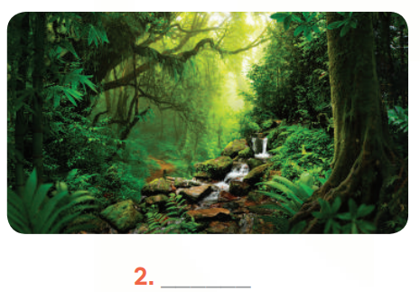
LISTENING
1
Write a word from the box under the correct picture.
a. rainforest
b. flora
c. fauna
rainforest

Slide 9
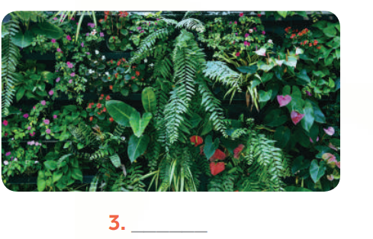
LISTENING
1
Write a word from the box under the correct picture.
a. rainforest
b. flora
c. fauna
flora

Slide 10

LISTENING
2
Listen to the passage and tick (√) the things you hear.
- Green lung of the world
- Causing climate change
- Threats to biodiversity
- Planting trees
- Exploring ecosystems
- Protecting wildlife
√
√
√
√

Slide 11
LISTENING
3
Listen again and choose the correct answers.
1. The Amazon Rainforest is rich in ______.
A. rivers and forests
C. climate change
B. flora and fauna
2. The threats to biodiversity are deforestation, fires, and extinction of rare animal ______.
A. flora
C. species
B. fauna

Slide 12
LISTENING
3
Listen again and choose the correct answers.
3. Which activity can governments and communities do to restore damaged ecosystems?
A. Punishing loggers.
C. Putting out fires.
B. Establishing parks.
4. Governments are encouraging people to live in a way that doesn’t hurt the ______.
A. environment
C. marine life
B. animals

Slide 13
LESSON 6: SKILLS 2
WARM-UP
Brainstorming
Task 1: Write a word from the box under the correct picture.
Task 2: Listen to the passage and tick (√) the things you hear.
Task 3: Listen again and choose the correct answers.
LISTENING
Task 4: Work in pairs. Brainstorm ideas about a natural wonder/beautiful landscape in your area. Ask and answer about it, using the following prompts.
Task 5: Write a paragraph (100 - 120 words) about the natural wonder/ beautiful landscape you have talked about in 4.
WRITING

Slide 14
WRITING
4
Work in pairs. Brainstorm ideas about a natural wonder/beautiful landscape in your area. Ask and answer about it, using the following prompts.
- Think of a natural wonder / beauty spot / landscape in your area.
- Work in pairs. One asks questions and one answers, based on the following cues:
– Name of the natural wonder / beautiful landscape
– Location
– Natural features
– Activities
– Ways to protect it

Slide 15
WRITING
Example:
Name of the natural wonder:
What is it / is its name?
Location:
Where is it located?
Natural features:
What are its natural features?
Activities:
What (activities) can visitors do there?
Ways to protect it:
What are the ways to protect it?

Slide 16
WRITING
5
Write a paragraph (100 - 120 words) about the natural wonder/ beautiful landscape you have talked about in 4.
- Use the ideas in Activity 4 for your writing.
There is a beautiful ___________________________ near my home. ______________________________________________________________________________________________________________
____________________________________________________________________________________________________________________________________________________________________________________________________________________________
There is a beautiful river near my home. It is called Dong Son River. It is not very large, but it is nice and peaceful. On the right bank of the river near my village, there are rice fields and patches of green grass. There are also bushes and a lot of wild flowers. At weekends a lot of people gather here for entertainment. Young people go camping and have a picnic. Old people may spend their time fishing or playing chess. Many swim in the river or row a boat on it. This place is becoming more and more popular, so it is more and more crowded. I think the authorities need to do something to protect this natural beauty. (121 words)

Slide 17
WRITING
Suggested answer:
There is a beautiful river near my home. It is called Dong Son River. It is not very large, but it is nice and peaceful. On the right bank of the river near my village, there are rice fields and patches of green grass. There are also bushes and a lot of wild flowers. At weekends, a lot of people gather here for entertainment. Young people go camping and have a picnic. Old people may spend their time fishing or playing chess. Many swim in the river or row a boat on it. This place is becoming more and more popular, so it is more and more crowded. I think the authorities need to do something to protect this natural beauty.

Slide 18
LESSON 6: SKILLS 2
WARM-UP
Brainstorming
Task 1: Write a word from the box under the correct picture.
Task 2: Listen to the passage and tick (√) the things you hear.
Task 3: Listen again and choose the correct answers.
LISTENING
Task 4: Work in pairs. Brainstorm ideas about a natural wonder/beautiful landscape in your area. Ask and answer about it, using the following prompts.
Task 5: Write a paragraph (100 - 120 words) about the natural wonder/ beautiful landscape you have talked about in 4.
WRITING
CONSOLIDATION
Wrap-up
Homework

Slide 19

CONSOLIDATION
1
Wrap-up
What have we learnt in this lesson?
Listen for specific information about the Amazon Rainforest;
Write about a natural wonder / landscape in their area.

Slide 20

CONSOLIDATION
2
Homework
- Rewrite the paragraph in the notebooks.
- Do exercises in the workbook.

Slide 21
Website: hoclieu.vn
Fanpage: facebook.com/www.tienganhglobalsuccess.vn/

