Slide 1

Unit 5: Sports and hobbies
Lesson 3.3
Page 76

Slide 2
Lesson Outline
Warm-up
Speaking
Consolidation
Wrap-up

Slide 3
Objectives
By the end of this lesson, students will be able to ask for permission, using
Vocabulary: watch TV, go skateboarding, go out, go swimming
Structure: May I watch TV?
- Yes, you may./ No, you may not.

Slide 4

WARM UP

Slide 5
BROKEN WORDS
BROKEN WORDS

Slide 6

ska
go
ing
gh
te
rd
boa
set
Click on the piece.

Slide 7
BROKEN WORDS
go skateboarding

Slide 8
ly
swi
ing
mm
go
rd
wa
set

Slide 9
BROKEN WORDS
go swimming

Slide 10
go
re
ing
th
wa
si
tch
TV

Slide 11
BROKEN WORDS
watch TV

Slide 12
ty
wh
ou
u
go
rd
w
t

Slide 13
BROKEN WORDS
Go out

Slide 14

It’s time to learn …

Slide 15

Speaking

Slide 16

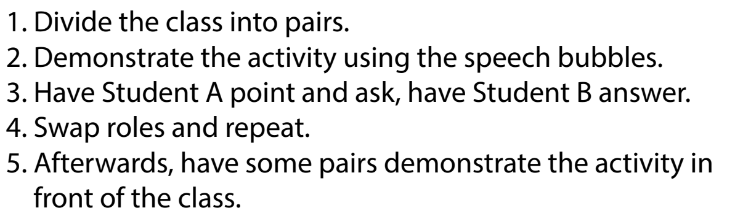

Slide 17

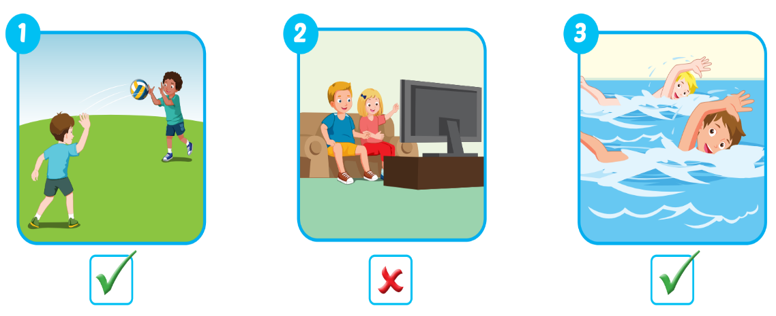

Slide 18

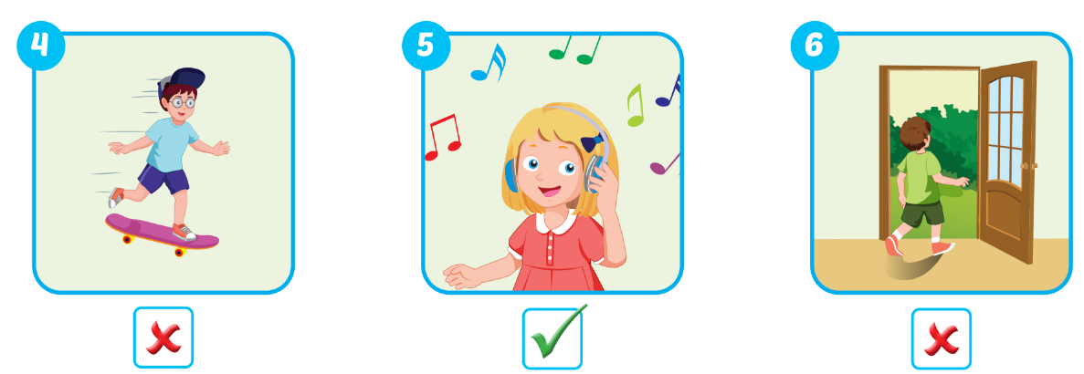

Slide 19

Practice

Slide 20

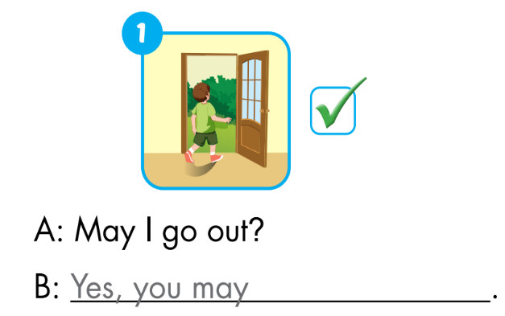
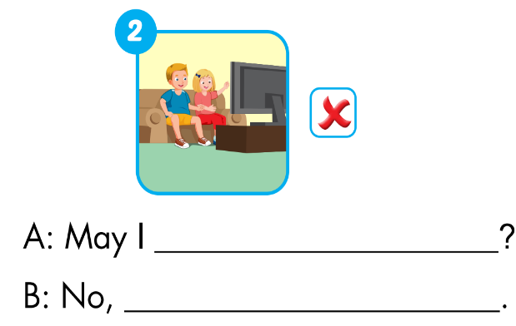
Extra Practice
WB, page 53.
watch TV
you may not

Slide 21
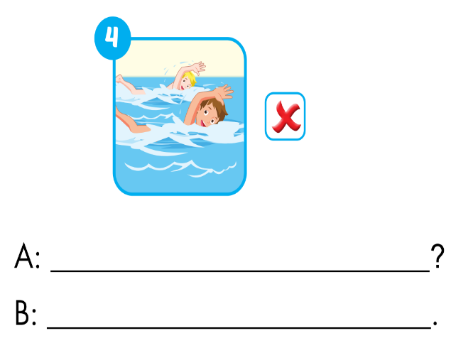
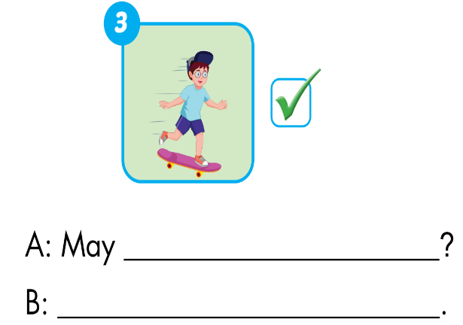
Extra Practice
WB, page 53.
I go skateboarding
May I go swimming?
Yes, you may.
No, you may not

Slide 22

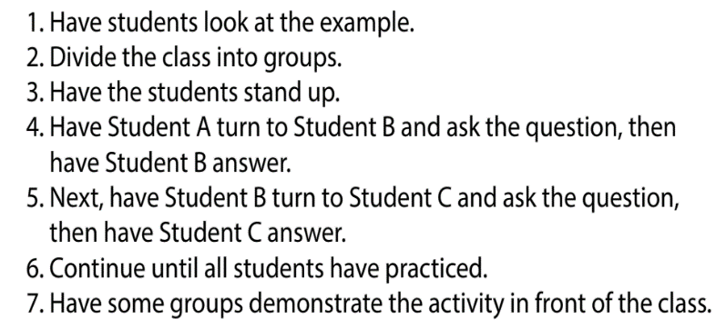

Slide 23
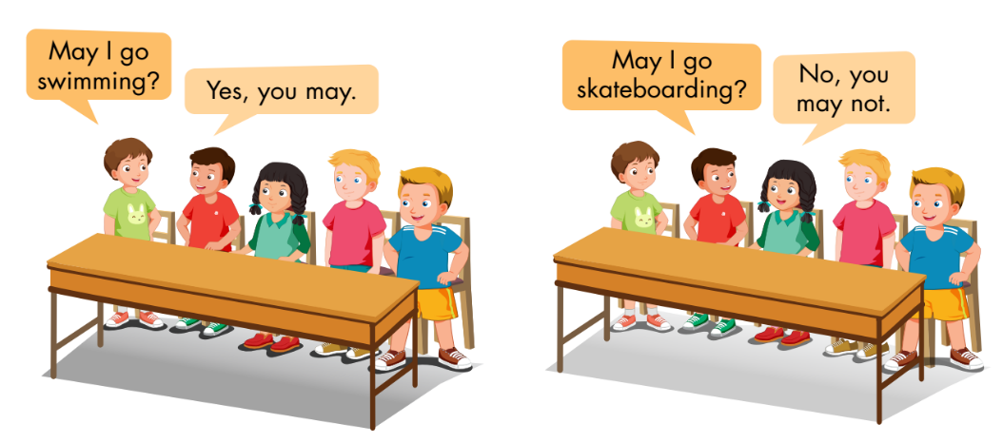

Slide 24

CONSOLIDATION

Slide 25
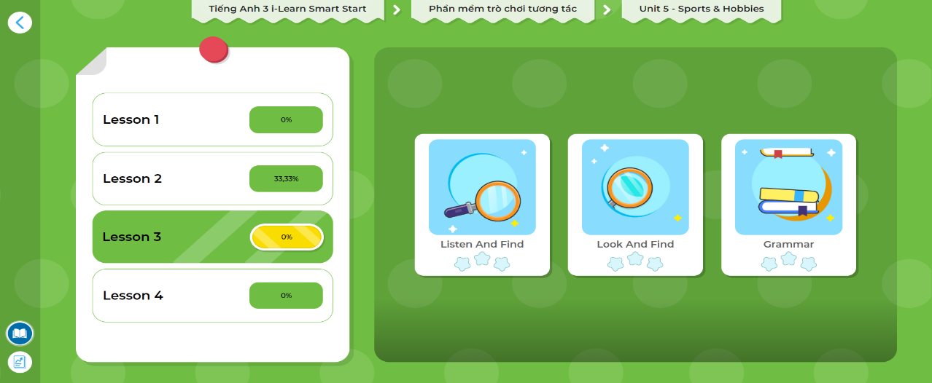
LET’S PLAY!
Click here to play the games!

Slide 26

WRAP-UP

Slide 27

1. Divide the class into two teams.
2. Show a flashcard to the class and say "yes" or "no."
3. Have Team A ask the question and Team B answer.
4. Swap roles and repeat.

Slide 28
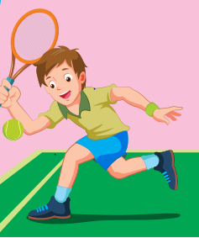
Team A:
May I play tennis?
❌
No, you may not.
Team B:

Slide 29

❌

Slide 30

✓

Slide 31
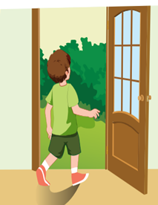
❌

Slide 32

✓

Slide 33

✓

Slide 34
Today’s lesson
Vocabularies
watch TV
go skateboarding
go out
go swimming
Structures/ Sentence patterns
May I watch TV?
- Yes, you may./No, you may not.

Slide 35
Homework
Practice the vocabularies/ structures and make sentences using them.
Do the exercises on page 53 WB
Do the exercises in Tiếng Anh 3 i-Learn Smart Start Notebook on page 36.
Prepare the next lesson (page 77 SB)
Play the consolidation games in Tiếng Anh 3 i-Learn Smart Start DHA App on www.eduhome.com.vn

Slide 36

Lesson 3
Stay positive and have a nice day!

