Slide 1





Slide 4
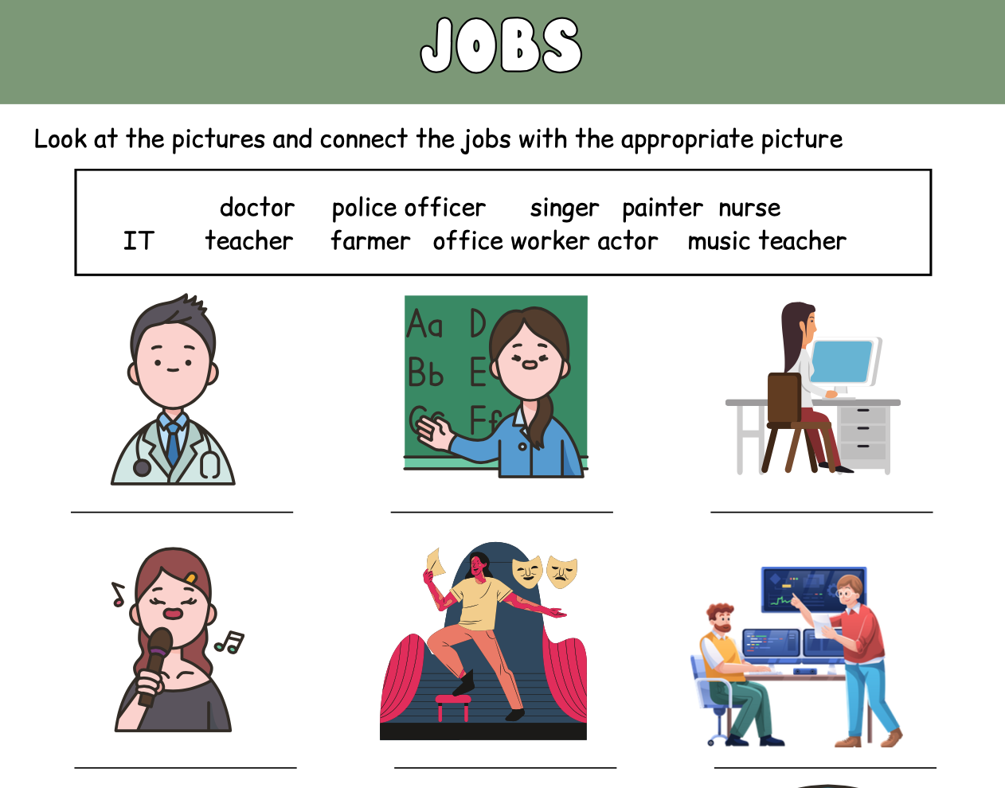
Match the job with the picture

Slide 5
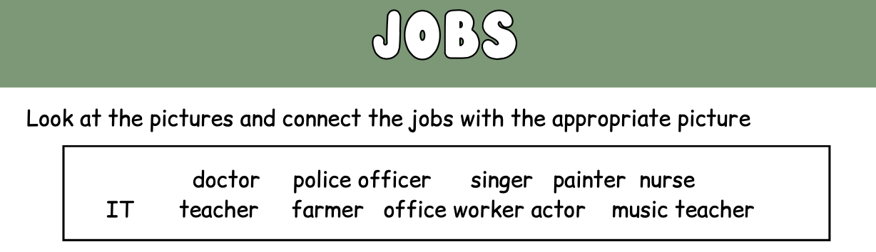


Slide 6
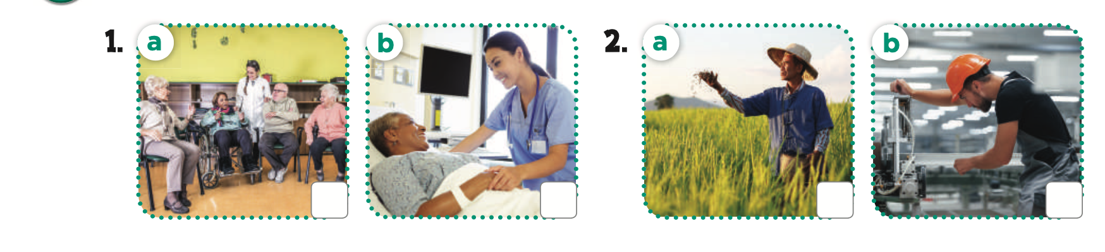

Slide 7


Slide 8
v
v
Notes:
Key:

Slide 9
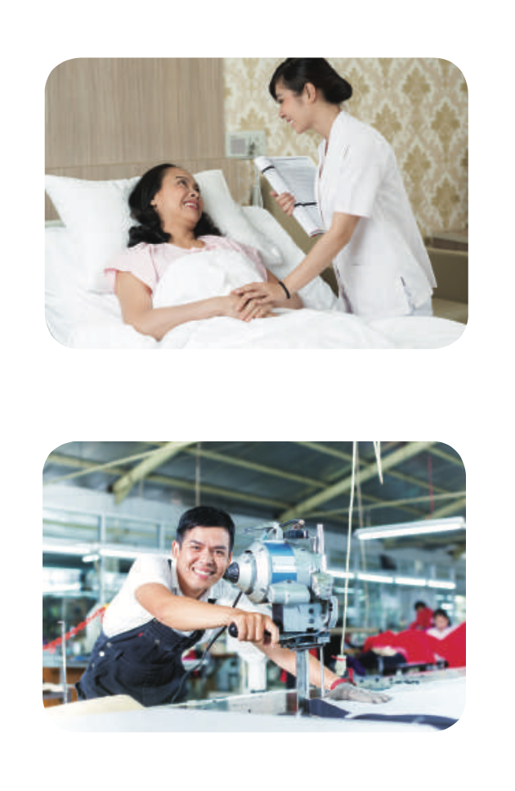
Notes:
explore the pictures

Slide 10
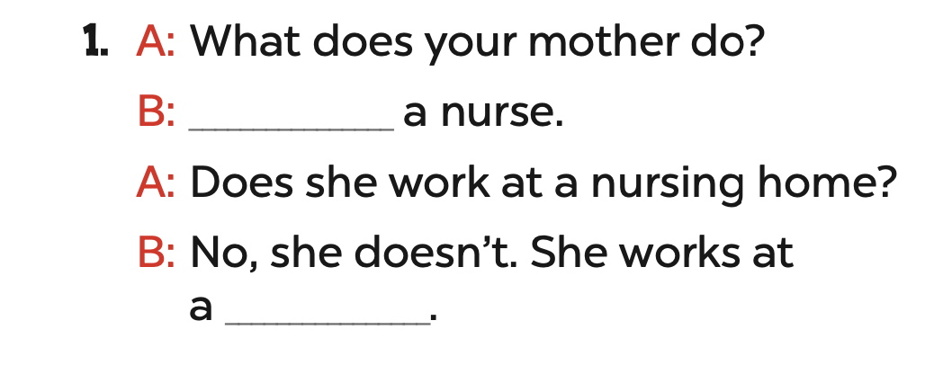
She’s
a hospital
Notes:
gives answer

Slide 11
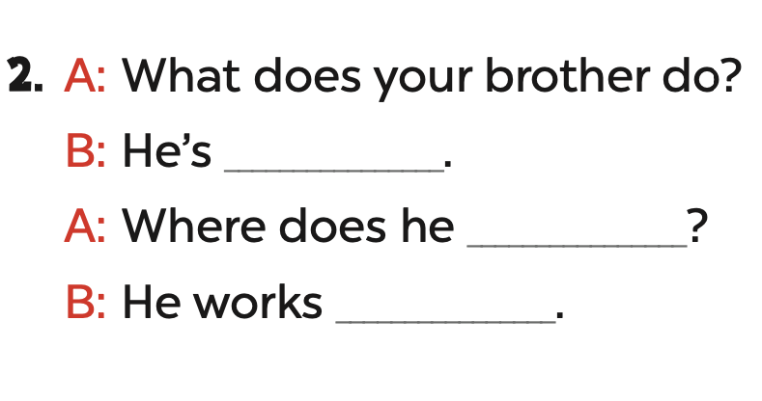
a worker
work
at a factory
Notes:
give answers

Slide 12
Notes:
check again

Slide 13
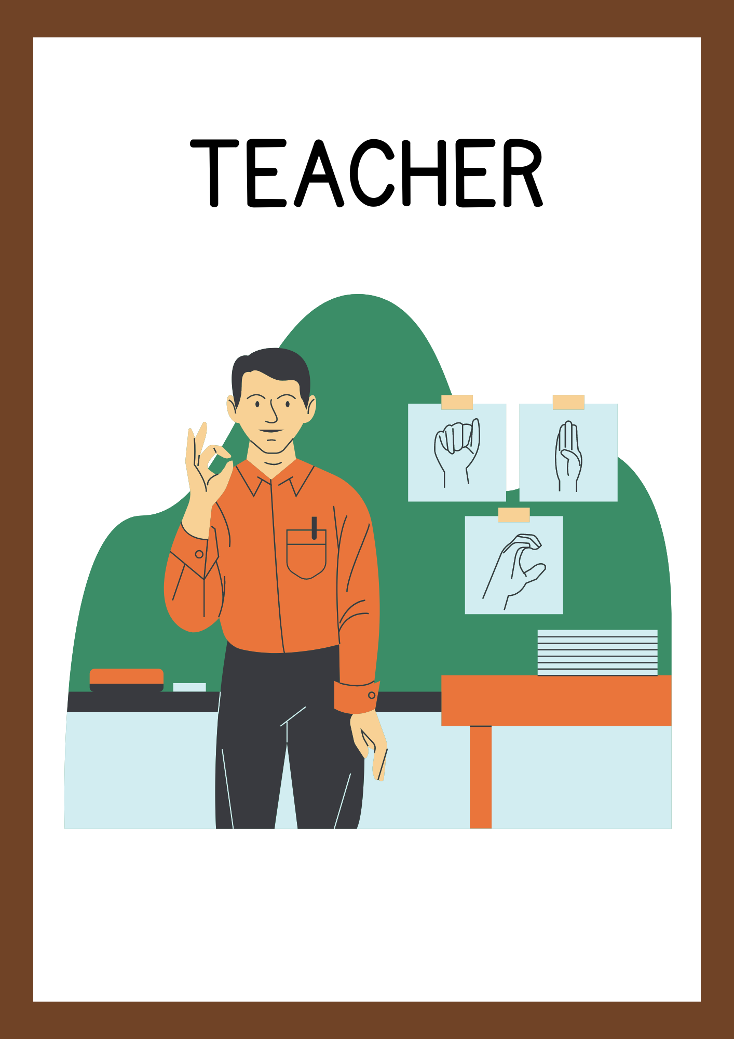

PRACTICE
A teacher, where does she work
A doctor, where does he work?

Slide 14
Notes:
DIVIDE PUPILS INTO GROUPS

Slide 15
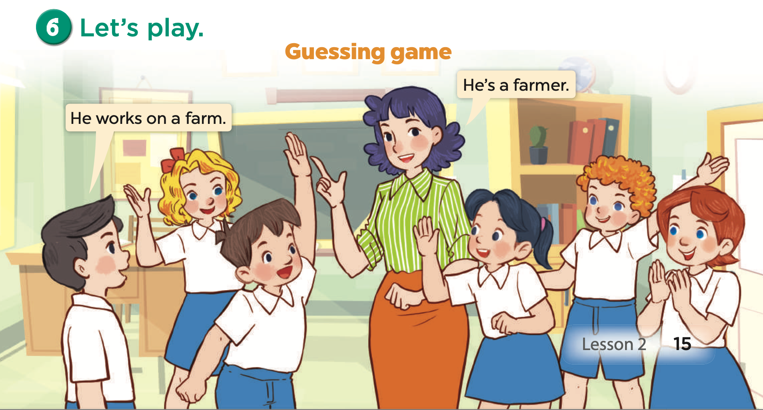
Notes:
divide pupils into groups, group 1 says: he works on a farm- group 2 says: He’s a farmer

Slide 16
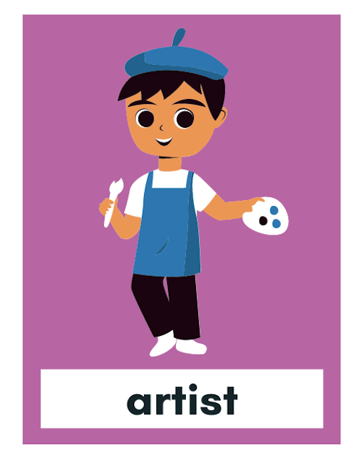
He works in a studio he works with colours

Slide 17

She works on a farm

Slide 18
so who am I?
I am not a doctor
I have to work all day
They are not fine
They feel tired and sick

Slide 19







THANK YOU

