Slide 1

Unit 6: Be green
Progress Check (Cont.)
Page 109

Slide 2
Lesson Outline
Reading
Speaking
Writing
Wrap-up

Slide 3
Objectives
By the end of this lesson, students will be able to…
to read for details.
to practise everyday English.
to write a diary entry about a visit to a place of natural beauty.

Slide 4

WARM-UP

Slide 5
Choose the word whose underlined part is pronounced from that of the others. Practise saying them.
1. A. parked B. washed C. stayed D. hoped
/pɑːkt/ /wɒʃt/ /steɪd/ /həʊpt/
2. A. falls B. plans C. spends D. plants
/fɔːlz/ /plænz/ /spendz/ /plɑːnts/
3. A. received B. practised C. entered D. installed
/rɪˈsiːvd/ /ˈpræktɪst/ /ˈentərd/ /ɪnˈstɔːld/

Slide 6
Choose the word whose main stress is placed differently from that of the others. Practise saying them.
1. A. yoghurt B. river C. laundry D. event
/ˈjɒɡət/ /ˈrɪvər/ /ˈlɔːndri/ /ɪˈvent/
2. A. donate B. compare C. tidy D. repair
/dəʊˈneɪt/ /kəmˈpeər/ /ˈtaɪdi/ /rɪˈpeər/
3. A. scientist B. photograph C. pollution D. energy
/ˈsaɪəntɪst/ /ˈfəʊtəɡrɑːf/ /pəˈluːʃən/ /ˈenədʒi/

Slide 7

It’s time to learn …

Slide 8
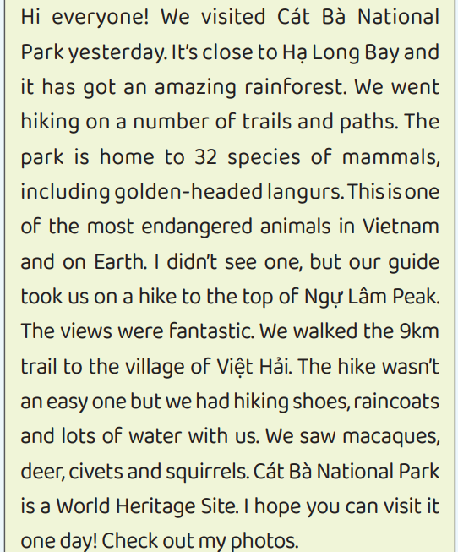
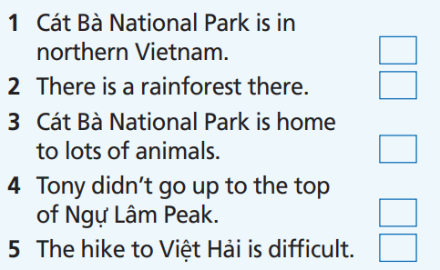
READING
Read the text. Decide if the statements are R (right), W (wrong) or DS (doesn’t say).
First, underline the key words.

Slide 9
READING
Read the text. Decide if the statements are R (right), W (wrong) or DS (doesn’t say).
DS
R
R
W
R

Slide 10
Extra-practice
Read the text and choose the best answer.
First, read the instruction and underline the key words.
Where is Cát Bà National Park?
Near Hạ Long Bay
On the top of Ngự Lâm Peak
Close to the village of Việt Hải
2. What did Tony do there?
Went swimming
Went hiking
Visited Hạ Long Bay
3. What animals did Tony see during his trip?
Golden-headed langurs.
32 species of mammals.
Macaques, deer, civets and squirrels
4. Where did Tony visit?
Hạ Long Bay and Ngự Lâm Peak
Việt Hải village and Ngự Lâm peak
Hạ Long Bay and Ngự Lâm Peak

Slide 11
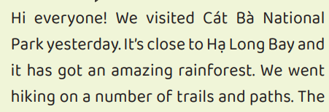
Extra-practice
Read the text and choose the best answer.
Where is Cát Bà National Park?
Near Hạ Long Bay
On the top of Ngự Lâm Peak
Close to the village of Việt Hải

Slide 12
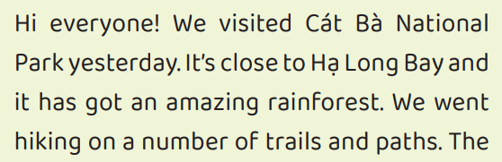
Extra-practice
Read the text and choose the best answer.
2. What did Tony do there?
a. Went swimming
b. Went hiking
c. Visited Hạ Long Bay

Slide 13
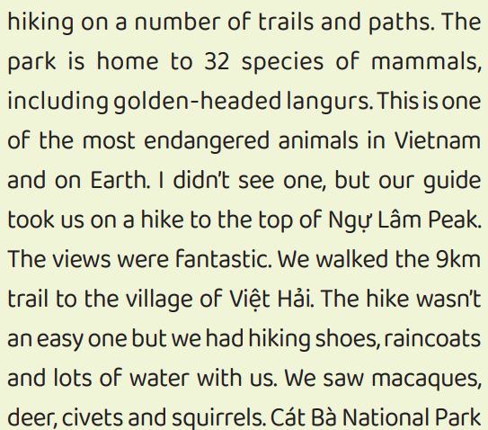
Extra-practice
Read the text and choose the best answer.
3. What animals did Tony see during his trip?
a. Golden-headed langurs.
b. 32 species of mammals.
c. Macaques, deer, civets and squirrels

Slide 14
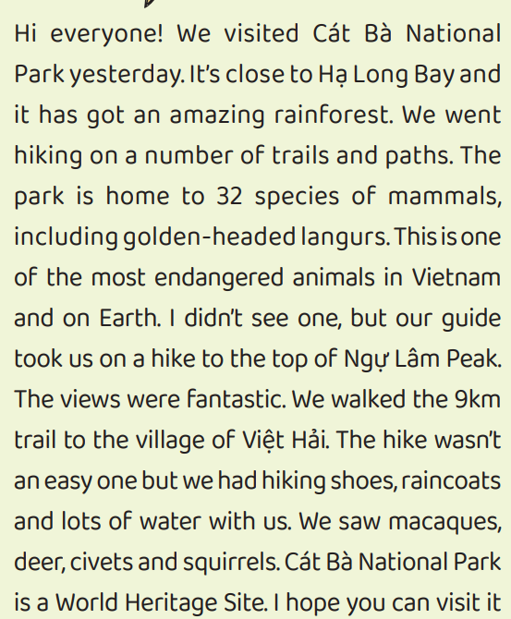
Extra-practice
Read the text and choose the best answer.
4. Where did Tony visit?
a. Hạ Long Bay and Ngự Lâm Peak
b. Việt Hải village and Ngự Lâm peak
c. Hạ Long Bay and Ngự Lâm Peak

Slide 15
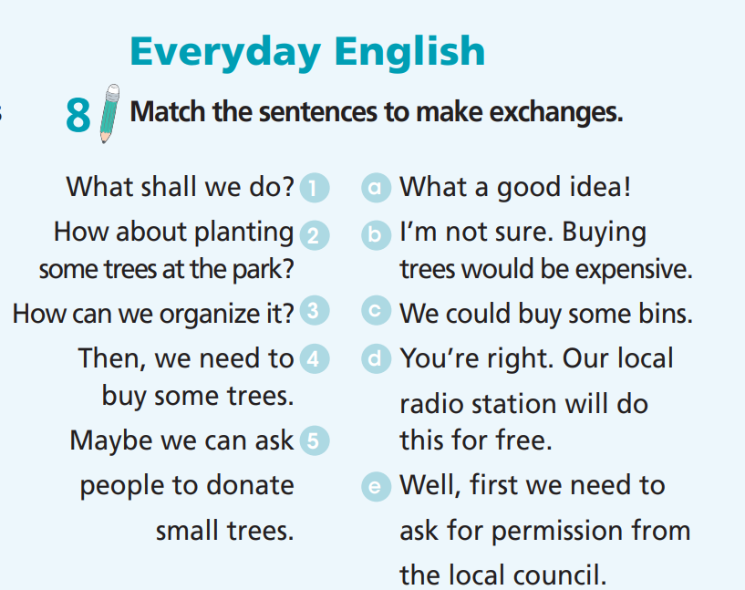
EVERYDAY ENGLISH

Slide 16
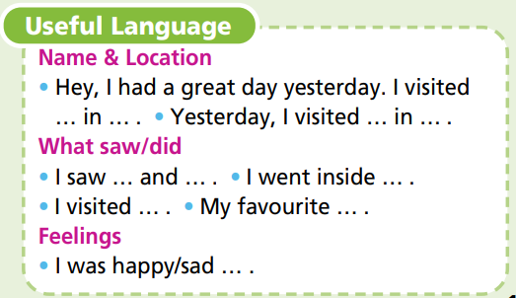
Imagine you visited a place of natural beauty in your country or another country. Write a diary entry about your experiences there (about 60-80 words). Include the name and the location of the place, what activities you did and your feelings.
Writing
SAMPLE
Last weekend, I went to Howletts National Park in Kent. It was amazing! I saw a lot of animals there, but my favourite animals were the giraffes. I knew giraffes are tall, but I was still surprised about how tall they actually were! I picked up litter and fed the animals. I had a wonderful time! I was sad when it was time to go home, but I felt happy that I went there. I can’t wait to go again!

Slide 17

WRAP-UP

Slide 18
Today’s lesson
To read for details.
To practise everyday English.
To write a diary entry about a visit to a place of natural beauty.

Slide 19
Homework
Do Unit 6 Test 2 in Bài Tập Bổ Trợ TA 7 Right On (pages 56 & 57).
Do Semester 2 Test in TA 7 Right On Notebook (pages 70-73).
Review all the vocabularies and grammar points in TA 7 Right on.
Be well-prepared for Term 2 Final Test.

Slide 20

Enjoy your day!

