Slide 1



Unit
12
LESSON 2: A CLOSER LOOK 1

Slide 2

Unit
12
CAREER CHOICES
LESSON 2: A CLOSER LOOK 1

Slide 3

OBJECTIVES
By the end of the lesson, students will be able to:
Use the lexical items related to the topic CAREER CHOICES
Say statements used as questions with correct intonation.

Slide 4
LESSON 2: A CLOSER LOOK 1
LESSON 2: A CLOSER LOOK 1
WARM-UP
Option 1: Jumple words
Option 2: One-sentence Job stories
Vocabulary
Task 1: Match the words in A with their definitions/explanations in B.
Task 2: Choose the correct answer A, B, C, or D to complete each sentence.
Task 3: Complete the texts, using the words from the box.
VOCABULARY
Task 4: Listen to the conversations. Pay attention the tone of statement questions. Then practise the conversations with a partner.
Task 5: Complete each conversation with a statement question. Then practice with a partner. Pay attention the intonation of each sentence.
PRONUNCIATION
CONSOLIDATION
Wrap-up
Homework

Slide 5

WARM-UP
OPTION 1
HOW TO PLAY
- There are some JUMBLE WORDS.
- Work in teams to unscramble them.

Slide 6
WARM-UP
OPTION 1
P | C | L | I | O | E
P | O | L | I | C | E

Slide 7
WARM-UP
OPTION 1
A | C | H | T | E | R | E
T | E | A | C | H | E | R

Slide 8
WARM-UP
OPTION 1
N | R | E | E | N | I | G | E
E | N | G | I | N | E | E | R

Slide 9
WARM-UP
OPTION 1
S | I | H | E | C | A | R
C | A | S | H | I | E | R

Slide 10
WARM-UP
OPTION 1
S | E | E | N | G | I | D
 | A | S | O | N | I | H | F
F | A | S | H | I | O | N | E | D
 | D | E | S | I | G | N | E | R

Slide 11
WARM-UP
OPTION 1
M | N | T | E | R | A | G
 | K | O | R | W | R | E
G | A | R | M | E | N | T | E | D
 | W | O | R | K | E | R

Slide 12
WARM-UP
OPTION 2
One-sentence Job stories

Slide 13
WARM-UP
OPTION 2
One-sentence Job stories
- Write down a one-sentence story about a specific job.
- Read out or have volunteers share their sentences, and try to guess the jobs based on the clues.
Example:
- As a baker, I wake up to the sweet smell of fresh bread.

Slide 14

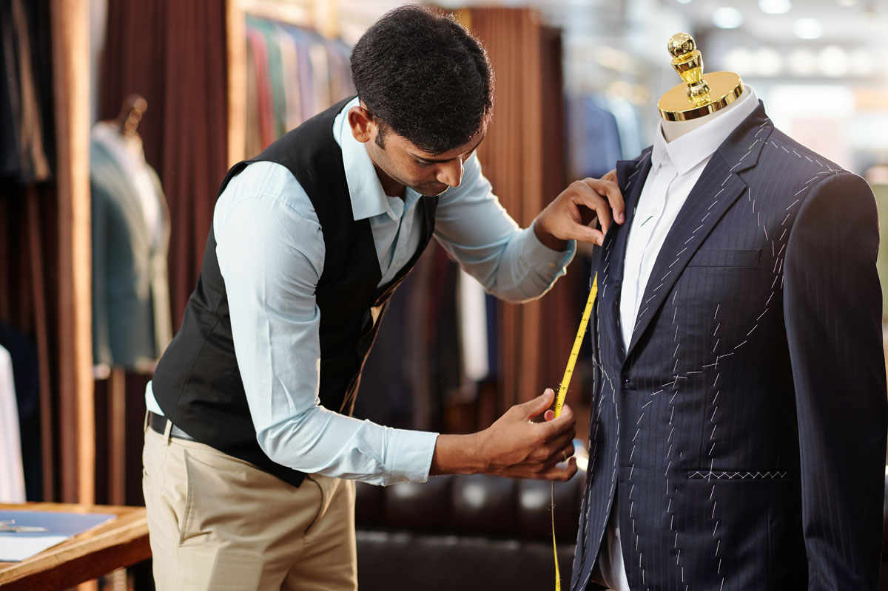
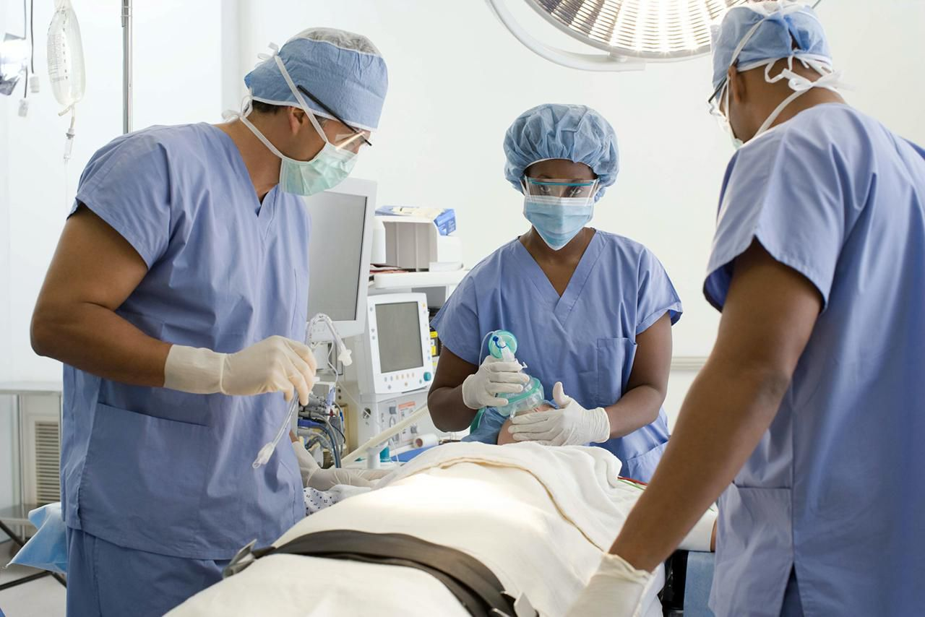
VOCABULARY
someone who repairs, makes, and adjusts clothes.
tailor (n)
/ˈteɪ.lər/
thợ may

Slide 15
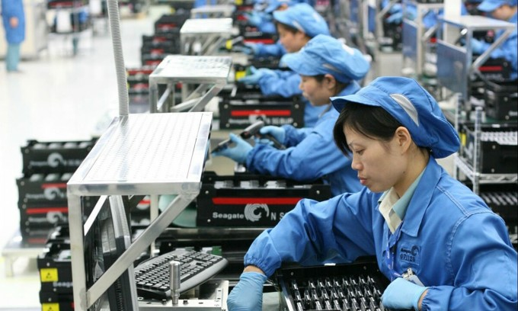
VOCABULARY
a doctor who is specially trained to perform medical operations.
surgeon (n)
/ˈsɜːdʒən/
bác sĩ phẫu thuật

Slide 16
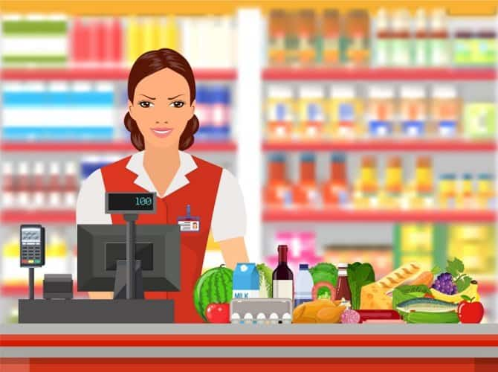
VOCABULARY
a person who works in a factory on an assembly factory on an assembly line, performing a particular job which must be finished before the product moves to the next person.
assembly worker (n)
/əˈsembli ˈwɜːkə/
công nhân dây chuyền

Slide 17

VOCABULARY
a person whose job is to receive and pay out money in a shop, bank, restaurant, etc.
cashier (n)
/kæˈʃɪə/
thu ngân

Slide 18
VOCABULARY
someone whose job is to create computer programs
software engineer (n)
/ˈsɒftweər endʒɪˈnɪə/
kĩ sư phần mềm

Slide 19

VOCABULARY
able to make decisions quickly and confidently
decisive (adj)
Ex: a decisive reply
/dɪˈsaɪsɪv/
quyết đoán

Slide 20
VOCABULARY
well-paid (adj)
earning a lot of money.
/ˌwel ˈpeɪd/
được trả lương cao

Slide 21
VOCABULARY
rewarding (adj)
satisfying or beneficial
Ex: a rewarding experience
/rɪˈwɔːdɪŋ/
bổ ích, xứng đáng

Slide 22


VOCABULARY
demanding (adj)
needing a lot of attention, effort or time.
/dɪˈmɑːndɪŋ/
(yêu cầu) khắt khe, phức tạp

Slide 23
VOCABULARY
doing or saying the same thing several times, especially in a way that is boring.
repetitive (adj)
/rɪˈpetətɪv/
lặp đi lặp lại

Slide 24
VOCABULARY
New words | Pronunciation | Meaning
1. tailor (n) | /ˈteɪ.lər/ | thợ may
2. surgeon (n) | /ˈsɜːdʒən/ | bác sĩ phẫu thuật
3. assembly worker (n) | /əˈsembli ˈwɜːkə/ | công nhân dây chuyền
4. cashier (n) | /kæˈʃɪə/ | thu ngân
5. software engineer (n) | /ˈsɒftweər endʒɪˈnɪə/ | kĩ sư phần mềm

Slide 25
VOCABULARY
New words | Pronunciation | Meaning
6. decisive (adj) | /dɪˈsaɪsɪv/ | quyết đoán
7. well-paid (adj) | /ˌwel ˈpeɪd/ | được trả lương cao
8. rewarding (adj) | /rɪˈwɔːdɪŋ/ | bổ ích, xứng đáng
9. demanding (adj) | /dɪˈmɑːndɪŋ/ | (yêu cầu) khắt khe, phức tạp
10. repetitive (adj) | /rɪˈpetətɪv/ | lặp đi lặp lại

Slide 26
VOCABULARY
1
Match the words in A with their definitions/explanations in B.
A | B
1. A tailor | a. receives and pays out money in a shop, bank, restaurant, etc. | 1.
2. A surgeon | b. performs a particular task in the process of making a product in a factory | 2.
3. An assembly worker | c. designs and develops computer software. | 3.
4. A cashier | d. performs medical operations. | 4.
5. A software engineer | e. makes clothes. | 5.
e
d
c
a
b

Slide 27
EXTRA ACTIVITY
- There are six jobs on the board.
- Work in teams
- Choose 4 members to join the game
- The members of each team stand in a line.
- Take turn to describe a job without mentioning its name.
- Members of the teams run quickly to the board and slap the correct job.

Slide 28
PRACTICE
2
Choose the correct answer A, B, C, or D to complete each sentence.
1. My brother is applying for a ______ as a customer manager in a supermarket.
A. job
C. career
B. duty
D. work
2. Mr Hoang was a police officer. He had a successful ______ in the police force.
A. work
C. career
B. job
D. task

Slide 29
PRACTICE
2
Choose the correct answer A, B, C, or D to complete each sentence.
3. A cashier has to do ______ tasks, such as receiving money and printing receipts.
A. effective
C. decisive
B. creative
D. repetitive
4. A tailor can have a ______ job if he / she is creative and knowledgeable about fabric.
A. boring
C. well-paid
B. basic
D. difficult

Slide 30
demanding repetitive software engineer
well-paid assembly worker
PRACTICE
2
Choose the correct answer A, B, C, or D to complete each sentence.
5. A surgeon’s job is ______. He / She works long hours and occasionally deals with life-and-death situations.
Mr Lam: I’m a(n) (1) ______________ . I design and develop programmes for computers. My job is (2) ______________. I work long hours on the computer, especially when deadlines approach. However, it’s a (3) ______________ job, so I’m happy with it.
A. easy
C. rewarding
B. demanding
D. stress-free

Slide 31
PRACTICE
3
Complete the following sentences with the words from the box.
demanding repetitive software engineer
well-paid assembly worker
software engineer
Ms Nga: I’m a(n) (4) ______________. I’m in charge of sticking labels on the products. Besides basic skills, I must be able to stand for a long time and do (5) ______________tasks at a reasonable speed.
Mr Lam: I’m a(n) (1) ______________ . I design and develop programmes for computers. My job is (2) ______________. I work long hours on the computer, especially when deadlines approach. However, it’s a (3) ______________ job, so I’m happy with it.
demanding
well-paid

Slide 32
PRACTICE
3
Complete the following sentences with the words from the box.
demanding repetitive software engineer
well-paid assembly worker
Mr Lam: I’m a(n) (1) ______________ . I design and develop programmes for computers. My job is (2) ______________. I work long hours on the computer, especially when deadlines approach. However, it’s a (3) ______________ job, so I’m happy with it.
assembly worker
Ms Nga: I’m a(n) (4) ______________. I’m in charge of sticking labels on the products. Besides basic skills, I must be able to stand for a long time and do (5) ______________tasks at a reasonable speed.
repetitive

Slide 33
PRACTICE
3
- There are some adjectives that describe jobs in the passages (repetitive, well-paid, demanding, ...)
- Add more adjectives to the list
(stressful, challenging, rewarding, etc.)
- Which job you prefer and why?

Slide 34
PRACTICE
Example answer: + I prefer the job of a software engineer. It is a difficult but well-paid job. Moreover, I like working with computer, so I think I can do the job well. + I prefer the job of an assembly worker. I only need a short time to train for the job, so I can start making a living soon.)

Slide 35
LESSON 2: A CLOSER LOOK 1
LESSON 2: A CLOSER LOOK 1
WARM-UP
Option 1: Jumple words
Option 2: One-sentence Job stories
Vocabulary
Task 1: Match the words in A with their definitions/explanations in B.
Task 2: Choose the correct answer A, B, C, or D to complete each sentence.
Task 3: Complete the texts, using the words from the box.
VOCABULARY
Task 4: Listen to the conversations. Pay attention the tone of statement questions. Then practise the conversations with a partner.
Task 5: Complete each conversation with a statement question. Then practice with a partner. Pay attention the intonation of each sentence.
PRONUNCIATION

Slide 36



PRONUNCIATION
Look at Remember box (p.126)
1
Minh: It’s 4:20 now. I must go. Hoa: It’s 4:20? Oh dear, I must go, too!
We use a statement question when we want to express our surprise at the previous statement. In some cases, we use it to check if our information is correct. In these cases, we raise our voice at the end of the statement.
Example:
A: I want to be a doctor.
B: You want to be a doctor?
2
Mai: Mum, Ms Lan has invited you to a party.
Mother: She invited me to a party?

Slide 37
PRONUNCIATION
4
Listen to the conversations. Pay attention the tone of statement questions. Then practise the conversations with a partner.
1
Minh: It’s 4:20 now. I must go. Hoa: It’s 4:20? Oh dear, I must go, too!
2
Mai: Mum, Ms Lan has invited you to a party.
Mother: She invited me to a party?

Slide 38
PRONUNCIATION
5
Complete each conversation with a statement question. Then practice with a partner. Pay attention the intonation of each sentence.
- Work in pairs.
- Complete the conversations with appropriate statement questions.
1
Nick: Minh is very happy with the vocational test.
Trang: ______? He told me something different.
2
Elena: I want to become a surgeon.
Tom: ______? Do you have skilful hands?

Slide 39
PRONUNCIATION
5
Complete each conversation with a statement question. Then practice with a partner. Pay attention the intonation of each sentence.
1
Nick: Minh is very happy with the vocational test.
Trang: ______? He told me something different.
2
Elena: I want to become a surgeon.
Tom: ______? Do you have skilful hands?
1
2
Nick: Minh is very happy with the vocational test.
Trang: Minh is very happy with the vocational test? He told me something different.
Elena: I want to become a surgeon.
Tom: You want to become a surgeon? Do you have skilful hands?

Slide 40
1
2
Nick: Minh is very happy with the vocational test.
Trang: ______? He told me something different.
Elena: I want to become a surgeon.
Tom: ______? Do you have skilful hands?
PRONUNCIATION
Sample:
1
Nick: Minh is very happy with the vocational test.
Trang: Minh is very happy with the vocational test? He told me something different.
2
Elena: I want to become a surgeon.
Tom: You want to become a surgeon? Do you have skilful hands?

Slide 41
LESSON 2: A CLOSER LOOK 1
LESSON 2: A CLOSER LOOK 1
WARM-UP
Option 1: Jumple words
Option 2: One-sentence Job stories
Vocabulary
Task 1: Match the words in A with their definitions/explanations in B.
Task 2: Choose the correct answer A, B, C, or D to complete each sentence.
Task 3: Complete the texts, using the words from the box.
VOCABULARY
Task 4: Listen to the conversations. Pay attention the tone of statement questions. Then practise the conversations with a partner.
Task 5: Complete each conversation with a statement question. Then practice with a partner. Pay attention the intonation of each sentence.
PRONUNCIATION
CONSOLIDATION
Wrap-up
Homework

Slide 42

CONSOLIDATION
1
Wrap-up
What have we learnt in this lesson?
Use the lexical items related to the topic CAREER CHOICES
Say statements used as questions with correct intonation.

Slide 43

CONSOLIDATION
2
Homework
- Do exercises in the workbook.

Slide 44
Website: hoclieu.vn
Fanpage: facebook.com/www.tienganhglobalsuccess.vn/

