Slide 2
Unit
1
1
Unit
FAMILY LIFE
FAMILY LIFE
LESSON 6
WRITING
Writing about family routines

Slide 3
1
OBJECTIVES
Unit
1. Knowledge
- use lexical items related to the topic “Family life”;
- write about family routines.
2. Core competence
- be collaborative and supportive in pair work and team work;
- actively join in class activities;
- develop presentation skills.
3. Personal qualities
- be able and willing to sharing housework in the family.

Slide 4
LESSON 6
WRITING
Unit
GETTING STARTED
WARM-UP
Task 1: Choose a routine.
PRE-WRITING
Task 2: Read the email and complete the table.
WHILE-WRITING
Task 3: Complete the email about Dong’s family routines.
POST-WRITING
Peer review and evaluation
CONSOLIDATION
Wrap-up
Home work

Slide 5
LESSON 6
WRITING
Unit
GETTING STARTED
WARM-UP
Task 1: Choose a routine.

Slide 6
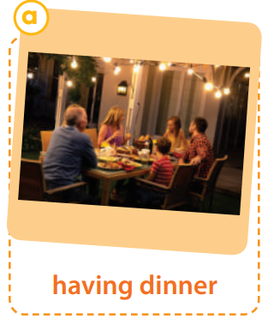
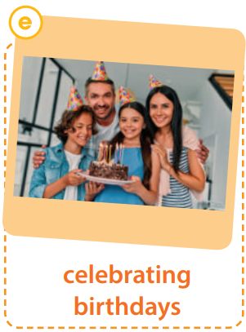
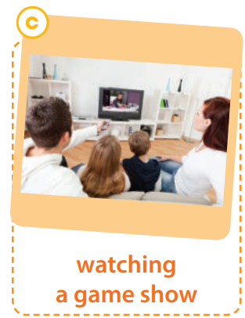
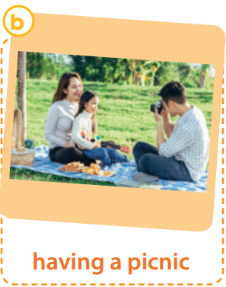
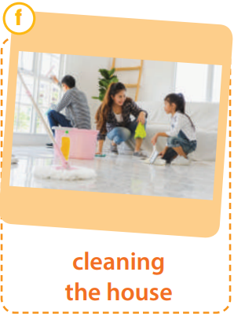
WARM-UP
What activity is the most frequent in your family?
1

Slide 7
LESSON 6
WRITING
Unit
GETTING STARTED
WARM-UP
Task 1: Choose a routine.
PRE-WRITING
Task 2: Read the email and complete the table.

Slide 8
PRE-WRITING
Read the email and complete the table.
New message | __ X
To: dong@webmail.com
Subject: My family routines
Hi Dong, How are you getting on? In your last email you asked me about my family routines. Well, we have quite a few routines to help us learn life skills and build family bonds, but I’ll tell you about three main ones. First, my family always have dinner together. Dinners are important for us since we share our daily experiences and talk about the latest news. Second, we watch our favourite game show on TV together every Friday evening. We discuss the questions and guess the answers. It’s great fun every time we get a correct answer. Third, every two weeks, on Saturday we clean the house together. We make a list of all the chores. Each of us then chooses one or two household tasks according to personal choice. We all feel happy and proud when we see our home spotlessly clean at the end of the day. Do you have similar family routines? I’d be interested to know about your family. Please write back soon. Best, Joey
2
SEND

Slide 9
PRE-WRITING
Routines | When / How often | Things to do to strengthen family bonds
1. have dinner together
2. | every Friday evening
3. |  | - make a list of chores - choose tasks
- share daily experiences
- talk about the latest news.
every day
watch favorite game show on TV together
- discuss the questions
- guess the answers
clean the house together
every two weeks, on Saturday

Slide 10
LESSON 6
WRITING
Unit
GETTING STARTED
WARM-UP
Task 1: Choose a routine.
PRE-WRITING
Task 2: Read the email and complete the table.
WHILE-WRITING
Task 3: Complete the email about Dong’s family routines.

Slide 11
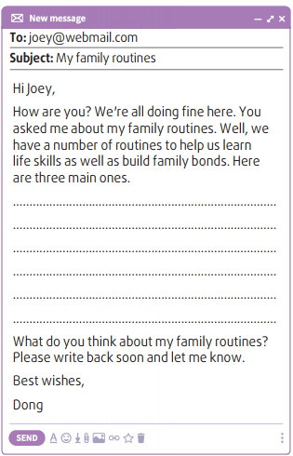
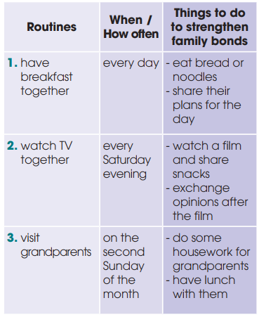
WHILE-WRITING
3
Complete the email about Dong’s family routines using the information in the box.

Slide 12
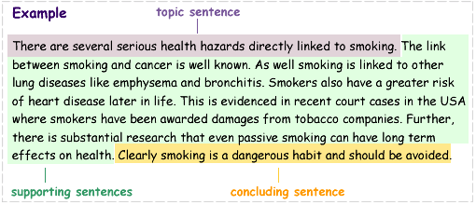
WHILE-WRITING
3.1. STRUCTURE OF A PARAGRAPH

Slide 13
WHILE-WRITING
3.2. QUALITIES OF A GOOD PARAGRAPH
QUALITIES OF A GOOD PARAGRAPH
Unity
(i.e. one main idea is developed)
Coherence (i.e. all the sentences and ideas flows smoothly to make clear and logical points about the topic)

Slide 14
WHILE-WRITING
3.3. CONNECTORS
To list ideas | First, Second, In addition, Additionally, Moreover, Furthermore, Another idea worth noting is that, Finally
To give an example | For example/ For instance, To illustrate
To conclude | In conclusion, In brief, In short

Slide 15
LESSON 6
WRITING
Unit
GETTING STARTED
WARM-UP
Task 1: Choose a routine.
PRE-WRITING
Task 2: Read the email and complete the table.
WHILE-WRITING
Task 3: Complete the email about Dong’s family routines.
POST-WRITING
Peer review and evaluation

Slide 16
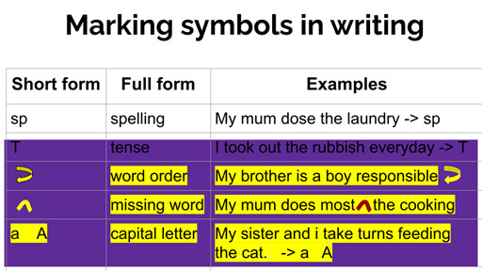
POST-WRITING
PEER CHECK & REVIEW
- Work in pairs
- Give comments on your partner’s writing

Slide 17
POST-WRITING
SAMPLE PARAGRAPH
First, my family always have breakfast together. Breakfast is a quick meal with just bread or noodles because both my parents work and we, kids, have morning classes. But the most important thing is that we can sit down together, eat healthy food and share our plans for the day. Second, we spend Saturday evenings as a family. We often watch a film, share snacks and then exchange our opinions after the film. I can even argue and defend my ideas about the film with my grandparents or brother. Third, on the second Sunday of the month, we visit our grandparents. We come to my parents’ home quite early in the morning to help them do some housework such as cleaning the house or washing clothes. Then, we have a big lunch with them. My parents are very happy when we come to see them. The visits make me feel closer to my grandparents.

Slide 18
CONSOLIDATION
1
Wrap-up
lexical items about family routines
ways to write an email about family routines.

Slide 19
CONSOLIDATION
2
Homework
- exercises in the workbook
- prepare for Communication and Culture lesson

Slide 20
Website: hoclieu.vn
Fanpage: facebook.com/www.tienganhglobalsuccess.vn

