Slide 1

Unit 3: School
Lesson 2.3
Page 43

Slide 2
Lesson Outline
Warm-up
Practice
Speaking
Consolidation
Wrap-up

Slide 3
Objectives
By the end of this lesson, students will be able to ask what subjects people like.
Vocabulary: math, English, art, P.E. (physical education), music
Structure: Do you like math?
- Yes, I do./No, I don't.

Slide 4

WARM UP

Slide 5
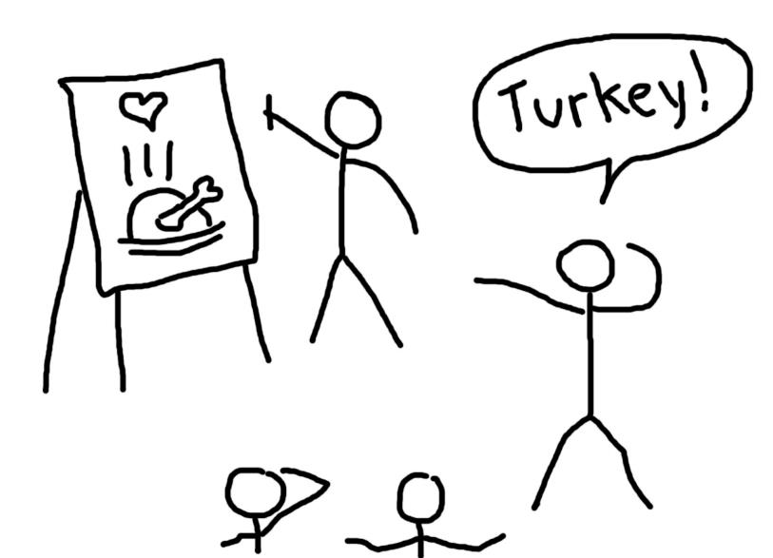
Let’s play!
Pictionary

Slide 6
How to play
Pictionary
Put the words in a bag.
Divide the class into 2 teams and draw a line down the middle of the board.
Ask one member from each team to choose a word from the bag.
Tell the students to draw the word as a picture on the board and encourage their team to guess the word.
The first team to shout the correct answer gets a point.

Slide 7

It’s time to learn …

Slide 8
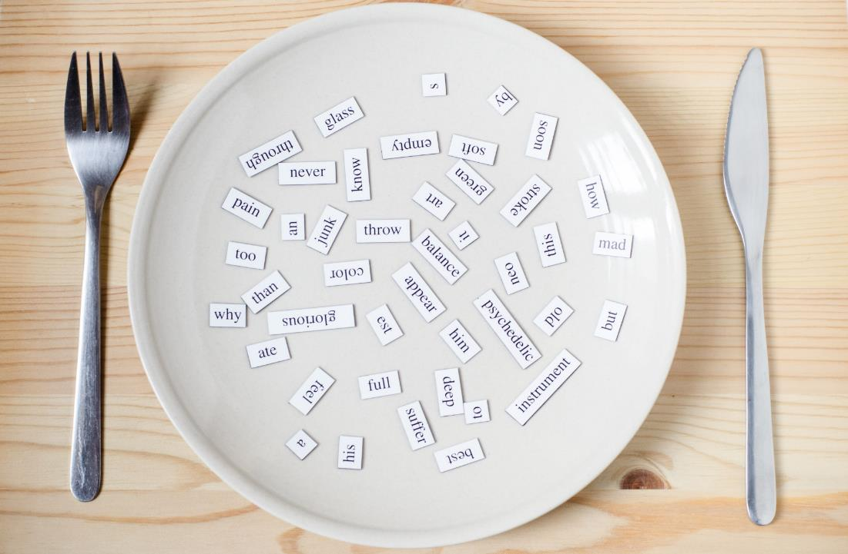
Structures
Do you like math?
Yes, I do./No, I don’t.

Slide 9

Practice

Slide 10

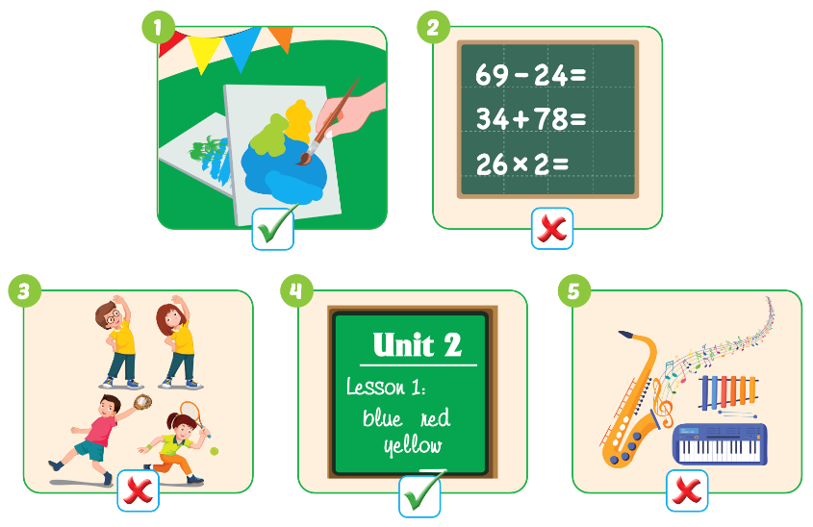

Slide 11




Teacher models first!

Slide 12
Divide the class into two teams.
Have Team A ask the question and Team B answer.
Swap roles and repeat.

Slide 13
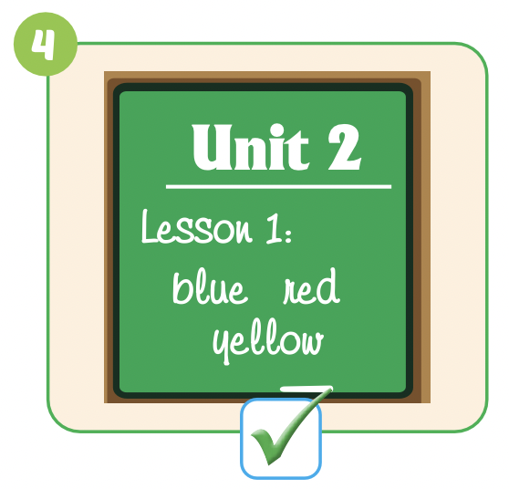
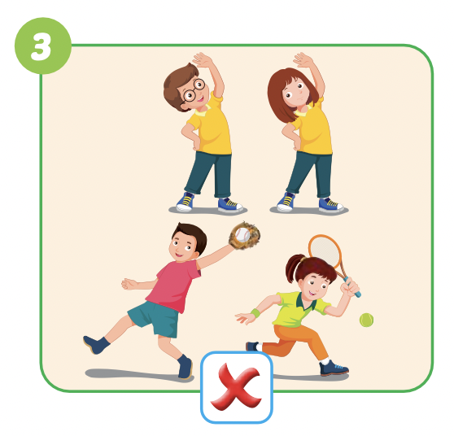

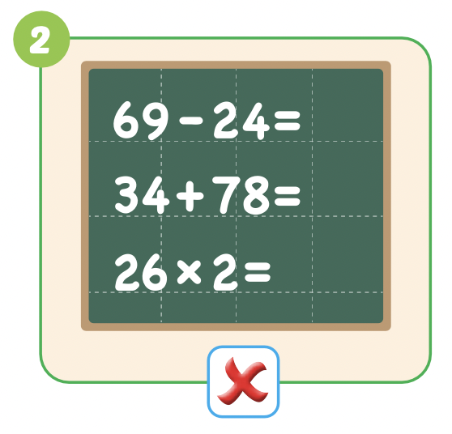
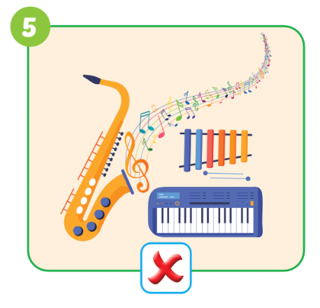

Slide 14

Speaking

Slide 15

Pairwork

Slide 16

DEMONSTRATION
Have some pairs demonstrate the activity in front of the class

Slide 17
Let’s play!

Slide 18



Do you like………….?
- …….................

Slide 19

NEXT
Help me please!

Slide 20


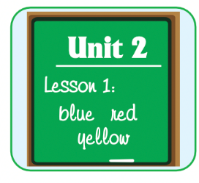


1
NEXT
Do you like English?
Do you like………….?
- …….................
ANSWER
No, I don’t.

Slide 21

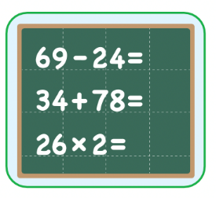


1
NEXT
2
Do you like math?
Do you like………….?
- …….................
ANSWER
Yes, I do.

Slide 22


1
NEXT
2
3
Do you like art?
Do you like………….?
- …….................
ANSWER
Yes, I do.

Slide 23

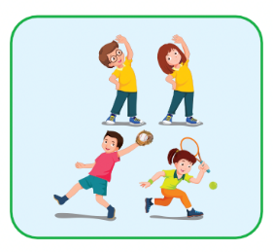
1
NEXT
2
3
Do you like P.E.?
4
Do you like………….?
- …….................
ANSWER
No, I don’t.

Slide 24


1
NEXT
2
3
Do you like music?
4
Do you like………….?
- …….................
5
ANSWER
Yes, I do.

Slide 25

1
END
2
Hurray!
We found the treasure!
THANK YOU!
3
4
5
ANSWER

Slide 26

Production

Slide 27
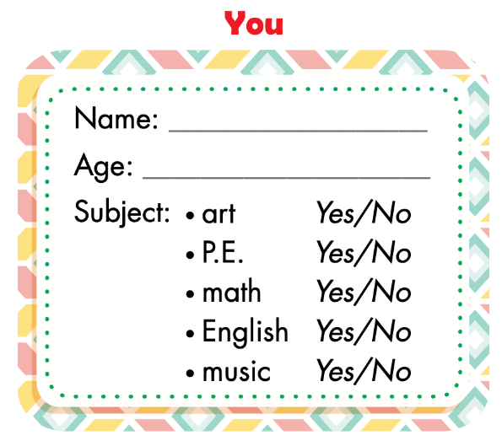
Fill in the form.
Notes:
Divide the class into groups of four.
Have Student A cover their eyes.
Have the other students put one of their own items on the
desk in a random order.
Have Student A open their eyes and try to guess.
Have other students respond.
Have students swap roles and repeat.

Slide 28
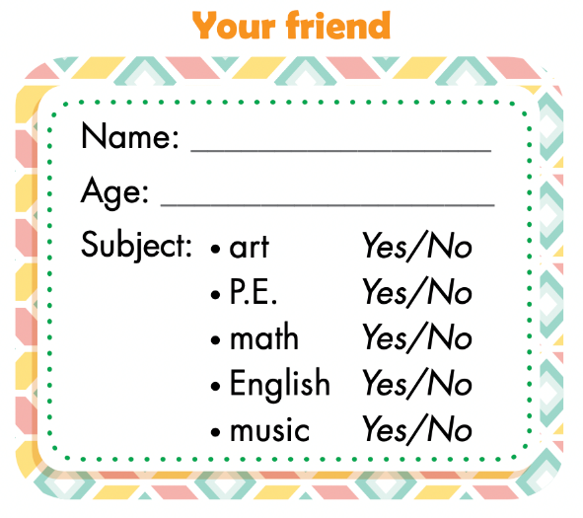



Ask, write, and circle.
Example:
Tam
8
I am 8.
Yes, I do.
I am Tam.

Slide 29

Pairwork

Slide 30

CONSOLIDATION

Slide 31
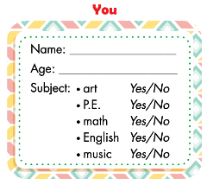
Groupwork: draw a bar graph.
Work in groups of 6
Take out YOU form and count
Fill in the form 1 (count students say YES)
Draw a bar graph
Notes:
134722862

Slide 32
subjects | Numbers of students
art
P.E.
math
English
music
6
1
3

Slide 33
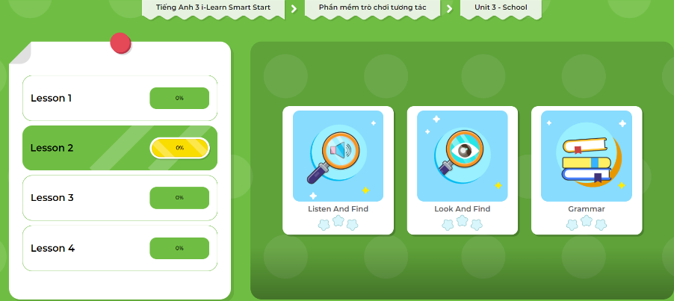
Extra Practice
DHA App
Let’s play!
Click here to play the games.

Slide 34

WRAP-UP

Slide 35
Lesson 3
Today’s lesson
Vocabularies
math, English, art,
P.E. (physical education), music
Structures/ Sentence patterns
Do you like math?
- Yes, I do./No, I don't.

Slide 36
Lesson 3
Homework
Review the vocabularies, structure and make sentences using them.
Do the exercises on page 31 WB.
Do the exercises in Tiếng Anh 3 i-Learn Smart Start Notebook on page 23.
Prepare the next lesson (page 44 SB).
Play the consolidation games in Tiếng Anh 3 i-Learn Smart Start DHA App on www.eduhome.com.vn

Slide 37

Enjoy your day!

Slide 38

Lesson 3
Stay positive and have a nice day!

