Slide 1

Unit 8: Festivals around the World
Lesson 1.2: Grammar
Page 61

Slide 2



LESSSON OUTLINE
Consolidation

Slide 3

By the end of this lesson, students will be able to…
use the Future Simple to give and ask for information about events in the future.
talk about the fire festival Up Helly Aa.

Slide 4

WARM-UP

Slide 5
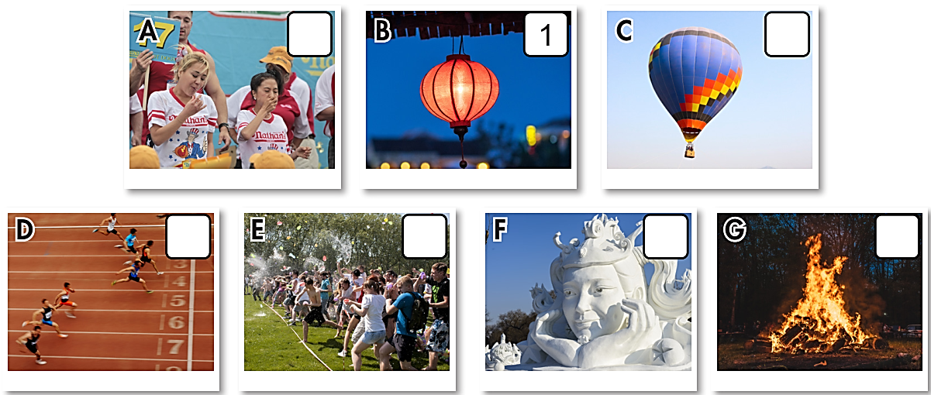

What can you see?
lantern

Slide 6
What can you see?
hot-air balloon

Slide 7
What can you see?
sculpture

Slide 8
What can you see?
bonfire

Slide 9
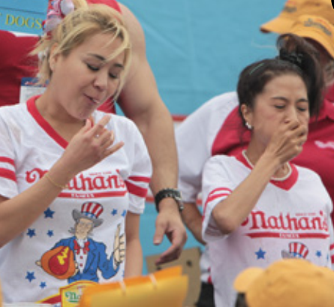
What can you see?
eating competition

Slide 10
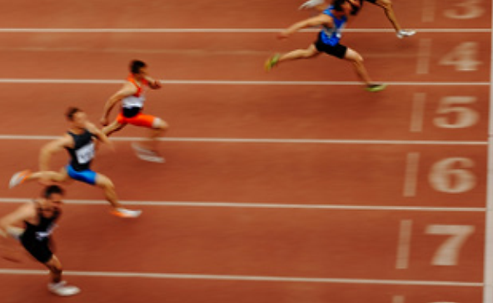
What can you see?
race

Slide 11
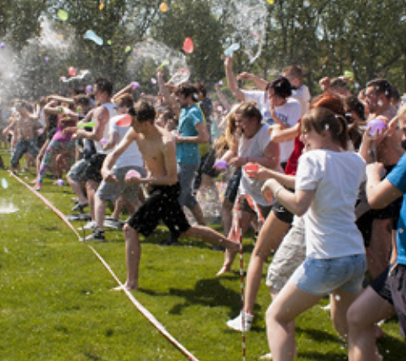
What can you see?
water fight

Slide 12
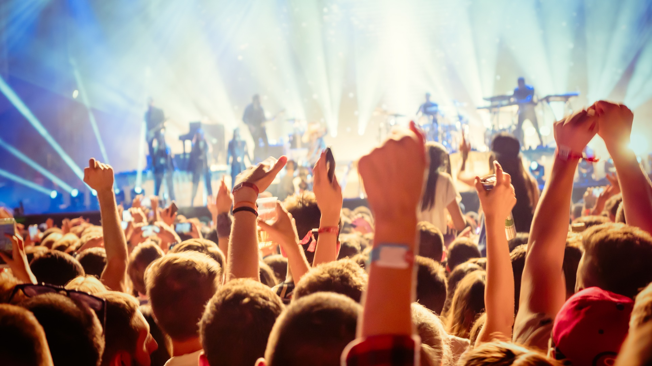
What kind of festival is it?
music festival

Slide 13
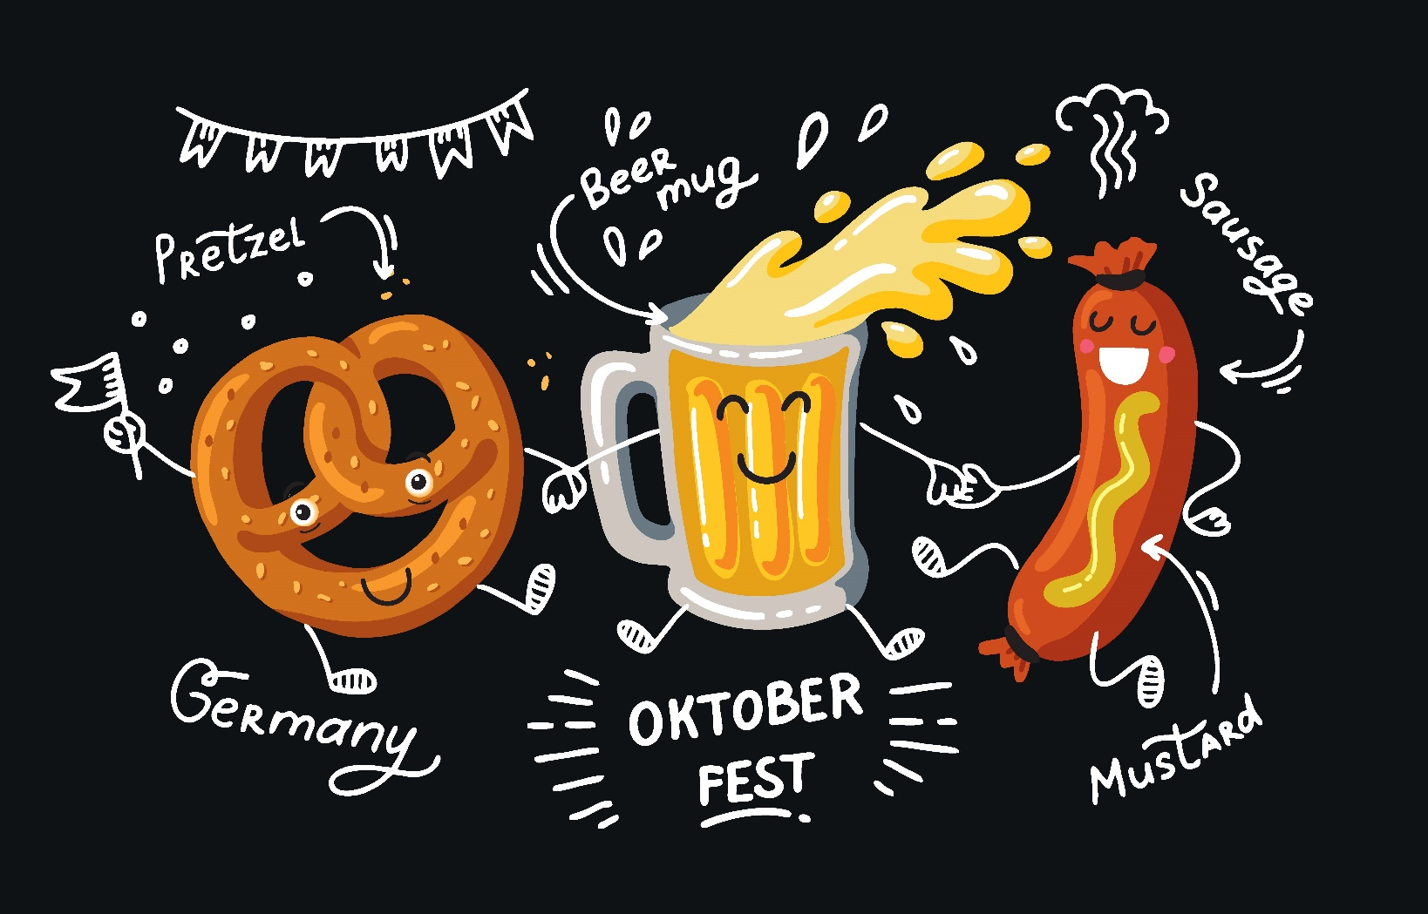
What kind of festival is it?
beer festival

Slide 14
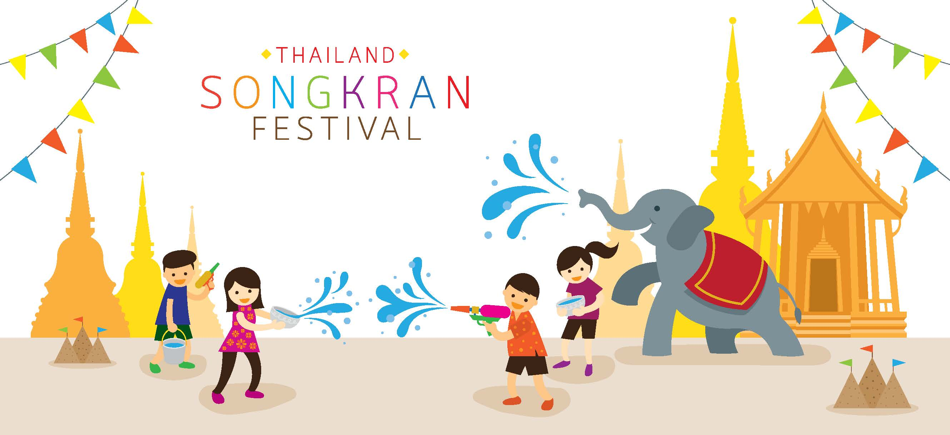
What kind of festival is it?
water festival

Slide 15
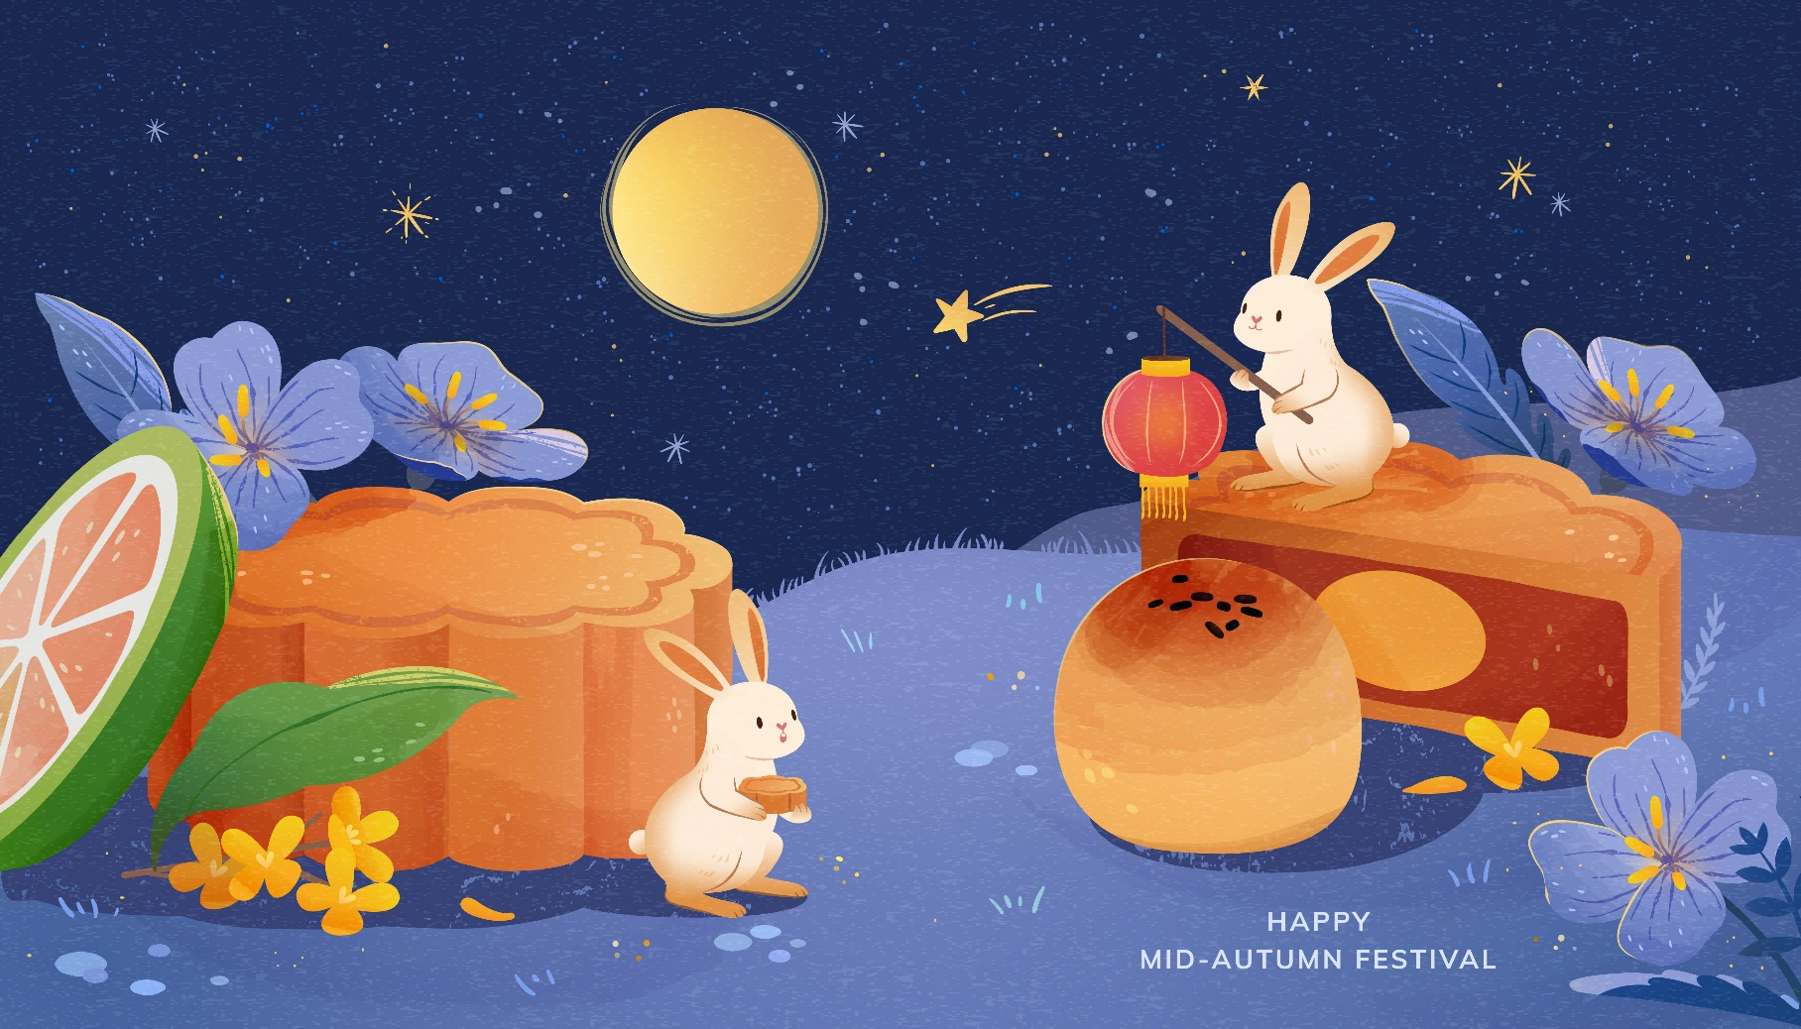
What festival is it?
Mid-Autumn festival/ Moon festival

Slide 16
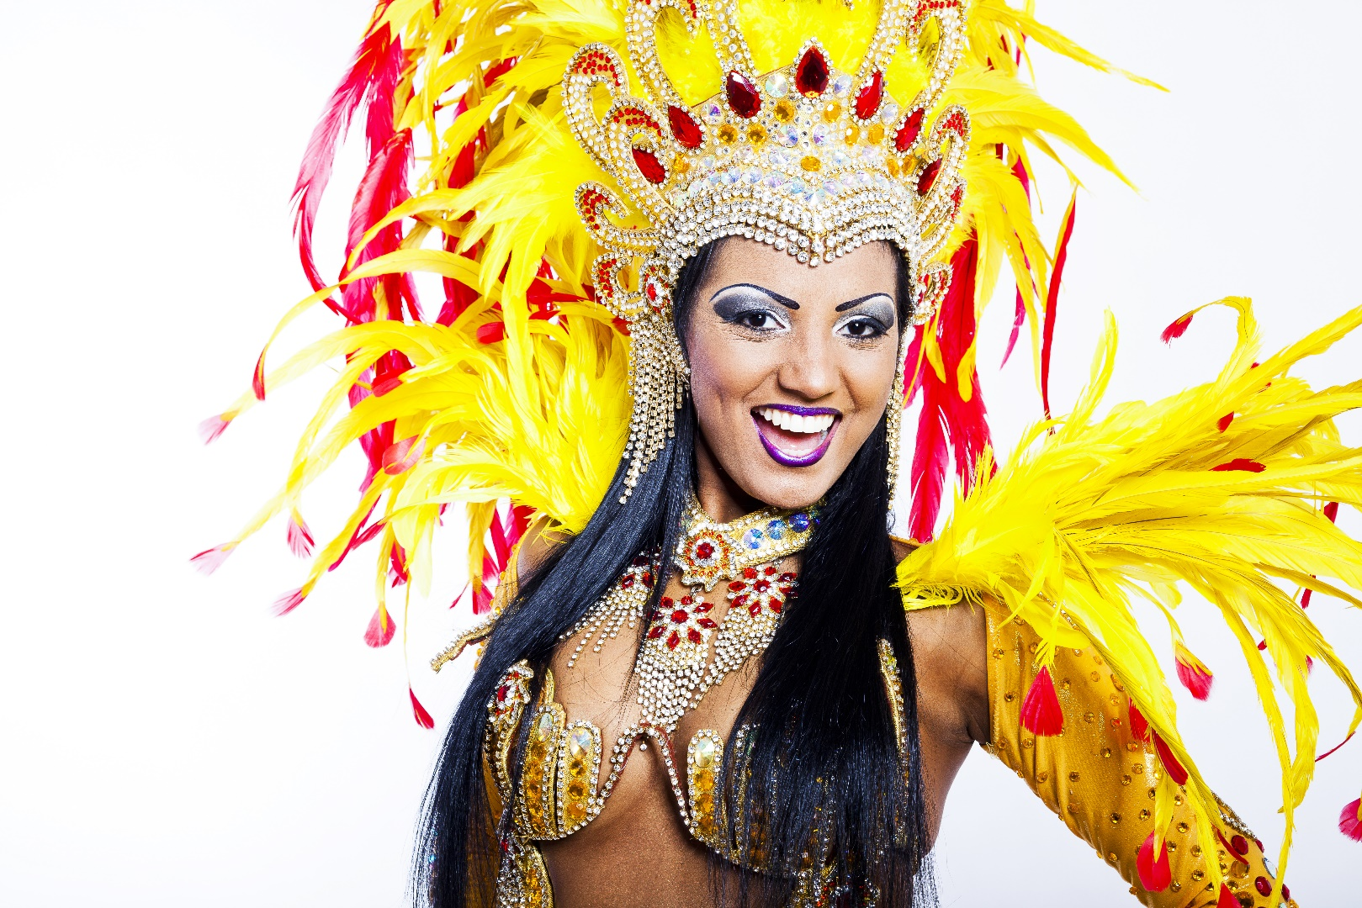
What festival is it?
carnival

Slide 17
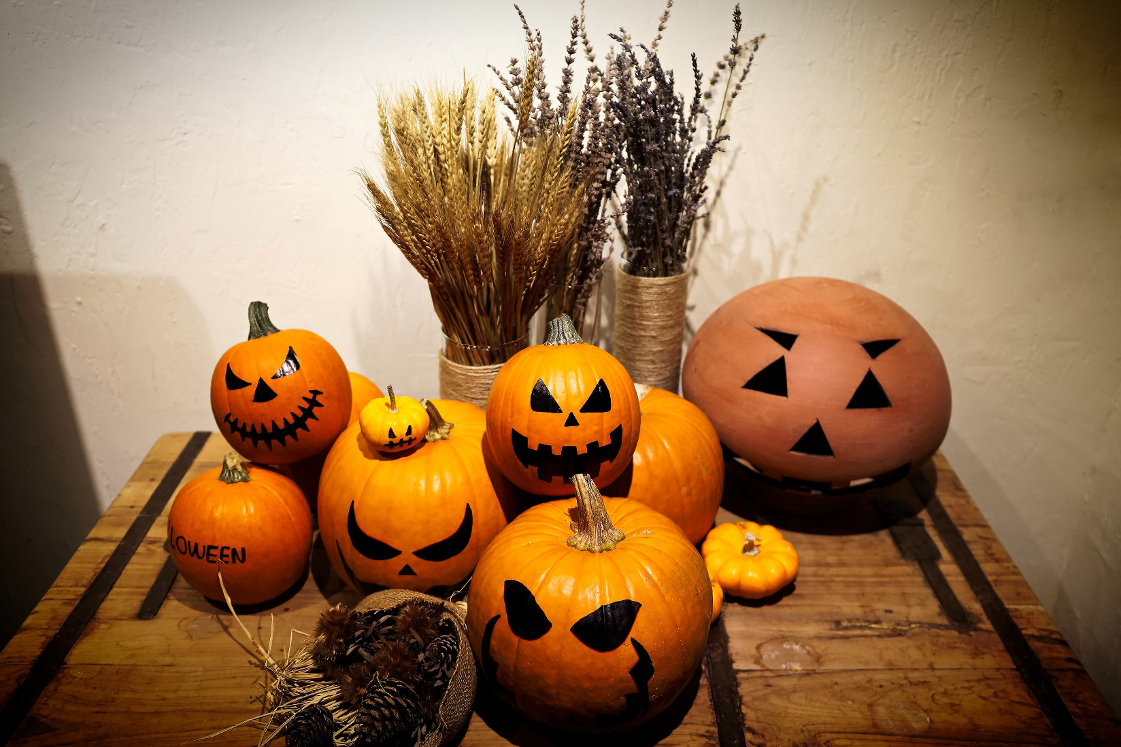
What festival is it?
Halloween

Slide 18



Slide 19

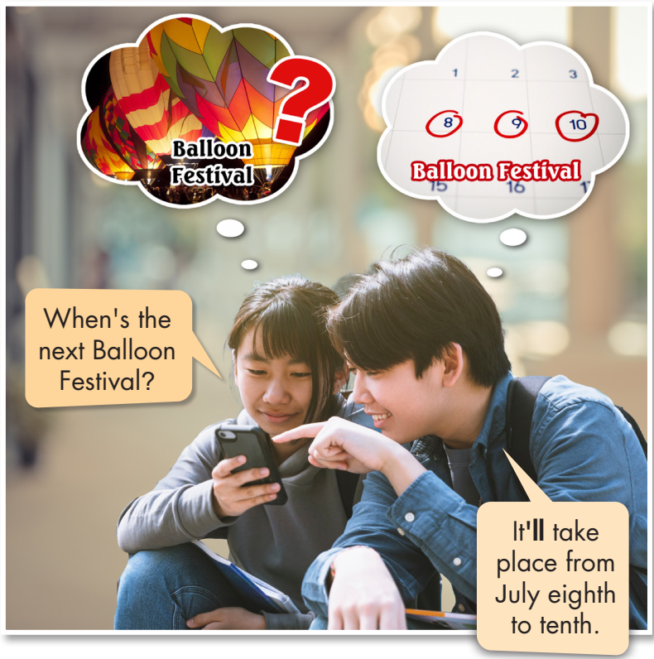
Click on the icon to hear the sound

Slide 20
Look and read the sentences:
I will have a great time at the festival.
I’ll have a great time at the festival.
You will have a great time at the festival.
You’ll have a great time at the festival.
We will have a great time at the festival.
We’ll have a great time at the festival.
They will have a great time at the festival.
They’ll have a great time at the festival.
He will have a great time at the festival.
He’ll have a great time at the festival.

Slide 21
Look and read the sentences:
She will have a great time at the festival.
She’ll have a great time at the festival.
It will take place from May 12th to 15th.
It’ll take place from May 12th to 15th.
Rob Curly will not perform this year.
Rob Curly won’t perform this year.
Which bands will perform this year?
Will The Big Gs play this year?
Yes, they will./ No, they, won’t.

Slide 22
THE FUTURE SIMPLE
We use the Future Simple to give and ask for information about events in the future.
I You We They She He It | will + V | I will = I’ll You will = You’ll We will = We’ll They will = They’ll He will = He’ll She will = She’ll It will = It’ll will not = won’t
 | will not + V
Will | I You We They She He It | V?

Slide 23

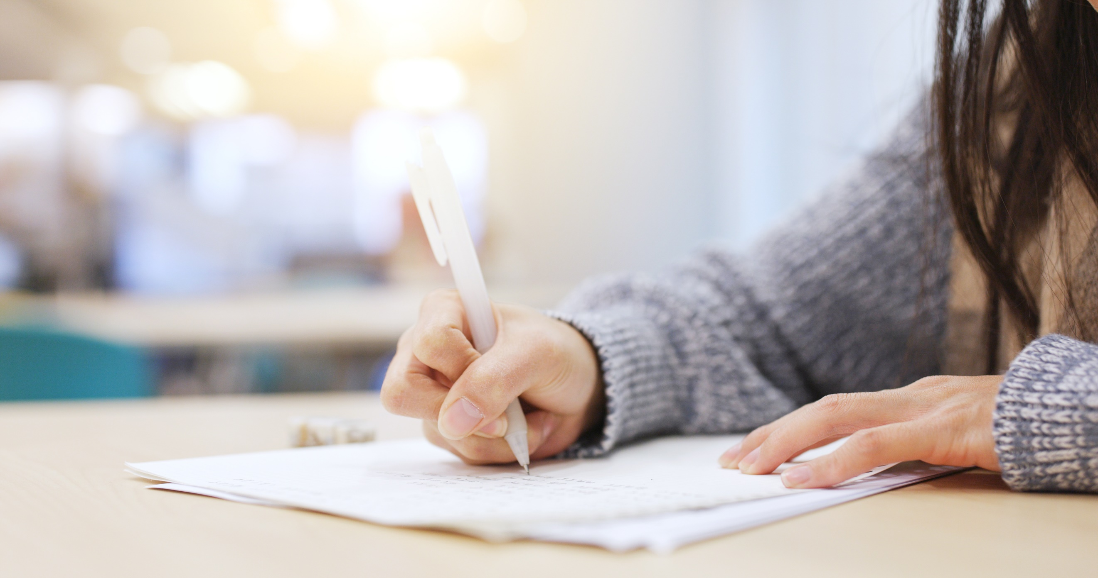

Slide 24
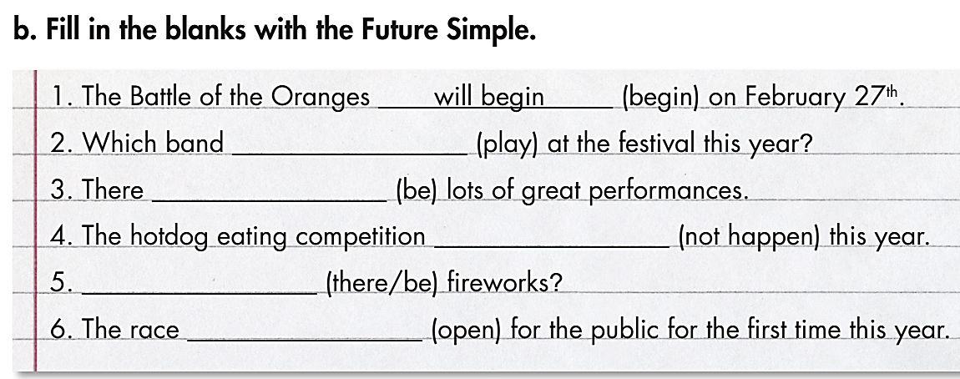
will play
will be
won’t happen
Will there be
will open

Slide 25
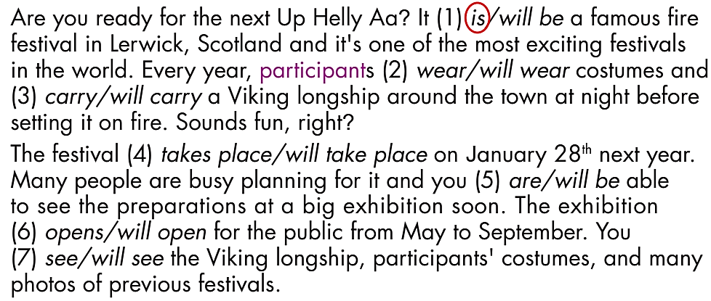
Look at the text quickly:
What kind of festival is it about?
What is the name of the festival?
It’s about a fire festival.
It’s Up Helly Aa.

Slide 26
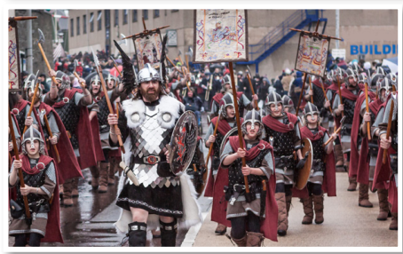
What are the festival participants wearing?
Viking costumes

Slide 27
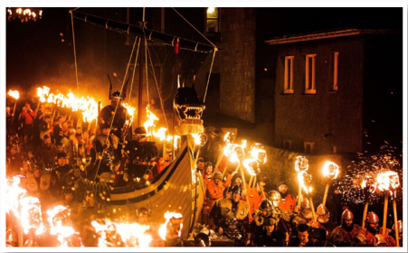
What are the people carrying?
a Viking longship

Slide 28

Are you ready for the next Up Helly Aa? It (1) is/will be a famous fire festival in Lerwick, Scotland and it's one of the most exciting festivals in the world. Every year, participants (2) wear/will wear costumes and (3) carry/will carry a Viking longship around the town at night before setting it on fire. Sounds fun, right?
The festival (4) takes place/will take place on January 28th next year. Many people are busy planning for it and you (5) are/will be able to see the preparations at a big exhibition soon. The exhibition (6) opens/will open for the public from May to September. You (7) see/will see the Viking longship, participants' costumes, and many photos of previous festivals.
If you go to Up Helly Aa next year, you will experience more than just a giant bonfire. There (8) is/will be lots of music and other fun events on the days before and after the festival, so make sure you plan your trip to Lerwick around the festival to get the whole experience!

Slide 29
Are you ready for the next Up Helly Aa? It (1) is/will be a famous fire festival in Lerwick, Scotland and it's one of the most exciting festivals in the world. Every year, participants
(2) wear/will wear costumes and (3) carry/will carry a Viking longship around the town at night before setting it on fire. Sounds fun, right?

Slide 30
The festival (4) takes place/will take place on January 28th next year. Many people are busy planning for it and you (5) are/will be able to see the preparations at a big exhibition soon. The exhibition (6) opens/will open for the public from May to September. You (7) see/will see the Viking longship, participants' costumes, and many photos of previous festivals.

Slide 31
If you go to Up Helly Aa next year, you will experience more than just a giant bonfire. There (8) is/will be lots of music and other fun events on the days before and after the festival, so make sure you plan your trip to Lerwick around the festival to get the whole experience!

Slide 32
Make questions about the next Up Helly Aa, using the prompts:
Are you ready for the next Up Helly Aa? It is a famous fire festival in Lerwick, Scotland and it's one of the most exciting festivals in the world. Every year, participants wear costumes and carry a Viking longship around the town at night before setting it on fire. Sounds fun, right?
The festival will take place on January 28th next year. Many people are busy planning for it and you will be able to see the preparations at a big exhibition soon. The exhibition will open for the public from May to September. You will see the Viking longship, participants' costumes, and many photos of previous festivals.
If you go to Up Helly Aa next year, you will experience more than just a giant bonfire. There will be lots of music and other fun events on the days before and after the festival, so make sure you plan your trip to Lerwick around the festival to get the whole experience!

Slide 33
Make questions about the next Up Helly Aa, using the prompts:
Prompts | Questions (suggested)
Time
Do
See
Hear
When will the next Up Helly Aa take place?
What will participants do?
What will you see at the exhibition?
When will you hear music?

Slide 34
Prompts | Questions (suggested)
Time
Do
See
Hear
When will the next Up Helly Aa take place?
What will participants do?
What will you see at the exhibition?
When will you hear music?

Slide 35
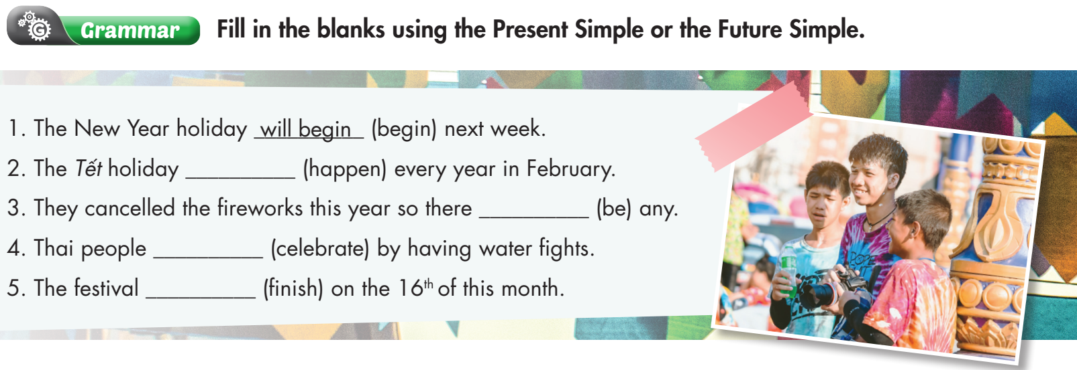
Extra Practice
WB, page 45
happens
won’t be
celebrate
will finish

Slide 36

CONSOLIDATION

Slide 37
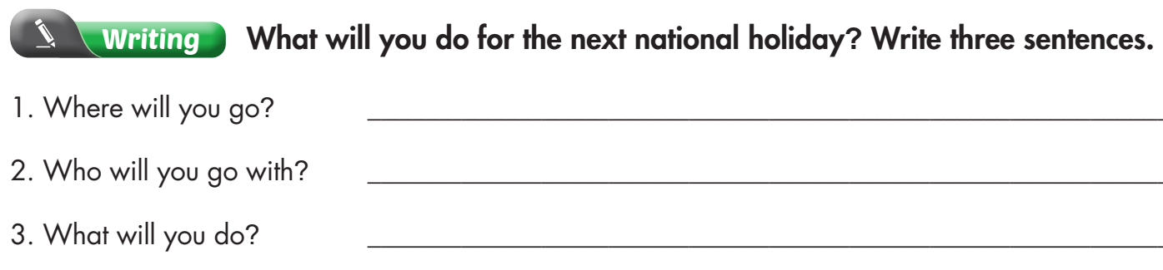
Extra Practice
WB, page 45

Slide 38

WRAP-UP

Slide 39
Today’s lesson
Vocabularies
participants
Viking costumes
Viking longship
exhibition
previous

Slide 40
Today’s lesson
Grammar:
- Using the Future Simple to give and ask for information about events in the future.
- Understanding the difference between the Present Simple and the Future Simple.
Speaking:
- Talking about the fire festival Up Helly Aa.

Slide 41
Homework
Learn by heart vocabularies and make sentences using them.
Complete the grammar notes in Tiếng Anh 7 i-Learn Smart World Notebook on page 49.
Prepare the next lesson (page 62 SB).
Play the consolidation games in Tiếng Anh 7 i-Learn Smart World DHA App on www.eduhome.com.vn

Slide 42

Lesson 3
Stay positive and have a nice day!

