Slide 1


Slide 2


Unit
8
SHOPPING
LESSON 7: LOOKING BACK AND PROJECT
1

Slide 3
LESSON 7: LOOKING BACK & PROJECT
WARM-UP
Kim’s game
Task 1: Match the words and phrases with the meanings.
Task 2: Complete the sentences with the words and phrases from the box.
VOCABULARY
Task 3: Complete each sentence with a suitable adverb of frequency.
Task 4: Use the correct tense and form of the verbs in brackets to complete the sentences.
GRAMMAR
PROJECT
Your dream shopping place
CONSOLIDATION
Wrap-up
Homework

Slide 4

KIM’S GAME
WARM-UP
Work in groups of three or four.
Watch a video clip and try to remember all types of shops mentioned in the clip without taking notes.
After finishing watching the clip, write down as many stores/ shops as possible.
The group with the most correct answers will win.
Notes:
Video link: https://www.youtube.com/watch?v=UjJ7y9fGx2A

Slide 5
KIM’S GAME
WARM-UP
Answers:
1. bakery
2. fruit store
3. butcher shop
4. fish market
5. pastry shop
6. flower shop
7. shoe shop
8. toy store
9. stationery shop
10. book store
11. hardware store
12. jewelry store
13. pharmacy

Slide 6
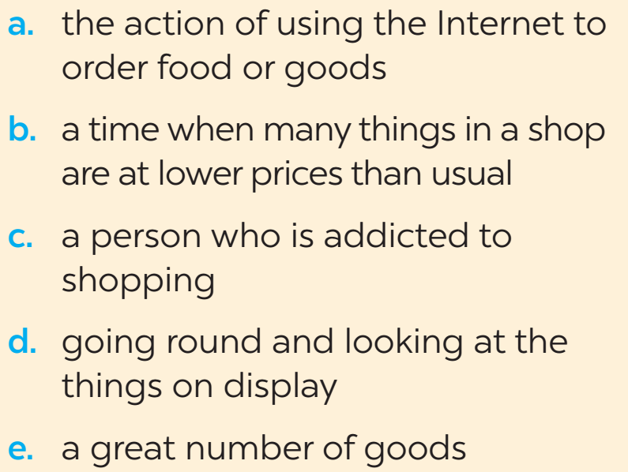
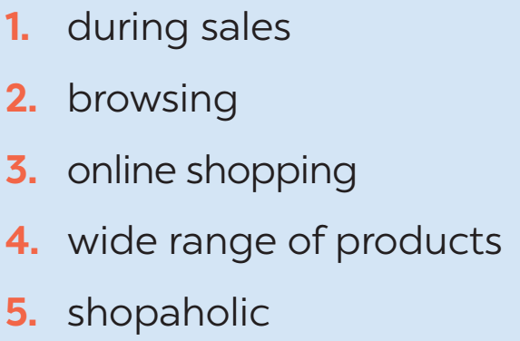
VOCABULARY
1
Match the words and phrases (1-5) with the meanings (a-e).

Slide 7
VOCABULARY
2
Complete the sentences with the words and phrases from the box.
Internet access
bargain
offline
on sale
home-grown
1. Look! These sports shoes are __________. They are 30% off.
2. This item has a price tag, so you cannot ___________.
3. Do you have ______________ here? I want to check my email.
4. When you visit a farmers’ market, you will find a lot of ___________
fruit and vegetables.
5. My mother always shops ________. She never shops online.

Slide 8
GRAMMAR
3
Complete each sentence with a suitable adverb of frequency.
1. My sister ________ watches the Junior Master Chef programme. She never misses an episode.
2. My mum ______________ shops at the supermarket. But I don’t go there often.
3. My father ______ goes to a dollar store. He says there’s nothing worth buying there.
4. We don’t ____________ go to the supermarket. It’s far from our home.
5. Theses brands are ______ on sale, just once or twice a year.
always
always/ usually
never
often/ usually
rarely

Slide 9
GRAMMAR
4
Use the correct tense and form of the verbs in brackets to complete the sentences.
1. The shuttle bus (leave) _______ every 15 minutes to take customers to the parking lot.
2. - Mum, what time (be) ____ the show tonight?
- Let me check.
3. We (can / use) ________ these vouchers for the next shopping.
4. The announcement says that the sale (last) _____ for just two hours, from 17:00 to 19:00 tomorrow.
5. We (not / have) _________ home economics next semester. We have music instead.
leaves
is
can use
lasts
don’t have

Slide 10

PROJECT
YOUR DREAM SHOPPING PLACE
1
Imagine a shopping place you would like to have in your neighbourhood.

Slide 11
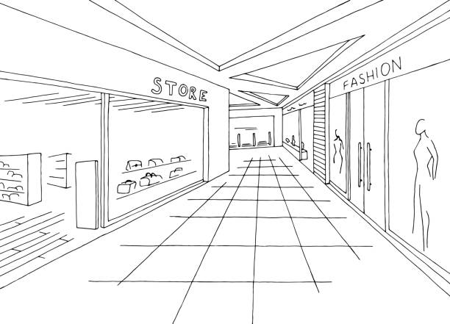
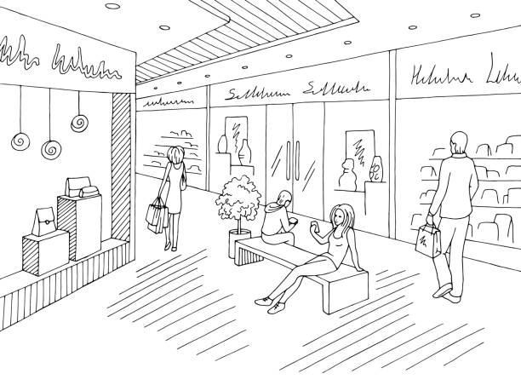
PROJECT
YOUR DREAM SHOPPING PLACE
2
Draw it or find a picture similar to it.

Slide 12
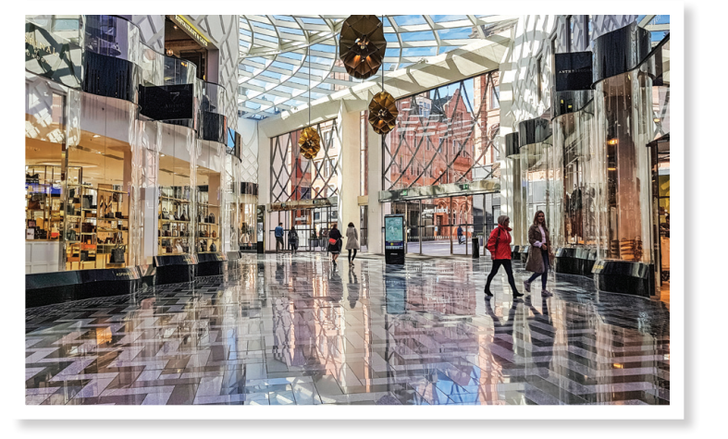
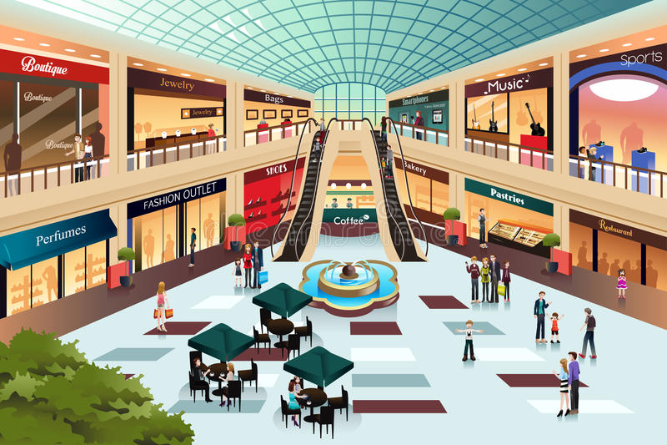
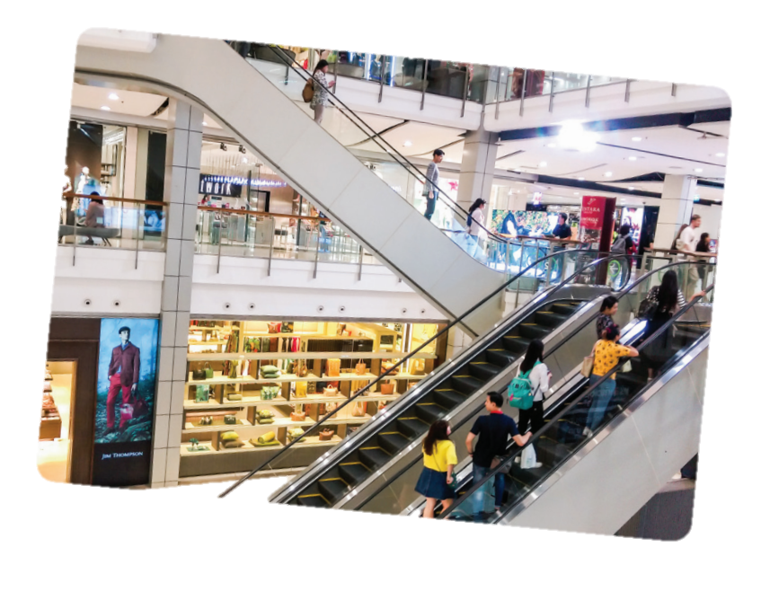
PROJECT

Slide 13

CONSOLIDATION
1
Wrap-up
What have we learnt in this lesson?
Reviewing vocabulary in Unit 8
Reviewing present simple and adverbs of frequency
Present about a dream shopping place

Slide 14

CONSOLIDATION
2
Homework
Do the exercises in the Workbook

Slide 15

Website: hoclieu.vn
Fanpage: facebook.com/tienganhglobalsuccess.vn/

