Slide 1

Unit 4: Community Services
Lesson 3.2: Writing
Page 35

Slide 2


Lesson 3.2
LESSON OUTLINE
Consolidation

Slide 3

By the end of this lesson, students will be able to…
write an email.
talk about an environmental clean-up.

Slide 4

WARM-UP

Slide 5

Work in groups.
What did you do to help the environment?
When and where did you do it?
Who did you do it with?

Slide 6


It’s writing time….

Slide 7
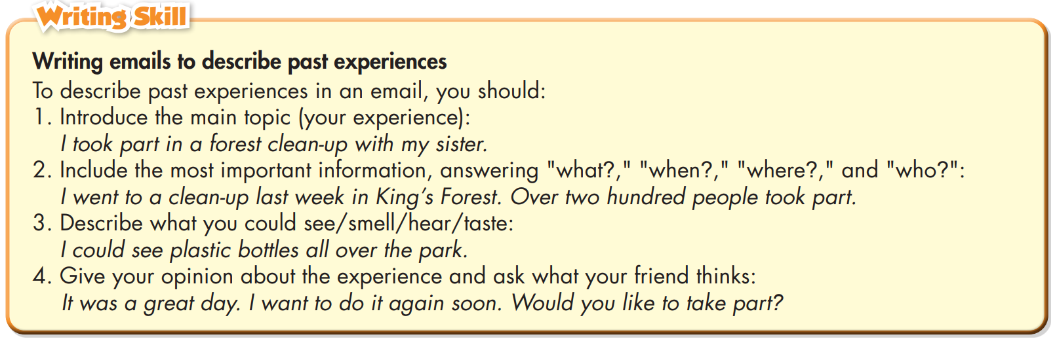
Pre - writing
a. Read about writing emails to describe past experiences. Then, read Jane’s email again and underline the information matching each point in the box.

Slide 8
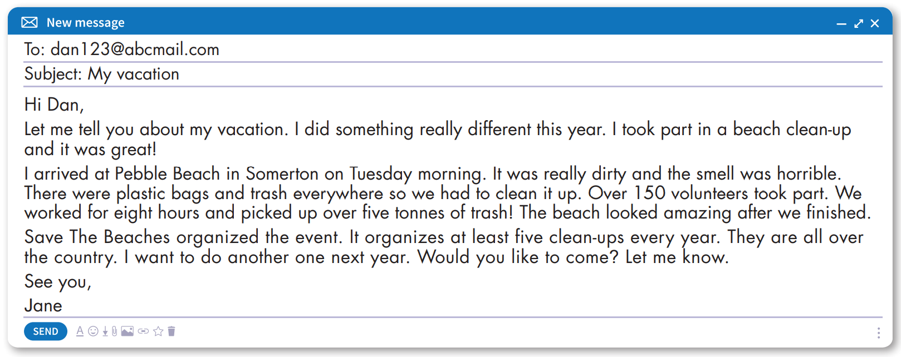

Slide 9
Introduce the main topic (your experience):
I took part in a forest clean-up with my sister.
Hi Dan,
Let me tell you about my vacation. I did something really different this year. I took part in a beach clean-up and it was great!
I arrived at Pebble Beach in Somerton on Tuesday morning. It was really dirty and the smell was horrible. There were plastic bags and trash everywhere so we had to clean it up. Over 150 volunteers took part. We worked for eight hours and picked up over five tonnes of trash! The beach looked amazing after we finished.
Save The Beaches organized the event. It organizes at least five clean-ups every year. They are all over the country. I want to do another one next year. Would you like to come? Let me know.
See you,
Jane

Slide 10
2. Include the most important information, answering "what?," "when?," "where?," and "who?":
I went to a clean-up last week in King’s Forest. Over two hundred people took part.
Hi Dan,
Let me tell you about my vacation. I did something really different this year. I took part in a beach clean-up and it was great!
I arrived at Pebble Beach in Somerton on Tuesday morning. It was really dirty and the smell was horrible. There were plastic bags and trash everywhere so we had to clean it up. Over 150 volunteers took part. We worked for eight hours and picked up over five tonnes of trash! The beach looked amazing after we finished.
Save The Beaches organized the event. It organizes at least five clean-ups every year. They are all over the country. I want to do another one next year. Would you like to come? Let me know.
See you,
Jane

Slide 11
3. Describe what you could see/smell/hear/taste:
I could see plastic bottles all over the park.
Hi Dan,
Let me tell you about my vacation. I did something really different this year. I took part in a beach clean-up and it was great!
I arrived at Pebble Beach in Somerton on Tuesday morning. It was really dirty and the smell was horrible. There were plastic bags and trash everywhere so we had to clean it up. Over 150 volunteers took part. We worked for eight hours and picked up over five tonnes of trash! The beach looked amazing after we finished.
Save The Beaches organized the event. It organizes at least five clean-ups every year. They are all over the country. I want to do another one next year. Would you like to come? Let me know.
See you,
Jane

Slide 12
4. Give your opinion about the experience and ask what your friend thinks:
It was a great day. I want to do it again soon. Would you like to take part in?
Hi Dan,
Let me tell you about my vacation. I did something really different this year. I took part in a beach clean-up and it was great!
I arrived at Pebble Beach in Somerton on Tuesday morning. It was really dirty and the smell was horrible. There were plastic bags and trash everywhere so we had to clean it up. Over 150 volunteers took part. We worked for eight hours and picked up over five tonnes of trash! The beach looked amazing after we finished.
Save The Beaches organized the event. It organizes at least five clean-ups every year. They are all over the country. I want to do another one next year. Would you like to come? Let me know.
See you,
Jane

Slide 13
b. Write full sentences using the prompts. Then, number the sentences (1-4) to match them with the order in the skill box.
A. It/great/event. Would/you/like/join/year?
__________________________________________________________
B. I/took/part/beach/clean-up/Hightown.
__________________________________________________________
C. I/went/clean-up/last/week/Rocky Beach. Over/fifty/took/part.
__________________________________________________________
D. I/could/smell/trash./It/terrible!
__________________________________________________________
It was a great event. Would you like to join next year?
I took part in a beach clean-up in Hightown.
I went to a clean-up last week at Rocky Beach. Over fifty people took part.
I could smell the trash. It was terrible!

Slide 14
A. It was a great event. Would you like to join next year?
B. I took part in a beach clean-up in Hightown.
C. I went to a clean-up last week at Rocky Beach. Over fifty people took part.
D. I could smell the trash. It was terrible!
Hi Dan,
Let me tell you about my vacation. I did something really different this year. I took part in a beach clean-up and it was great!
I arrived at Pebble Beach in Somerton on Tuesday morning. It was really dirty and the smell was horrible. There were plastic bags and trash everywhere so we had to clean it up. Over 150 volunteers took part. We worked for eight hours and picked up over five tonnes of trash! The beach looked amazing after we finished.
Save The Beaches organized the event. It organizes at least five clean-ups every year. They are all over the country. I want to do another one next year. Would you like to come? Let me know.
See you,
Jane
4
1
2
3

Slide 15
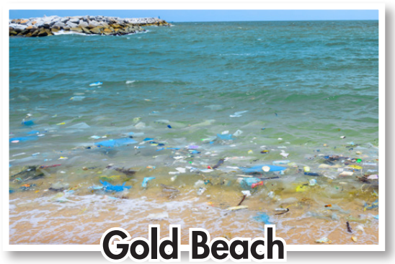
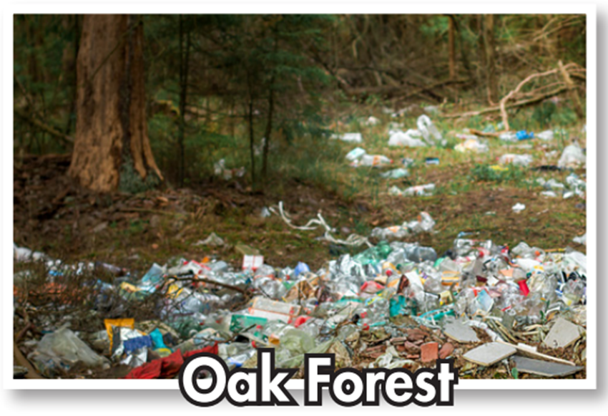
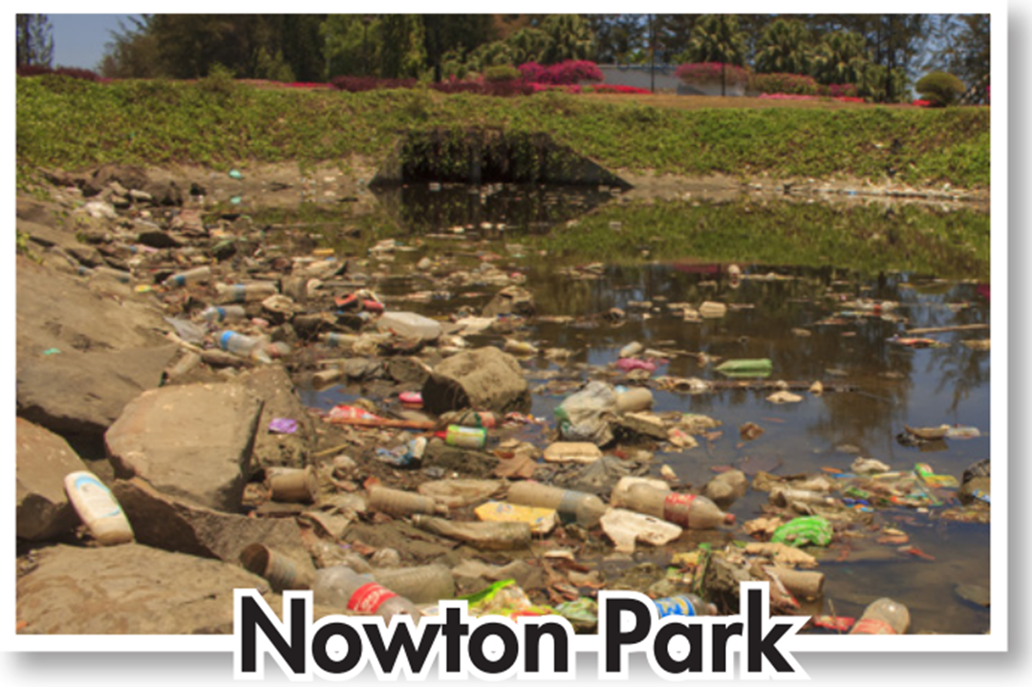

Slide 16
Pair work
Can you see similar problems near where you live? Where? Why is there so much trash?
Yes. I can see a lot of trash along Nhieu Loc Canal. Local people throw plastic bottles, bags, cans, and food into the canal.

Slide 17
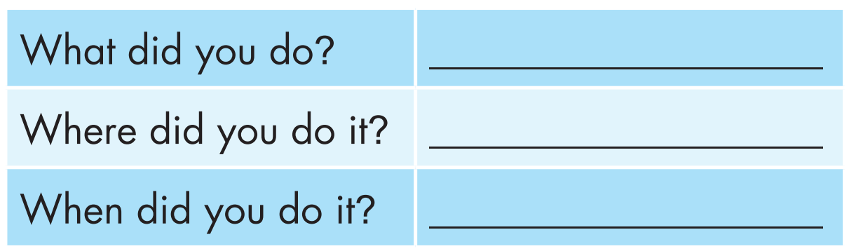
b. Now, choose a place in Greenview City. Use your own ideas to fill in the tables about a clean-up there.
go to a park clean-up
Nowton Park, Greenview City
last week

Slide 18
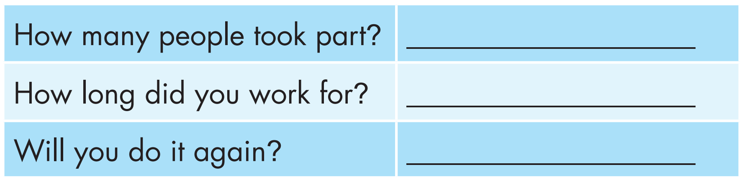
over 400
3 hours
yes

Slide 19
While - writing
Use the information in Task b to write the email.
I went to a park clean-up in Greenview City.
I did it in Nowton Park, Greenview City.
Last week, I went to Nowton Park.

Slide 20




Four hundred volunteers took part.
We worked for three hours.
I want to do it again soon.

Slide 21

Now, write an email to a friend describing your experience of an environmental clean-up. Use the Feedback form to help you. Write 60 to 80 words.
Sample answer:
Hi Nguyên,
I went to a park clean-up in Greenview City. It was really fun.
Last week, I went to Nowton Park. There was lots of trash in the park. Four hundred volunteers took part. We worked for three hours. The park looked very clean after.
It was a good day. I want to do it again soon. Do you want to do it, too?
See you,
Mạnh

Slide 22
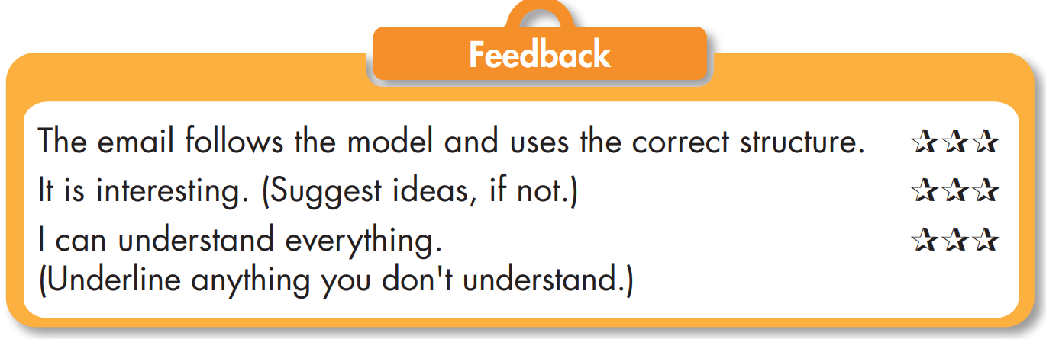

Slide 23

CONSOLIDATION

Slide 24
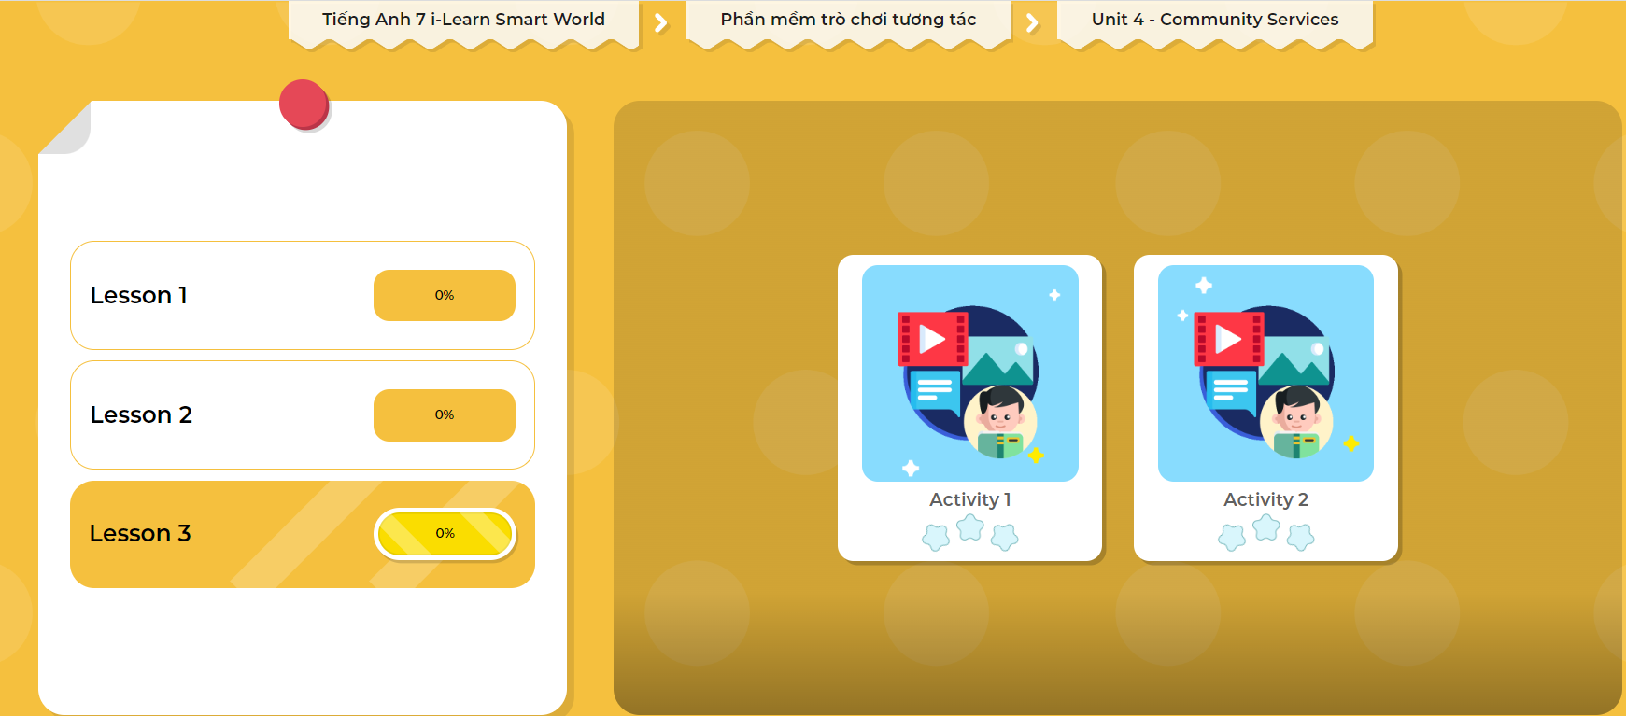
LET’S PLAY!
Click here to play the games

Slide 25

WRAP-UP

Slide 26
Today’s lesson
Writing:
- Understand how to write an email about past experiences.
Practice writing an email to a friend about a past experience.
Speaking:
- Talk about environmental problems near where you live.

Slide 27
Homework
Do the Writing skill on page 25 WB.
Complete the writing notes in Tiếng Anh 7 i-Learn Smart World Notebook on page 27.
Prepare Review Unit 10 (pages 92 & 93 SB).
Play the consolidation games in Tiếng Anh 7 i-Learn Smart World DHA App on www.eduhome.com.vn

Slide 28

Lesson 3
Stay positive and have a nice day!

